Slide 1

C#-Delegates and Introduction to File I/O

Slide 2
Contents:
Introduction to Delegates
Properties of Delegates
Example of Delegates
Syntax
Use of Delegates
Types of Delegates
Single Cast Delegates
Example of Single Cast Delegates
Output of Single Cast Delegates
Multi-Cast Delegates
Example of Multi-Cast Delegates
Output of Multi-Cast Delegates
Introduction to File I\O
Syntax
Parameters of FileMode
Parameters of FileAccess
Parameters of FileShare

Slide 3
Introduction to Delegates
A delegate is an object which refers to a method which is used as a reference type variable that can hold a reference to the methods.
Delegates in C# are similar to the function pointer in C/C++.
All delegates are implicitly derived from the System.Delegate class.
Why Delegates??
Type safe
Object Oriented
Secure

Slide 4
Properties of Delegates
Provides a good way to encapsulate the methods.
Delegates are the library class in System namespace.
These are the type-safe pointer of any method.
Delegates are mainly used in implementing the call-back methods and events.
Delegates can be chained together as two or more methods can be called on a single event.
It doesn’t care about the class of the object that it references.
Delegates can also be used in “anonymous methods” invocation.

Slide 5
Example of Delegates
For example, if you click an Button on a form (Windows Form application), the program would call a specific method. In simple words, it is a type that represents references to methods with a particular parameter list and return type and then calls the method in a program for execution when it is needed.

Slide 6
Syntax
Step 1 - Declaration
Delegate is getting declared here.
Modifer delegate return_type delegate_name ( [Parameter....])
Step 2 - Instantiation
Object of delegate is getting created as passing method as argument
Delegate_name delg_object_name = new Delegate_name( method_name);
Step 3 - Invocation
Delegate is getting called here.
Delg_object_name([parameter....]);

Slide 7
Use of Delegates
These are used to represent or refer to one or more functions.
These can only be used to define call-back methods.
In order to consume a delegate, we need to create an object to delegate.

Slide 8
Types of Delegates
Single Cast Delegates
Multi Cast Delegates

Slide 9
Single Cast Delegates
A delegate that represents only a single function is known as Single Cast Delegate.

Slide 10
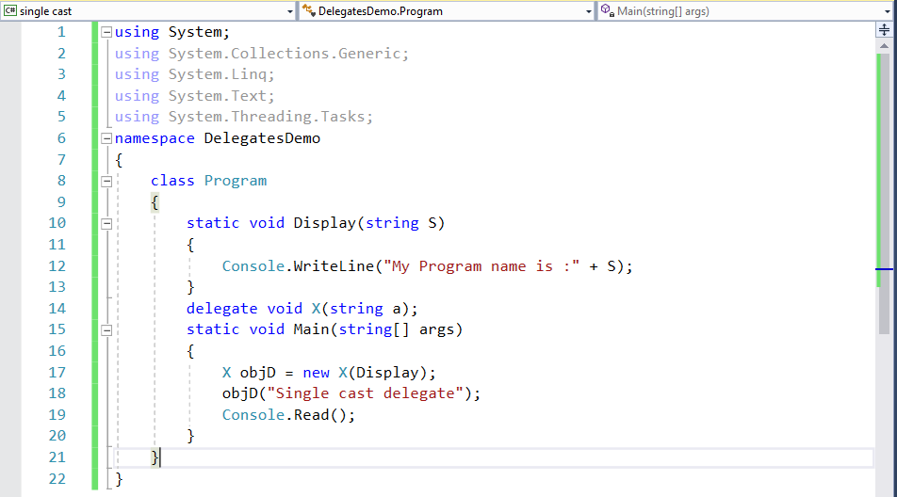
Example of Single Cast Delegates

Slide 11
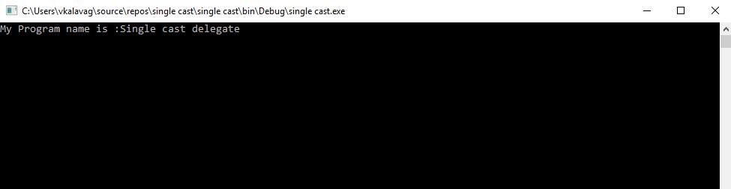
Output of Single Cast Delegate

Slide 12
Multi-Cast Delegates
A delegate that represents more than one function is known as Multi Cast Delegate.
Properties:
Delegates are combined and when you call a delegate then a complete list of methods is called.
All methods are called in First in First Out(FIFO) order.
‘+’ or ‘+=’ Operator is used to add the methods to delegates.
‘–’ or ‘-=’ Operator is used to remove the methods from the delegates list.

Slide 13
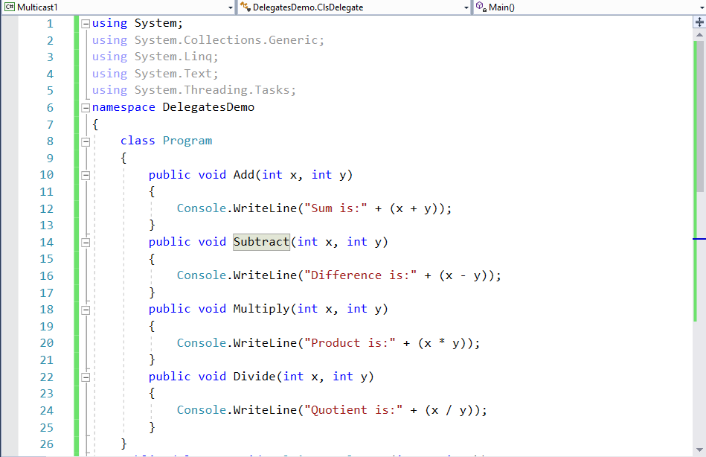
Example of Multi-Cast Delegates

Slide 14
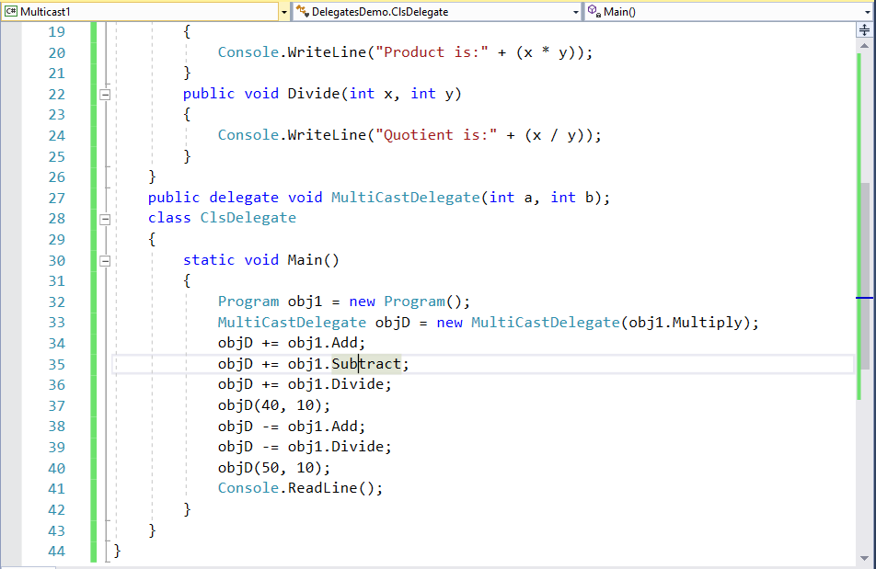

Slide 15
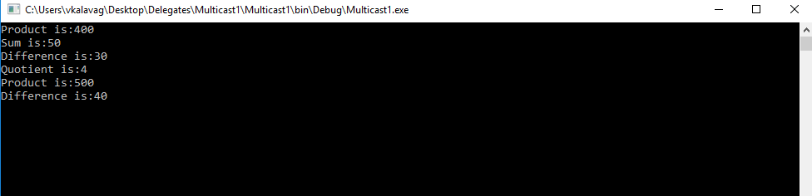
Output of Multi-Cast Delegate

Slide 16
Introduction to File I\O
A file is a collection of data stored in a disk with a specific name and a directory path. When a file is opened for reading or writing, it becomes a stream.
Stream is a sequence of bytes traveling from a source to a destination over a communication path.
The System.IO namespace includes various classes for file handling.

Slide 17
Syntax:
FileStream <object_name> = new FileStream( <file_name>, <FileMode Enumerator>, <FileAccess Enumerator>, <FileShare Enumerator>);

Slide 18
Parameters of FileMode
The FileMode enumerator defines various methods for opening files. The members of the FileMode enumerator are
Append − It opens an existing file and puts cursor at the end of file, or creates the file, if the file does not exist.
Create − It creates a new file.
CreateNew − It specifies to the operating system, that it should create a new file.
Open − It opens an existing file.
OpenOrCreate − It specifies to the operating system that it should open a file if it exists, otherwise it should create a new file.
Truncate − It opens an existing file and truncates its size to zero bytes.

Slide 19
Parameters of FileAccess
FileAccess enumerators have members: Read, ReadWrite and Write.

Slide 20
Parameters of FileShare
FileShare enumerators have the following members −
Inheritable − It allows a file handle to pass inheritance to the child processes
None − It declines sharing of the current file
Read − It allows opening the file for readin.
ReadWrite − It allows opening the file for reading and writing
Write − It allows opening the file for writing

