Slide 1
Project
Natural Language Processing
Rashmi Dhamija

Slide 2
Part A: IMDb Movie Review Sentiment Analysis
Problem Statement:
The primary objective of this project is to build a machine learning classification model that can predict the sentiment of IMDb movie reviews.
The dataset contains a collection of movie reviews, and each review is labeled as either positive or negative.
Using text preprocessing, feature extraction techniques (such as TF-IDF), and various classification algorithms, the project will aim to develop a model that can effectively classify the sentiment of movie reviews.
The model's performance will be evaluated using standard classification metrics, such as accuracy, precision, recall, and F1-score.
Dataset Information:
Text of the review: The actual review provided by the user.
Sentiment label: The sentiment of the review, either “positive” or “negative”.

Slide 3
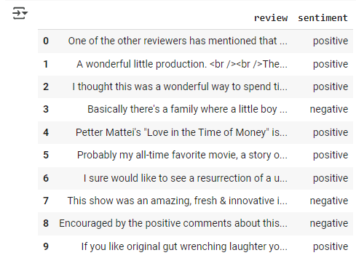
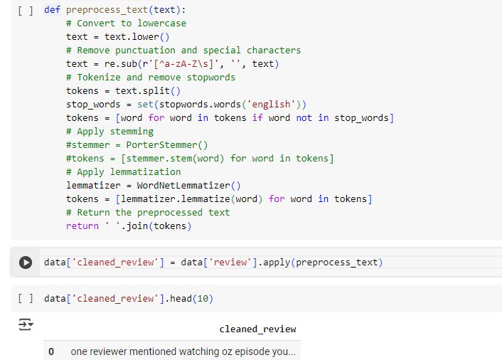
Procedure
Data Exploration and Pre-processing

Slide 4
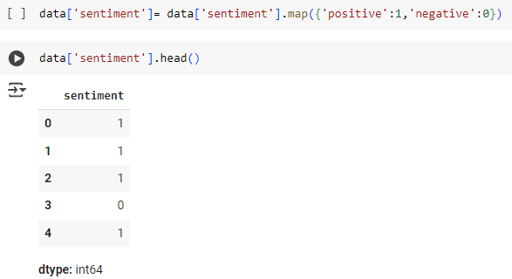
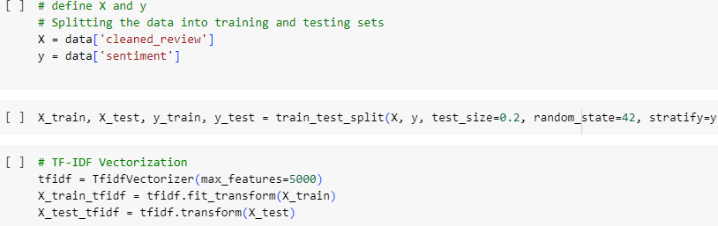
Target Variable:
2. Feature Engineering

Slide 5
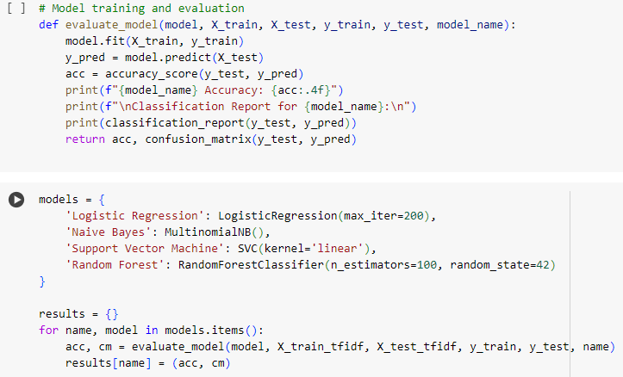
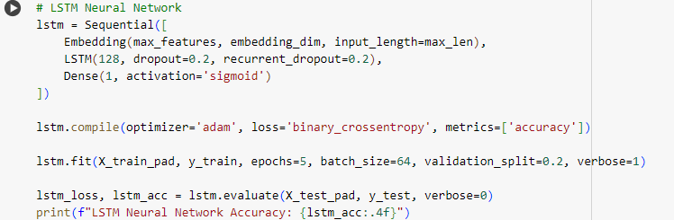
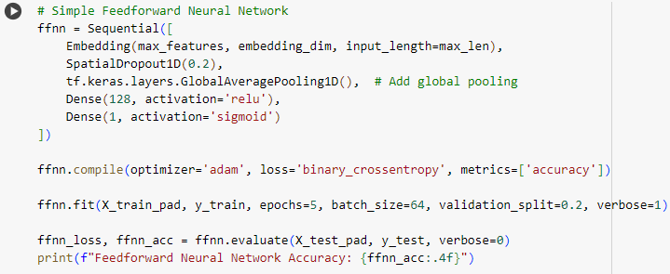
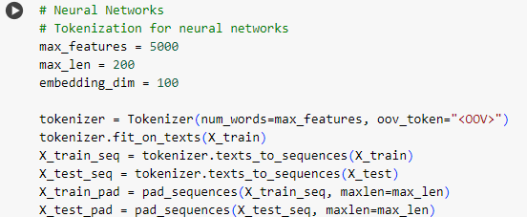
3. Model Development

Slide 6
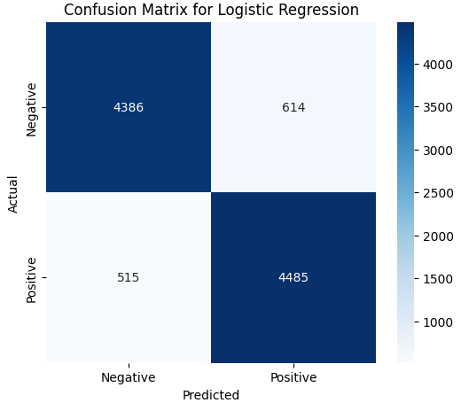
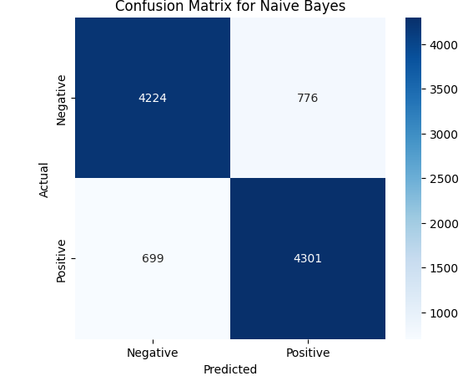
4. Model Evaluation

Slide 7
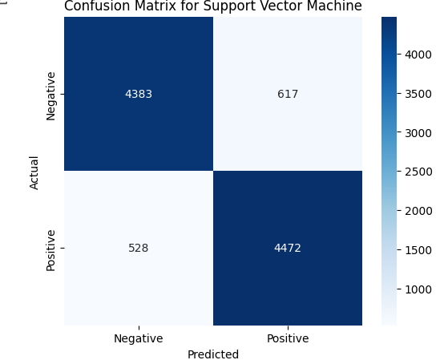
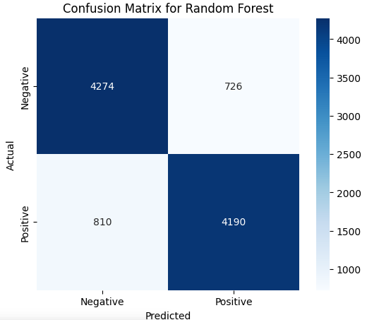

Slide 8
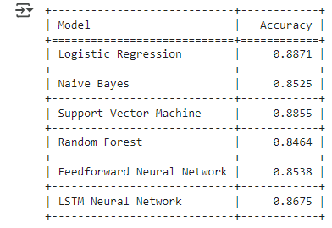
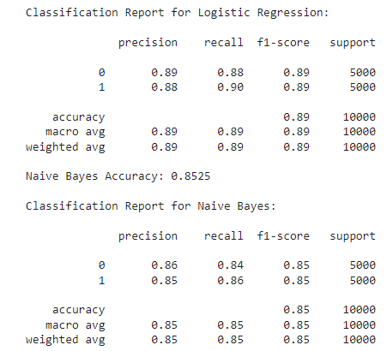
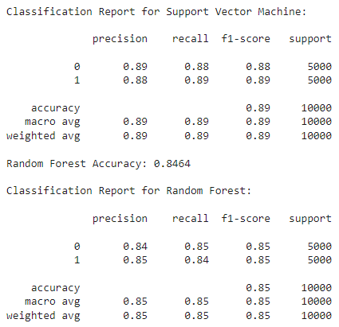

Slide 9
Summary
Logistic Regression and Support Vector Machine model gives best performance with a high accuracy and F1-score. Neural Network models (Feed Forward and LSTM) perform similarly to that of Naïve Bayes and Random Forest Classifier.
Data pre-processing and feature engineering (TF-IDF) played a significant role in the model performance.
Next, one can expand the dataset with diverse movie reviews to make the model more generalized.
One can apply sentiment predictions to prioritize and respond to negative reviews quickly, enhancing customer satisfaction.
One can consider applying the sentiment analysis model to social media for broader insights.

Slide 10
Part B: News Article Classification
Problem Statement:
The primary objective of this project is to build a classification model that can automatically categorize news articles into different predefined categories.
The model will be trained using a labeled dataset of news articles and will output the most likely category (e.g., sports, politics, or technology) for any given article.
Goal:
Develop a robust classifier capable of handling articles from multiple categories.
Preprocess the text data, extract meaningful features, and train models to classify the articles.
Evaluate the model performance and provide actionable insights on how well it classifies articles.

Slide 11
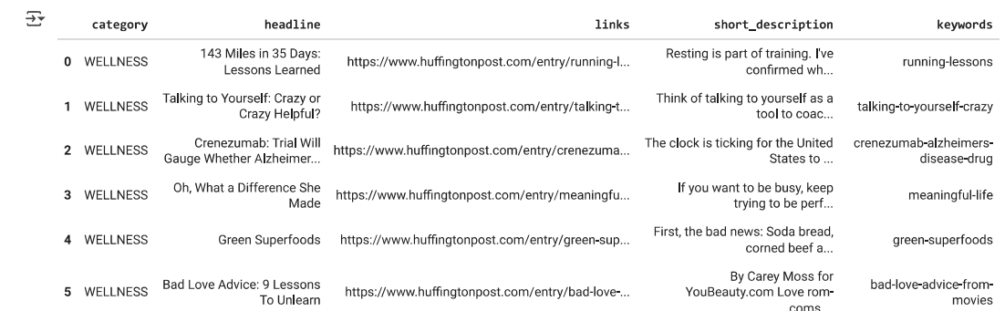
Procedure
Data Exploration and Pre-processing
Steps:
Handling Missing Values.
Converting text to lower , removing punctuation and stopwords, and applying lemmatization.

Slide 12
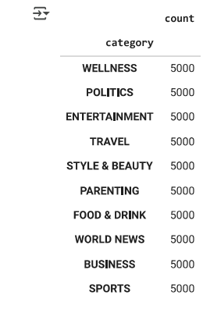
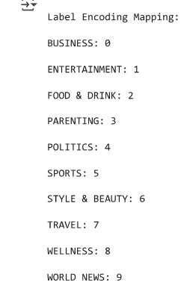
Target Variable:
10 distinct categories.
Applied Label Encoding to
Convert category to
numeric.
2. Feature Engineering

Slide 13
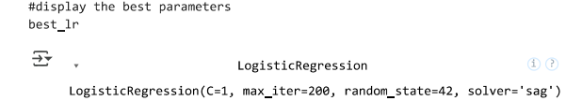
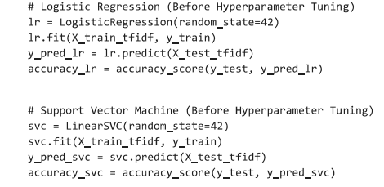
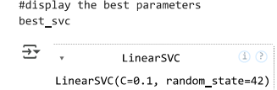
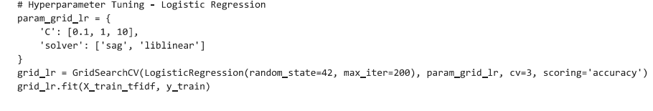
3. Model Development
Logistic Regression.
Linear Support Vector Classifier

Slide 14
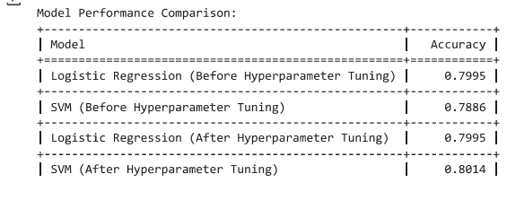
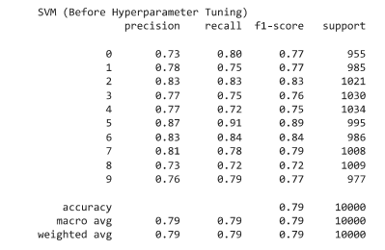
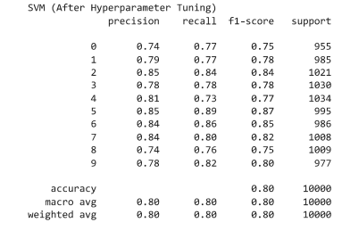
4. Model Evaluation

Slide 15
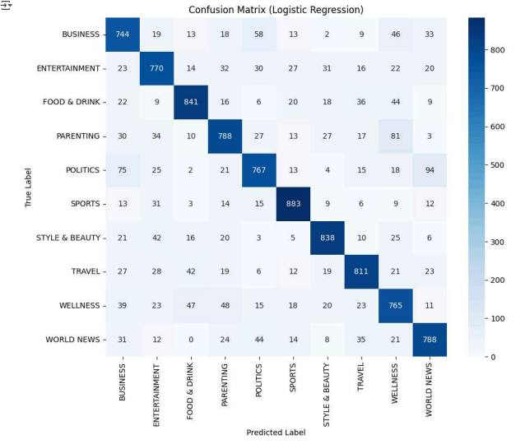
4. Model Evaluation

Slide 16
Summary
Logistic Regression is consistent but did not improve after hyperparameter tuning. SVM showed slight improvement after hyperparameter tuning, outperforming Logistic Regression after tuning.
In general, both the models performs well in categorizing news articles with an accuracy of ~80%.
The precision, recall, and F1-score varies slightly across categories with highest for “Sports”. The lower F1-score indicates that those categories (for e.g. “wellness”) are misclassified.
Next, Collect more data for underperforming categories to balance the dataset.
Use the model's category predictions to build personalized news feeds for users based on their preferences.

