Slide 1
Sales Performance & Business Analytics
InternNova Data Analytics Internship — Week 6 Final Project
Rashmi Bhandari
github.com/Rashmi27032005/Sales-Performance-Business-Analytics

Slide 2
1. Project Overview
Turning raw sales transactions into business insights
• Analyze sales performance across time, regions, categories, and sub-categories.
• Prepare and validate the dataset for reliable analysis.
• Perform exploratory data analysis, correlation analysis, and outlier detection.
• Create meaningful visualizations and a Power BI business dashboard.
• Convert findings into practical recommendations for improving sales and profitability.

Slide 3
2. Dataset & Data Preparation
Public Superstore sales dataset
ORIGINAL ROWS
ORIGINAL COLUMNS
MISSING VALUES
DUPLICATES
9,994
21
0
0
• Converted Order Date and Ship Date to datetime format.
• Validated Sales, Quantity, and Discount values.
• Removed the unnecessary Row ID field.
• Final cleaned dataset: 9,994 rows × 20 columns.
• Saved cleaned data as Superstore_Sales_Cleaned.csv.

Slide 4
3. Exploratory Data Analysis
Overall performance and key analytical findings
TOTAL SALES
TOTAL PROFIT
TOTAL QUANTITY
PROFIT MARGIN
$2.30M
$286.40K
37,873
12.47%
• West is the highest-sales region: $725,457.82.
• South is the lowest-sales region: $391,721.91.
• Technology is the highest-sales category: $836,154.03.
• Tables is the largest loss-making sub-category: -$17,725.48.
• 1,871 transactions were loss-making, totaling approximately -$156,131.29.

Slide 5
4. Visualization & Trend Analysis
Python visualizations created with Matplotlib and Seaborn
Monthly Sales Trend
Sales by Region
Sales increase overall toward 2017, with a peak in Nov 2017.
West
East
Central
South
SALES BY CATEGORY
TOP MONTH
CORRELATION
Technology leads
Nov 2017 — $118.45K
Sales–Profit: 0.479
Five chart files are stored in the Visualizations folder.

Slide 6
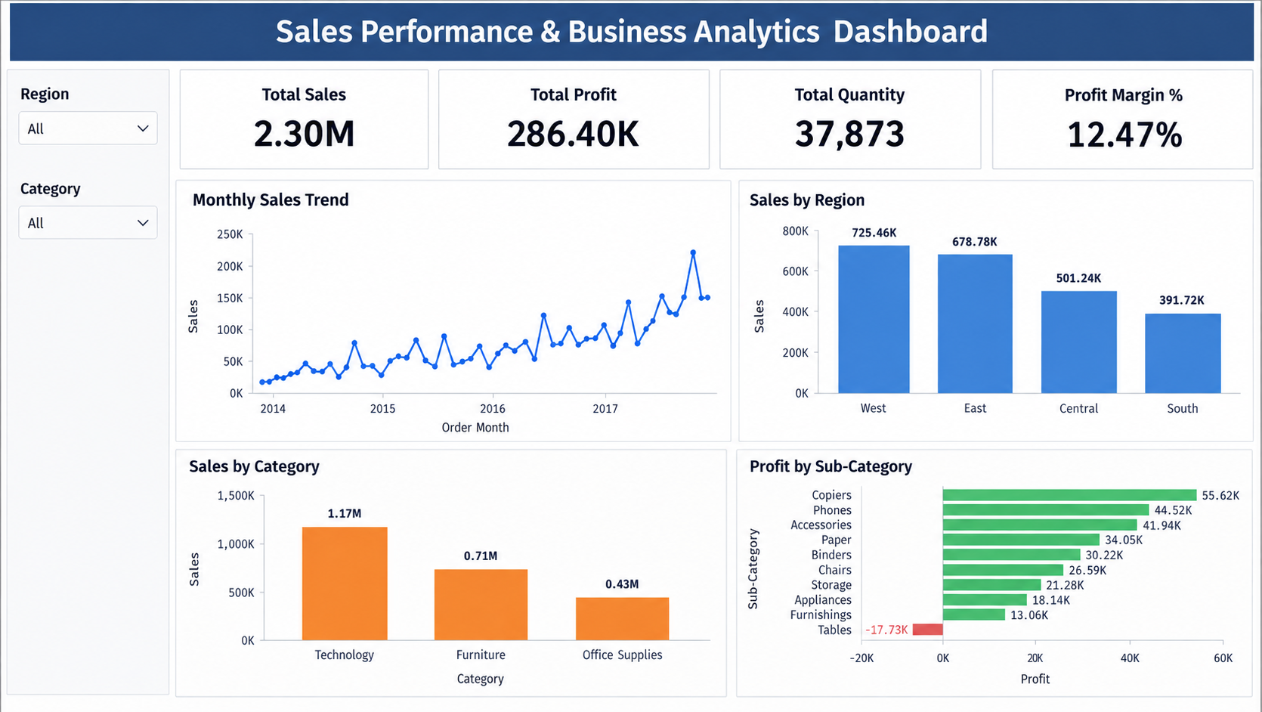
5. Power BI Dashboard

Slide 7
6. Key Insights & Recommendations
Turning analysis into business action
KEY INSIGHTS
RECOMMENDATIONS
• West leads regional sales.
• South has the lowest regional sales.
• Technology leads sales and profit.
• Furniture has high sales but relatively low profit.
• Tables is the largest loss-making sub-category.
• Use targeted marketing to improve South-region performance.
• Review Furniture pricing, discounts, and costs.
• Reduce recurring losses in Tables.
• Focus on profitable Technology products.
• Monitor discount impact on profitability.

Slide 8
Conclusion
The project demonstrates an end-to-end data analytics workflow — from data preparation
and EDA to visualization, Power BI reporting, and business recommendations.
Python • Pandas • NumPy • Matplotlib • Seaborn • Power BI • DAX • Git • GitHub
github.com/Rashmi27032005/Sales-Performance-Business-Analytics

