Slide 1


BADRUN

Slide 2
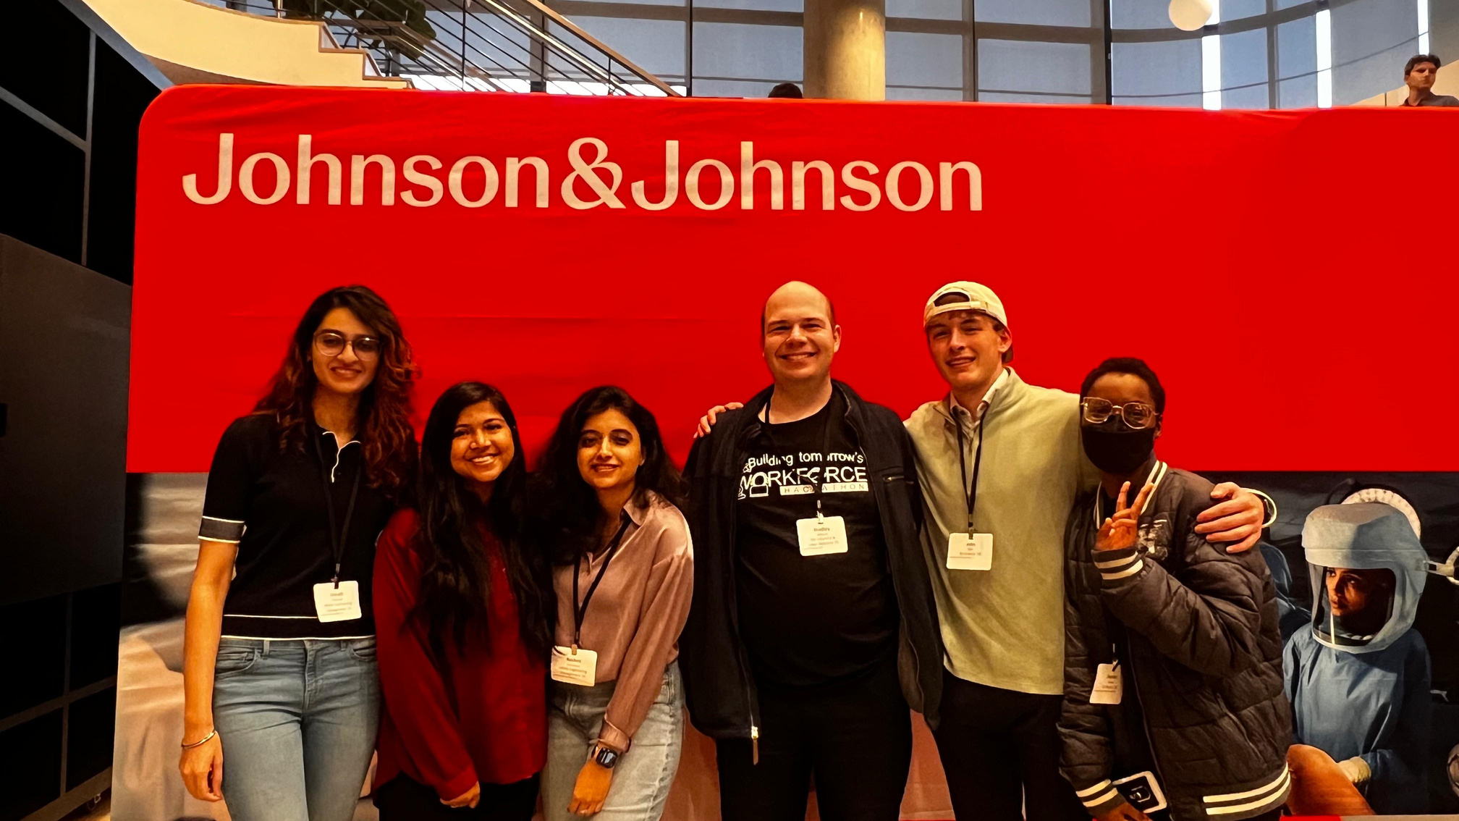
BRADLEY, AIDAN (JOHN), DESTINY, RASHMI, UNNATI, NAZMUN

Slide 3
AGENDA
OVERVIEW
PROBLEM STATEMENT
BIG IDEA!
PROTOTYPE
FINANCIALS
FUTURE FORWARD

Slide 4
OVERVIEW
32% OF THE CANDIDATE POOL IS GEN Z
CURRENT CANDIDATE EXPERIENCE JOURNEY
APPLICATION > SCREENING > INITIAL ASSESSMENT BY RECRUITER > MULTIPLE ROUNDS OF INTERVIEW
EVALUATE BEHAVIORS & VALUES ALONGSIDE SKILLS

Slide 5
PROBLEM STATEMENT
LENGTHY RECRUITING PROCESS & CANDIDATES LEFT HANGING
ONLY FOCUSING ON HARD SKILLS DURING THE INITIAL SCREENING
LACK OF BLEND IN ASSESSING HARD & SOFT SKILLS TO FIND BEST FIT CANDIDATE
CANDIDATE EXPERIENCE – ONLY UNDERSTAND THE WORK CULTURE ONCE THEY JOIN
NO HUMAN/INTERPERSONAL CONNECTION BEFORE INTERVIEW ROUNDS
RECRUITERS EVIDENCE IN SUPPORTING THEIR JUDGEMENT FOR ADVOCATING A CANDIDATE

Slide 6
PROBLEM STATEMENT
STREAMLINE THE HIRING PROCESS BY ENABLING RECRUITERS TO DISCOVER EACH CANDIDATE’S UNIQUE STORY, BLENDING HARD & SOFT SKILLS, THROUGH AN IMMERSIVE ‘DAY-IN-THE-LIFE’ EXPERIENCE AS AN EMPLOYEE

Slide 7
BIG IDEA
WELCOME TO J&J'S NEXT EVOLUTION IN HIRING—WHERE
APPLYING IS AN EXPERIENCE, NOT JUST A PROCESS!

Slide 8


WHAT IS IT?
INVOLVEU
FOR CANDIDATES:
A "DAY-IN-THE-LIFE" SIMULATION ALLOWS CANDIDATES TO ACTIVELY EXPERIENCE J&J'S CULTURE, VALUES, AND TASKS AS THEIR FIRST TOUCHPOINT!
Transform recruitment into an immersive, gamified experience where candidates start their journey as if they’re already part of J&J!
FOR RECRUITERS:
IT SIMPLIFIES SCREENING WITH REAL-TIME INSIGHTS AND A DASHBOARD SUMMARIZING EACH CANDIDATE'S UNIQUE STORY (BLENDING SOFT AND HARD SKILL EVALUATION), REDUCING THE NEED FOR MULTIPLE INTERVIEW ROUNDS.

Slide 9
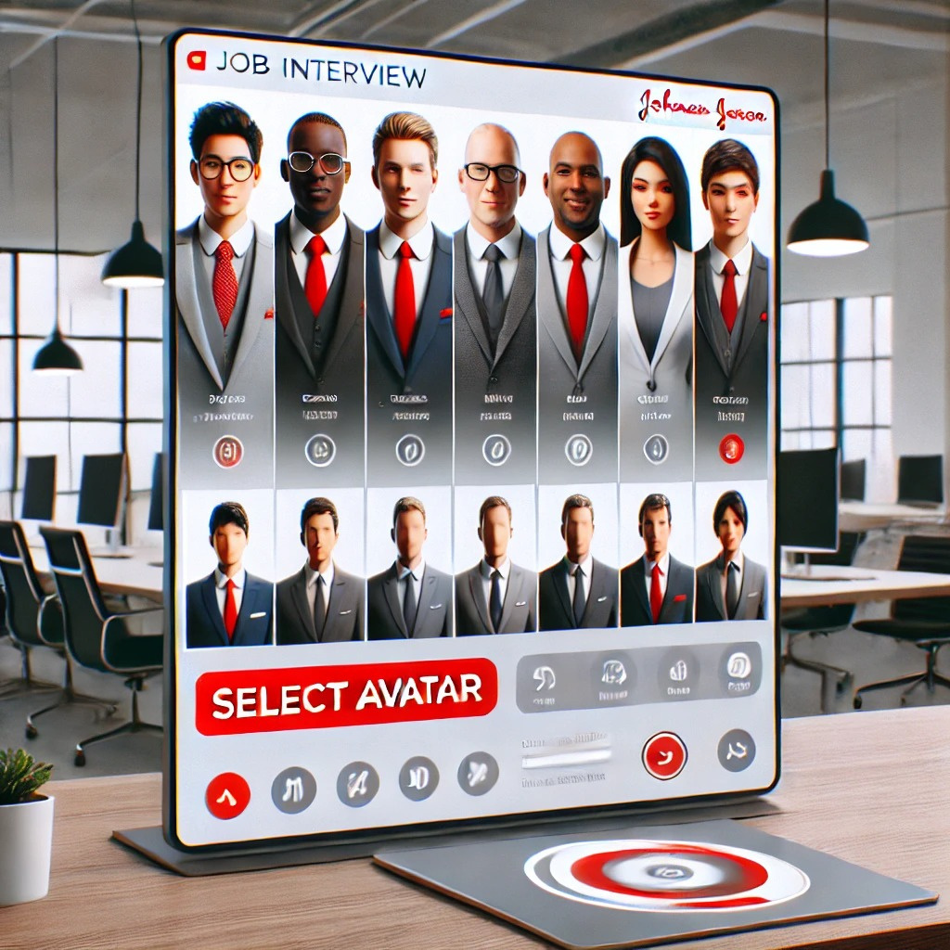
PROTOTYPE

Slide 10
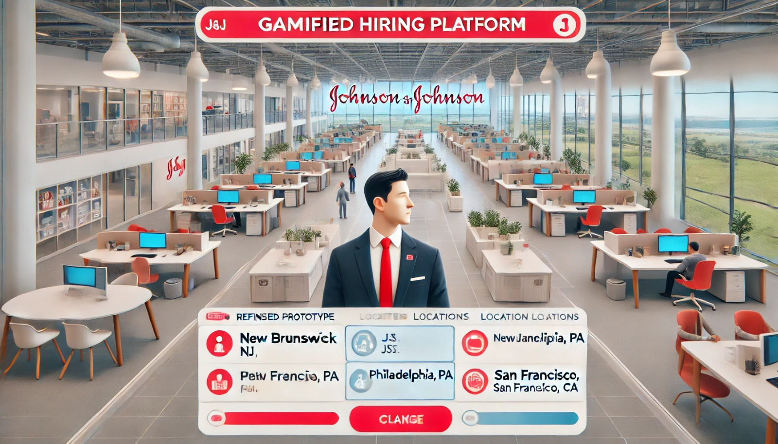
PROTOTYPE

Slide 11




8:42
RECRUITER DASHBOARD
IT IS 8:42 AM. IT IS YOUR FIRST DAY IN YOUR NEW ROLE AT J&J. YOU ARE SUPER EXCITED TO MEET ALL OF YOUR NEW COLLEAGUES BUT DO NOT KNOW WHAT TO DO. YOU SEE A LOT OF DIFFERENT GROUPS HAVING CONVERSATIONS AND DO NOT KNOW WHAT TO JOIN.
TALK WITH THE GROUP OF 4
TALK WITH THE PEOPLE IN THE CORNER
GO TO THE NEXT ROOM
FIND YOUR MANAGER

Slide 12




14:27
YOUR COWORKER ASKS TO TELL HER ABOUT YOUR MOST RECENT EXPERIIENCE?
Click to Speak

Slide 13
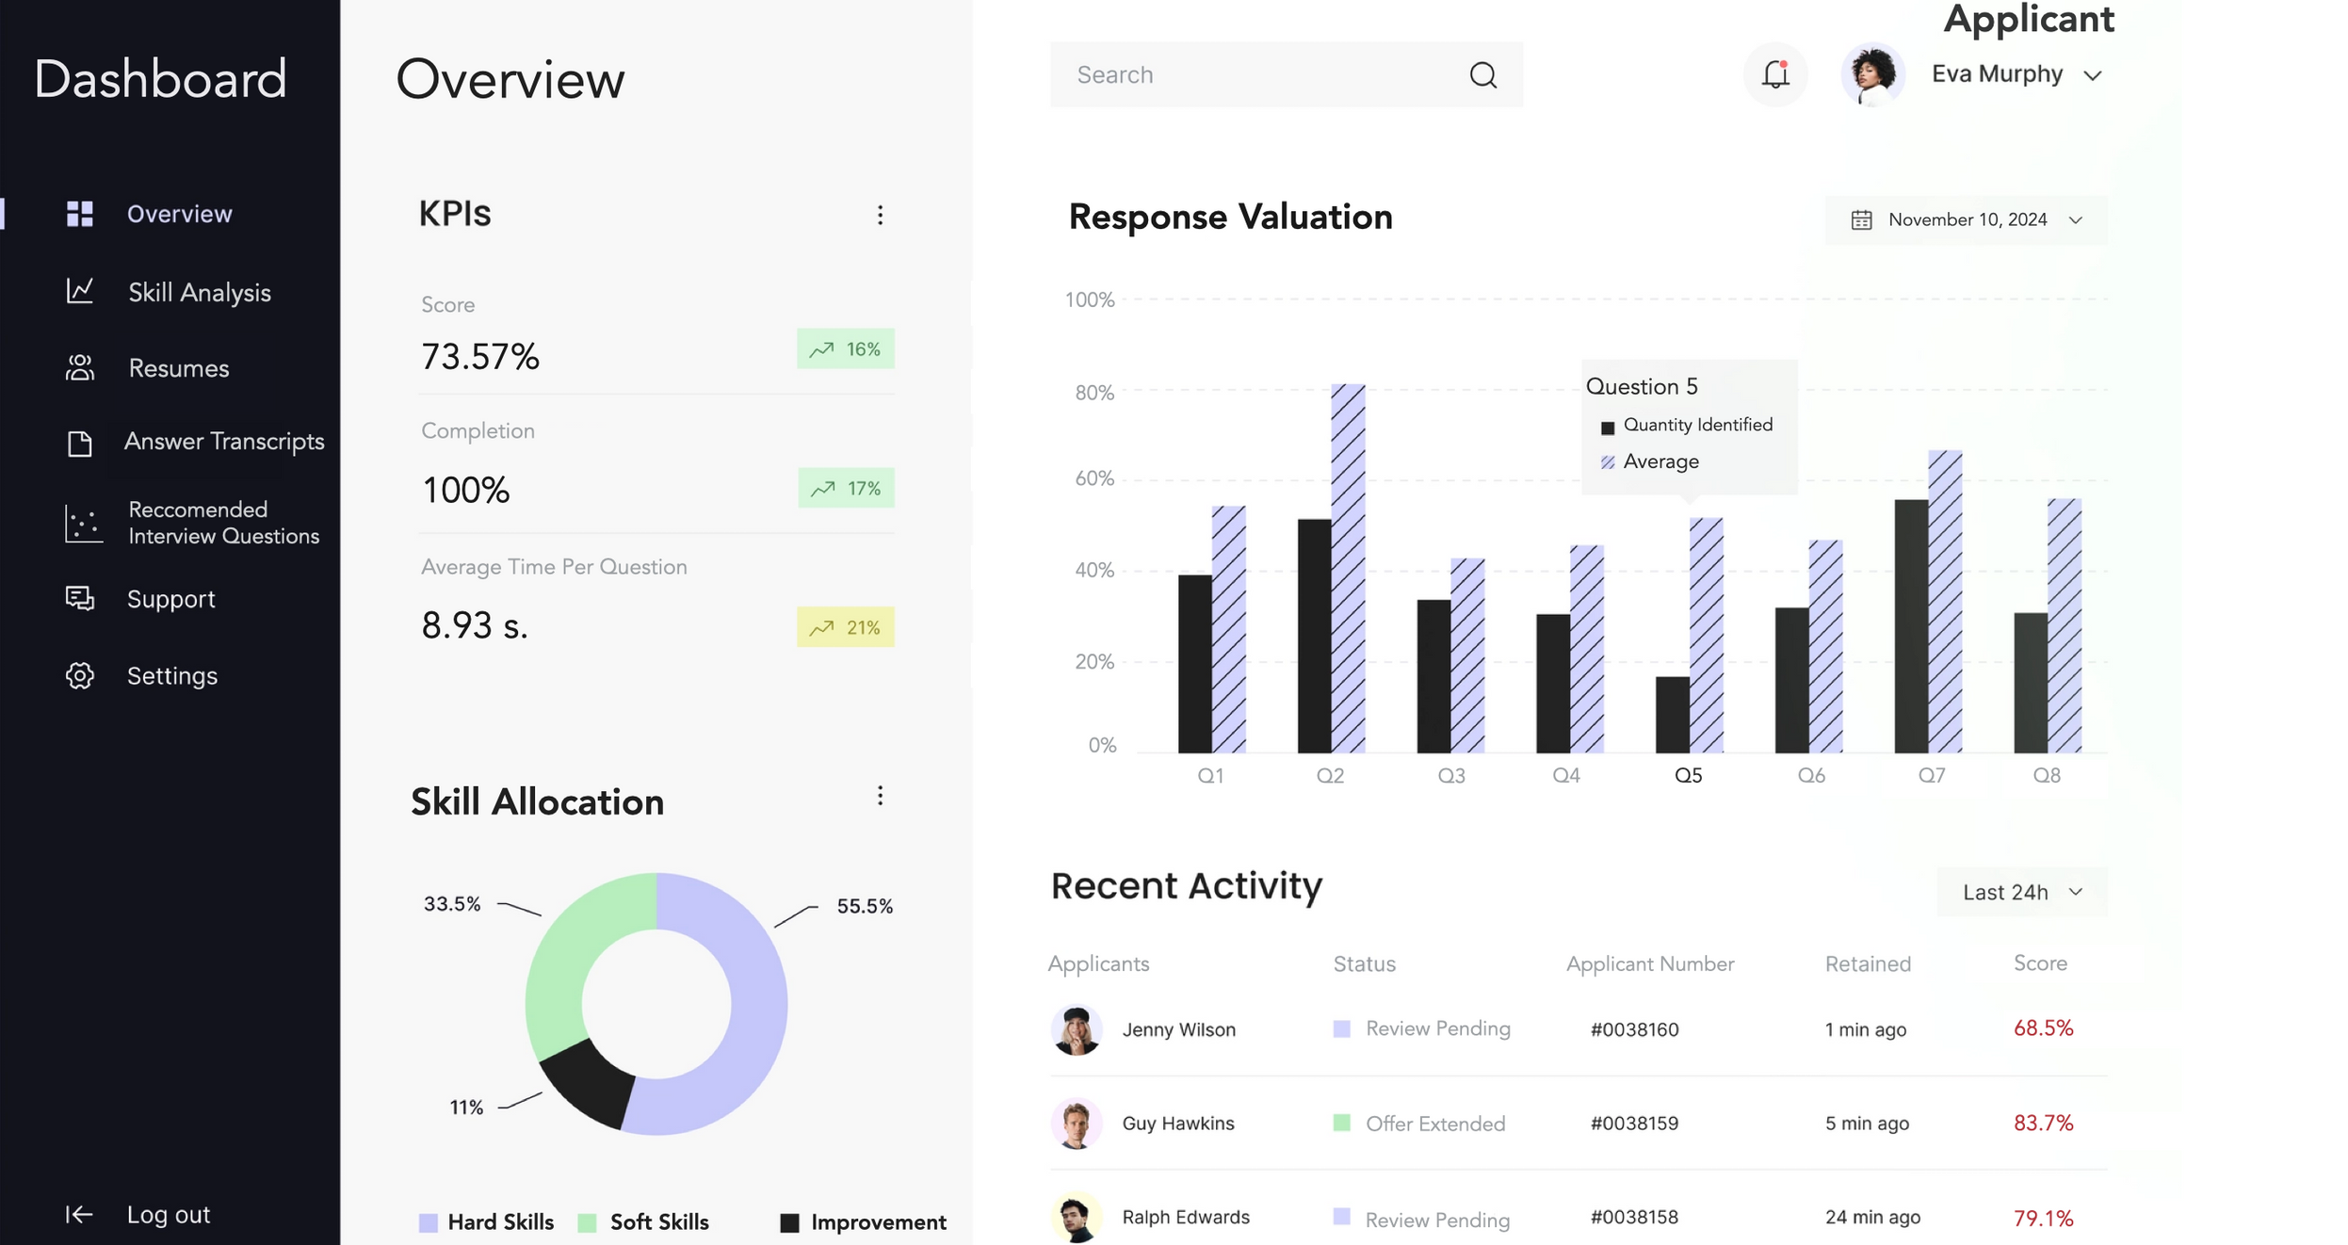

Slide 14


RISKS & CONSIDERATIONS
Risks
Considerations
Risks
Recruiting Employees with Similar Values
Potentially Time-Consuming and Cost-Intensive to Implement and Maintain
Unintentional Bias
Potential Negative Experience
Misalignment with Job Requirements
Relying Solely on AI to Generate Data – Focusing on Training the Data
Considering Whether Existing Metrics Are Truly Evaluative of a Prospective J&J Candidate
Complies with Data Privacy and Security Regulations
Providing Training to Recruiters on Evaluating Gamified Results in an Unbiased Manner, Focusing on Job-Relevant Insights

Slide 15


FINANCIALS & TIMELINES
Gamification reduces time-to-hire by 25%
Traditional hiring at J&J takes 47 days
AI reduces time-to-hire by 30%
Traditional hiring costs $4,000 per hire
Time to Hire (Days)
Cost per Hire (USD)
Hiring Method
Hiring Method

Slide 16



FUTURE FORWARD
Scaling to include older demographics and experienced hires
Modifying the space to support the onboarding of new hires
Adapting the space to incorporate an application tracker

Slide 17
THANK YOU

Slide 18
References
https://www.demandsage.com/ai-recruitment-statistics/#:~:text=AI%20is%20rapidly%20transforming%20recruitment,costs%20by%2030%25%20per%20hire.
https://www.hr-play.com/blog/gamification-in-recruitment-case-studies-in-recruitment-gamification

