Slide 1
Global Hackathon Event: Resume Best Match ​
Team 282​
Bhagabat Barik​
Arun Badhai​
Rashmi​
Subash​
Sangamesh​
Saritha​

Slide 2
Agenda ​
Problem Statement​
Goal​
Assumption​
Technology Stack ​
Technical Overview ​
Flow Diagram ​​
Key Advantage​

Slide 3
Problem Statement
To address your request, you would likely need to develop a software tool or platform that integrates with Wells Fargo's recruiting systems and utilizes other supporting tools to automatically search for resumes matching a given job description (JD). Here's a potential approach:
Data Integration: Establish connections with Wells Fargo's recruiting systems to access their database of resumes and job postings.
Natural Language Processing (NLP): Implement NLP algorithms to analyze job descriptions and resumes. This involves parsing the job description to identify key skills, qualifications, and requirements.
Resume Parsing: Develop a resume parsing tool to extract relevant information from resumes, such as work experience, skills, education, and certifications.
Matching Algorithm: Create an algorithm that compares the requirements outlined in the job description with the content of each resume. This algorithm should prioritize resumes that closely match the JD.
Machine Learning: Train machine learning models to improve the accuracy of resume-job description matching over time. This involves providing feedback on the relevance of matched resumes to continuously refine the algorithm.

Slide 4
Problem Statement
Integration with Supporting Tools: Integrate with other tools or databases that provide additional information or context, such as LinkedIn profiles, GitHub repositories, or online portfolios. This can enhance the evaluation of candidates beyond the information provided in their resumes.
Automation: Implement automation features to streamline the entire process, from retrieving job descriptions to presenting matched resumes, reducing manual intervention as much as possible.
Testing and Validation: Thoroughly tested the product to ensure accuracy, efficiency, and reliability. Validate the results against manual searches conducted by recruiters to confirm the effectiveness of the tool.
Feedback Loop: Establish a feedback loop with recruiters to gather input on the tool's performance and identify areas for improvement.
By following these steps, you can develop a product that automates the process of retrieving resumes from Wells Fargo's recruiting systems and matching them to specific job descriptions, reducing the manual effort required by recruiters.

Slide 5
Goal
The goal of the architecture redesign project is to address these challenges by developing an architecture that enables the system to utilize existing resumes and job descriptions from Workday and perform the following requirements.
Recruiters and candidates should be able to search resumes and jobs using keywords, with capabilities akin to Google-like keyword searches, allowing them to search using a combination of skills, experience domains, and other relevant criteria.
Additionally, the ML-based recommendation algorithm should effectively analyse search keywords, resumes, and job listings to generate relevant and meaningful suggestions.
Note: We have exposed a REST API to evaluate the model's efficiency. The API contract will be provided in this document at the bottom.

Slide 6
Assumptions
Workday portal functionalities are pre- existing in the system and that includes features such as a the creation of accounts, the capability to upload resumes PDF/Word format ​
User provide accurate and up-to-date information regarding their job description, skills, experience and preferences.​
The system is designed to handle a growing number of users, job listings, and the data without compromising performance.​
Focused effort is required on building recommendation engine which can be plugged – in with Workday.

Slide 7
Tech Stack
Language: Python​
Framework: Flask​
API: REST Service ​
Platform: Azure cloud​
Build: Docker​
Version Control: GitHub​
ML Library Used: nltk, tika, scikit-learn.​

Slide 8
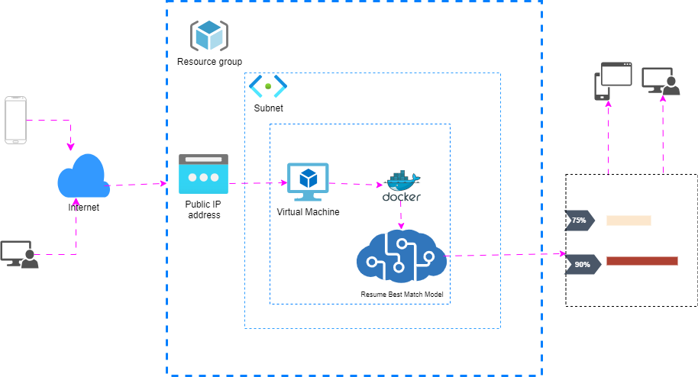
Technical Overview

Slide 9
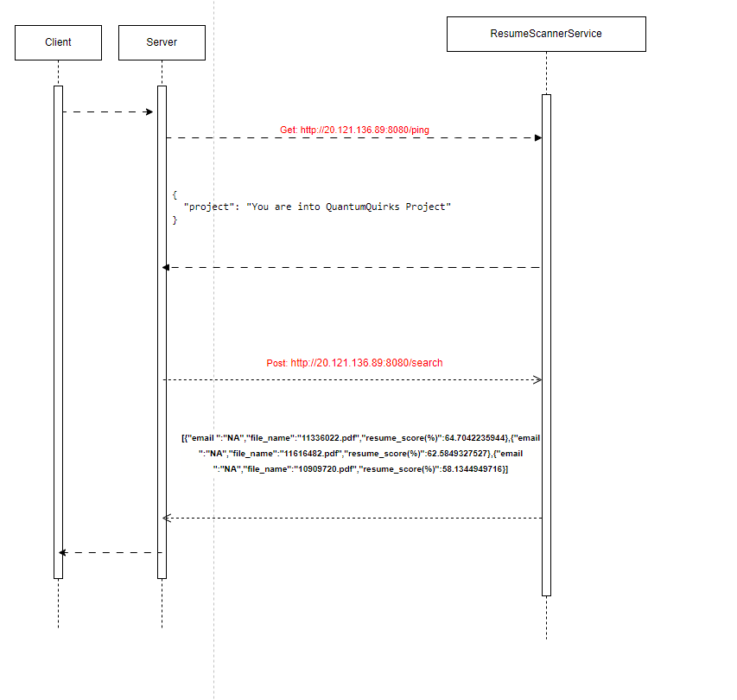
Low Level Diagram

Slide 10
Non-functional requirements (NFR)​
Performance ​
It’s a user-friendly interface making both recruiters and candidates resume or job search.​
This will provide accuracy percentage of the resume using NLP model.​
Scalability​
We are utilizing Azure Virtual Machines which can be scaled based on the load.
Portability and Compatibility ​
We are deploying application in Azure cloud​.
Additionally, Docker containers can be employed to enhance scalability and manage resources more efficiently.

Slide 11
Advantages
Resume and job search process tailored opportunities, savings time both recruiters and candidates.​
Minimized the recruiters or candidates missing suitable opportunity, job openings a comprehensive exploration of relevant candidates and job options based on their skills.​
Improve the user experience with a user friendly web interface making the recruiters and candidates resume or job search and application process more intuitive and accessible.​

Slide 12


