Slide 1

MSDS-6373 Time Series FLS Unit 1
By-Rashmi Patel

Slide 2
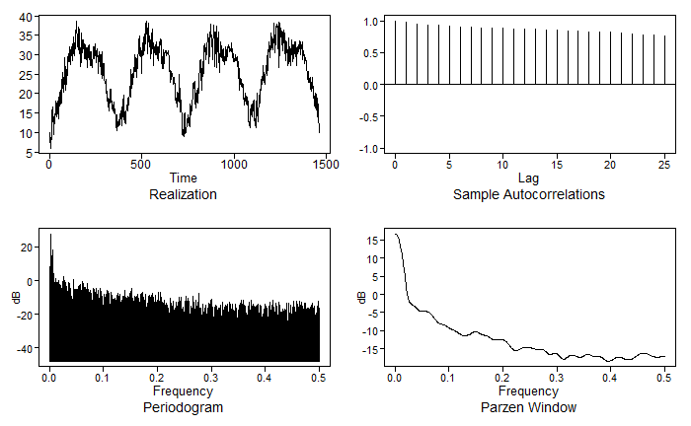
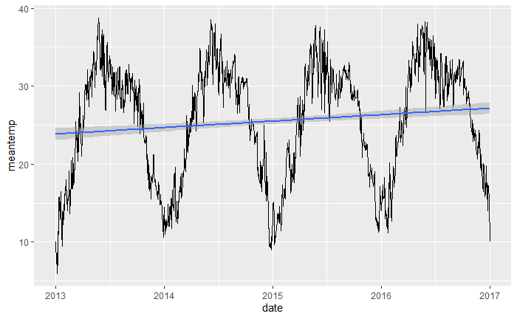
Stationary Time Series
New Delhi Temperature data
Time series plot for temperature in New Delhi
Write a brief one- to three-sentence description in the Google Doc provided by your instructor.
Description: This is a time series dataset which is about the mean temperature recorded in Delhi, India from 1st January 2013 to 24th April 2017. The dataset is publicly available in Kaggle (https://www.kaggle.com/datasets/sumanthvrao/daily-climate-time-series-data )

Slide 3
Takeaways
Realization: A realization is a particular instance of time series.
Expected Value: the expected value of a random variable X (E[X]) is the mean or intuitively the long-run average of the event that variable represents.
Stationarity and assumptions
Autocorrelation
Weak Stationary Process
Independence in tswge (in R)
We can obtain an estimate of the variance for a given time t with a single observation.

