Slide 1

MSDS-6373 Time Series FLS Unit 2
By-Rashmi Patel

Slide 2
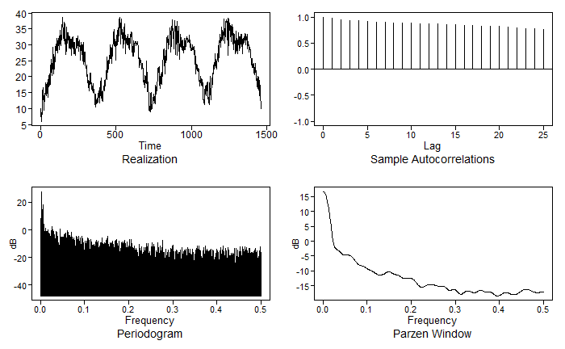
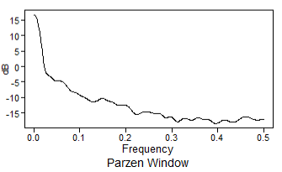
Spectral Density Plot
New Delhi Temperature data
Spectral density plot
Since the temperature is recorded daily for almost 3 years, so the period will be 365 days and the frequency for my time series will be 1/365= 0.0027.
Since the peak for the spectral density plot appears at 0, the time series can be considered as Aperiodic. We can say that the data has a wandering behavior because there is no high and specific peak other than 0.

Slide 3
Takeaways
A spectral plot is a graphical technique for examining cyclic structure in the frequency domain. It is a smoothed Fourier transform of the autocovariance function.
Frequency is inversely related to Period.
Delta constant is called phase shift.
Sine function shift horizontally when phase shift is applied.
A broad class of functions can be written as a sum of sine and cosine functions, even if the function is not periodic or cyclic.
The Nyquist frequency is the highest observable frequency when sampling at the integers because you need at least two observations to observe one cycle.
When sampling at the integers, a series with a frequency higher than .5 may become aliased with a series with lower frequency.

