Slide 1

MSDS-6373 Time Series
FLS Unit 3
By-Rashmi Patel

Slide 2
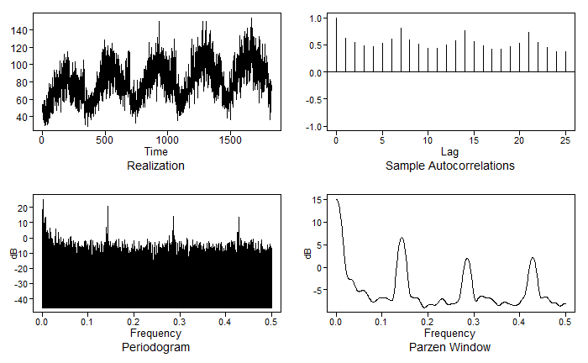
Walmart Data
Walmart Store 8 Item 50 time series data
Condition 1:
The data contains 1826 daily observations for about 5 years measuring sales of one item at Walmart. It seems that there is a seasonal component to the series. This is evidence against a stationary time series.
Condition 2:
Given that the series is not thought to be stationary, it is tough to assess the constant variance since we only have one observation per day.
Condition 3:
We see evidence of annual trend which leads us to that the autocorrelations do not depend on where they are in time, rather just on the lag.
Because the three conditions of a stationary time series cannot be confirmed, it must be concluded that this is not a stationary time series and that there is a dependency on time driving the position of each successive data point.

Slide 3
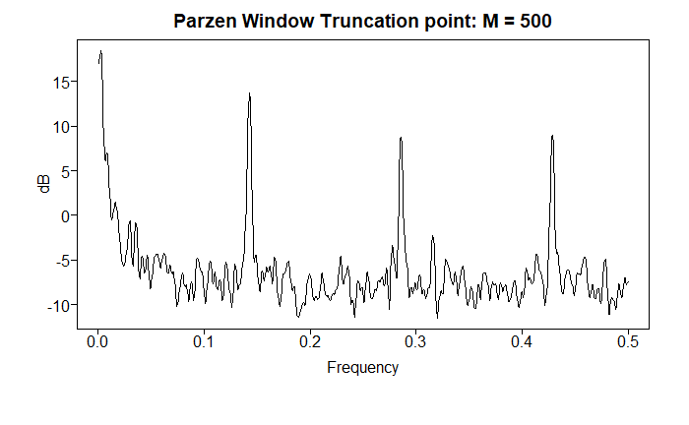
Spectral Density Plot
There is a peak in the spectral density at 0 which is evidence of some wandering behavior that is apparent in the realization.
There is also evidence of cyclic behavior in the realization which is supported both by our intuition and the spectral density. There is a peak at about .083 which is indicative of a period at 1/.083 = 12, showing evidence of some monthly seasonality. This makes sense intuitively as an annual cycle seems to make sense in this sales data.
There also looks to be evidence of a peak in the spectral density at .14, .28 and .42.

Slide 4
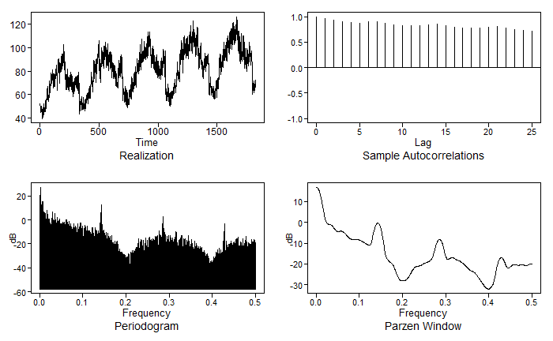
5-Point Moving Average
Spectral Density:
There is still a peak in the spectral density at 0 which is evidence of some wandering behavior that is apparent in the realization.
There is also evidence of cyclic behavior in the realization which is supported both by our intuition and the spectral density. The peek around .083 which is indicative of a period at 1/.083 = 12, showing evidence of some monthly seasonality, is starting to fade.
The other peak in the spectral density at .14, .28 and .42 are also smoothing out.
ma51 = stats::filter(data50, rep(1,5))/5
ma51 = ma51[!is.na(ma51)]
p = plotts.sample.wge(ma51)

Slide 5
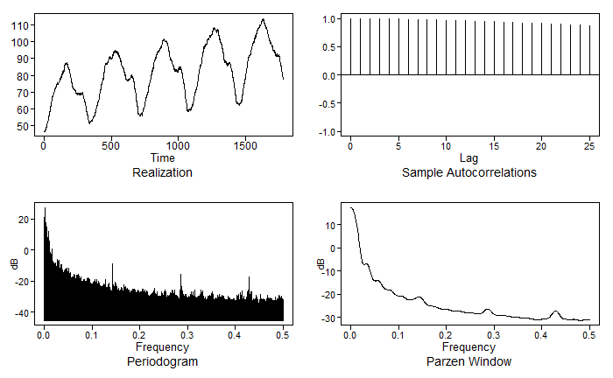
50-Point Moving Average
Spectral Density:
After doing large number moving average, there still seems to be some evidence of some wandering behavior with a peak in the spectral density at 0. There are still small peaks at .14, .28 and .42. which could be seen more predominately in the 5-Point Moving Average.
ma51 = stats::filter(data50, rep(1,50))/50
ma51 = ma51[!is.na(ma51)]
p = plotts.sample.wge(ma51)

Slide 6


Questions from 2DS
AR(1): X _{t} – φ ₁X_{t – 1} = a_{t}
Stationarity:
Stationary if |$φ_{1}$| <1
Autocorrelation:
$$ρ_{k}=\text{j}\text{1}\text{k} for k ≥1$$
damped exponential
(oscillating and exponentially damping if ϕ₁ <0)
Realizations look like:
ϕ₁ > 0 : Seem to be “wandering,” aperiodic in nature. (ϕ₁ Positive)
ϕ₁ < 0 : Seem to be “oscillating” (ϕ₁ Negative)
Spectrum:
has a peak at f = 0 (ϕ₁ > 0) or f = 0.5 (ϕ₁ < 0)

Slide 7
Takeaways
The differenced data (Z_{t}) is the realization length of n-1.
The difference removes the long-term trending behavior and retains the monthly cyclic pattern (high-pass filter), which could be very useful if we wanted to just analyze the frequency of the data.
The five-point moving average filter removes the high frequency and leaves the low frequency, thus making it, again, a low-pass filter.
Autoregressive models tend to be useful for describing stationary data that move forward in time.
The realizations are wandering or oscillating depending on whether or not the root of the characteristic equation is positive or negative. If phi 1 was positive, then we would have that wandering behavior. And if phi 1 was negative, then we would have that oscillating behavior.
The autocorrelations are damped exponential or damped oscillating exponentials depending on whether the root, again, of that characteristic equation is positive or negative, respectively.
The spectral densities have a peak at f equals 0 or f equals 0.5 depending on whether the root of that characteristic equation is positive or negative, respectively.

