Slide 1

MSDS-6373 Time Series FLS Unit 4
By-Rashmi Patel

Slide 2
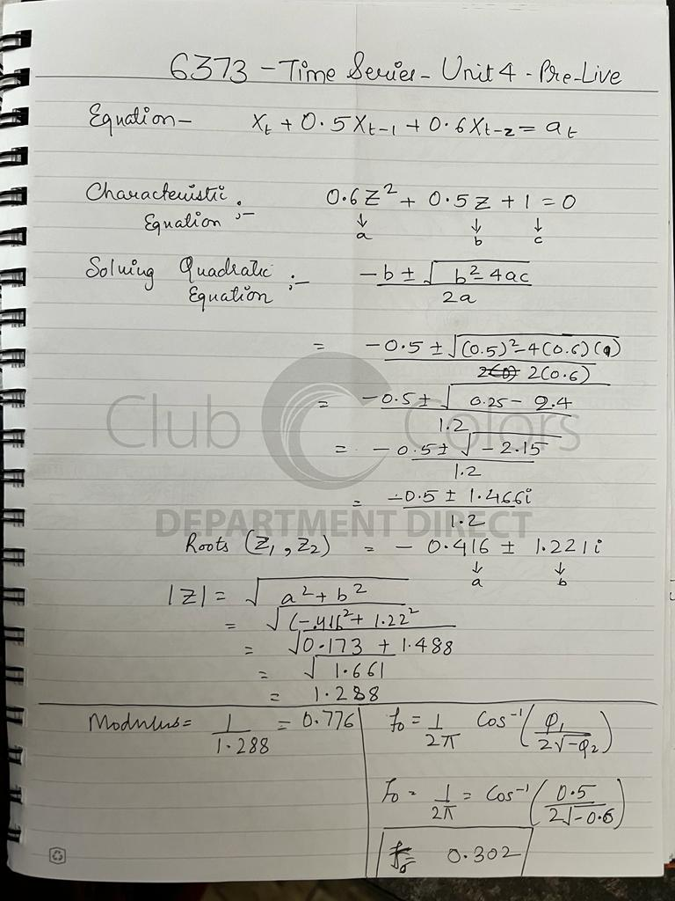
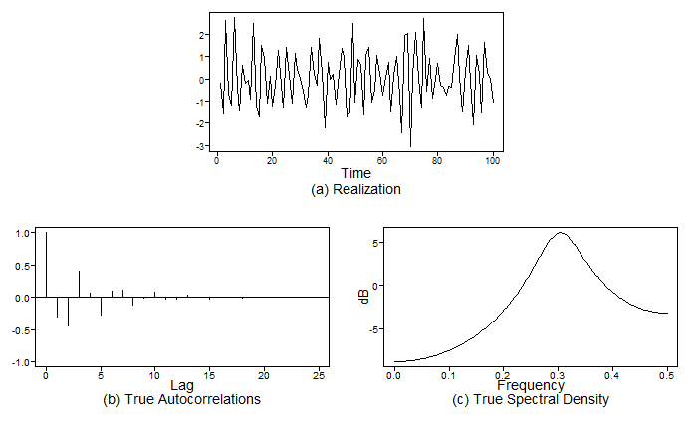
AR(p) model

Slide 3
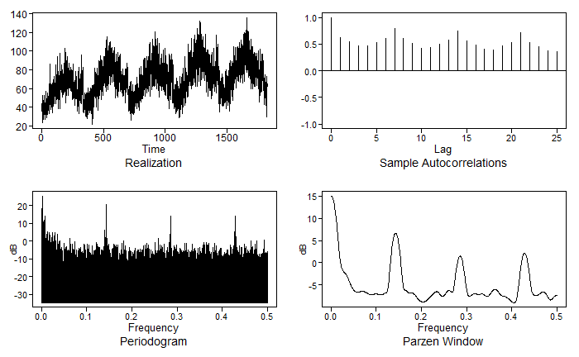
Walmart data (Store 9 Item 50)
The plot shows that the data has a some sinusoidal for the autocorrelation and frequency peaks are occurring at 0, 0.14,0.28, and 0.42. We must look for models that has frequencies close to this. The frequency occurrence between 0-0.5 tells us that the model should be A-r model type.

Slide 4

AR(1) Model
Looking at AR(1) model, we can conclude that the model is not complex enough to be a better model. Reading the observation from the Factor table we can say that there is peak at 0.5 and no conjugate roots are obtained, the model will not have sinusoidal ACF plot.

Slide 5
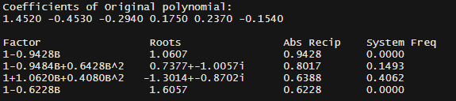
AR(6) Model
Looking at AR(6) model, we can conclude that the model is a better model compared to AR(1) model. Reading the observation from the Factor table we can say that there is peak at 0, 0.1493 and 0.4062 and conjugate roots are suggested that the model will have sinusoidal ACF plot. But since the Absolute reciprocal of Real roots (1-0.9428B) is dominating with value of 0.9428, therefore, we will see damped autocorrelations but no sinusoidal patterns.

Slide 6
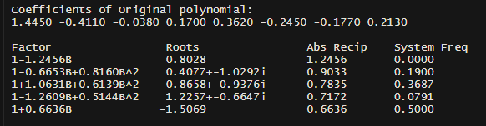
AR(8) Model
Looking at AR(8) model, we can conclude that the model is not stationary because one of the real roots lie inside the unit circle so we can eliminate from the comparison list.

Slide 7
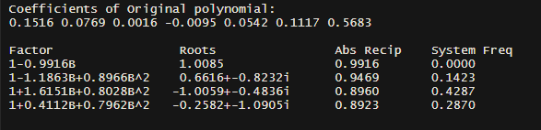
AR(9) Model
Looking at AR(9) model, we can conclude that the model is a better model compared to AR(1) and AR(6) model. Reading the observation from the Factor table we can say that there is peak at 0, 0.1423, 0.2870 and 0.4287 and conjugate roots are suggested that the model will have sinusoidal ACF plot. But since the Absolute reciprocal of Real roots (1-0.9916B) is dominating with value of 0.9916, therefore, we will see damped autocorrelations with some sinusoidal patterns.

Slide 8
Model Comparison
Comparing all the models we can say that AR(9) model is best for Walmart data for Store 9 Item 50.

Slide 9
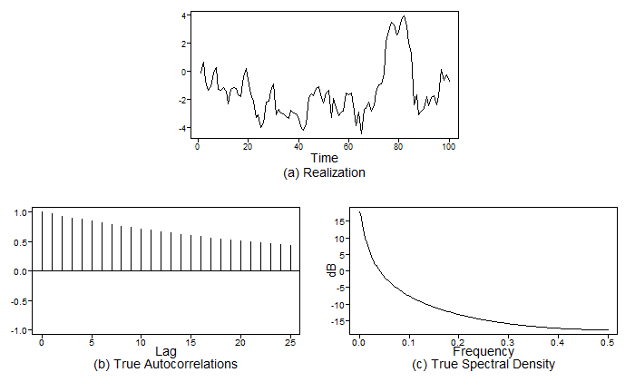
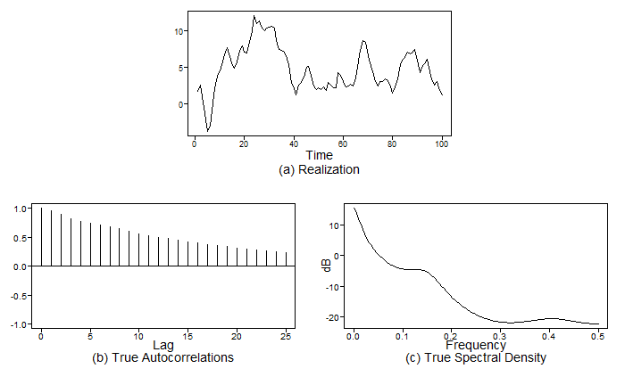
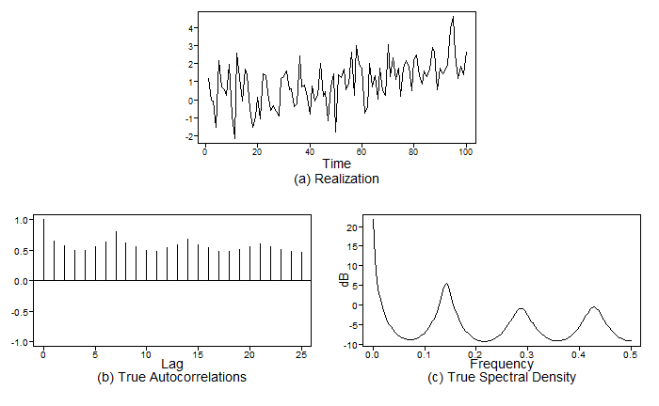
Plots
AR(1) Model
AR(6)Model
AR(9) Model

Slide 10
Takeaways
For an AR(2) model, the only way to get a system frequency between 0 and .5 is if the roots of the characteristic equation are imaginary.
All polynomials can be factored using first and second order factors.
The fundamental behavior of autocorrelations and spectral density depends on whether the roots of the characteristic equation are real or complex.
A stationary AR(2) model with second degree order whose characteristic equation has complex conjugate roots
Has realizations that shows a pseudo-cyclic behavior with cycle length about 1/f₀.
The autocorrelation function has the appearance of a damped sinusoidal with frequency f_{0.}
The spectral density has a peak at about f₀.
There are 3 types of model with first and second order factor with AR(P):
Model A: With roots equally close to the unit circle.
Model A-r: Real root closer to the unit circle than complex roots.
Model A-c: Complex root closer to the unit circle than real root.
Which ever root that is closer to the unit circle in an AR(P) model would be more prominent in the realizations, functions and spectral densities.
When roots were equally close to the unit circle, we saw both first and second order behaviors.
When the positive real root was closest to the unit circle, the first order behavior dominated.
When complex roots are closer to the unit circle, second order behavior dominates.

