Slide 1

MSDS-6373 Time Series FLS Unit 5
By-Rashmi Patel

Slide 2
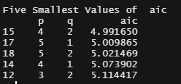
Walmart Data
Walmart Store 9 Item 50 AIC values
Question: Use Aic5 to assess the use of ARMA models in the Walmart data.
Answer:
Looking at the AIC table for Walmart store 9 item 50, obtained using aic5.wge() function, we can conclude that ARMA(p, q) model with p=4 and q=2 will have lowest AIC=4.991, so our preferred model w.r.t. AIC is ARMA(4,2)

Slide 3

Walmart Data
Question: Find $ρ_{1}$ for the following model by hand.
$$X_{t}=a_{t}−.8a_{t−1}+.5a_{t−2}$$
Answer:
$$ρ_{1}=\frac{−θ_{1}+θ_{1}θ_{2}}{1+θ_{1}^{2}+θ_{2}^{2}}$$
$=\frac{−.8+(.8)(−.5)}{1+{.8}^{2}+{(−.5)}^{2}}$
$$=−.6349206$$

Slide 4
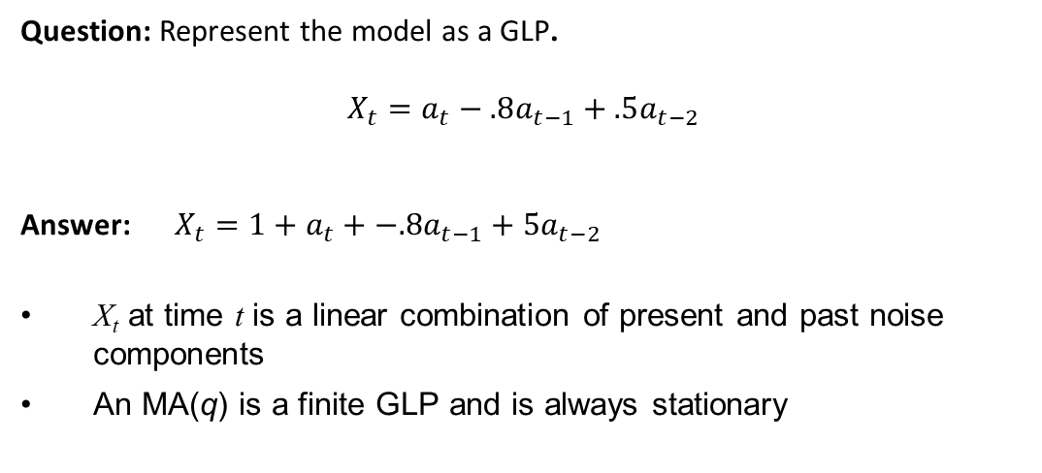
Walmart Data
Question: Represent the model as a GLP.
$$X_{t}=a_{t}−.8a_{t−1}+.5a_{t−2}$$
Answer: $X_{t}=1+a_{t}+−.8a_{t−1}+5a_{t−2}$
X_{t} at time t is a linear combination of present and past noise components
An MA(q) is a finite GLP and is always stationary

Slide 5
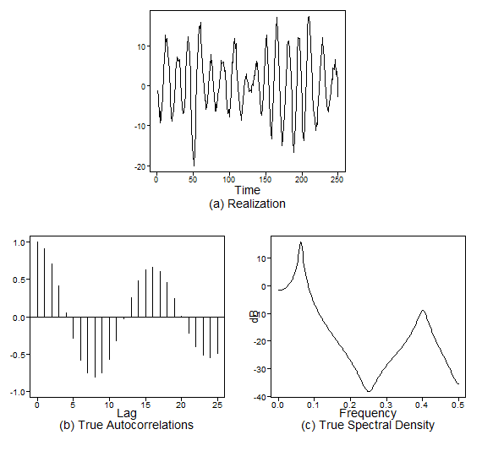
Walmart Data
Question: Generate a realizations from an ARMA model. You pick p and q. Include the ACF and spectral density.
Answer: I decided to run following ARMA(4,3) model:
plotts.true.wge(250, phi = c(.3,.9,.1,-.8075), theta = c(-.9, -.8,-.72))

Slide 6
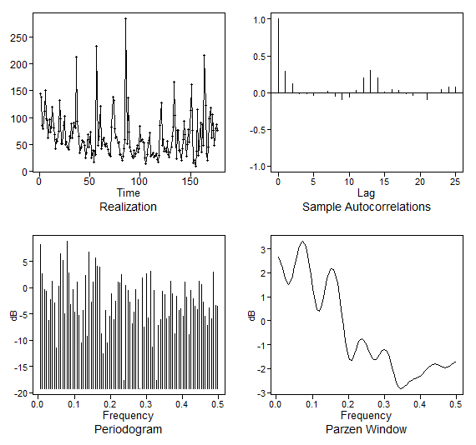
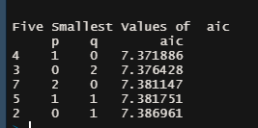
Walmart Data
Question: Use AIC 5 to identify the top five quality models with respect to AIC for the cancelled flight data from the SWADelay.csv data set (column: arr_cancelled). Comment on which are AR, MA, and ARMA.
Answer:
# Read in the data
SWA = read.csv("swadelay.csv",header = TRUE)
plotts.wge(SWA$arr_cancelled)
plotts.sample.wge(SWA$arr_cancelled)
aic5.wge(SWA$arr_cancelled)
Looking at the AIC values obtained using above lines of code, we can conclude that the model AR(1) will have the lowest AIC=7.371. The second is an MA(2) with and AIC of 7.376428. Third will be and AR(2) model with a score of 7.381147. Forth is the only ARMA in the group; it is an ARMA(1,1) and scores a 7.381147. Finally, there is an MA(1) that has an AIC of 7.386961.

Slide 7
Takeaways
ϕ(B)X_{t} = θ(B)a_{t} is a stationary and invertible ARMA(p,q) process if:
Roots of ϕ(z) = 0 are all outside the unit circle
Roots of θ(z) = 0 are all outside the unit circle
Note: In order to refer to a process as “ARMA,” we will require it to be stationary and invertible
Wording for AR models for which the characteristic equation has complex conjugate roots.
The data have a pseudo-cyclic appearance.
The autocorrelations show damped sinusoidal behavior.
The spectral density has a peak at some f₀ between 0 and .5 (at approximately .1 in this case).
Akaike’s Information Criterion
used to evaluate and compare the quality of models
the model with the lowest AIC is thought to have the most quality
ψ-Weights are used in establishing prediction limits on forecasts
calculate ψ-weights using tswge command
psi.weights.wge()

