Slide 1


6390 Case Study 2 From Report to Story
By-Rashmi Patel

Slide 2
Case Study #2 (Tell a Story 6.11)
Dashboards and regular reporting (weekly, monthly, quarterly)—we can use these tools as one way to explore our data and figure out what could be interesting, or worth further investigation. But too often, we share dashboards or reports meant for exploration when really we should be taking it a step further, making it clear to our audience what they should focus on and what they should do with the information we share.
Consider the figure below which shows a page from a monthly report on ticket volume and related metrics. Complete the following steps:
1) First practice putting the takeaway for each graph into words.
2) Do we need all of this data? It may be important to look at all of these things as we explore the data, but not all of the data is necessarily equally interesting when it comes to communicating it to our audience. Imagine you need to tell a story with this data: which parts of the report would you focus on and which would you omit?
3) Use the attached data and create graphs and/or slides to tell a visual story with the elements you selected in step 2). How would you show the data? How will you incorporate words? Create your preferred visuals. Decide whether you would present this live or send the information off to be consumed on its own. Optimize your approach for the scenario you’ve chosen.

Slide 4
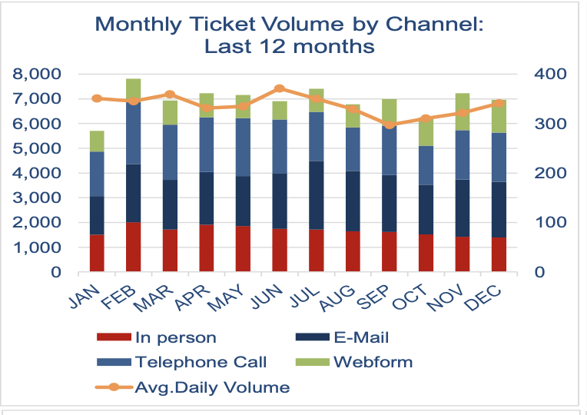
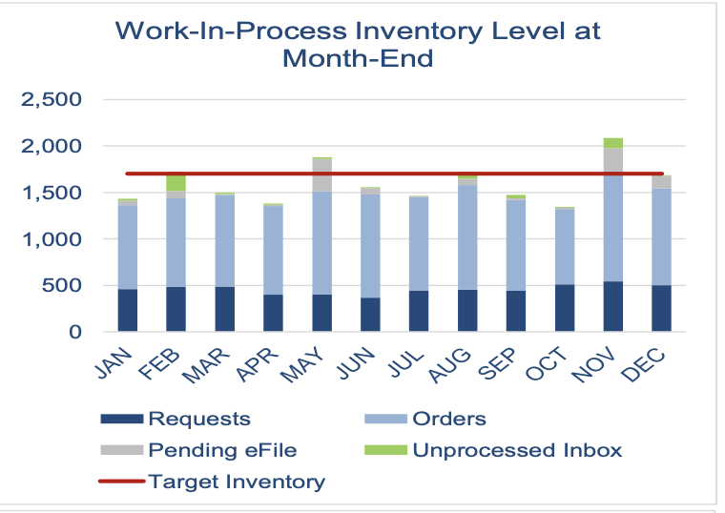
1) First practice putting the takeaway for each graph into words
“Monthly Ticket Volume by Channel: Last 12 Months”
This chart aims to visualize the monthly ticket volume totals broken down into channels. Those channels are :
In person
Telephone
Email
Webform
Average daily volume.
This chart seeks to show the overall trend of ticket volume, while also being broken down by channel by using a stacked bar chart. The takeaway is that the ticket volume is consistent year-round whereas the channel breakdown varies during the time period.
“Work-in-Process inventory level at month-end.”
This chart aims to visualize a few pieces of information including the breakdown of work-in-process inventory. It also shows a target line of how the goal was exceeded or missed. The takeaway is that the target inventory level is usually not met.

Slide 5
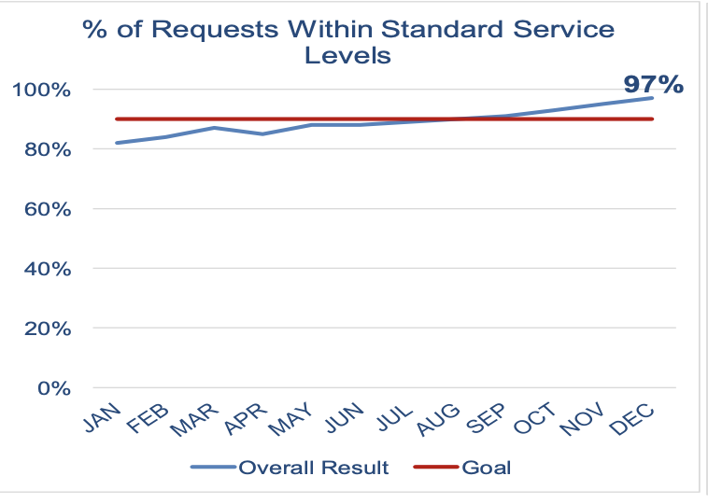
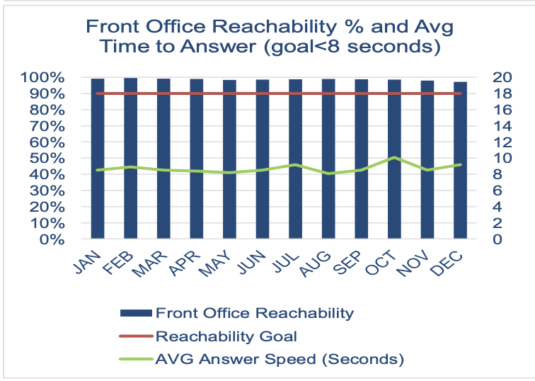
1) First practice putting the takeaway for each graph into words
“% of Requests Within Standard Service levels”
This chart aims to visualize a projected goal of anticipated standard service levels vs the actual level of standard service delivered. This chart follows the data over the course of the year. The takeaway is that during first half of year % of requests were below standard service levels, but the trend changes mid-year and by the end-of-year the standard service level exceeds the anticipated service level.
“Front Office Reachability % and average”
This chart aims to visualize what percentage of time the front office is available and secondarily the chart shows the average time to answer. The takeaway is that the front office achieves greater than 95% reachability and average answer speed on average exceeds goal which is 8 seconds.

Slide 6
2) Do we need all this data?
Lots of data is contained in the four charts- some of which may be repetitive and unnecessary.
The story I am interested in telling: How is our company responding to all the tickets through the different channels and how quickly can we respond to them?
If we aim on telling a story of ticket volume and the company's ability to handle and respond to all these tickets, I believe that the charts above tell the best and most compelling story regarding the story I have chosen.

Slide 7
2) Do we need all this data?
If I am focused on the question at hand. The charts above tells the most convincing visual story of that question. The first chart answers the question of the company’s ability to answer and respond to those requests. Not only measuring their ability to respond to calls, but how quickly and how often they were available.
The second chart tells the other side of this story. This chart breaks down each of the channels and how they change over time.
As previously stated, these charts tell the same story, but from different sides.

Slide 8
3) How would you show the data?

Slide 9
How will you incorporate words?
The visual shows that as overall channel volume increases, front office reliability actually decreases.
This is important because during the middle of the year as the cumulative channel volume increases, the front office has an issue keeping up with the reliability.
The front office reliability should be increased during these busy months

