Slide 1


6390 Case Study 1-Think like a designer
By-Rashmi Patel

Slide 2
Total touchpoints and touchpoint per customer remains flat
Total touchpoints have increased slightly
to ~500K (+3.8% y/y)
Touchpoints per customer remain flat over the past 3 years
 | Phone | Chat | Email | Total
January ‘18 | 0.43 | 0.13 | 0.55 | 1.11
January ‘19 | 0.45 | 0.16 | 0.58 | 1.19
January-20 | 0.29 | 0.26 | 0.5 | 1.10
478,123 touchpoints
496,234 touchpoints
1
0.5

Slide 3
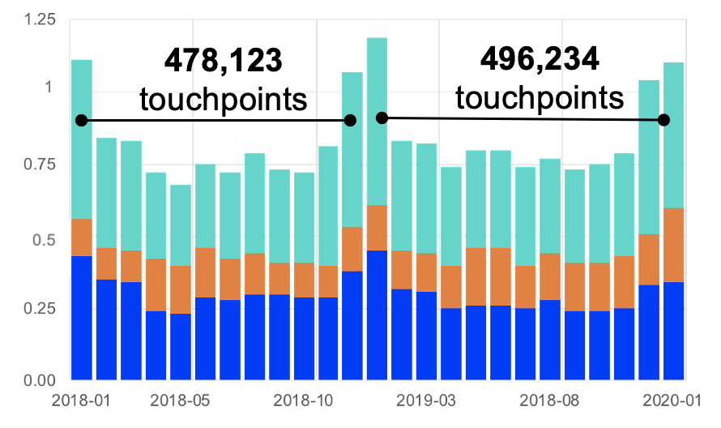
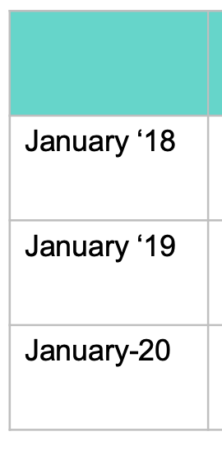
What feedback would you give your colleague about the design of their slide related to attention to detail?
The first detail to note for my colleague is a strong mistake and shows a lack of attention to detail. Between “2019-03” and “2020-01” there is “2018-08.” This is a seemly small mistake, but this mistake makes the data sequence difficult to understand, this is compounded by the other data points being sequential.
The second detail is that the time scales are not equal with each other. We can see from the 2018 data that the intervals are from January to December. The second set covers the interval between 2019 and the beginning of 2020. This doesn’t seem to convey a consistent message.
The third detail concerns the overall message of the data. The bar chart shows roughly two years' worth of data and the table shows three years' worth of data. This inattention to detail
detracts from the audience’s understanding of the time period and makes the message difficult to interpret.

Slide 4
Are there changes you would make to the way this data is shown? How might you design the data in a way that is more intuitive for the audience?
The breakdown of the touchpoints by month detracts from the overall message, this information is about the yearly difference and could be simplified by at a minimum reducing the amount of data points. There by, we don’t need a bar chart for every month.
Tables are unappealing and don’t tell a compelling story. The table should be omitted.
Since we are interested in trends, we don’t need all the numbers from these two charts. There are so many numbers sticking out at the audience, they lose effectiveness. Instead, we should focus on the most important numbers that we want to stick out to the audience.
The chart and the table can best be combined as a line chart- we can reduce the two items into one and more easily convey the information.

Slide 5
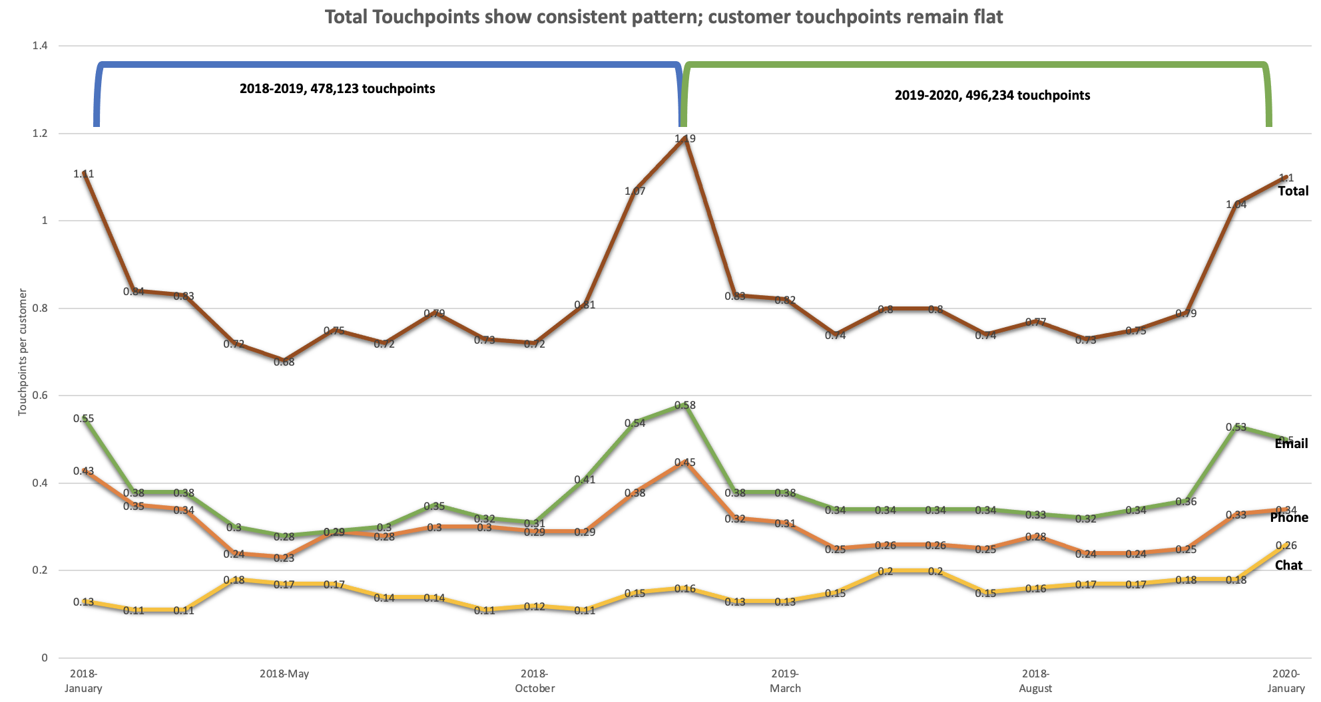
Use the data to remake the slide, incorporating your feedback and ideas in your tool of choice

