Slide 1

DS 7333: Case Study 6-Particle Detection using Neural Networks
Submitted by-
Rashmi Patel
Date: March 28, 2022

Slide 2
Objective
The objective of this case study is to build a dense neural network that can predict the new particle accurately. The goal is to maximize the accuracy.

Slide 3
Data Description
The dataset provided consists of 29 variables including the target variable and 7 million values with it.

Slide 4
Data Evaluation & Engineering

Slide 5
Checking for missing values
There are no missing values found in the dataset

Slide 6
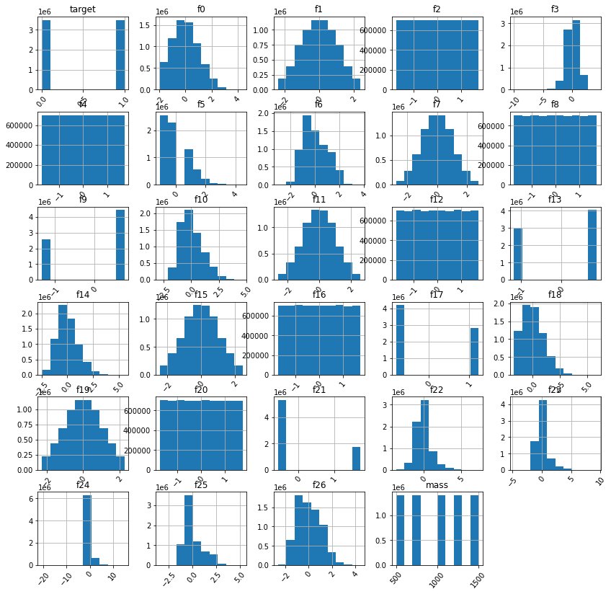
Variable Distribution
The graph shows the data distribution of each variable.

Slide 7
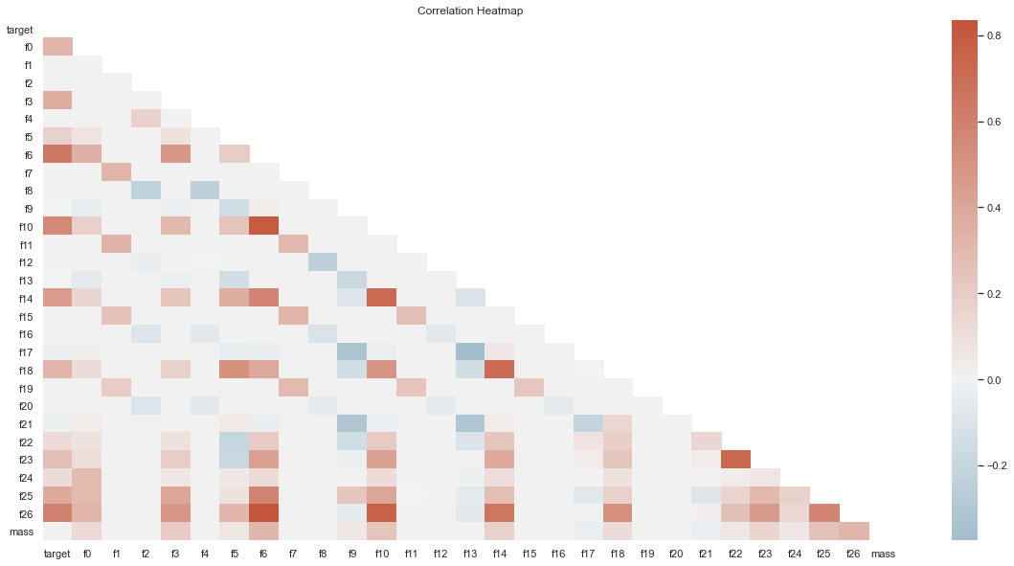
Checking for correlations
The 5 top positively correlated variables are:
f6/f26=0.835
f6/f10=0.799
f26/f10=0.760
f22/f23=0.727
f14/f10=0.721
The 5 top negatively correlated variables are:
f13/f17=-0.374
f17/f9=-0.329
f9/f21=-0.307
f13/f21=-.306
f8/f12=-0.238

Slide 8
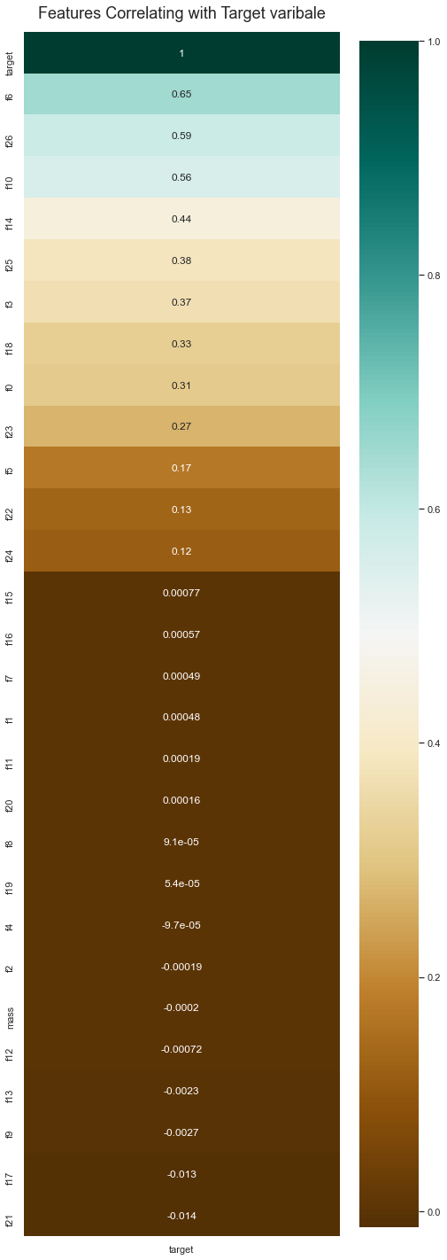
Correlation of variables with target variable
The 5 top correlated variable with target variable are:
Target/f6=0.65
Target/f26=0.59
Target/f10=0.56
Target/f14=0.44
Target/f25=0.38

Slide 9
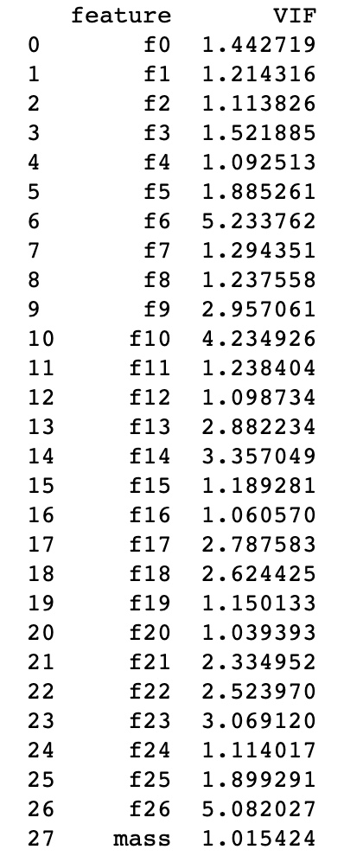
Checking Variance Inflation Factor (VIF)
Since the dataset is huge, so we randomly sampled 10000 data from 7 million data and checked VIF on that randomly sampled data.
Checking VIF helps to see how much each of the variable correlations affect the full model. It is standard that VIF above 5.0 is not acceptable, so we see that only f6 and f26 are above 5.0.
So, we will remove these variables.

Slide 10
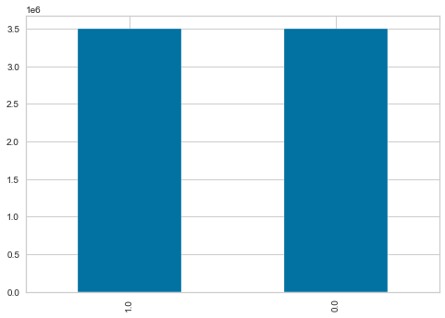
Target Variable
Distribution of Target Variable
It is important to have a balanced target variable. In this case study, we have almost equally distributed target variables.
Out of 7 million, 3500879 were assigned new particle detected and remaining 3499121 were no particle detected.

Slide 11
Model Preparation & Building

Slide 12
Neural Network with 3 hidden layers
Model with 3 layers, Adam optimizer and ReLU activation function
Model with 3 layers, SGD optimizer and ReLU activation function

Slide 13
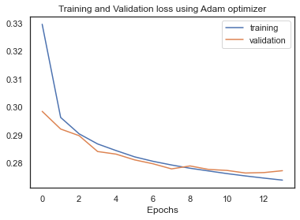
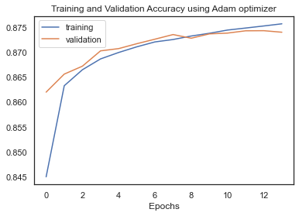
NN with 3 hidden layers, Adam optimizer and ReLU activation
For building this neural network model, an input layer of size 28, 3 hidden layers with ReLU activation function and the output layer with sigmoid function was added. The model built was then compiled using Adam optimizer and binary_crossentropy as the loss. The model was fitted through 50 epochs and early stopping with patience=2. The model stopped at 14th epoch where it achieved the following performance metrics:
Training-loss: 0.2740
Training-accuracy: 0.8758
Validation-loss: 0.2774
Validation-accuracy: 0.8741
Training-Precision: 0.8591
Validation-precision: 0.8512
Training-recall: 0.8992
Validation-recall: 0.9065
Training-auc: 0.9526
Validation-auc: 0.9517

Slide 14
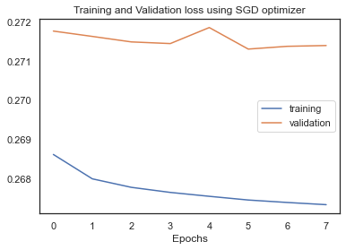
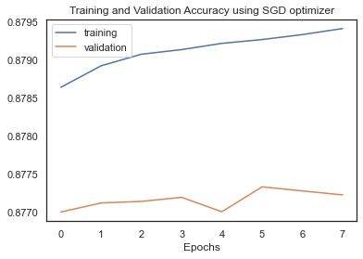
NN with 3 hidden layers, SGD optimizer and ReLU activation function
For building this neural network model, an input layer of size 28, 3 hidden layers with ReLU activation function and the output layer with sigmoid function was added. The model built was then compiled using SGD optimizer and binary_crossentropy as the loss. The model was fitted through 50 epochs and early stopping with patience=2. The model stopped at 8th epoch where it achieved the following performance metrics:
Training-loss: 0.2673
Training-accuracy: 0.8794
Validation-loss: 0.2714
Validation-accuracy: 0.8772
Training-Precision: 0.8629
Validation-precision: 0.8584
Training-recall: 0.9024
Validation-recall: 0.9033
Training-auc: 0.9549
Validation-auc: 0.9535

Slide 15
Neural Network with 5 hidden layers
Model with 5 layers, Adam optimizer and ReLU activation function
Model with 5 layers, SGD optimizer and ReLU activation function

Slide 16
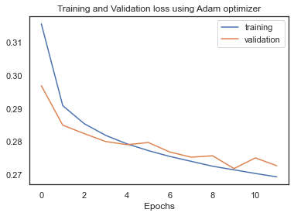
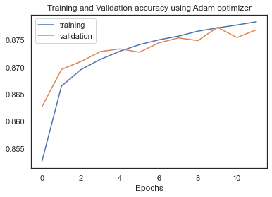
NN with 5 hidden layers, Adam optimizer and ReLU activation
For building this neural network model, an input layer of size 28, 5 hidden layers with ReLU activation function and the output layer with sigmoid function was added. The model built was then compiled using Adam optimizer and binary_crossentropy as the loss. The model was fitted through 50 epochs and early stopping with patience=2. The model stopped at 12th epoch where it achieved the following performance metrics:
Training-loss: 0.2694
Training-accuracy: 0.8784
Validation-loss: 0.2714
Validation-accuracy: 0.8769
Training-Precision: 0.8622
Validation-precision: 0.8530
Training-recall: 0.9009
Validation-recall: 0.9105
Training-auc: 0.9542
Validation-auc: 0.9533

Slide 17
NN with 5 hidden layers, SGD optimizer and ReLU activation function
For building this neural network model, an input layer of size 28, 5 hidden layers with ReLU activation function and the output layer with sigmoid function was added. The model built was then compiled using SGD optimizer and binary_crossentropy as the loss. The model was fitted through 50 epochs and early stopping with patience=2. The model stopped at 5th epoch where it achieved the following performance metrics:
Training-loss: 0.2611
Training-accuracy: 0.8828
Validation-loss: 0.2674
Validation-accuracy: 0.8798
Training-Precision: 0.8672
Validation-precision: 0.8626
Training-recall: 0.9042
Validation-recall: 0.9034
Training-auc: 0.9571
Validation-auc: 0.9550

Slide 18
Data Interpretation and Explanation

Slide 19
Deciding critical metric for model
The performance metric which was taken in account are:
Accuracy (critical metric)
Precision
Recall
F1-Score
Since the target variable was balanced so the most deterministic metric will be accuracy, so the best model was decided based on accuracy.

Slide 20
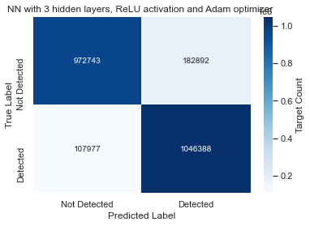
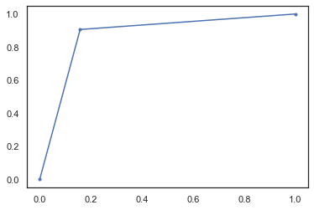
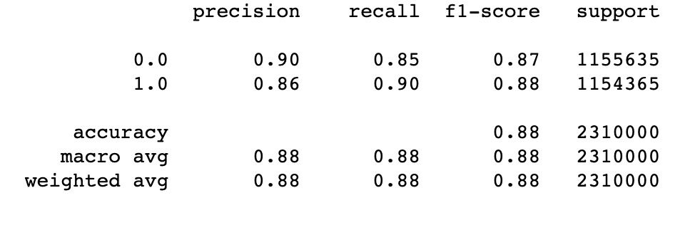
Model with 3 layers, Adam optimizer and ReLU activation function
The neural network performs well in predicting the existence of new particle with an accuracy of 87.408%.
AUC=0.87410

Slide 21
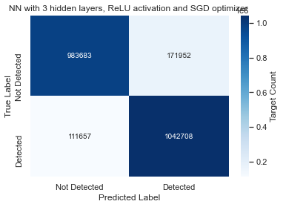

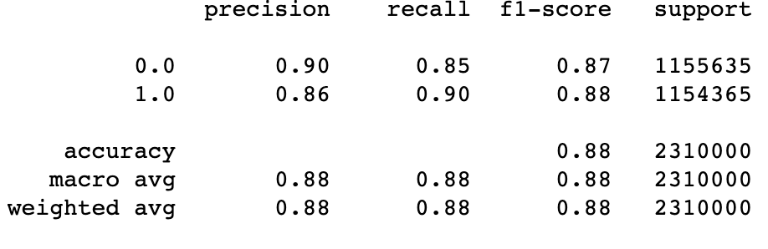
Model with 3 layers, SGD optimizer and ReLU activation function
The neural network performs well in predicting the existence of new particle with an accuracy of 87.722%.
AUC=0.87723

Slide 22


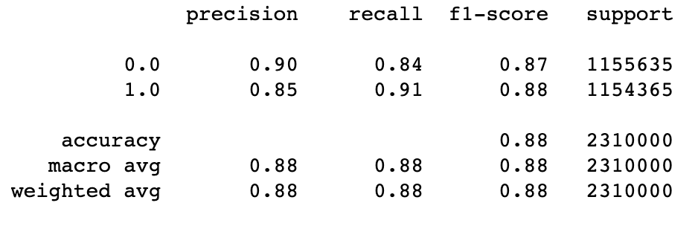
Model with 5 layers, Adam optimizer and ReLU activation function
The neural network performs well in predicting the existence of new particle with an accuracy of 87.691%.
AUC=0.87692

Slide 23
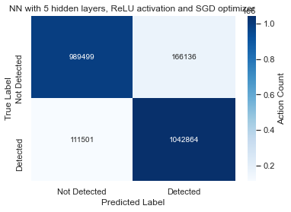

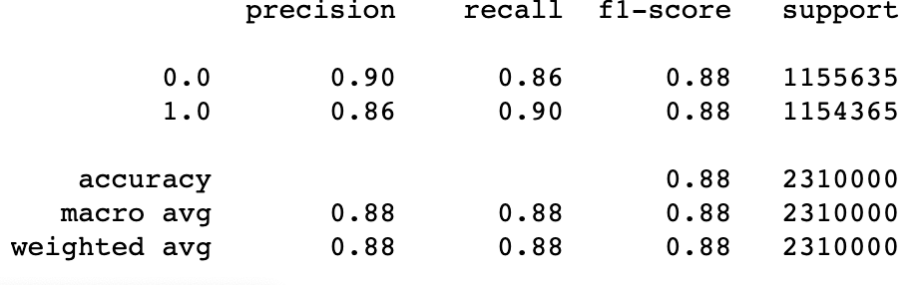
Model with 5 layers, SGD optimizer and ReLU activation function
The neural network performs well in predicting the existence of new particle with an accuracy of 87.981%.
AUC=0. 87982

Slide 24
Comparing NN model
The results obtained from these neural network models explains that increasing hidden layers can help in achieving better accuracy.
The model with 5 hidden layers, and Adam optimizer have better AUC than model with 3 hidden layers.
The model with 5 hidden layers, and SGD optimizer have better AUC than model with 3 hidden layers.
The model with 3 hidden layers and SGD optimizer have better AUC than model with 3 hidden layers and Adam optimizer.
The model with 5 hidden layers and SGD optimizer have better AUC than model with 5 hidden layers and Adam optimizer

Slide 25
Case Conclusion
The study examined the data using a neural network to predict the existence of new particles. We found that the neural network performed well on the validation set, and that the model was able to accurately predict the existence of new particles with approximately 88% accuracy. Depending on resources and other constraints, using a model that can be trained faster might be more appropriate.
After looking at the correlation between the variables, we see that 2 variables f6 and f26 identified to be significantly affecting the model. We can advise our clients to use a model without the f6 and f26 feature and look for more features like this that can be removed to improve the accuracy of the model.

