Slide 1
DS 7333: Case Study 2
Submitted by-
Rashmi Patel and Simerpreet Reddy
Date: Jan/31/2022

Slide 2
Case Study 2
Objective: Predict readmission of the patient within 30 days of initial hospitalization. This data set is specific to diabetes patients. We will be using Logistic Regression to build this model. Various data imputation techniques will also be used to replace missing values in the data set.

Slide 3
Data set details
This data set has 50 columns and 101,766 rows.
Target variable: “Readmitted” – The field shows if/when the patient was readmitted. It has the 3 distinct values:
'No'=No readmission, '>30'=Readmission done after 30 days and '<30'=Readmission done within 30 days
We recategorized the target variable into the following:
“'No' and '>30’”=0 and '<30’=1
Explanatory variables: There are 13 numerical and 36 string explanatory variables.
Dropped Fields: We dropped the below listed variables from data set because they did not seem to have any influence on the target variable:
Encounter ID - Unique identifier of an encounter
Patient Number - Unique identifier of a patient
Weight - Around 97% data is missing from the data set.
Examide – Only provided values are ‘No’, thus removing from the data set.
Citoglipton - Only provided values are ‘No’, thus removing from the data set.

Slide 4
Feature generation

Slide 5
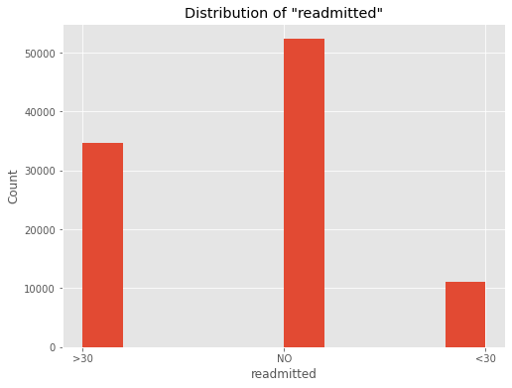
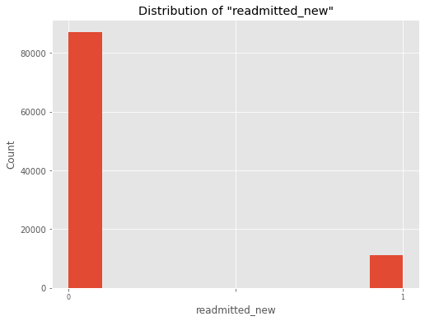
Readmitted_new from Readmitted
Following features were created after performing some initial EDA on this data set.
Readmitted_New > Created from “Readmitted’ . Values ‘No’ and '>30’ were encoded as 0 and '<30’ as 1.

Slide 6
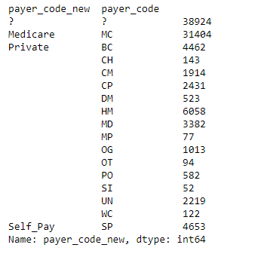
Payer_code_new from Payer_code
Payer_code_new > payer_code listed Medicare, SelfPay and other insurance providers such Blue Cross. The private providers were grouped into ‘private’, and Medicare and Selfpay were kept as is. The snapshot below shows the groupings.

Slide 7
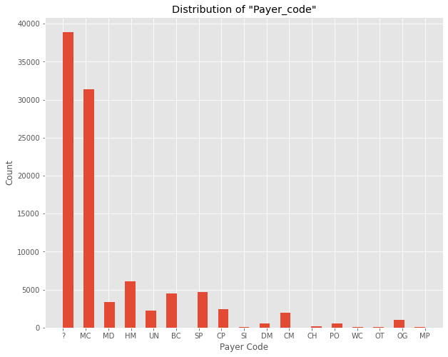
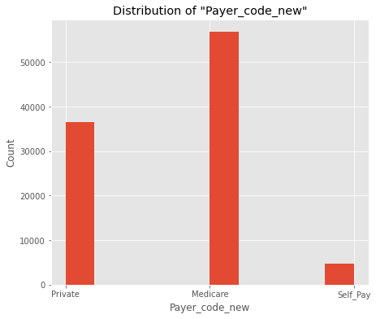
Payer_code_new from Payer_code
Payer_code_new > payer_code listed Medicare, SelfPay and other insurance providers such Blue Cross. The private providers were grouped into ‘private’, and Medicare and Selfpay were kept as is.

Slide 8
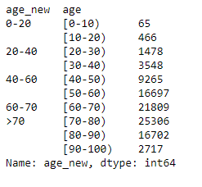
age_new from age
age_new > Different age group were grouped together. The snapshot below shows the groupings.

Slide 9
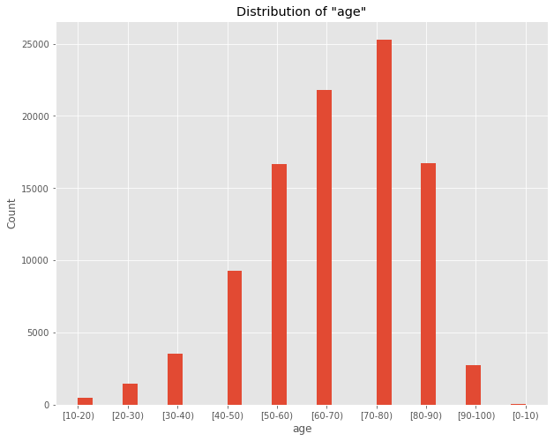
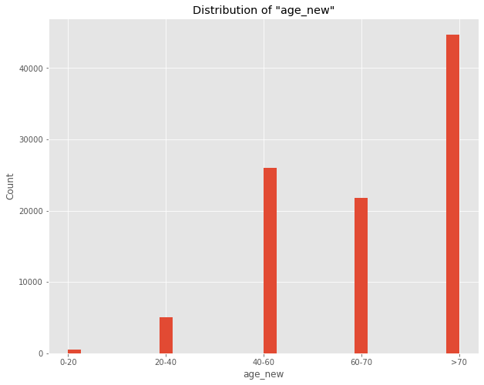
age_new from age
age_new > Different age group were grouped together.

Slide 10
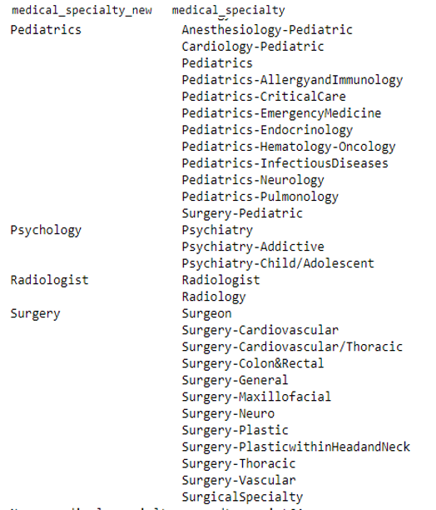
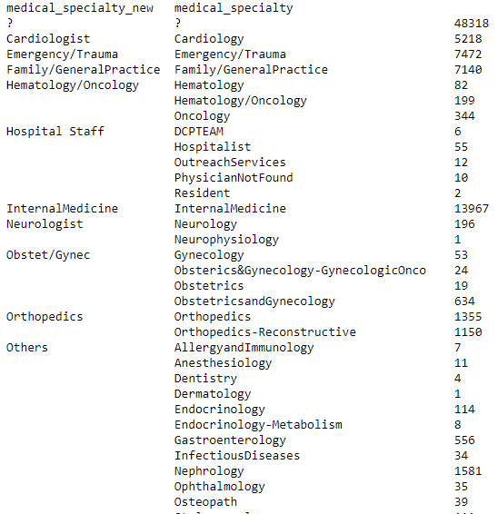
Medical_speciality_new from Medical_speciality
Medical_speciality_new > Similar specialties were grouped together. The snapshot below shows some of the groupings. Some of the misc. specialties were grouped as ‘Others’

Slide 11
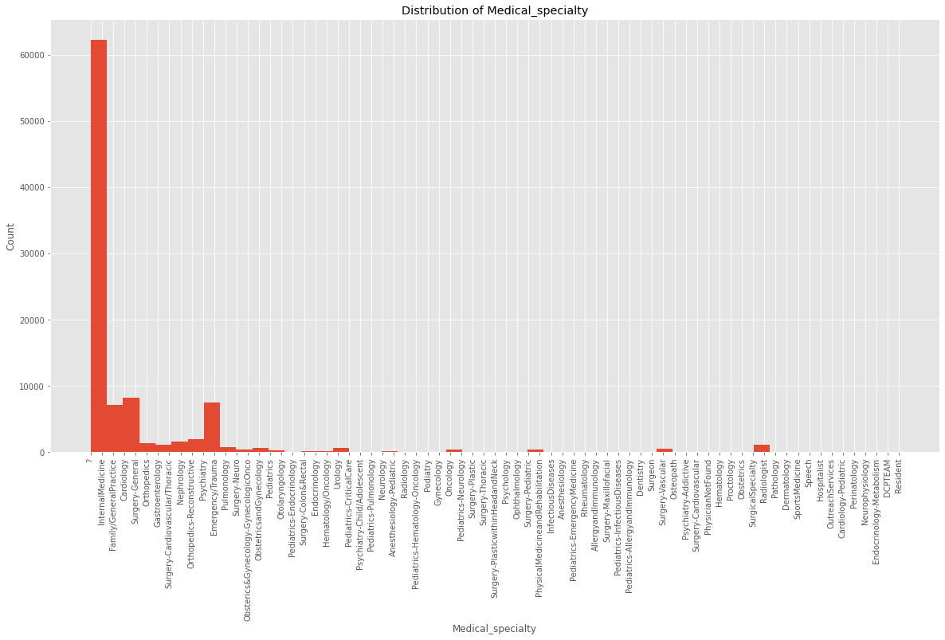
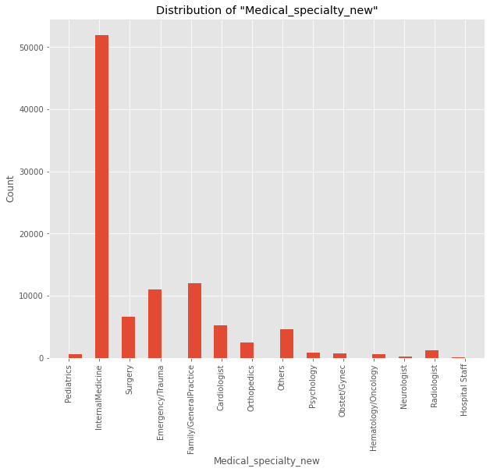
Medical_speciality from Medical_speciality_new

Slide 12
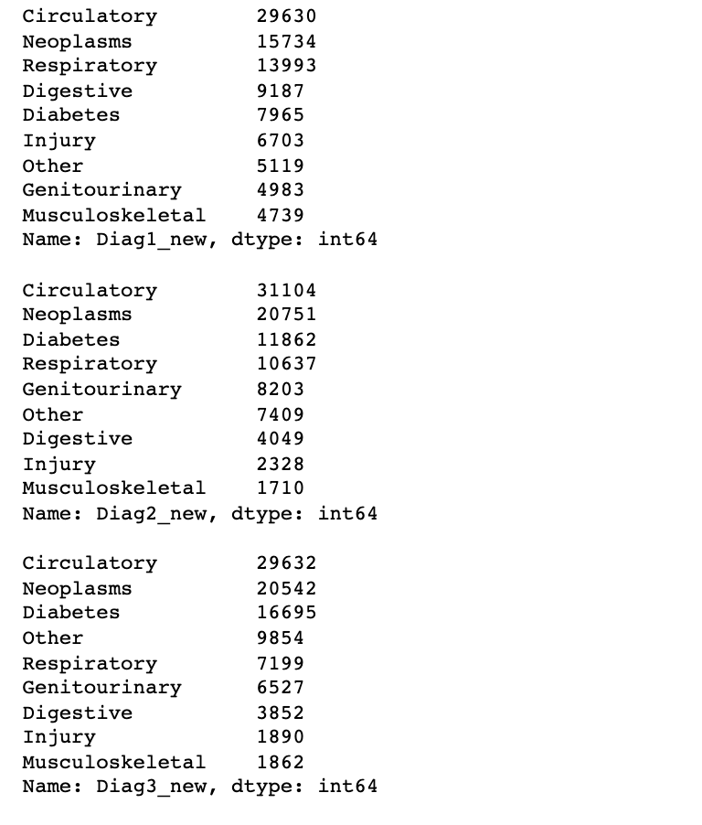
Clinical Groups from Diag_1, Diag_2, Diag_3
Diag1_new, Diag2_new, Diag3_new>From the article:https://www.hindawi.com/journals/bmri/2014/781670/tab2/, we found that diagnosis codes 1, 2, and 3 can be categorized into categories like circulatory, respiratory, etc. So, values in all diag_1, diag_2 and diag_3 were group together.

Slide 13
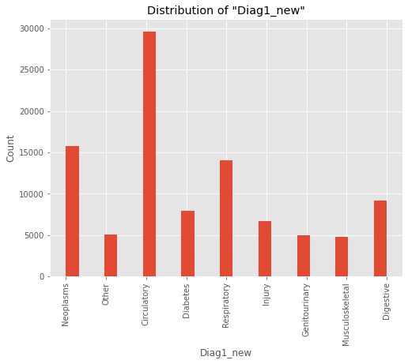
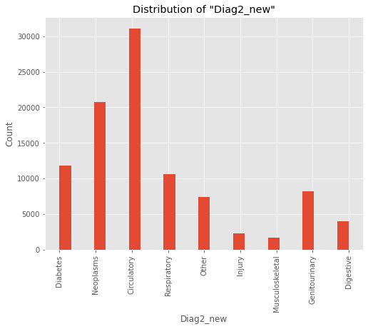
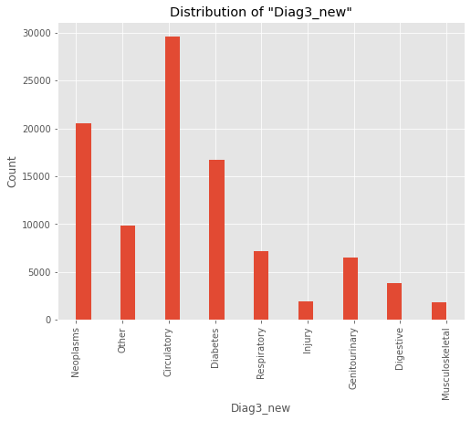
Clinical Groups from Diag_1, Diag_2, Diag_3

Slide 14
Data Imputation

Slide 15
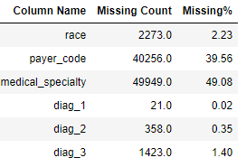
Missing Data
Null value (NaN) in this data set have been marked by a ‘?’. Below table shows the distribution of the missing data set.

Slide 16
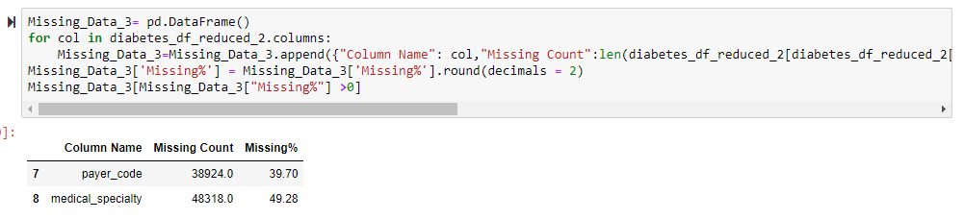
Imputation
The rows with missing data from the following columns was deleted – race, diag_1, diag_2 and diag_3. payer_code and medical_speciality were imputed, the details are provided in the next few slides.
From the table below, we can see that only payer_code and medical_speciality are left with missing values which will be handled using data imputation.

Slide 17
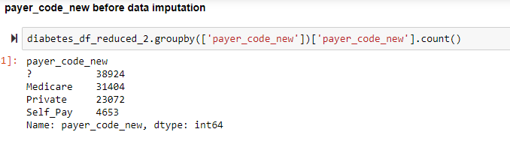
Payer_code
The new field payer_code_new, created from payer_code, had around 38K rows have missing values. We analyzed the relationship between age_new and payer_code_new. We decided to imputed missing values with the most common values in each age group. For example, in the age_group, payer_code_new= ‘Private’ was the most common, thus the ‘?’ were replaced with ‘Private’ in this age group.

Slide 18
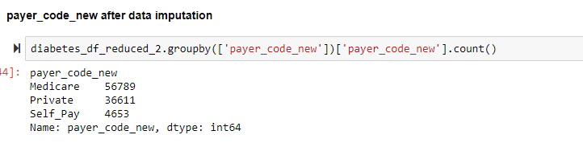
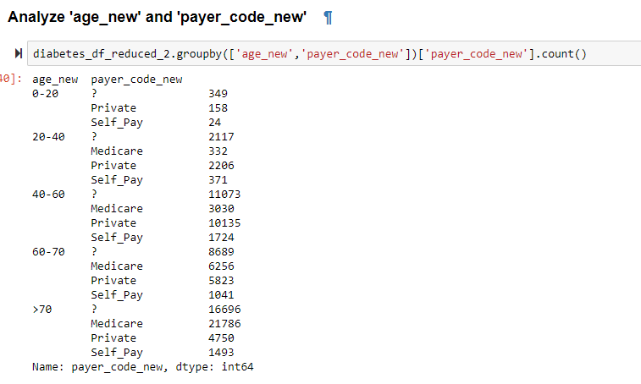
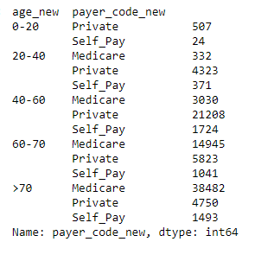
Payer_code
We analyzed the relationship between age_new and payer_code_new. We decided to impute missing values with the most common values in each age group. For example, in the age_group, payer_code_new= ‘Private’ was the most common, thus the ‘?’ were replaced with ‘Private’ in this age group.

Slide 19
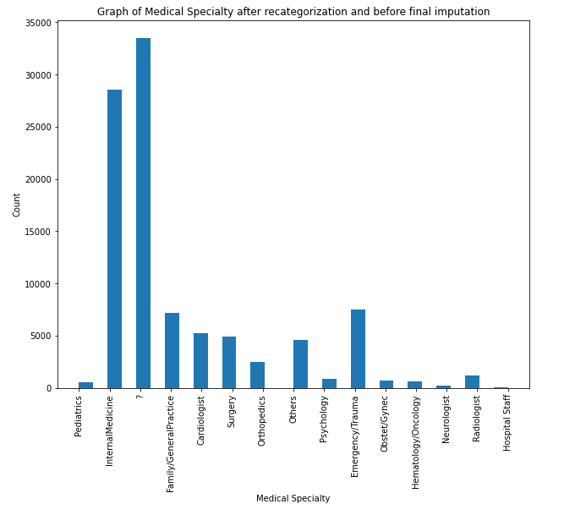
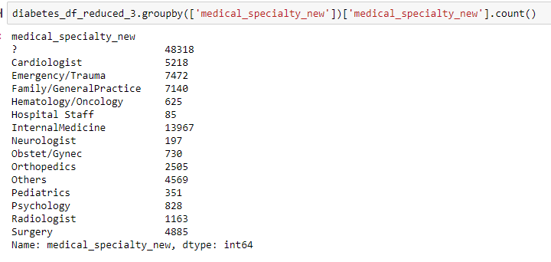
medical_speciality
The new field medical_speciality_new, created from medical_speciality, had around 38K rows have missing values. We analyzed the relationship between age_new and payer_code_new. We decided to imputed missing values with the most common values in each age group. For example, in the age_group, payer_code_new= ‘Private’ was the most common, thus the ‘?’ were replaced with ‘Private’ in this age group.

Slide 20
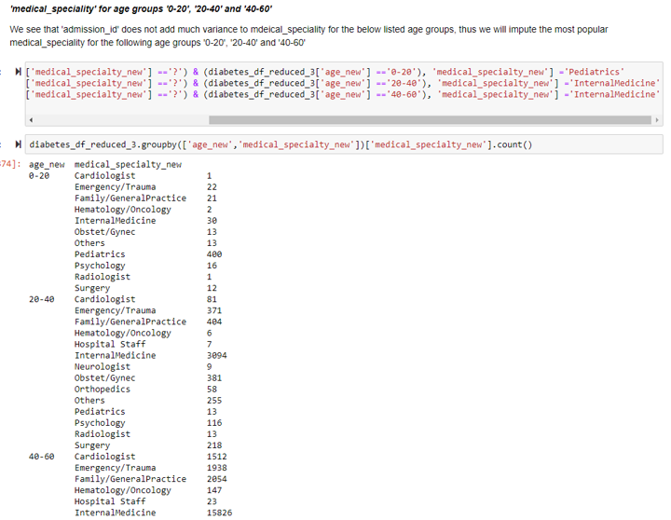
medical_speciality
We analyzed the relationship between age_new, admission_id and medical_speciality.
Admission_id did not seem to add much variance on medical_speciality for the age groups 0-20, 20-40 and 40-60.
Thus, we decided to imputed missing values with the most common values in each age group for these particular age groups.

Slide 21
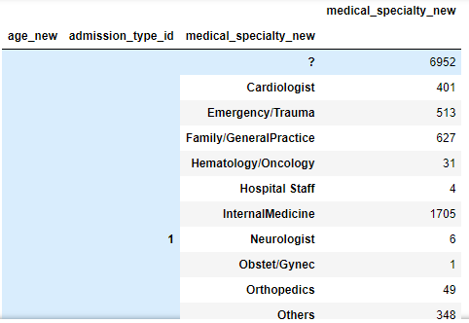
medical_speciality
For age_groups, 60-70 and >70, admission_id seemed to be a good factor in imputing missing values for medical speciality.
We decided to imputed missing values with the most common values in each age group and admission_id for these particular age groups.
For example, for age_grp 60-70 and admission_id =1, internal_medicine is the most common medical_speciality, thus the missing values were replaced with internal medicine.

Slide 22
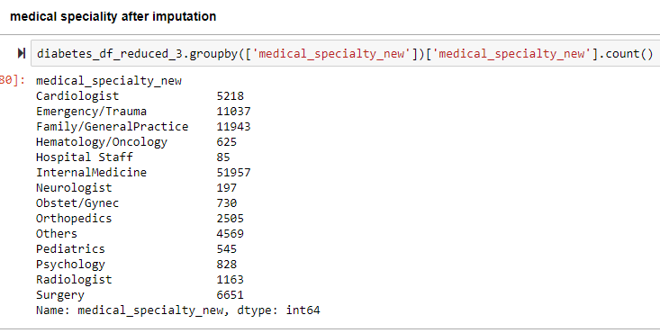
medical_speciality
For age_groups, 60-70 and >70, admission_id seemed to be a good factor in imputing missing values for medical speciality.
We decided to imputed missing values with the most common values in each age group and admission_id for these particular age groups.
For example, for age_grp 60-70 and admission_id =1, internal_medicine is the most common medical_speciality, thus the missing values were replaced with internal medicine.

Slide 23
Modeling

Slide 24
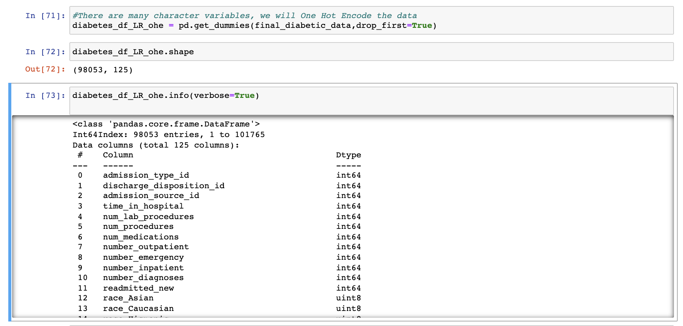
One Hot Encoding
We used one-hot encoding on the cleaned data set to convert all the categorical variable values in numeric form so that modeling can be done without any errors. After performing one-hot encoding, the new dataset obtained contains 124 columns and 98053 rows.

Slide 25
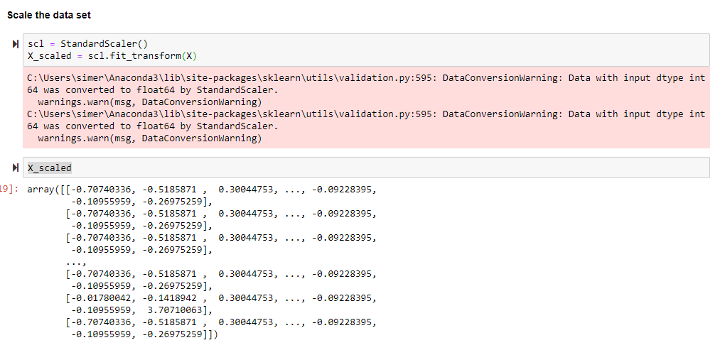
Scaling
We have used StandardScaler from sklearn.preprocessing to scale the data. Scaling will allow the variables to be in fixed range and avoid high varying magnitude values which can weight higher while modeling.

Slide 26
LogisticRegressionCV

Slide 27
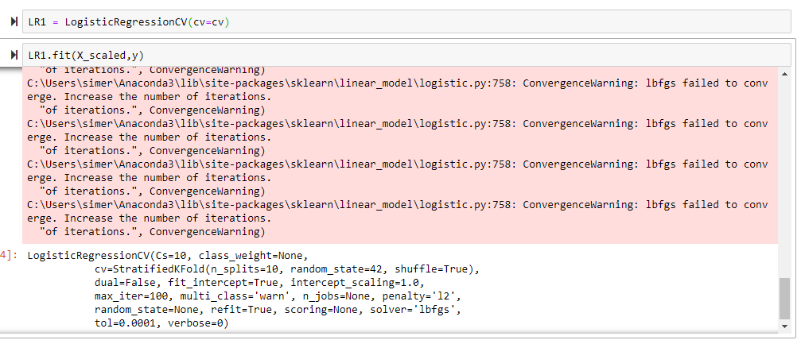
Logistic Regression using StratifiedKFold and CV
Model : We first created the cross-validation object using StratifiedKFold from sklearn.model_selection and using LogisticRegressionCV from sklearn.linear_model we built the model.

Slide 28
Cross Val Score
The default scoring method for LogisticRegressionCV is ‘accuracy’. We got a cross_val_score of 88.7%.

Slide 29
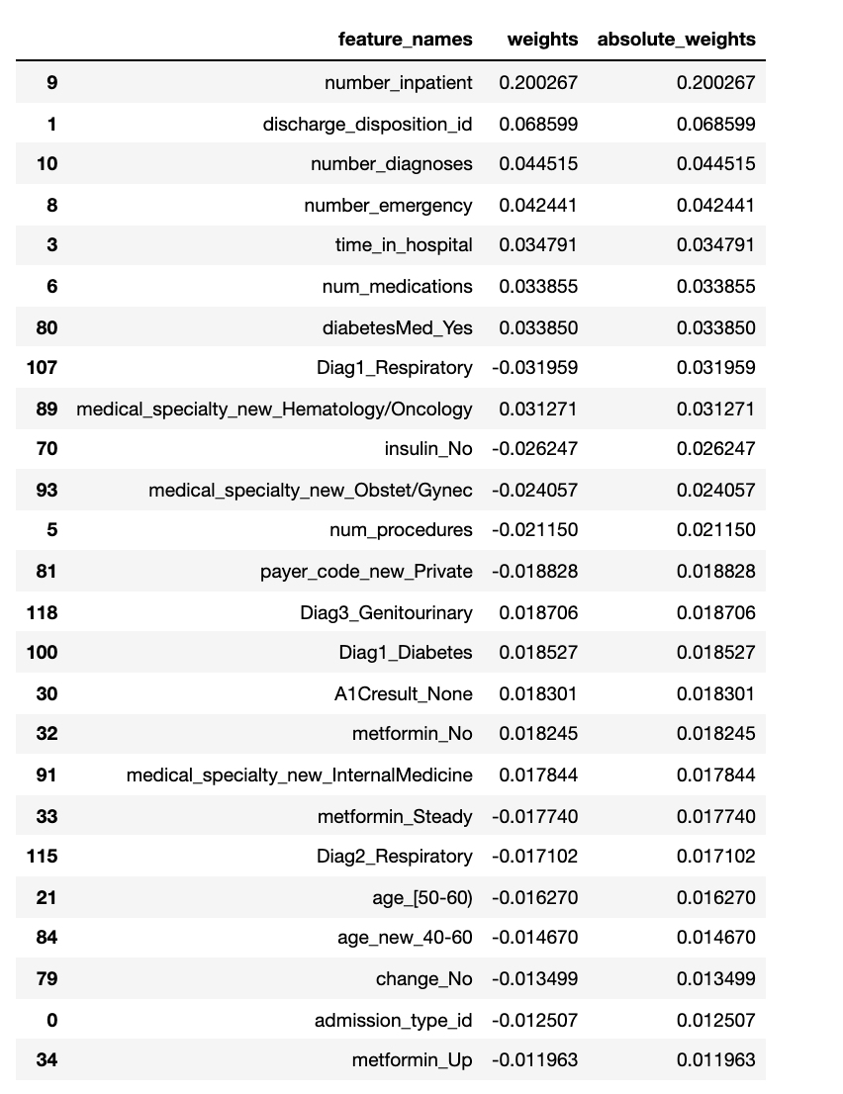
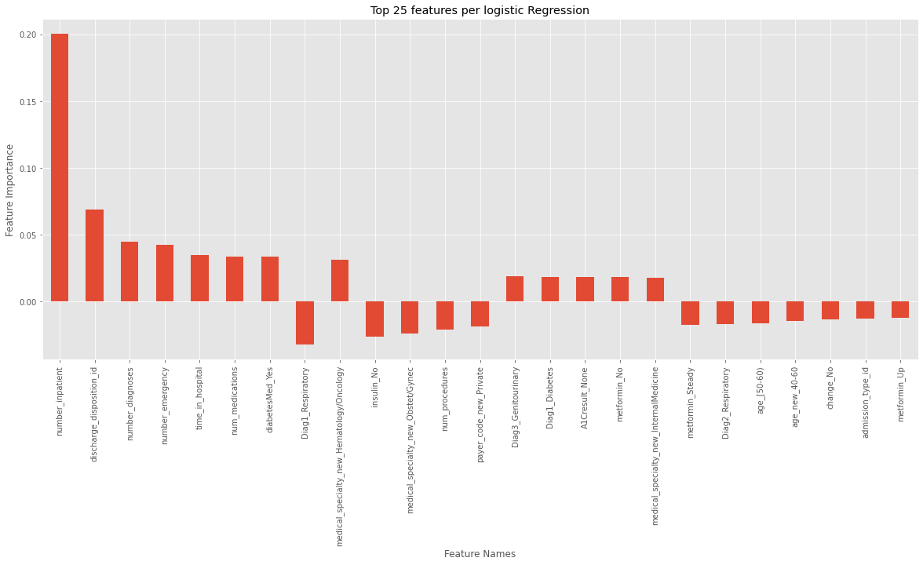
Top 25 features from Logistic Regression CV

Slide 30
LogisticRegression

Slide 31
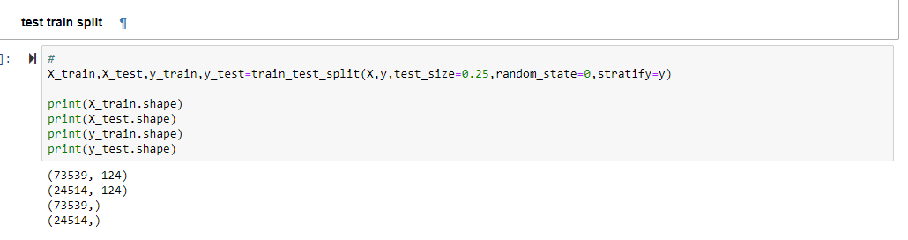
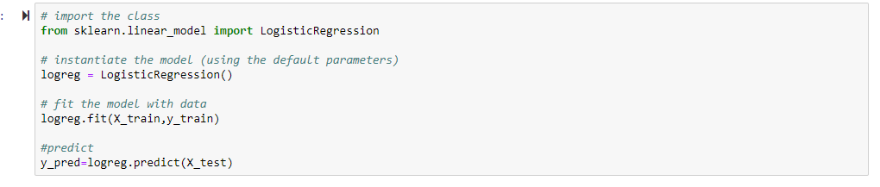
Logistic Regression using sklearn.LogisticRegression
Test-train split – We also ran logistic regression with explicit train-test (0.75/0.25) split with stratify=y
Logistic Regression

Slide 32
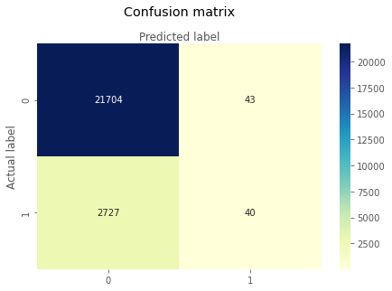
Confusion Matrix
For generating the confusion matrix, simple logistic regression model was built using train-test split having stratify option.

Slide 33

Class Statistics
The accuracy of simple logistic regression is almost same as the LogisticRegressionCV which was 88.78%

Slide 34
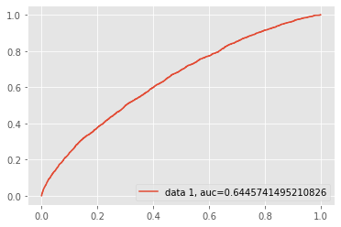
ROC Curve
This model gave us an ROC curve with auc = 0.64. The model with auc=1 is considered as best preforming classifier and auc=0.5 or less is worthless. So, our model is performing pretty good.

Slide 35
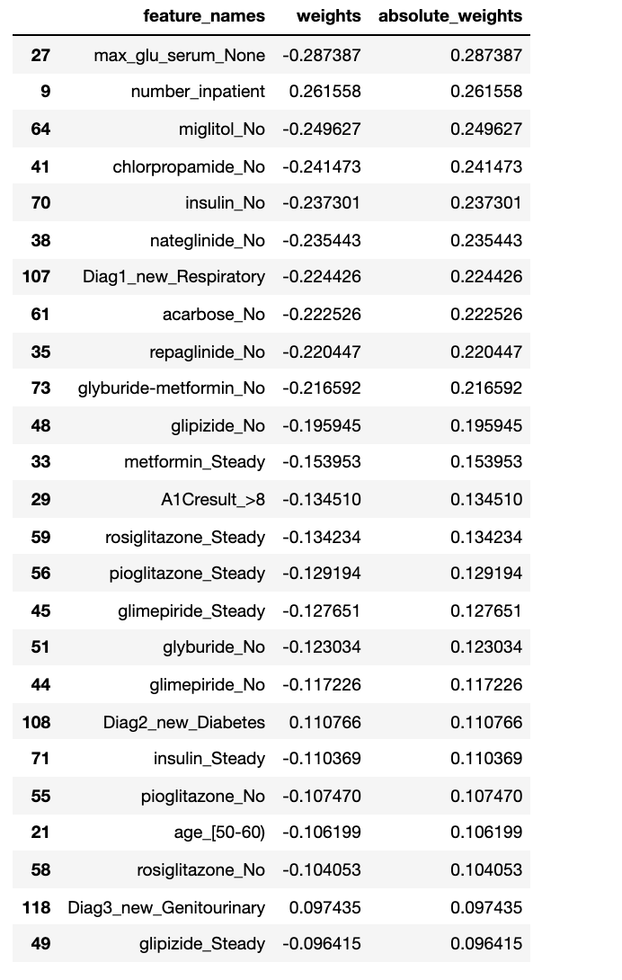
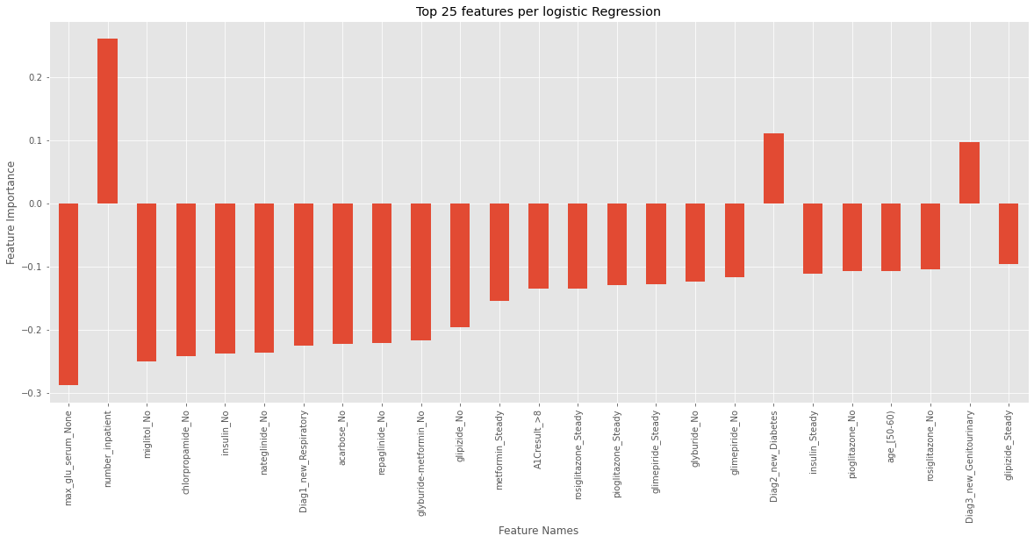
Top 25 features from Logistic Regression

Slide 36
Case Conclusion
What are we proposing to our audience and why?
Our primary takeaway is that in general patients who spend more time in hospitals are more prone to being readmitted. The readmission rate is high for the patients who have been in the hospital last year. In addition to this, number of prescriptions is also a strong indicator of being readmitted to the hospital.
How should they view our results and what to consider moving forward?
We believe that these results are reasonable and intuitive given the data in the above analysis, we believe that the medical community should keep a close eye on patients that often visit the hospital for both caregiving and financial reasons.

