Slide 1
DS 7333: Case Study 4-Bankruptcy Prediction
Submitted by-
Rashmi Patel
Date: February 28, 2022

Slide 2
Objective
The objective of this case study is to predict whether the financial company will enter a bankruptcy or not.

Slide 3
Dataset Details
The dataset provided contains 5 dataset (43405 total financial statements) with 65 different attributes(columns) in which one is the target attribute. Each dataset had a different number of observations with the lowest number of observations(rows) being 5910 and 10503 as the highest. The target variable is named as ‘class’.
The summary of number of financial statements in each dataset is as below:
1year.arff having 7027 financial statements
2year.arff having 10173 financial statements
3year.arff having 10503 financial statements
4year.arff having 9792 financial statements
5year.arff having 5910 financial statements

Slide 4
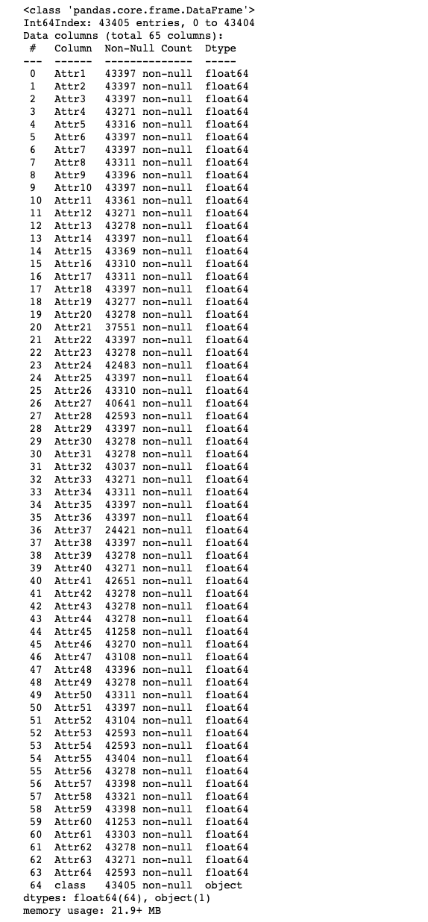
Data Description
The 5 datasets were merged, and a single data frame was created. The variable names were as Attr1, Attr2, etc. All the variables in the dataset were in numeric (float) format except the target variable ‘class’ which was in object format.

Slide 5
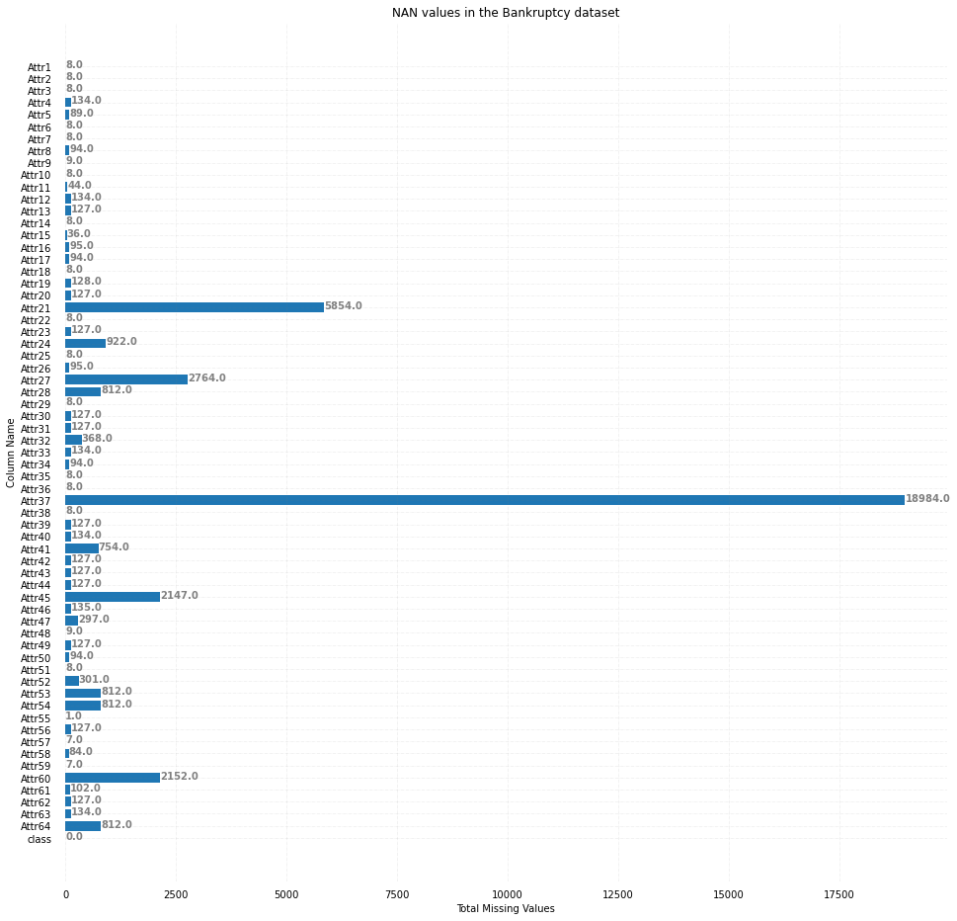
Missing Values
Many of the variables seem to have missing values.
Column ‘Attr21’ has approximately 13% missing data.
Column ‘Attr37’ has approximately 45% missing data.
These columns were dropped in the further analysis because it don’t contribute much while doing the predictions for bankruptcy.
Other columns were imputed by the mean of the respective columns after splitting the dataset for modeling.

Slide 6
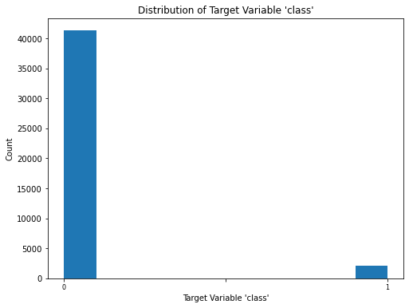
Target Variable- ‘class’
Looking at the graph indicates that the response variable is imbalanced.
Only 5% of the companies ended up filing the bankruptcy.
The imbalanced data was handled by using the cross validation.

Slide 7
Random Forest Classifier

Slide 8
Models built using Random forest
Random Forest model with default parameters
Random Forest model with best hyperparameters obtained using GridSearchCV

Slide 9
Random Forest model with default parameters

Slide 10
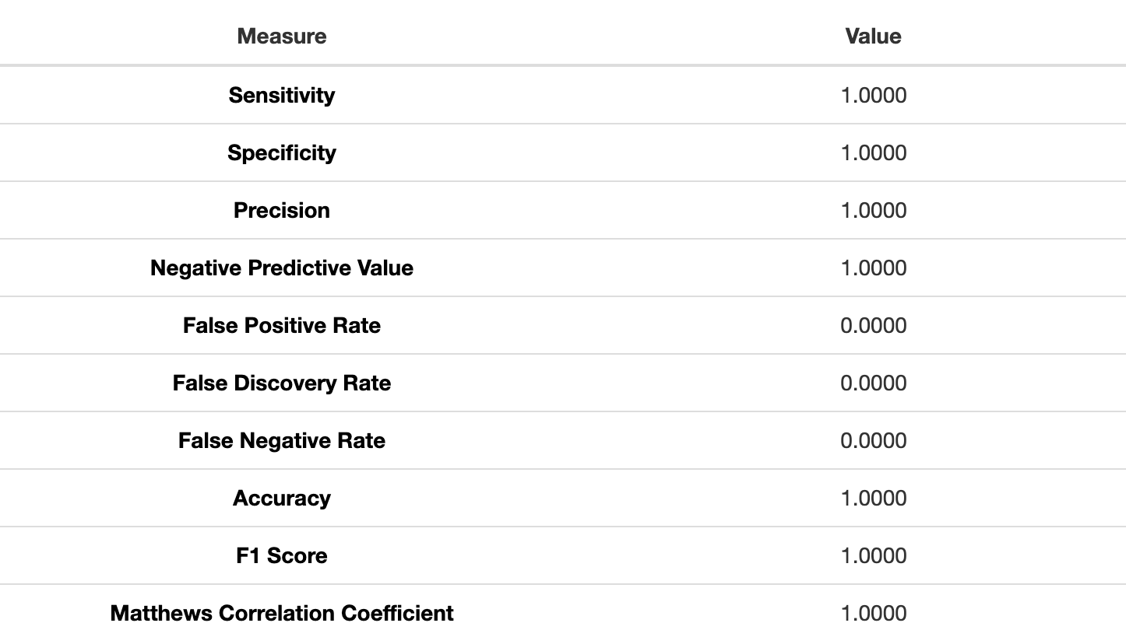
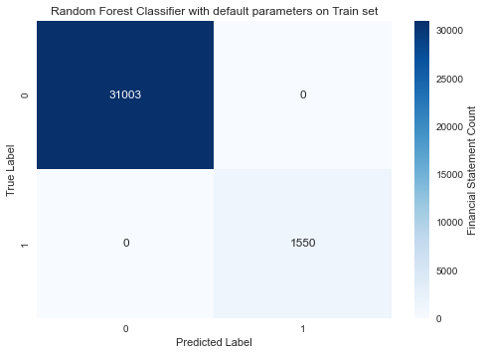
Confusion Matrix for Train Set-Default parameters
The default values were used to train the dataset. The training model seems to be overfitting.

Slide 11
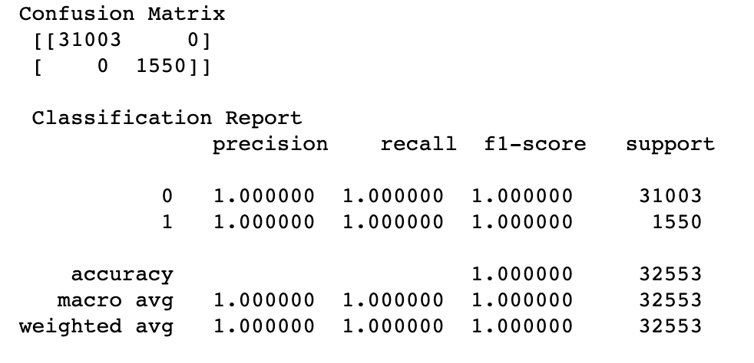
Performance Metrics for Train Set-Default parameters
Since the data in target variable ‘class’ was imbalanced, using which performance metric is important question.
We are trying to limit our False Negatives, so the most relevant metric would be the recall.
In this step, we are getting all perfect metrics value because parameters are set to default, and cross validation is not applied.

Slide 12
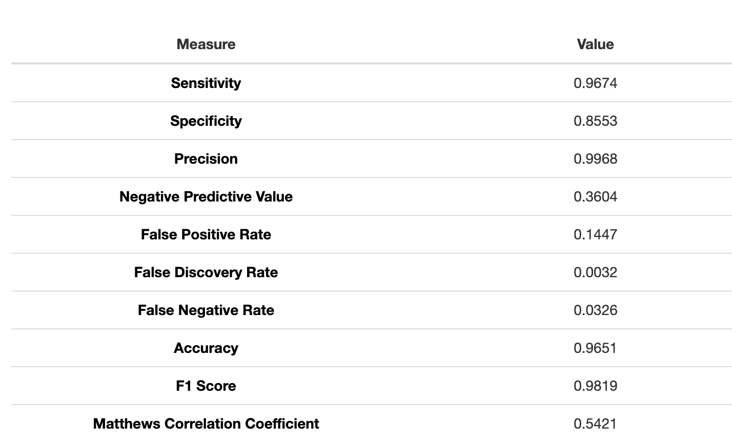
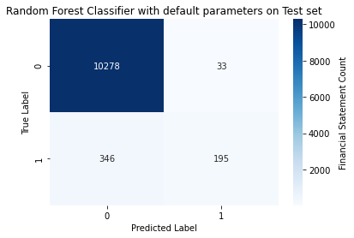
Confusion Matrix for Test Set-Default parameters
Precision, Recall and F1-Score are dropped drastically when using the model with default parameters on the test data.

Slide 13
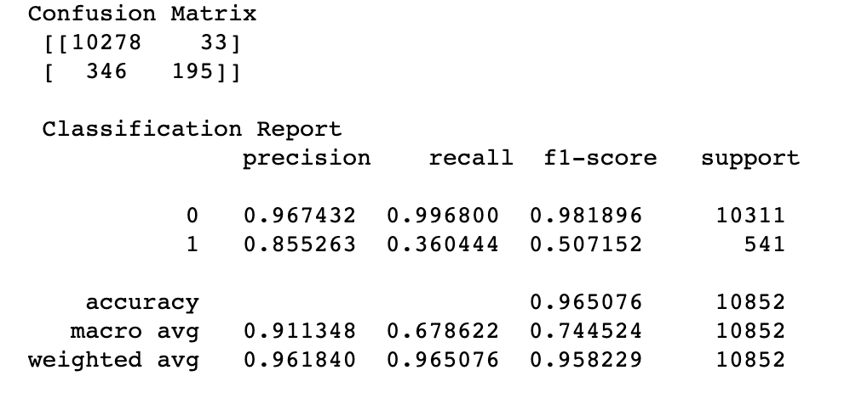
Performance Metrics for Test Set-Default parameters
Using random forest classifier with default parameters, Precision, Recall, and F1-score seems pretty good for predicting that company will not enter in bankruptcy, but the metrics for predicting bankruptcy is quite low.
We will try to improve the model metrics by assigning parameters for building the model.

Slide 14
Random Forest model with best hyperparameters obtained using GridSearchCV

Slide 15
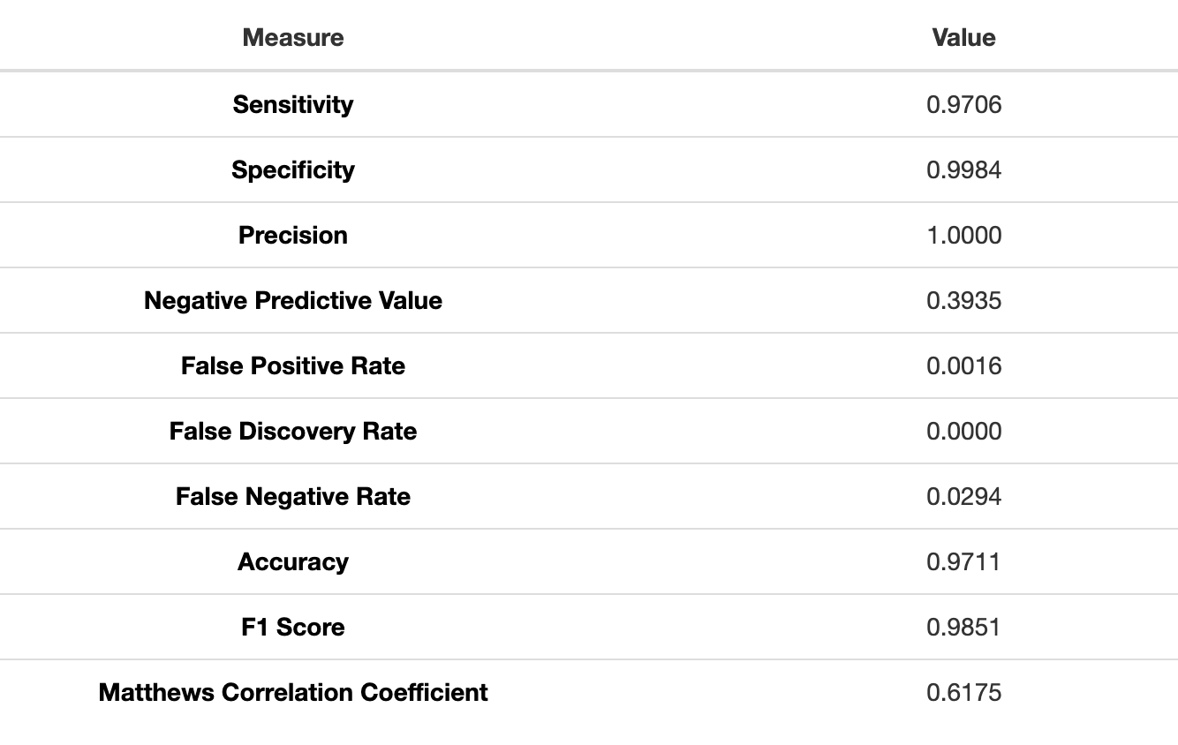
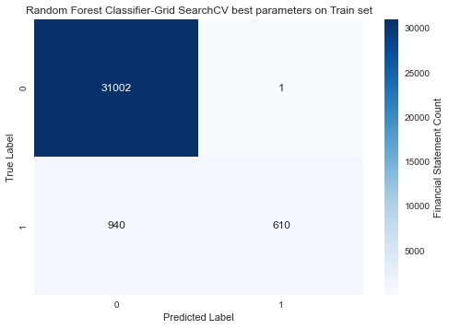
Confusion Matrix for Train Set-GridSearchCV best parameters
After implementing 3-fold cross validation to the random forest classifier, the best tuning hyperparameters obtained using GridSearchCV had following values:
{'criterion': 'gini', 'max_depth': 10, 'min_samples_split’: 4, 'n_estimators': 10}

Slide 16
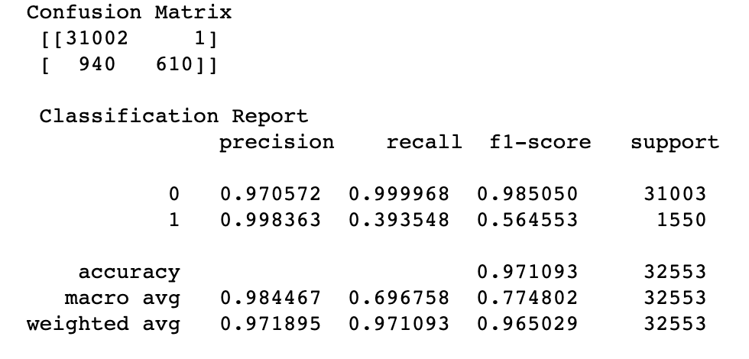
Performance Metrics for Train Set- GridSearchCV best parameters
The performance metrics are dropped, and much lower than it had in the model with default parameters for Train set.
Recall and F1-score are quite low as compared to the model with default parameters on Train set.

Slide 17
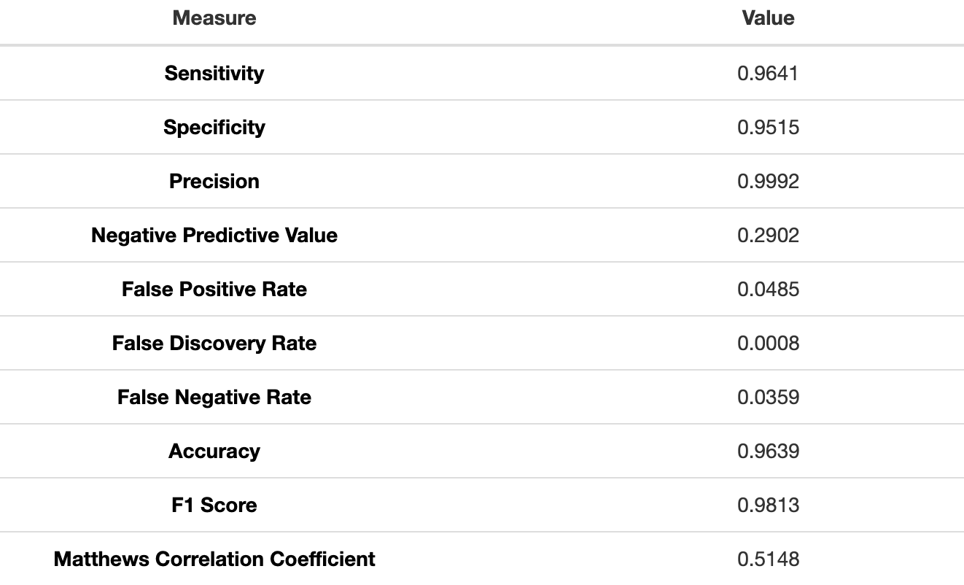
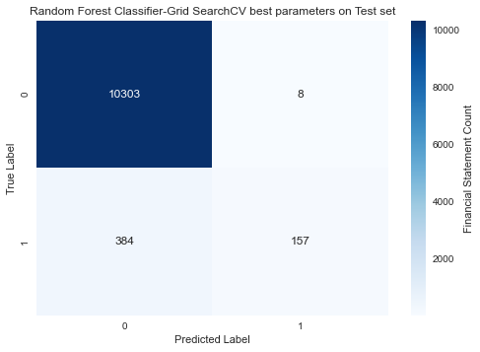
Confusion Matrix for Test Set-GridSearchCV best parameters
Precision, Recall and F1-Score drops a little in comparison to metrics obtained on Train Set.

Slide 18
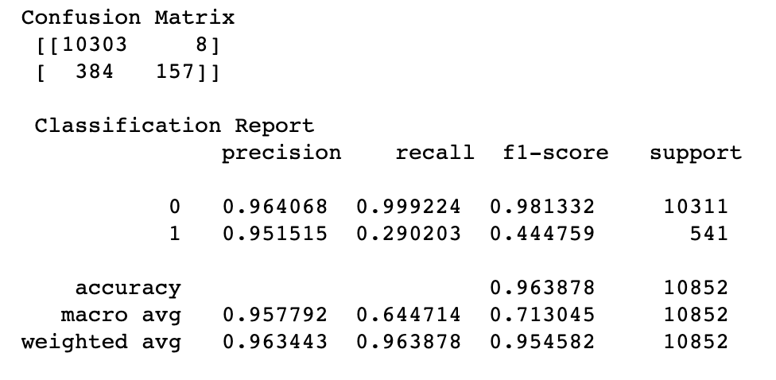
Performance Metrics for Test Set-GridSearchCV best parameters
Precision is higher than it was seen in test data for model with default parameters.
Recall and F1-Score remains lower than the test data scores with default parameters.

Slide 19
Performance Metrics Comparison Table
Method | Parameters | Dataset | Accuracy | Precision | Recall | F1-Score
Random Forest | Default | Train | 1.0000 | 1.0000 | 1.0000 | 1.0000
 |  | Test | 0.9651 | 0.9968 | 0.3604 | 0.9819
 | Best | Train | 0.9711 | 1.0000 | 0.3935 | 0.9851
 |  | Test | 0.9639 | 0.9992 | 0.2902 | 0.9813

Slide 20
XGBoost Classifier

Slide 21
Models built using XGBoost
XGBoost model with default parameters
XGBoost model with best hyperparameters obtained using GridSearchCV

Slide 22
XGBoost model with default parameters

Slide 23
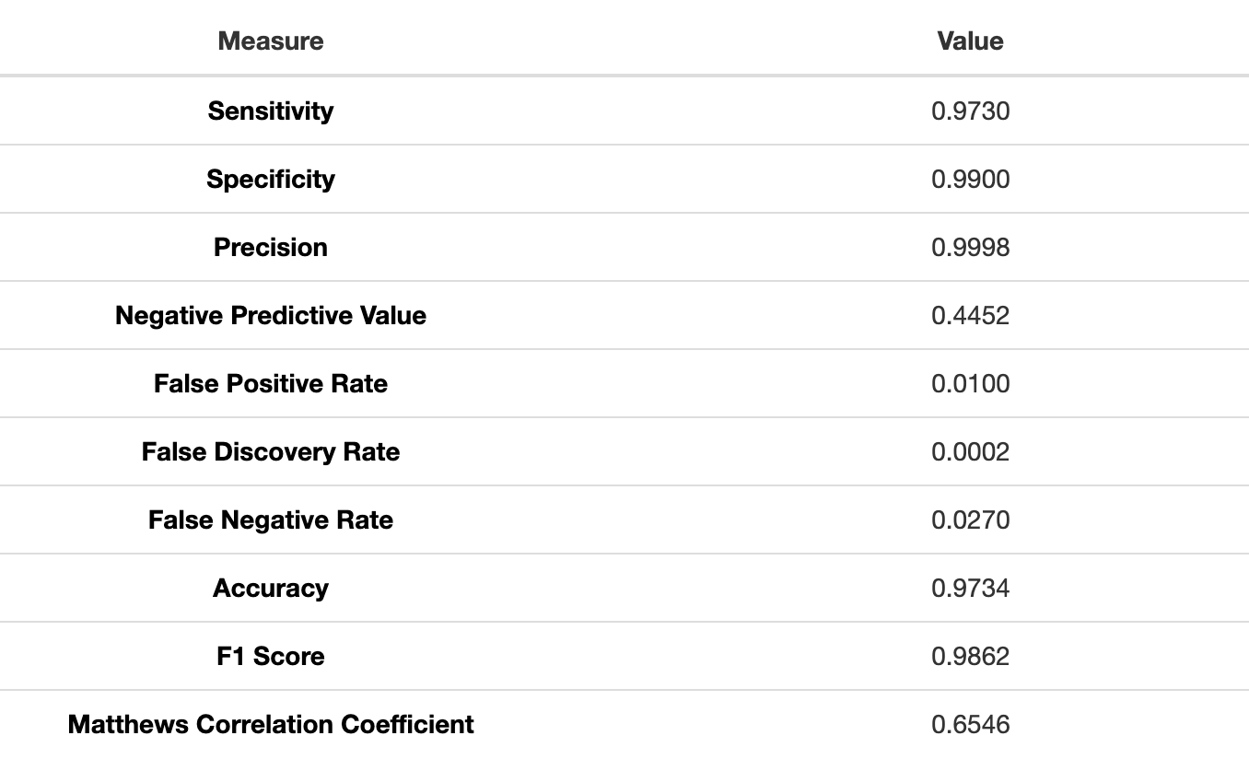
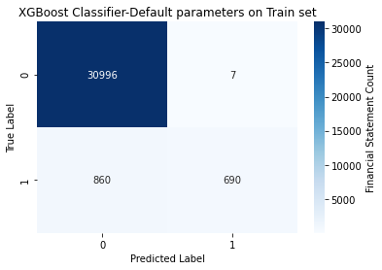
Confusion Matrix for Train Set-Default parameters
The default values were used to train the dataset. The training model seems to be overfitting but is having values lower than Random Forest equivalent model.

Slide 24
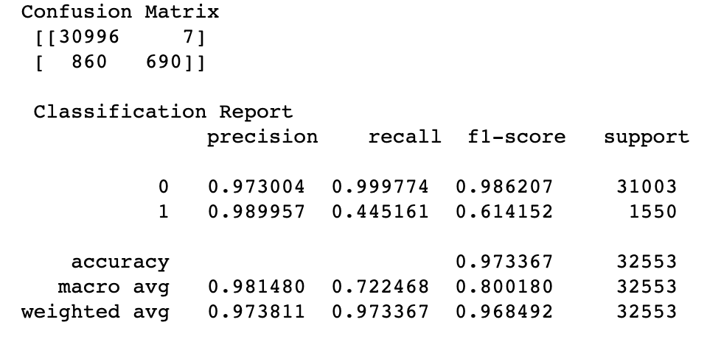
Performance Metrics for Train Set-Default parameters
Values of each metric is quite low than the metric values observed in Random Forest model with default parameters on Train set.
No cross validation was implemented in this step

Slide 25
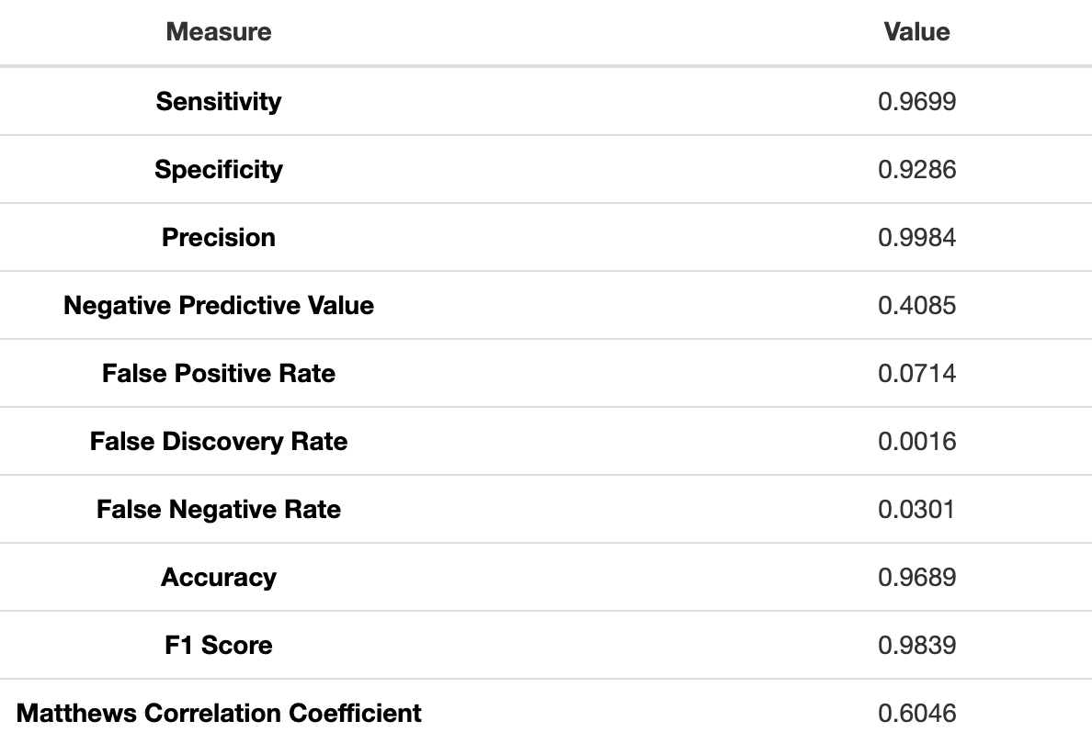
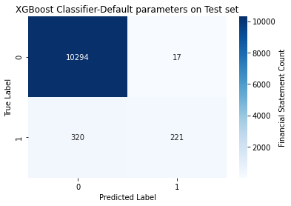
Confusion Matrix for Test Set-Default parameters
Although, sensitivity, specificity, accuracy and other metrics are high, but our critical metric recall (Negative Predictive Value) is still quite low.

Slide 26
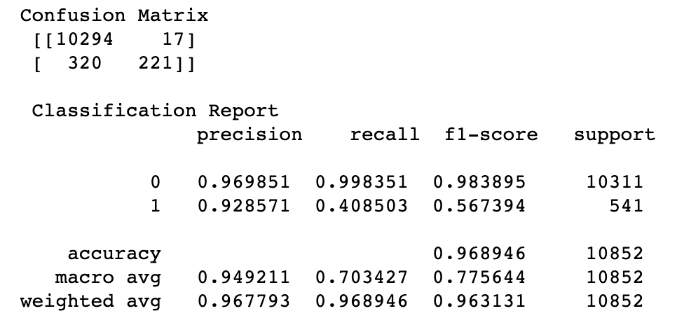
Performance Metrics for Test Set-Default parameters
Performance metrics in test data decreases in comparison to the train data but is slightly better than the performance metrics of random forest test data with default parameters.
The results are obtained without implementing the cross validation.

Slide 27
XGBoost model with best hyperparameters obtained using GridSearchCV

Slide 28
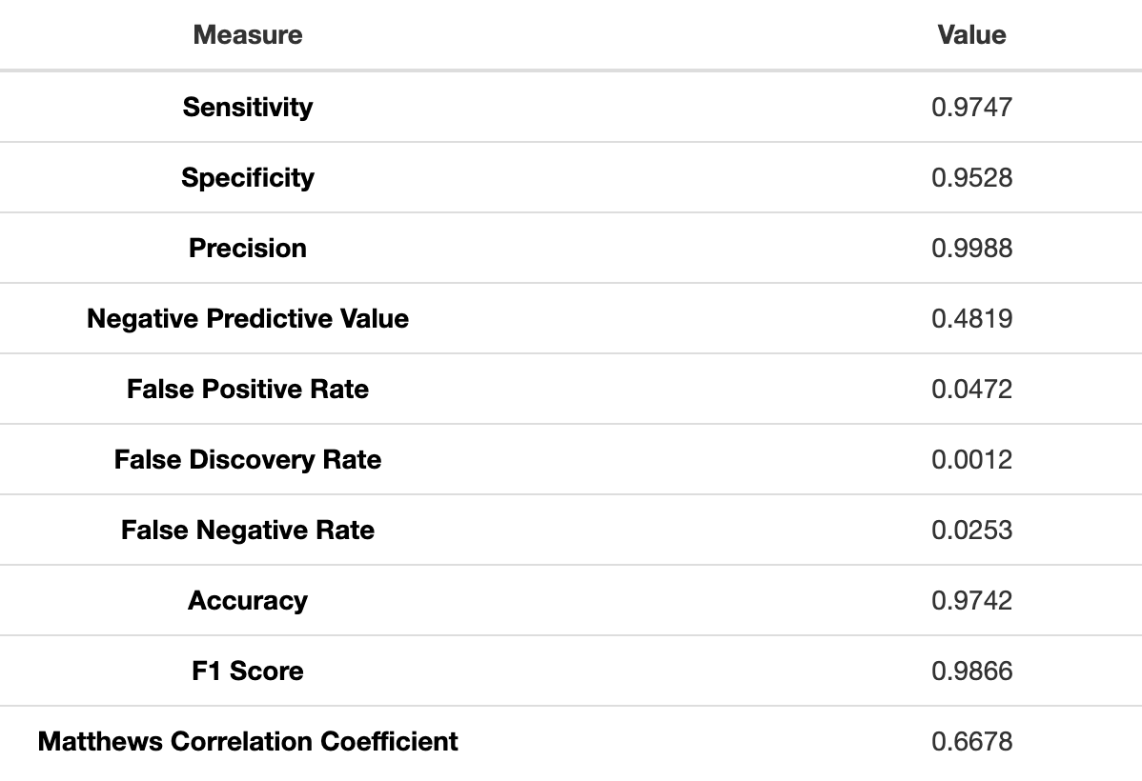
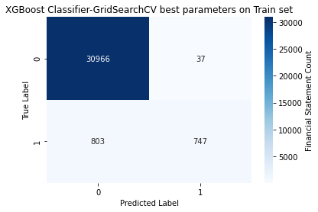
Confusion Matrix for Train Set-GridSeachCV best parameters
After applying hyperparameters using the GridSearchCV, the performance metrics seems to be better than the XGBoost model with default parameters. The best hyperparameters obtained after 3-fold cross-validation is as shown below:
{'learning_rate': 0.7, 'max_depth': 8, 'min_samples_leaf': 0.1, 'n_estimators': 30}

Slide 29
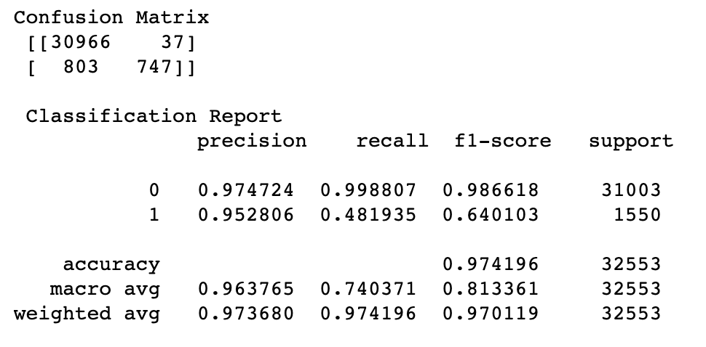
Performance Metrics for Train Set-GridSeachCV best parameters
The XGBoost model on train data with best hyperparameters obtained by 3-fold cross validation seems to be performing the best among all the models created in this study.

Slide 30
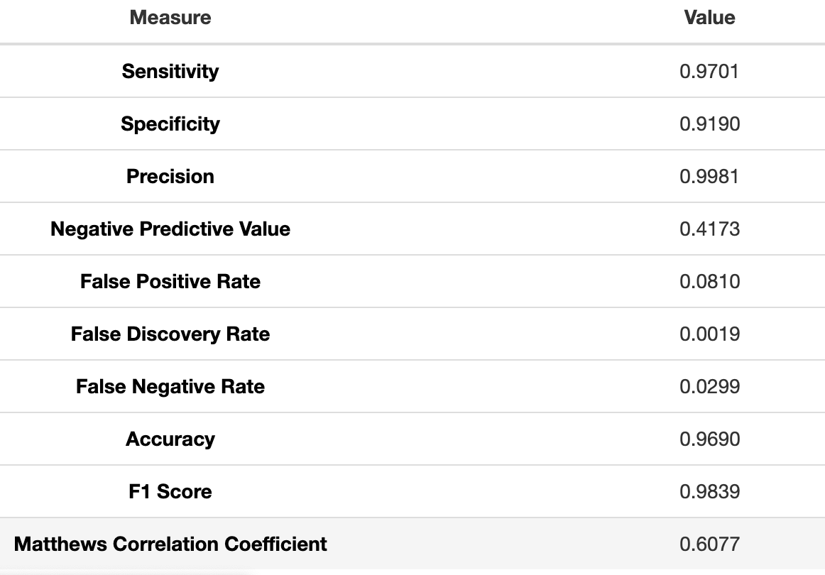
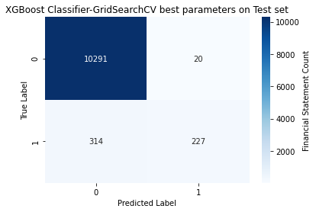
Confusion Matrix for Test Set-GridSeachCV best parameters
After applying hyperparameters using the GridSearchCV, the performance metrics ‘Recall’ of XGBoost test data seems to be quite low but is much better than ‘Recall’ of all other model’s.

Slide 31
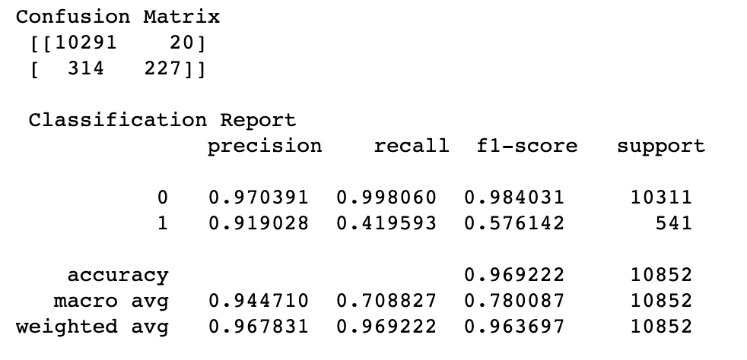
Performance Metrics for Test Set-GridSeachCV best parameters
After applying 3-fold cross validation using GridSearchCV with best hyperparameters, the XGBoost model is performing good on test data but Recall and F1-Score is still low.

Slide 32
Performance Metrics Comaprison Table
Method | Parameters | Dataset | Accuracy | Precision | Recall | F1-Score
XGBoost | Default | Train | 0.9734 | 0.9998 | 0.4852 | 0.9862
 |  | Test | 0.9689 | 0.9984 | 0.4085 | 0.9839
 | Best | Train | 0.9733 | 0.9998 | 0.4452 | 0.9862
 |  | Test | 0.9690 | 0.9981 | 0.4173 | 0.9839

Slide 33
Data Interpretation and Explanation

Slide 34
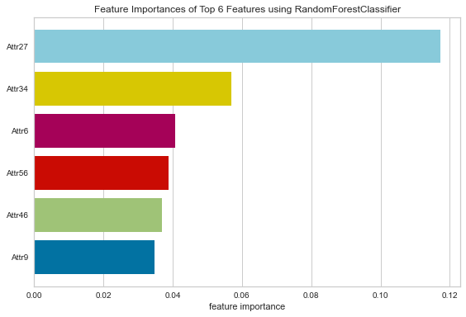
Feature Importance using Random Forest Classifier
The top 6 features obtained by using the Random Forest Classifier were:
Attr27-profit on operating activities / financial expenses
Attr34-operating expenses / total liabilities
Attr6-retained earnings / total assets
Attr56-(sales - cost of products sold) / sales
Attr46-(current assets - inventory) / short-term liabilities
Attr9-sales / total assets

Slide 35
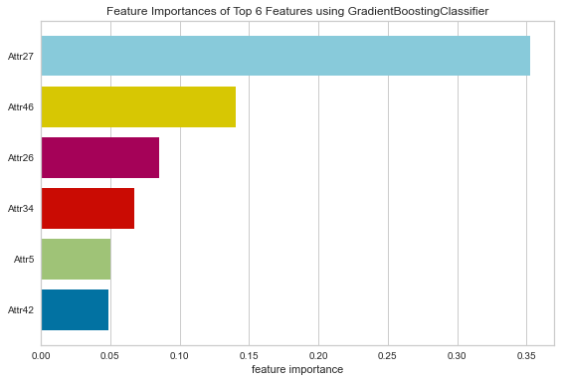
Feature Importance using XGBoostClassifier
The top 6 features obtained by using the Gradient Boosting Classifier-XGBoost were:
Attr27-profit on operating activities / financial expenses
Attr46-(current assets - inventory) / short-term liabilities
Attr26-(net profit + depreciation) / total liabilities
Attr34-operating expenses / total liabilities
Attr5- [(cash + short-term securities + receivables - short-term liabilities) / (operating expenses - depreciation)] * 365
Attr42-profit on operating activities / sales

Slide 36
Feature Importance
Both Random Forest and XGBoost classifier found Attr27 which was profit on operating activities / financial expenses to be the most important factor in determining risk of bankruptcy. This should be one of the first considerations when looking at bankruptcy risks for potential or current clients/companies.
Clients with larger operating expenses were at a far greater risks of bankruptcy according to features identified by the model. Profit, liabilities and assets while also important, were far outweighed by bankruptcy risks due to large operation expenses.

Slide 37
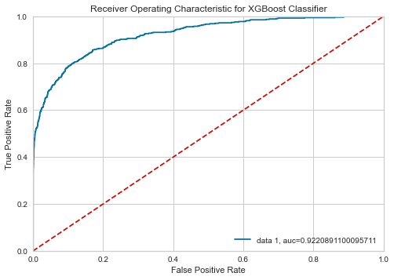
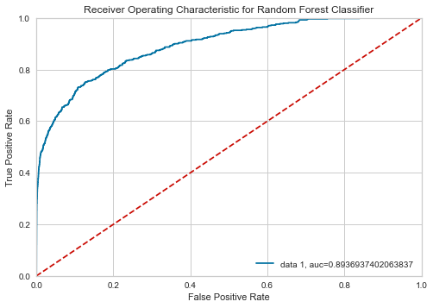
ROC Curve
Although both Random Forest and XGBoost is performing good but XGBoost seems to be winning between both with auc=0.9220.

Slide 38
Performance Metrics Comaprison Table
From the comparison table, we can say that the XGBoost with hyperparameters is the most efffective model. Precision of target was at 0.9984, this was only outperformed by the XGBoost model. However, our critical metric Recall=0.4173 was also outperformed by XGBoost only.
Method | Parameters | Dataset | Accuracy | Precision | Recall | F1-Score
Random Forest | Default | Train | 1.0000 | 1.0000 | 1.0000 | 1.0000
 |  | Test | 0.9651 | 0.9968 | 0.3604 | 0.9819
 | Best | Train | 0.9711 | 1.0000 | 0.3935 | 0.9851
 |  | Test | 0.9639 | 0.9992 | 0.2902 | 0.9813
XGBoost | Default | Train | 0.9734 | 0.9998 | 0.4852 | 0.9862
 |  | Test | 0.9689 | 0.9984 | 0.4085 | 0.9839
 | Best | Train | 0.9733 | 0.9998 | 0.4452 | 0.9862
 |  | Test | 0.9690 | 0.9981 | 0.4173 | 0.9839

Slide 39
Case Conclusion
RandomForest and XGBoost had comparable precision and accuracy, but XGBoost model performed slightly better in terms of recall. The higher Recall-Precision distribution across different thresholds also suggest that XGBoost is the better model.
Features such as Attr34 (operating expenses / total liabilities), Attr27(profit on operating activities / financial expenses), and Attr46 ((current assets – inventory) / short-term liabilities) are three most important factors for determining bankruptcies.
Further research is needed determine if these top features contribute to bankruptcies or not. Additionally, we could explore different sampling techniques to balance the dataset along with other ensemble methods.

