Slide 1
DS 7333: Case Study 3-Spam Classifier
Submitted by-
Rashmi Patel
Date: February 14, 2022

Slide 2
Objective
The objective of this case study is to classify a given email is whether a spam or not spam.

Slide 3
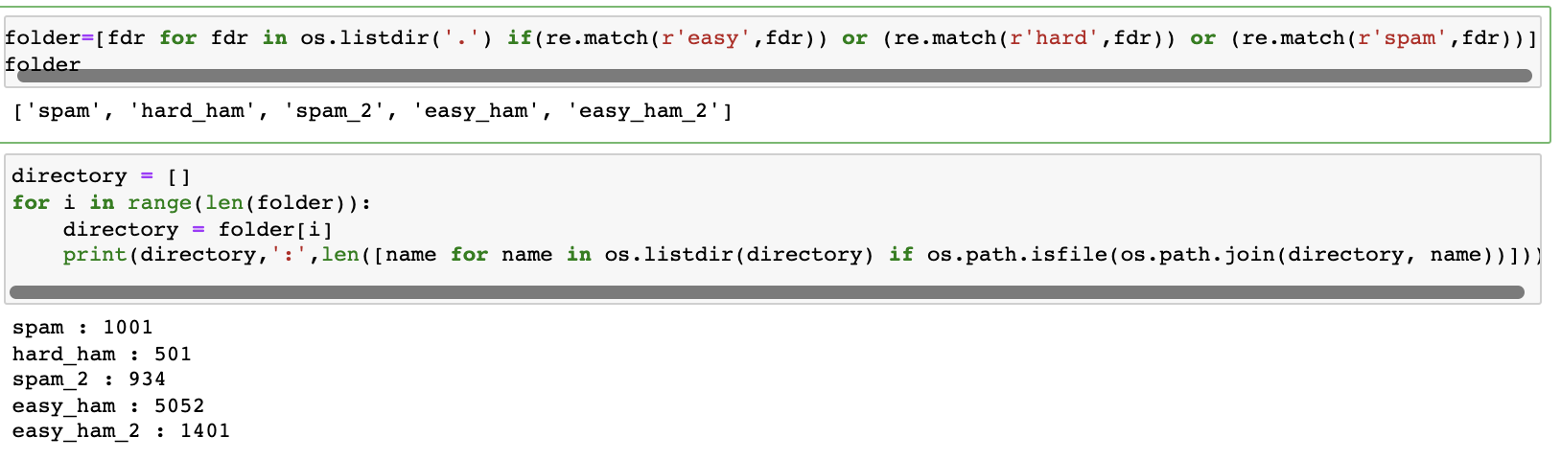
Dataset Details
The dataset provided contains 5 folders (8889 total emails) in which 3 folders contains ham emails (not spam) which count for 6954 and 2 folders contains Spam emails which count for 1953 emails.

Slide 4
Email Parsing
In email parsing, we removed all the unnecessary whitespace, \n, symbols, etc. with single whitespace. The parsed email is stored in an array and the 0 was appended for every not spam email to the array called ‘target’ and 1 for every spam email.

Slide 5
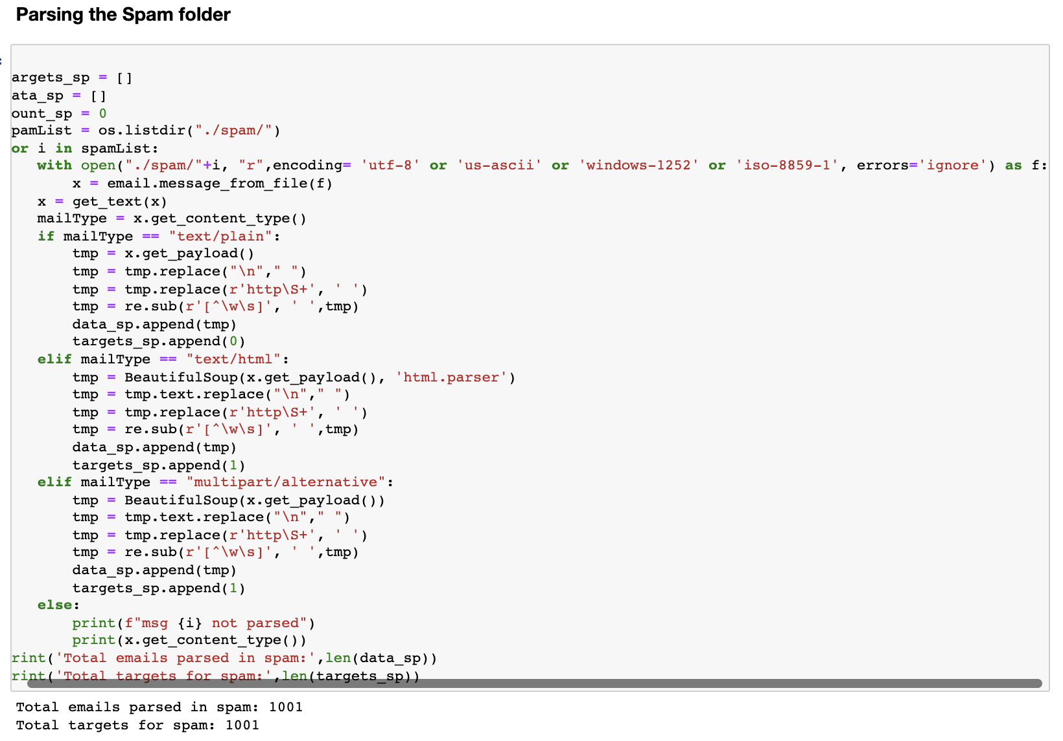
Parsing ‘spam’ Folder
There was none of the files which was not parsed in the ‘spam’ folder.

Slide 6
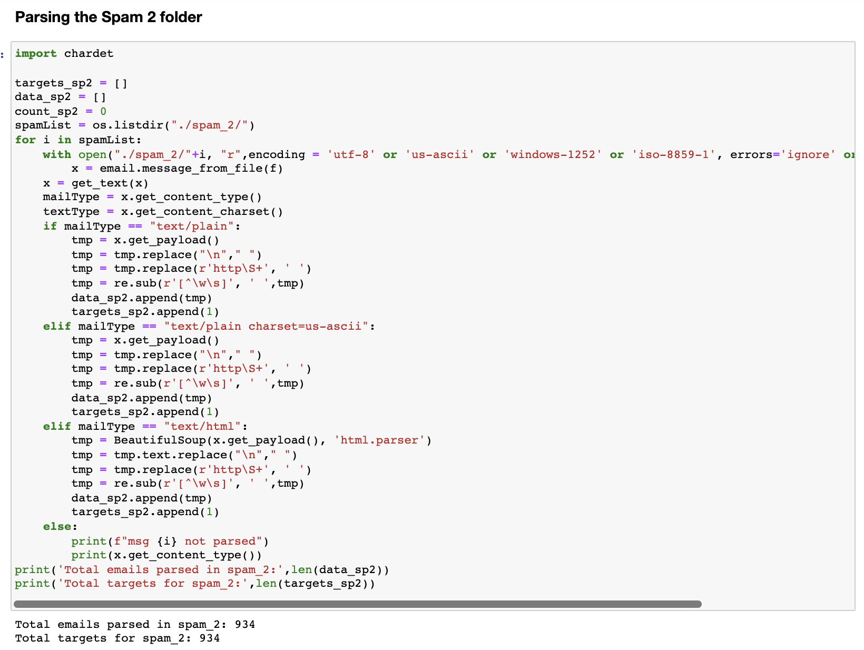
Parsing ‘spam_2’ Folder
There was none of the files which was not parsed in the ‘spam_2’ folder.

Slide 7
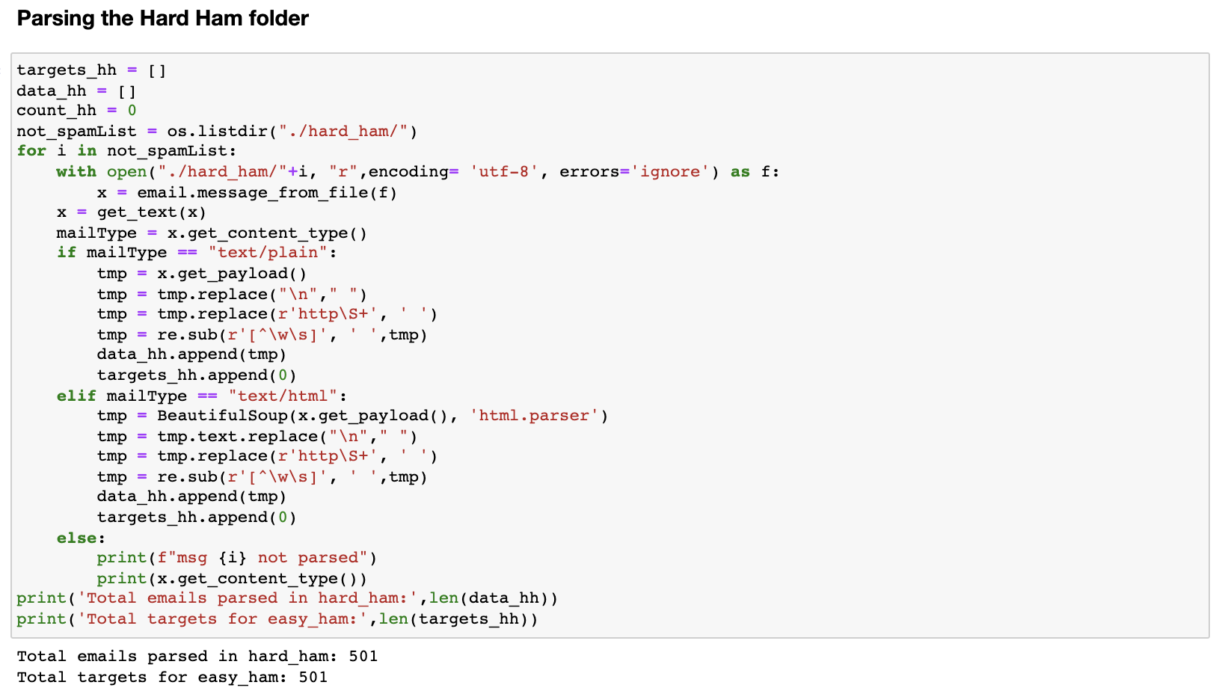
Parsing ‘hard_ham’ Folder
There was none of the files which was not parsed in the ‘hard_ham’ folder.

Slide 8
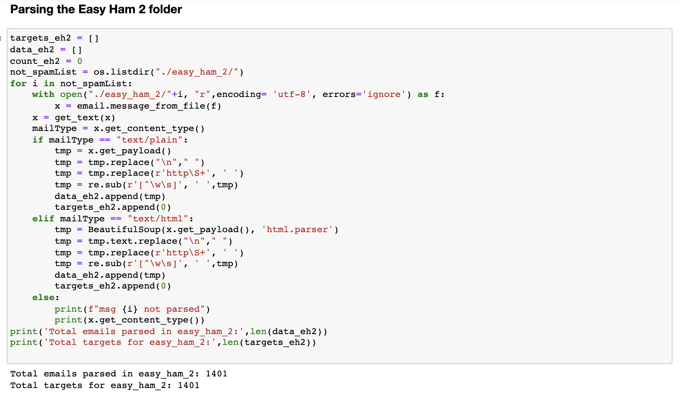
Parsing ‘easy_ham_2’ Folder
There was none of the files which was not parsed in the ‘easy_ham_2’ folder.

Slide 9
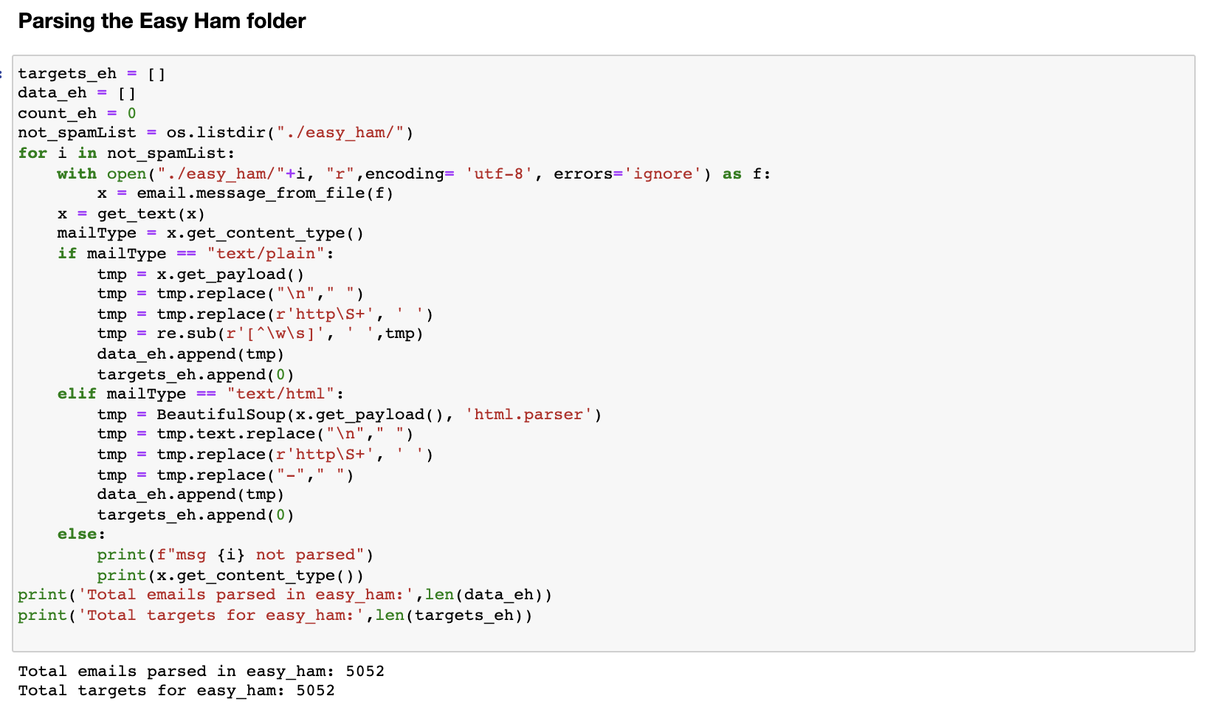
Parsing ‘easy_ham’ Folder
There was none of the files which was not parsed in the ‘easy_ham’ folder.

Slide 10
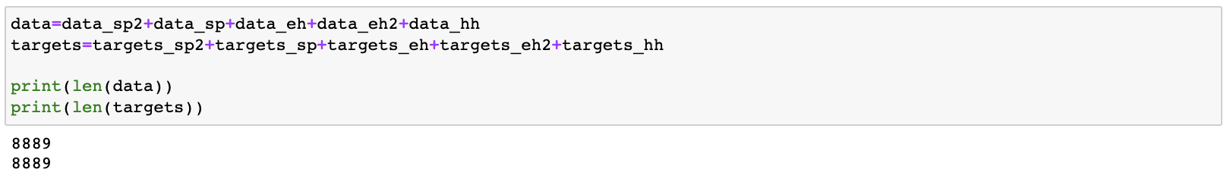
Merging the data and target array
We merged all the data and target array into one array.

Slide 11
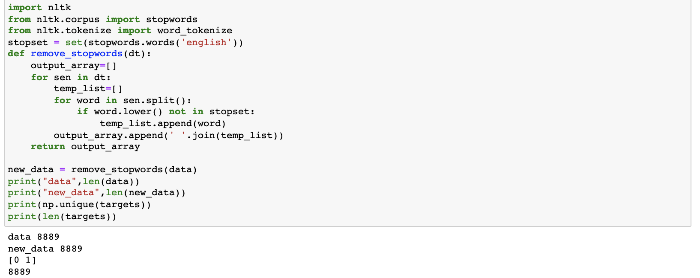
Removing all stop words
Using the nltk.stopwords library, we removed all the stopwords.

Slide 12
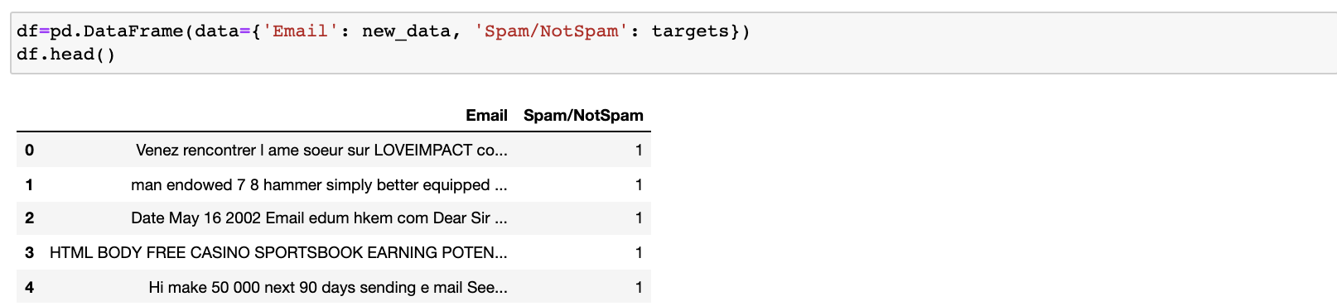
Creating the data frame
After successfully parsing the emails in all 5 folders, we merged the emails and target stored in the arrays which contained all emails and 0, 1 values for spam/not spam email.

Slide 13
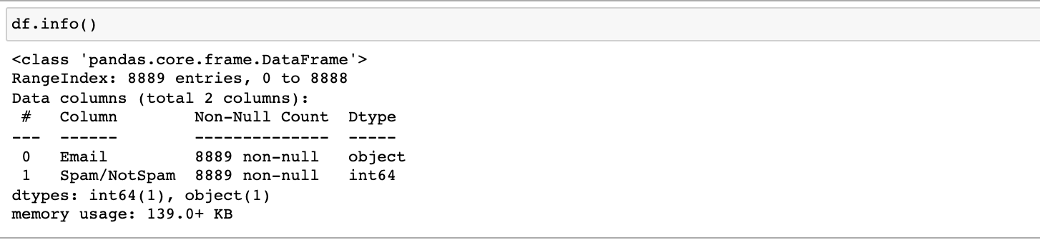
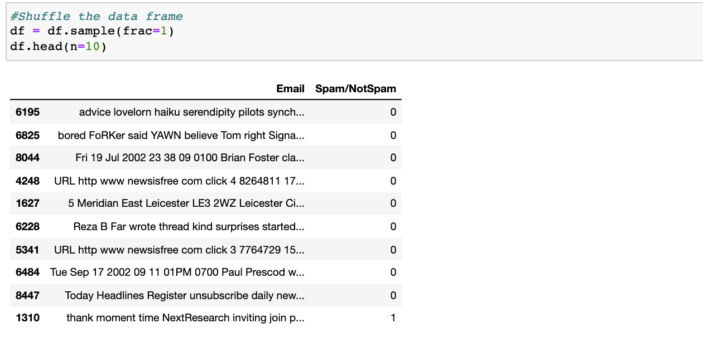
Information about the data frame created
We can see that the data frame created has Email as object type and Spam/NotSpam as numeric type.
By looking at the non-null count, we can say that there is no null values in the data frame.
We also shuffled the data frame values randomly.

Slide 14
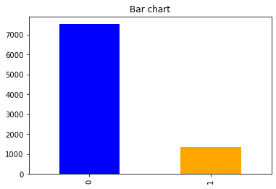
Target variable Spam/NotSpam
Unbalanced target data with 85% not spam and 15% spam emails.

Slide 15
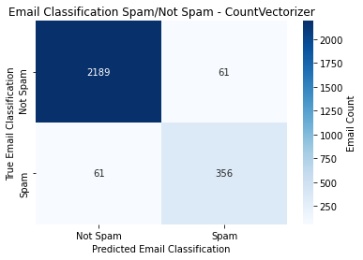
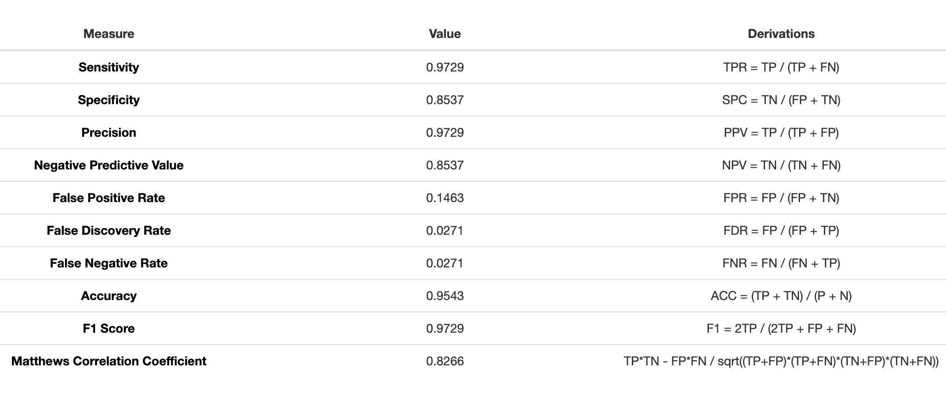
Model Building Using CountVectorizer

Slide 16
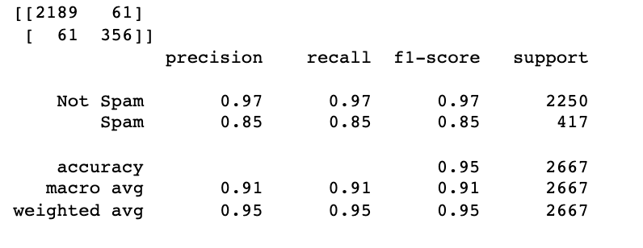
Performance Metrics for Count Vectorizer Model
Some other metrics by spam/not spam are as follows:
Precision:
Spam=0.85
Not Spam=0.97
Recall:
Spam=0.85
Not Spam=0.97
F1-Score
Spam=0.85
Not Spam=0.97

Slide 17
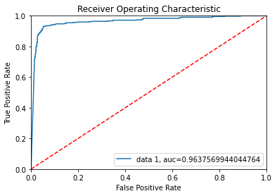
ROC-Curve for Count Vectorizer Model
The ROC curve for the model built using Count Vectorizer shows 96.37% accuracy indicating that model is working well.

Slide 18
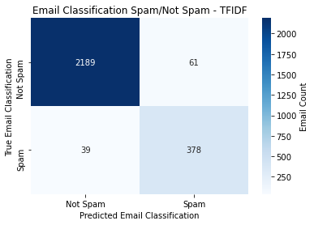
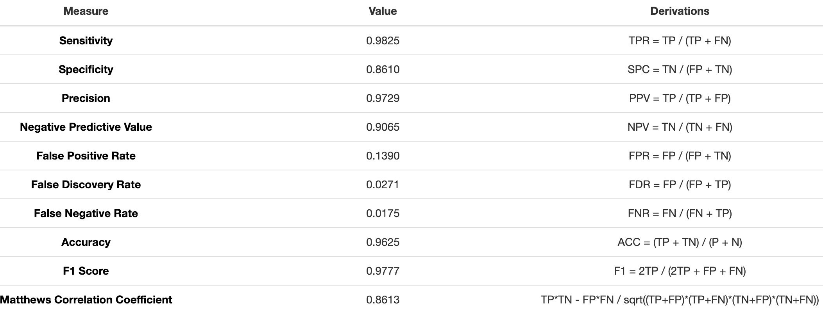
Model Building using TF-IDF

Slide 19
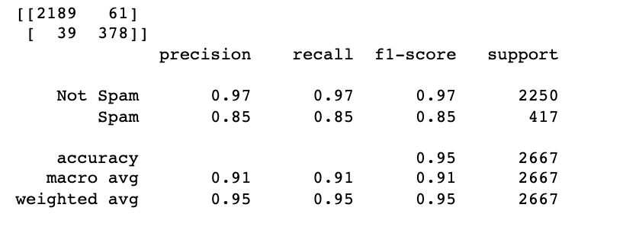
Performance Metrics for TF-IDF Model
Some other metrics by spam/not spam are as follows:
Precision:
Spam=0.85
Not Spam=0.97
Recall:
Spam=0.85
Not Spam=0.97
F1-Score
Spam=0.85
Not Spam=0.97
Note: Although above metrics are same as the Count Vectorizer model but the values in confusion matrix is different.

Slide 20
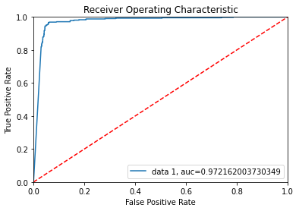
ROC-Curve for TF-IDF Model
The ROC curve for the model built using Count Vectorizer shows 97.21% accuracy indicating that model is working well and better than the model built using Count Vectorizer which was 96.37%

Slide 21
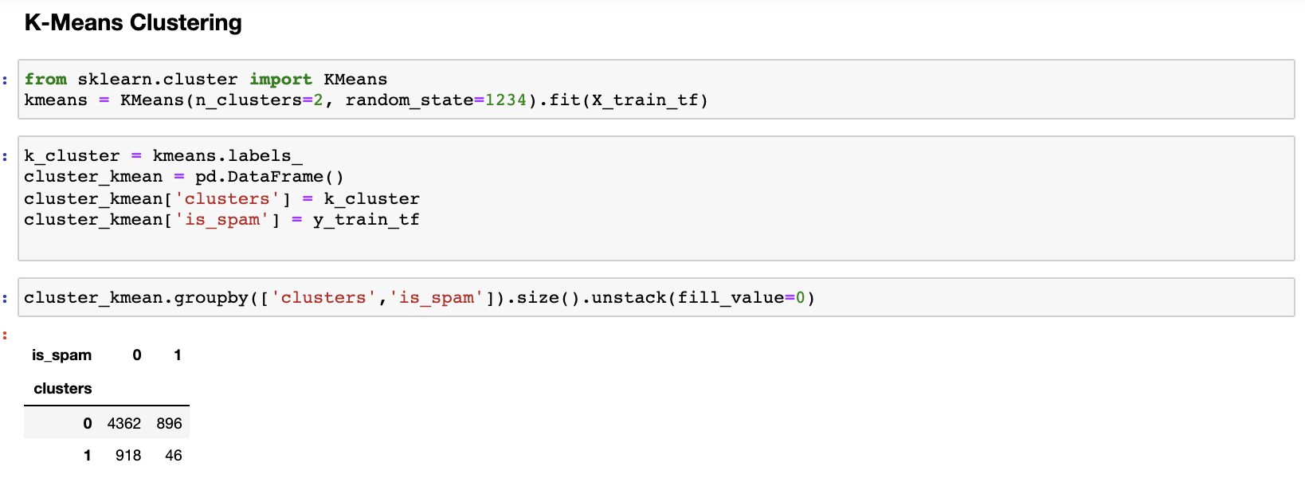
Clustering using K-Means
We have implemented clustering on TF-IDF model because the performance metric was better than Count Vectorizer model.
K-Means clustering is done just on X_train data because complete data was taking too long and hanging the system.
We created 2 clusters because it was just spam or not spam. It seems from the output that in the cluster 0, 4362 of them are not spam and 896 are spam whereas in cluster 1, 918 emails are not spam and 46 are spam.

Slide 22
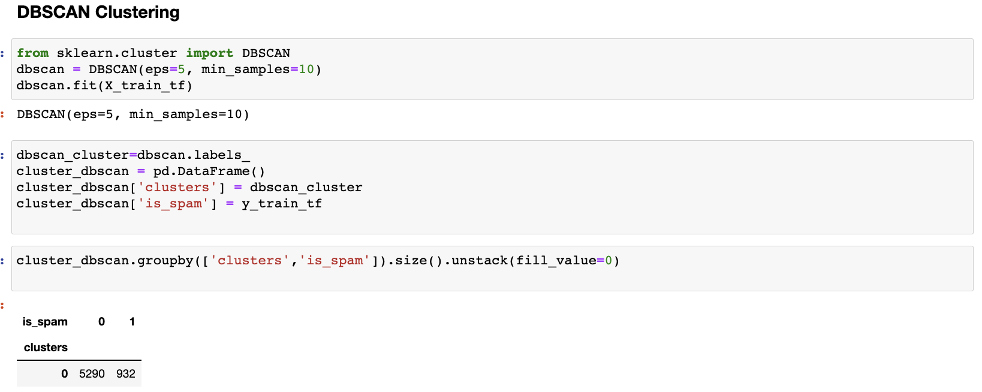
Clustering using DBSCAN
When we implemented DBSCAN on X_train of TF-IDF, no clusters were formed.

Slide 23
Case Conclusions
Our recommendation is leveraging the k-Means clustering on TF-IDF found on our emails to provide a prediction model. It provides a relatively high accuracy of 96.25% while maintaining a precision of 97.29%.

Slide 24
Appendix
The Jupyter Notebook for this case study 3 is available on Github: https://github.com/RashmiAPatel19/MSDS-7333-Quantifying-the-world/tree/main/CaseStudy3

