Slide 1



MSDS 6306: Case Study 2
Attrition & Salary Prediction
By: Rashmi Patel
Notes:
Hello everyone, my name is Rashmi Patel. Today I am going to present you the SMU dds case study 2. so, lets get started

Slide 2
Executive Summary
DDS Analytics is an analytics company that specializes in talent management solutions for Fortune 100 companies. The company wants to identify the factors that lead to attrition and higher salary. We will review some insights and factors that lead to attrition and higher salary.
Notes:
Dds analytics is an analytics company who have hired us to do some analysis on the data given by the client and find some useful insights and factors that lead to higher salary of the employees and the factors that leads to attrition.

Slide 3
Agenda
Data Summary
Data Cleaning
Addressing missing values
Unimportant variables
Exploratory Data Analysis(EDA)
Current Employees review on attrition
Correlation between numerical variables
Correlation between categorical variables
Graph for Monthly Income and numerical variables
Model comparison for Salary
Model comparison for Attrition
Conclusion

Slide 4
Data Summary
In the dataset, there are 36 variables and 870 entries in which 27 variables are continuous variable and 9 categorical variables.

Slide 5
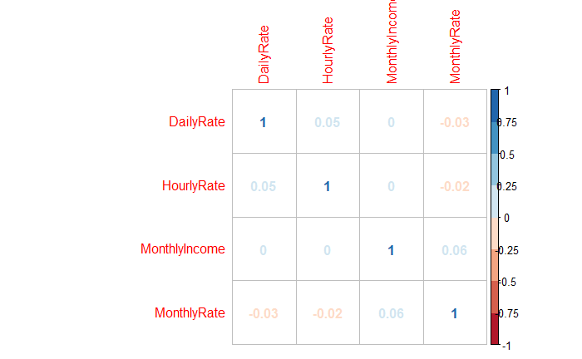
Data Cleaning
Addressing missing values
No missing values were found in the given data set.
Unimportant Variables
Constant values
Employee Count
Standard Hours
Over 18
No correlation variables with monthly income
Hourly Rate
Daily rate
Monthly Rate
Notes:
No missing values were found in the data. But While cleaning the data we found that monthly rate, daily rate and hourly rate were the variables which implies to income of an employee. Looking at the graph it seems to have no correlation between the variables with monthly income of an employee. Some constant values like standards hours employee count, and over 18 had same values in 870 entries. After cleaning the data, we were left with 19 continuous and 8 categorical variables

Slide 6
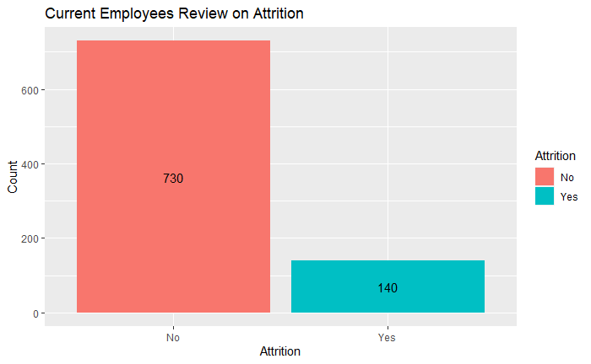
Current Employees review on attrition
Among the 870 current employees, 730 employees says “No” to Attrition and 140 says “Yes” to Attrition.
Notes:
Looking at the current employee review on attrition. We found that 730 employees says no to attrition and 140 says yes to attrition.

Slide 7
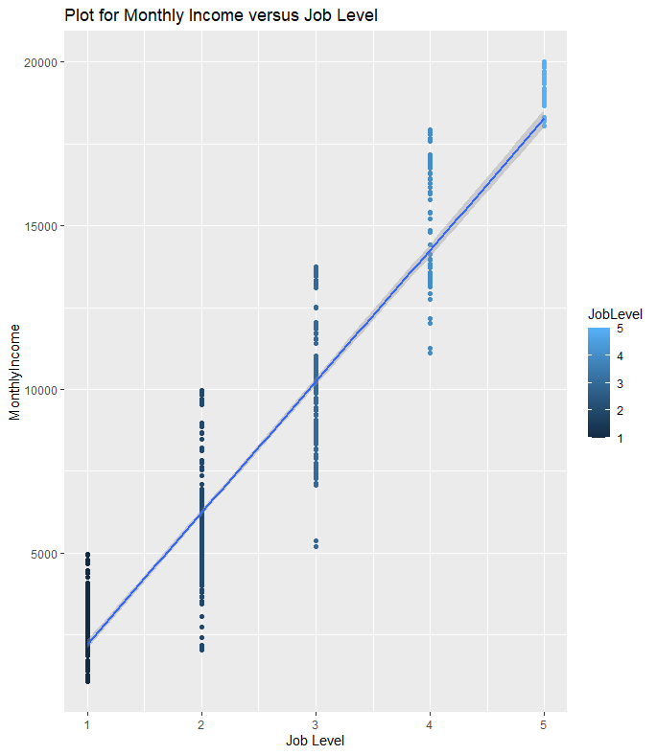
Plot for Monthly Income and Job Level
A strong linear relationship is found between job level and monthly income.
We found that 90.56% of the monthly income is associated with the job level.
Notes:
Visually it seems that there is a strong linear relationship between monthly income and job level. The relation ship is so strong that 90.56% of monthly income can be explained by the job level

Slide 8
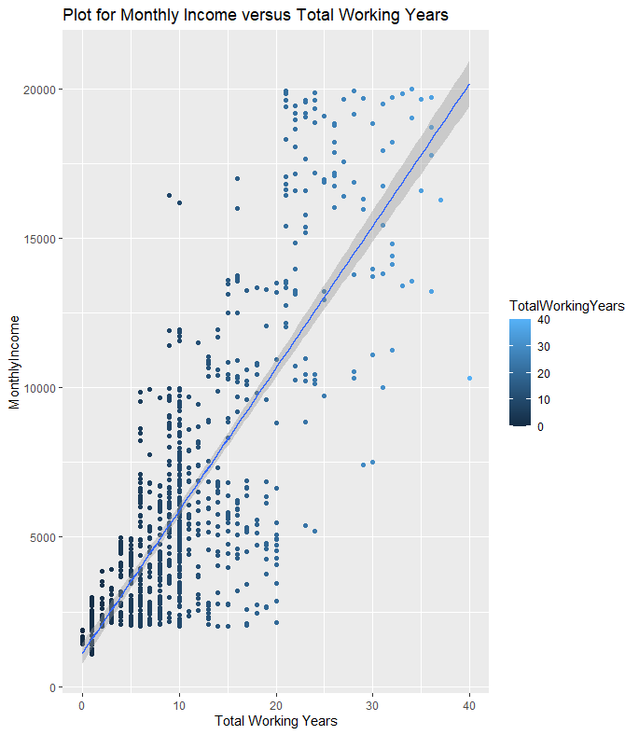
Plot for Monthly Income and Total Working Years
A moderate linear relationship is found between total working years and monthly income.
We found that 60.61% of the monthly income is associated with the total working years .
Notes:
Visually it seems that there is a moderate linear relationship between monthly income and total working years of an employee. The relation ship is moderate that 60.61% of monthly income can be explained by the total working years.

Slide 9
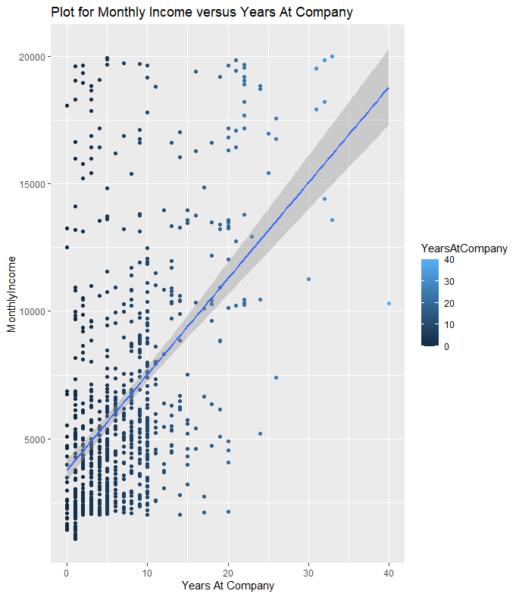
Plot for Monthly Income and Years at Company
A moderate linear relationship is found between years at company and monthly income.
We found that 24.15% of the monthly income is associated with the years at company.
Notes:
Visually it seems that there is a moderate linear relationship between monthly income and Years at company. The relation ship is so moderate that 24.15% of monthly income can be explained by the Years at company

Slide 10
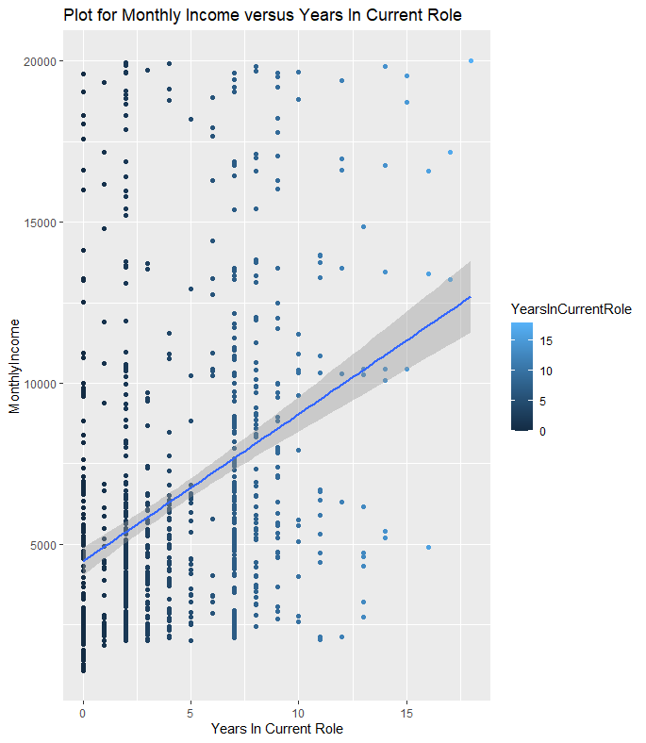
Plot for Monthly Income and Years in current role
A moderate linear relationship is found between years in current role and monthly income.
We found that 13.09% of the monthly income is associated with the years in current role .
Notes:
Visually it seems that there is a moderate linear relationship between monthly income and Years in current role. The relation ship is so moderate that just 13.09% of monthly income can be explained by the Years in current role

Slide 11
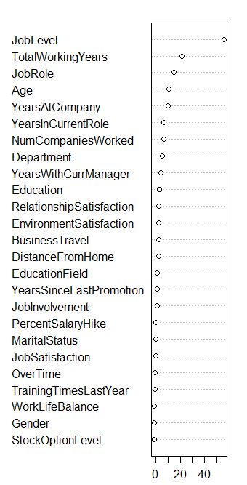
Feature selection for salary model
The top 5 influential factors that can lead to high monthly income are:
Job Level
Total Working years
Job Role
Age
Years At Company
Notes:
After looking at some graphs and knowing the data, we then used random forest feature selection method to see the top 5 influential factors that leads to higher salary.

Slide 12
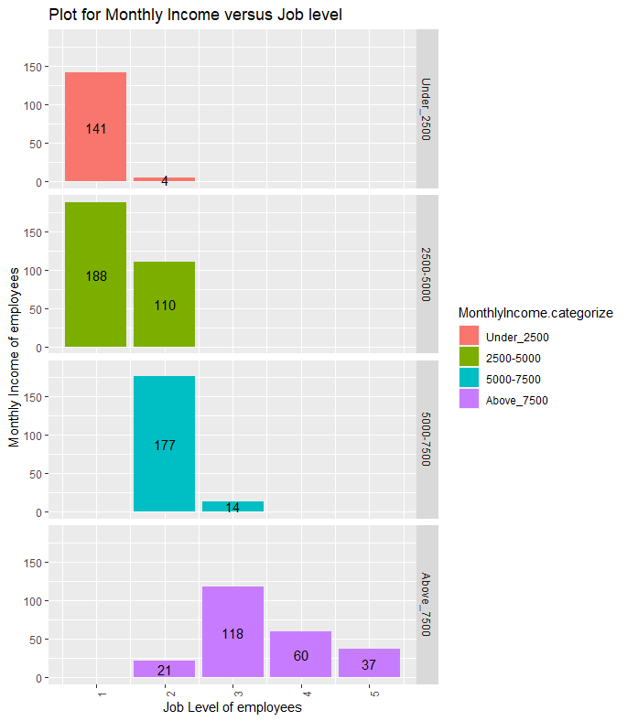
Plot for Monthly income and job level
Approximately 37.81% of the employees at the company are at job level 1.
Almost all the employees having monthly income under $2500 are at job level =1.
15.67% of the employees earning above $7500 per month are job level=5.
Notes:
For further analysis on monthly income, we have categorized the monthly income in 4 parts as under $2500, 2500-5000, 5000-7500 and above 7500. We can that only 37.81% of the total employees are at job level 1 and none of the employees at job level 1 are earning more than $5000

Slide 13
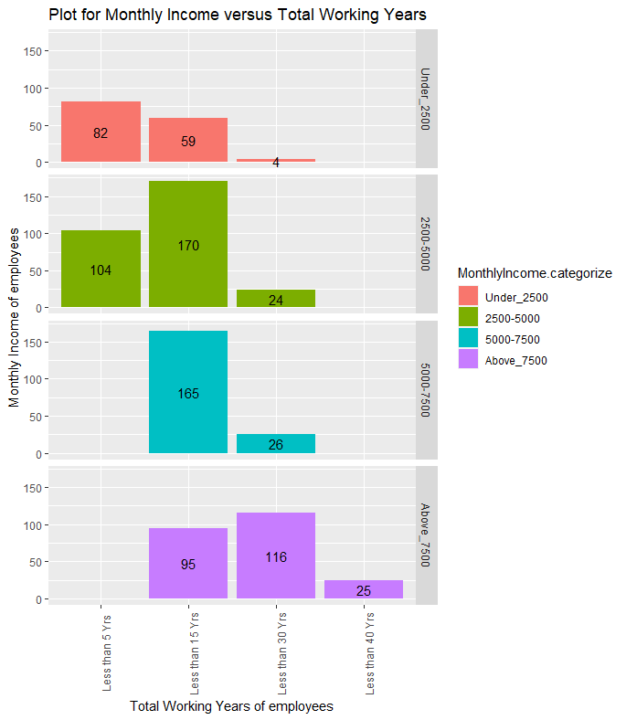
Plot for Monthly income and total working years
Only 10.59% of the employees earning above $7500 per month are working for more than 30 years.
No employees working less than 5 years are earning more than $5000 per month.
No employees working for more than 30 years are earning less than $7500 per month.
Notes:
Visually it seems that the employees working for more than 30 years are surely to get more than $7500 per month. On the other hand, none of the employees working for less than 5 years seems to have monthly income above 5000.

Slide 14
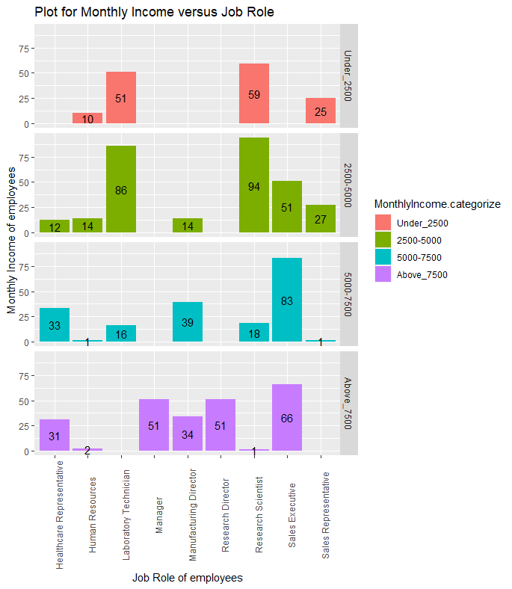
Plot for Monthly income and job role
27.12% of the total employees are earning above $7500 per month.
No Laboratory technician and sales representative are earning above $7500 per month.
No research director and manager earn below $7500 per month.
Notes:
Looking at the graph it seems that No Laboratory technician and sales representative are earning above $7500 per month. No research director and manager earn below $7500 per month.

Slide 15
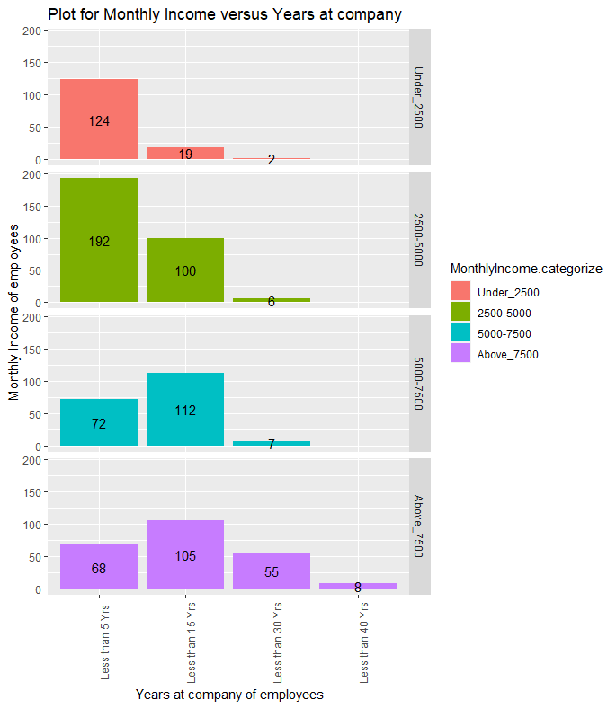
Plot for Monthly income and Years at company
Approximately 27.19% of the employees working at the company for less than 5 years are earning less than $2500 per month.
3.38% of the employees earning above $7500 are working at the company for more than 30 years.
Notes:
Visually. None of the employees working for more than 30 years have monthly income less than 7500. Approximately 27.19% of the employees working at the company for less than 5 years are earning less than $2500 per month.

Slide 16
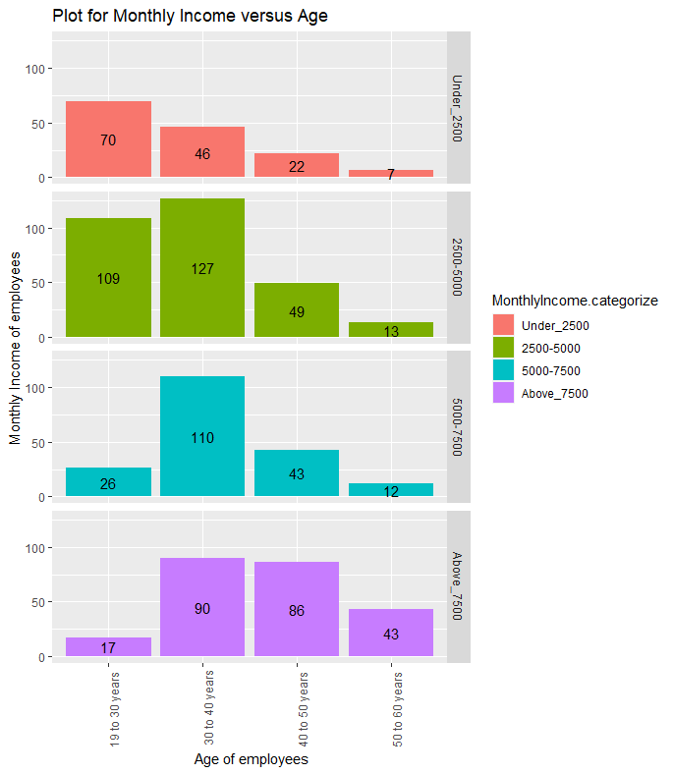
Plot for Monthly income and Years at company
Only 7.65% of the employees of 19 to 30 years of age are earning above $7500.
57.33% of the employees with 50 to 60 years age are earning above $7500.
Notes:
Only 7.65% of the employees under the age of 30 years are having monthly income above 7500. 57.33% employees with 50-60 years age are earning above 7500

Slide 17
Model for Monthly Income
The random forest model for monthly income performs better with R-squared=0.9472 than linear regression model with R-squared=0.9137.
Important features for random forest are:
Job level
Job role
Total working years
Age
Years at company
Important features for linear regression [p-value<=0.05]are:
BusinessTravel: Travel_Rarely
DistanceFromHome
EducationField: Marketing
JobLevel
TotalWorkingYears
YearsWithCurrManager
 | Linear regression model | Random forest model
R-squared | 0.9137 | 0.9472
RMSE | $1372.266 | $1069.555
Prediction Error | 0.2112 | 0.1651
Notes:
After looking at the graphs of the factors that leads to higher monthly income, we build the model for predicting the monthly income of an employee using the linear regression and random forest algorithms. We found that the random forest model is performing better than linear regression model with an accuracy of 94.72%. We can also see that the prediction error in random forest model is less than the linear regression model.

Slide 18
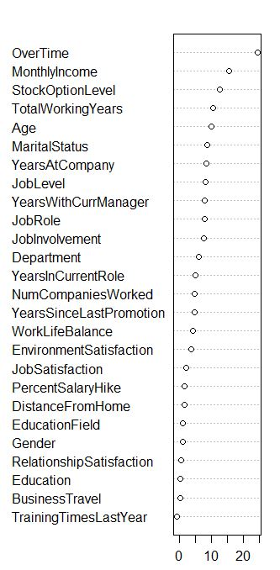
Feature selection for attrition model
The top 5 influential factors that can lead to high monthly income are:
OverTime
MonthlyIncome
StockOptionLevel
Age
MaritalStatus
Notes:
After building the model for salary , we again used random forest feature selection method to see the top 5 influential factors that leads to attrition.

Slide 19
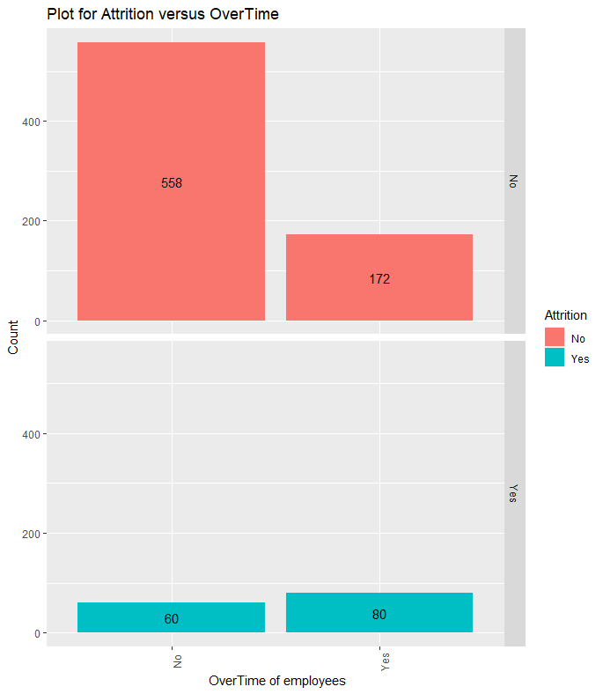
Plot for Attrition and Over Time
Employees doing over time at the company are more likely to leave.
Approximately 57.14% of the employees doing over time leave the company.
Notes:
Looking at the graph it seems that employees doing over time are more likely to leave the company. It is approximately 57.14% of the employees who leave the company.

Slide 20
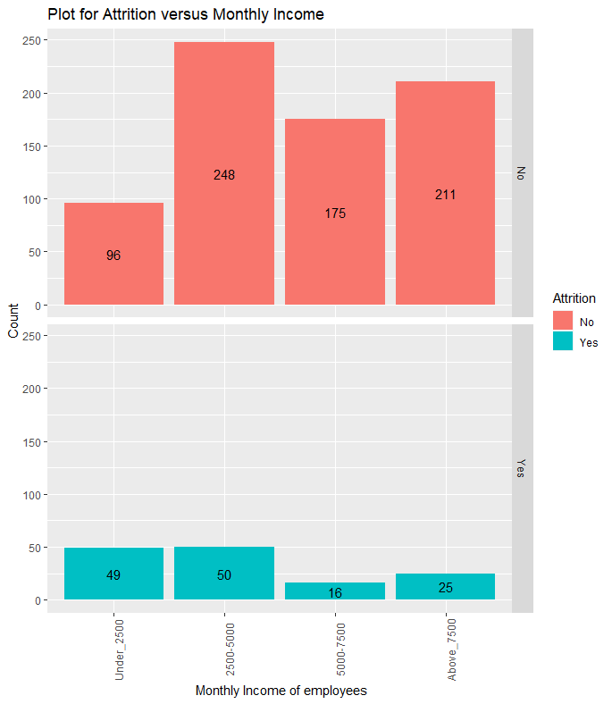
Plot for Attrition and Monthly Income
Employees who are leaving the company are earning under $5000 per month which is approximately 70.71%.
Notes:
Looking at the graph it seems that employees who leave the company are due to the reason of low income. It is approximately 70.71% of the employees who leave the company.

Slide 21
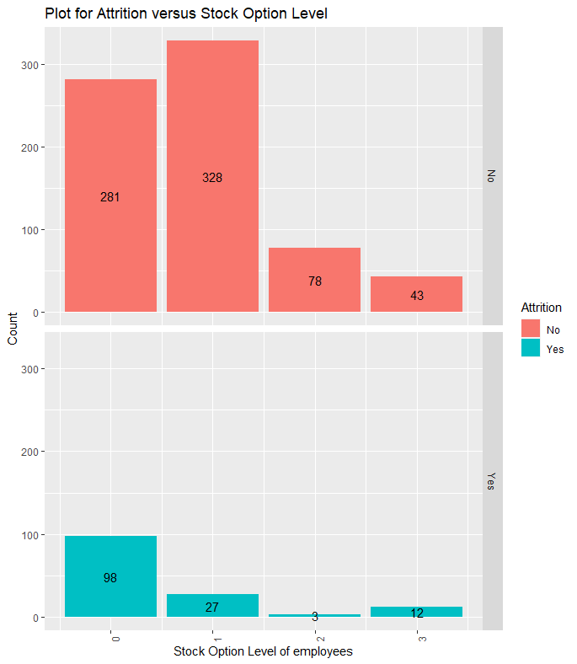
Plot for Attrition and Stock Option Level
70% of the employees who are leaving the company have no stock option level.
Notes:
Looking at the graph it seems that employees who leave the company are due to the reason of zero stock option level for them. It is approximately 70% of the employees who leave the company.

Slide 22
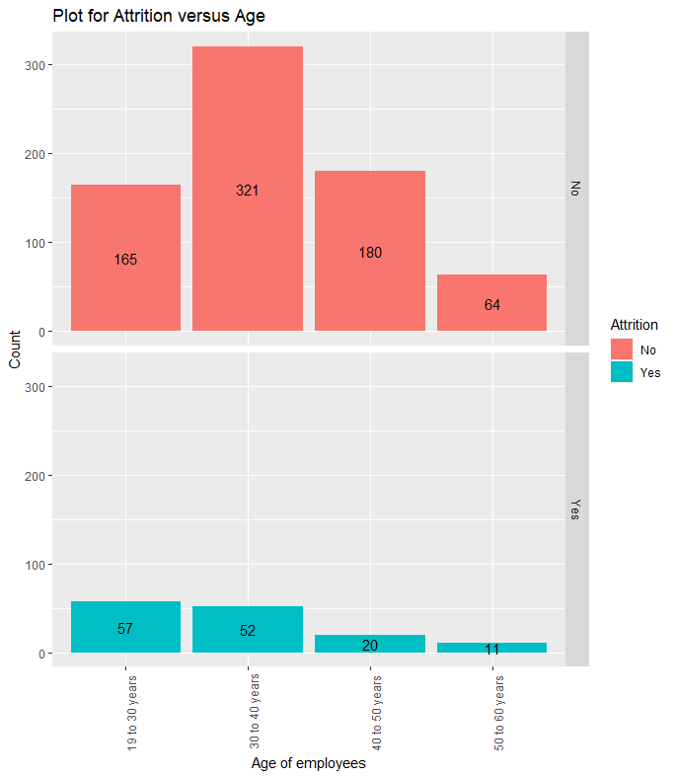
Plot for Attrition and Age
74.28% of the employees who are leaving the company are below 30 years age.
Notes:
Looking at the graph it seems that employees who leave the company fall under the category of 19 to 30 years of age.. It is approximately 74.28% of the employees who leave the company.

Slide 23
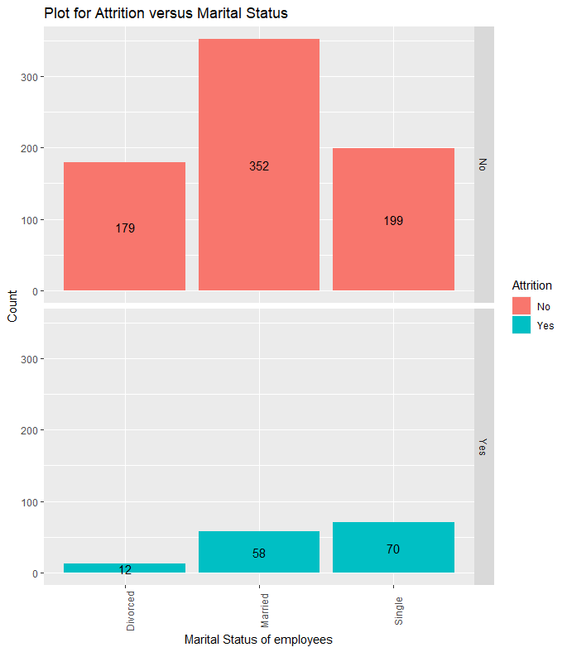
Plot for Attrition and Marital Status
50% of the employees who are leaving the company are single.
93.71% divorced employees are likely to stay.
Notes:
Looking at the graph it seems that employees who leave the company are single. We found that mostly divorced employees in the company are likely to stay.

Slide 24
Model for Attrition
Observed
K-Nearest Neighbor- The model obtained following results:
Accuracy:0.8736
Sensitivity:0.8717
Specificity:0.9167
 | No | Yes
No | 727 | 3
Yes | 107 | 33
Predicted
Observed
Random Forest - The model obtained following results:
Accuracy:0.9678
Sensitivity:0.9643
Specificity:0.9912
 | No | Yes
No | 729 | 1
Yes | 27 | 113
Predicted
Observed
Logistic Regression- The model obtained following results:
Accuracy:0.9011
Sensitivity:0.9160
Specificity:0.7812
 | No | Yes
No | 709 | 21
Yes | 65 | 75
Predicted
Notes:
After looking at the graphs for the top 5 influential factors that leads to attrition, we build a model using KNN , random forest and logistic regression. The model was tested on the complete data given. Looking at the results of all the three models it seems that the random forest model performs the best among the three models with maximum accuracy of 96.78%

Slide 25
Conclusion
The important factors that lead to higher monthly income of an employee are:
Job Level
Total Working Years
Job Role
Age
Years At Company
The important factors that lead to attrition are:
Over Time
Monthly Income
Stock Option Level
Marital Status
Age
Notes:
In conclusion we can say the if the company is planning to hire employees , they should take the following factors into consideration that leads to higher salary and the factors that leads to attrition.

