Slide 1
Presentation Axis Bank
Rashmi

Slide 2
Netra E-commerce Application
In todays world communicating through websites and apps have become a very common thing and every second person try to get the information through internet through some website to make the communication easier.
So that is why every organization from small to large try to first make a website to attract the customer in order to grow the business as well as to attract more and more customer which even make the work easier for them also because they don't need to store data manually they can directly store the data on cloud and can change and access them time to time making the work easier for them

Slide 3
Netra E-commerce Application
Within the context of increasing online sales, the e-Commerce industry is witnessing the most significant growth of mobile solutions development dictated by the need to satisfy customer desires. Consumers require the freedom to purchase goods and services anytime and from anywhere, even on the go. Hence, more online shoppers prefer mobile e-Commerce applications to websites, as they offer advanced speed, convenience and adaptability.
Most people rely on their first impression when evaluating something. It takes a person around 50 milliseconds to form an opinion about an object and decide whether he or she likes it or not. So, the appealing layout design of a mobile app/Web Application ensures a positive user experience, which significantly increases customer loyalty and speeds up the payback.

Slide 4
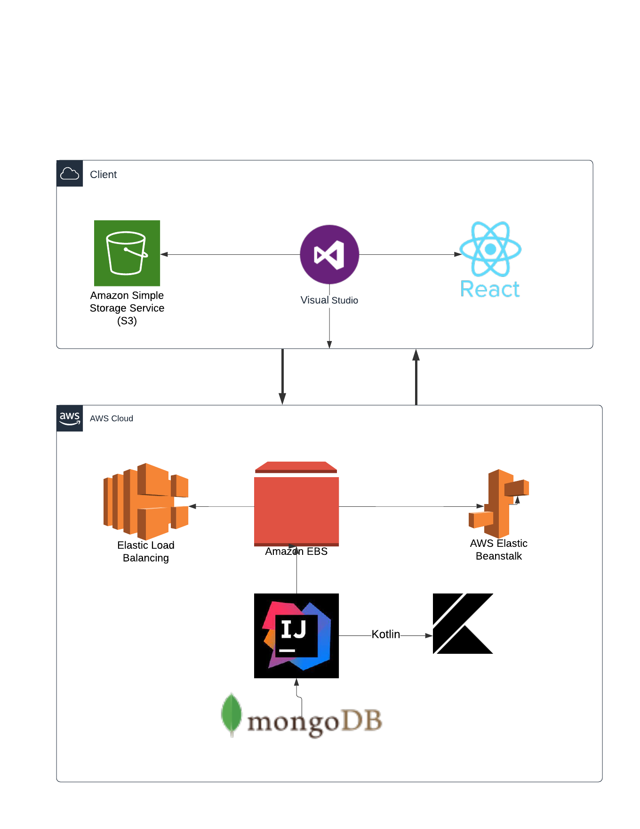

Slide 5
Diagrams
Technology Stack
Architecture Diagram
Flowchart Diagram

Slide 6
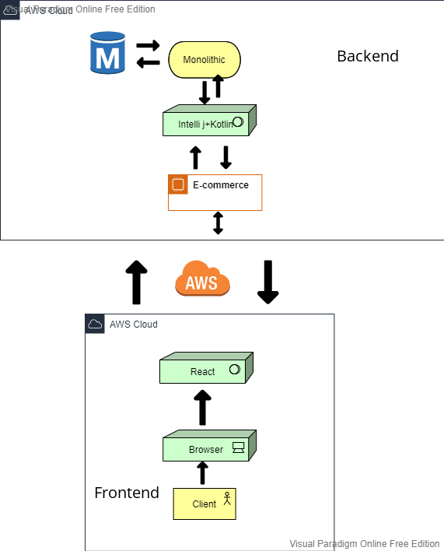
Architecture Diagram

Slide 7
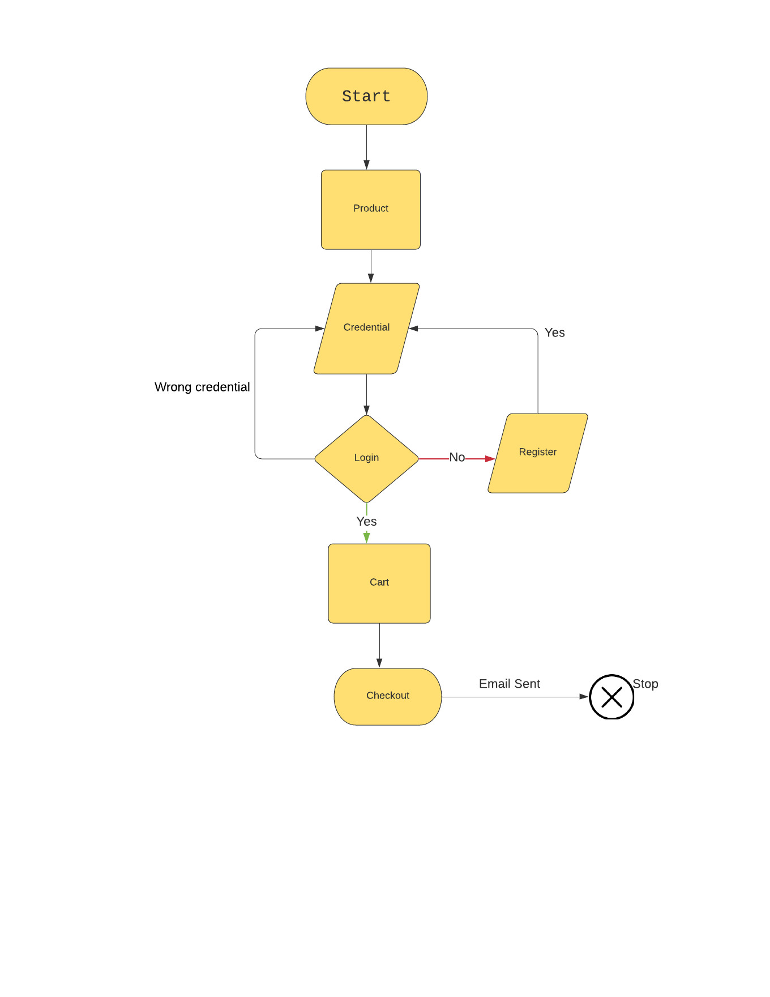

Slide 8
Advantages Of Monolithic Architecture
Easier and Faster Development
Easier Deployment
Easier Testing and Error Tracing
Trustworthiness

Slide 9
Thank You

