Slide 1
Presentation Axis Bank
Rashmi

Slide 2
Pet Clinic Application
In todays world communicating through websites and apps have become a very common thing and every second person try to get the information through internet through some website to make the communication easier.
So that is why every organization from small to large try to first make a website to attract the customer in order to grow the business as well as to attract more and more customer which even make the work easier for them also because they don't need to store data manually they can directly store the data on cloud and can change and access them time to time making the work easier for them

Slide 3
Pet Clinic Application
So in order to ease the communication between customer and pet clinic shop I made this application so that the customer can directly get the appointment date and time and can visit on that day at the shop to tell his/her concern regarding their pet rather that searching on different website and searching nearest pet clinic on internet
This project is for business purpose so that the admin at the clinic can give the slots according to customer request and after giving the slots and visiting time the customer can decide that whether he/she can visit on that day or not and according to that the customer can visit the clinic.

Slide 4





Technology stack

Slide 5
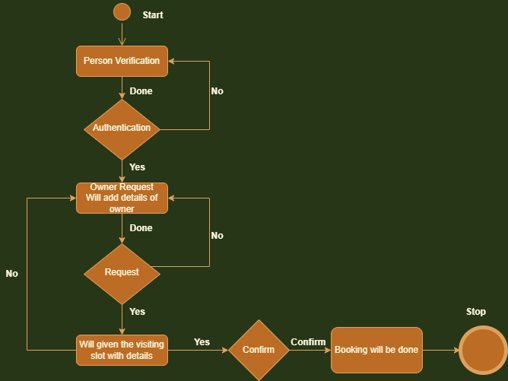

Slide 6
Thank You

