Slide 1
INFO 5709 FALL 2022
RASHMI JAKKANI
11445421
rj0233

Slide 2
COVID-19 DATA ANALYSIS
This project is about the analysis of covid-19 data in 2020 from many countries

Slide 3
Agenda:
Introduction
Background
Data set
Data Cleaning
Exploratory Data Analysis
Tools Used
Data Visualization and Results
Conclusion
References

Slide 4
Introduction:
To analyze the Covid-19 data which includes the death count, confirmed cases, etc.
Covid-19 is caused by a coronavirus called SARS-CoV-2. It was first identified in Wuhan, China
This affects most old age people, especially those who have heart or lung or diabetes diseases will have a higher risk.
Most people infected with this virus have experienced mild to moderate illness and also recover without requiring special treatment
The best way to prevent and slow down the spreading of this virus is to be well-informed by wearing face masks and sanitizing hands
Getting vaccinated is also so important due to which the covid cases have got reduced
This virus can spread from an infected person’s mouth or nose in small liquid particles when they cough, sneeze, speak, etc.

Slide 5
Background:
In late December 2019, a new virus was identified in China causing respiratory diseases including pneumonia
It was originally named as Novel coronavirus and the World Health Organization (WHO) advised some language associated with the virus. And then named the virus causing the infection as severe acute respiratory syndrome coronavirus 2 (SARS-CoV-2).
The disease caused as a result of infection is named – coronavirus disease (COVID-19). It has been categorized as an airborne High consequence Infectious disease.
Within a few days, SARS-CoV-2 is spreading among people globally and can be seen on the WHO situation reports dashboard which is updated daily. As a viral infection, antibodies are not an effective treatment and there are vaccinations available.
As we all know there are some symptoms to know whether this virus is infected or not like fever, cough, shortness of breath, fatigue, body aches, headache, loss of smell or taste, sore throat, diarrhea, and vomiting

Slide 6
Dataset:
The covid-19 dataset is collected from the Kaggle website.
It is a large dataset which 8 columns and 17 thousand rows collecting data on people infected with covid-19.
This dataset consists of columns like country/region which has a list of many countries, state/province which has a list of many states, observation date which has the dates of covid-19 observed, confirm cases, count of deaths, recovered cases list, and the last date update of the information provided.
This dataset contains two types of variables, our analysis is majorly dependent on the numeric type.
The number of deaths from covid-19 from each region to each country can be found by doing an exploratory data analysis on this dataset so that I can know the trends of the number of deaths per area as it is important to know the trends of covid-19 in every corner of the world

Slide 7
Data Cleaning & EDA:
Data Cleaning:
It is a process of cleaning the dataset if the dataset contains any unwanted columns, null values, missing values, incorrect format, removing incorrect values, or any errors in structure.
Exploratory Data Analysis:
Exploratory data analysis is also called EDA. Using pandas, NumPy, statistical techniques, and data visualization tools to understand insights about the intrinsic characteristics of different entities of a dataset, such as columns and rows, is useful for data provided in different kinds of analyses. One of the most important processes when fine-tuning a set. You can identify trends, outliers, and theories based on your understanding of the data. Python was used for exploratory data analysis. Removed the 'inf' value in the column and replaced it with 0. I checked for null values ​​and there were none.

Slide 8
Tools Used:
Microsoft Power BI :
Power BI is a data visualization software product which is developed by Microsoft. It is an interactive data product with a focus on business intelligence and is a collection of software services, apps, and connectors that will work together. In power bi, data can be imported and read by database, webpage, or structured files like spreadsheets, CSV, XML, and JSON. Generally, it provides a cloud-based service with a desktop-based interface. It offers data warehouse capabilities like data discovery, data interpretation, and some dashboards. And on the Azure cloud platform, Microsoft has released an additional service called power bi embedded.

Slide 9
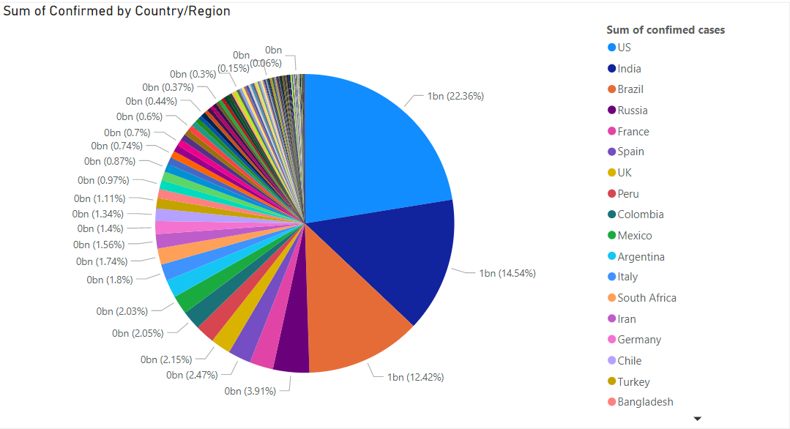
Data Visualization & Results:
What is the sum of covid-19 cases by each country?

Slide 10
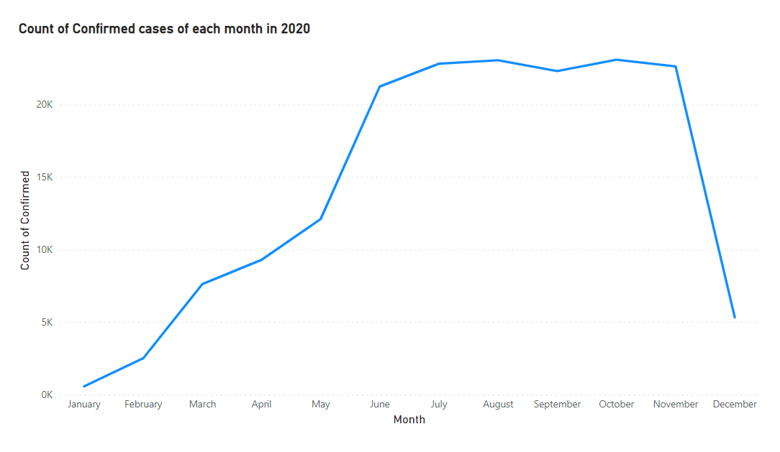
Data Visualization & Results:
2. How was the overall trend of confirmed covid-19 cases throughout 2020?

Slide 11
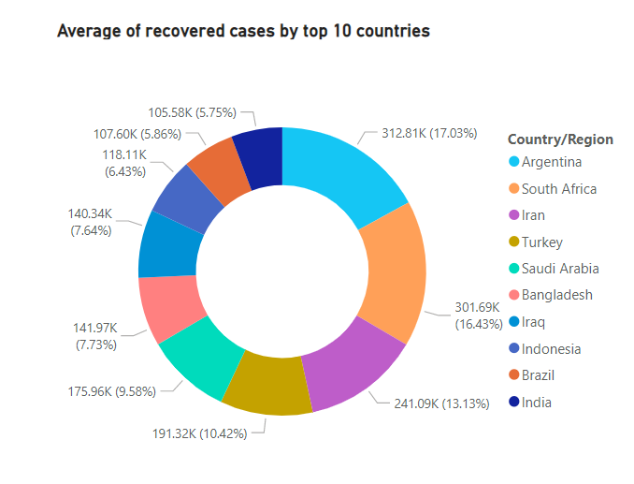
Data Visualization & Results:
What are the top 10 countries in recovery rates?

Slide 12
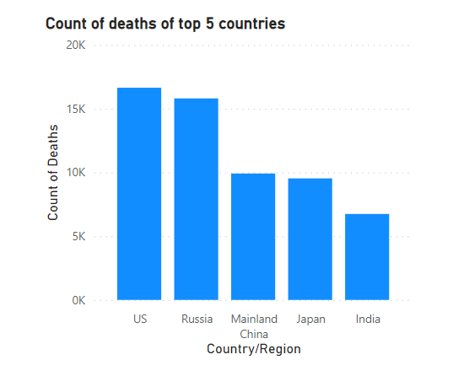
Data Visualization & Results:
4. What are the top 5 countries with maximum deaths?

Slide 13
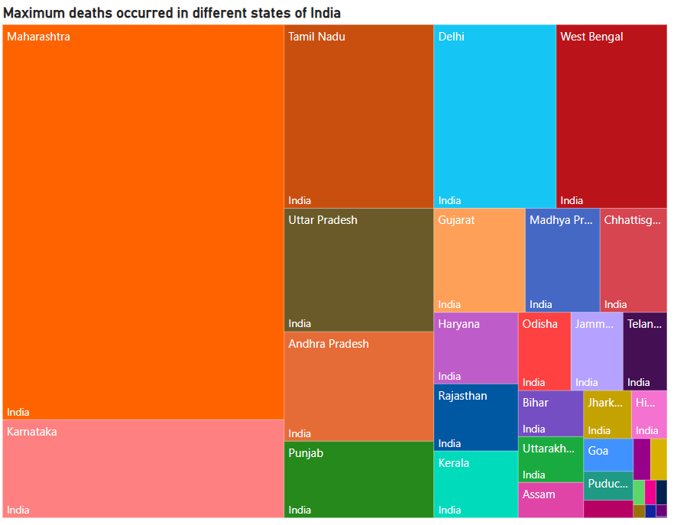
Data Visualization & Results:
5. What are the states that were worst hit by covid-19 deaths in India?

Slide 14
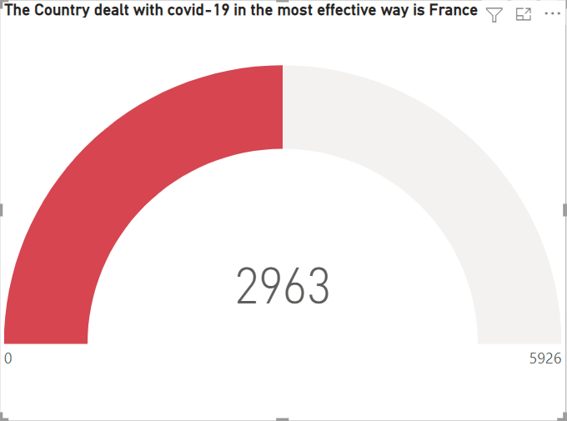
Data Visualization & Results:
6. Which country dealt with covid-19 in the most effective way?

Slide 15
Conclusion:
From all the visualizations and observations, the United States has the highest number of covid cases, Argentina has the highest recovery rate, the US has the highest count of deaths, and France is the most affected country. Initially, there is a graduate raise in covid cases but in between it has become constant with a high number of confirmed cases and gradually decreased by the end of the year throughout 2020. In particular, there are some states in India that are deadly affected by covid-19.

Slide 16
Reference:
https://www.kaggle.com/sudalairajkumar/novel-corona-virus-2019-dataset

Slide 17
Thank You

