Slide 1
RASHMI JAKKANI
INFO 4670/5810 Summer 2022
Mid Term Evaluation

Slide 2
FIFA 19 COMPLETE PLAYERS

Slide 3
LIST OF CONTENTS:
INTRODUCTION
DATASET
DATA CLEANING
DATA GOALS
DATA ANALYSIS
RESULTS OF THE ANALYSIS
CONCLUSION

Slide 4
Introduction:
This dataset has the information about the FIFA 19 players from different clubs.
It has different kinds of information like skillset, proficiency in each skill, etc
This data is downloaded from Kaggle and it is collected by Karan Gadiya.
This data can be considered as good dataset for analysis as it contains different types of variables like numeric, categorical, nominal, ordinal, etc
The popularity of FIFA is one of the main reasons for collecting this data.

Slide 5
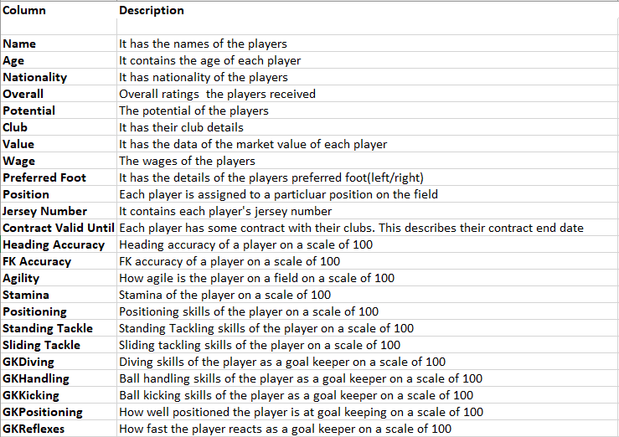
Dataset:
Dataset Name: FIFA 19 complete players dataset
Dataset Source: https://www.kaggle.com/karangadiya/fifa19/downloads/fifa19.zip/4
Description: This data has 18201 rows
in it with different columns
These are the attributes of the dataset:

Slide 6
Data Cleaning:
The data has many columns with the website links which are not required for the analysis are removed.
Columns with ratings are combined together to come up with a common value for each of those skills of the players like Heading Accuracy, Agility, Goal Keeping skills, etc.
Blank values and special characters in the dataset were taken care of before starting the analysis.
The dataset contains some fields which has the currency symbol as prefix, which was taken care of while performing arithmetic operations on those.

Slide 7
Data Goals:
Match Function
Vlookup
Range
Average
Minimum and Maximum Functions
Pivot Tables
Pivot Charts
Remove Duplicates
Create Subtotals
Date-Time Functions
Performed Combo Chart and Line Chart

Slide 8
Data Analysis:
Following are the questions answered as part of the analysis.
Who is the oldest player?
Who is the youngest player?
Which player has the best goal keeping skills?
What is the average potential of selected players?
What is the range of the selected players?
Which player has the highest and lowest wages?
What is the percentage of the players in different age groups?
What is the average of the players wages by their preferred foot?
What is the number of players joined FIFA 19 by days of the week?
What is the comparison of overall and potential of the players by each month?
What is the total time span of a nationality represented in FIFA 19?

Slide 9
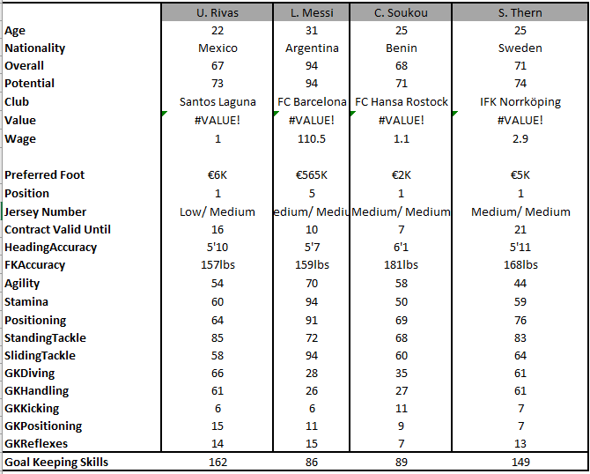
Results of the Analysis:
Vlookup:
Created a dashboard where the user
can select 4 players and starts
comparing.

Slide 10
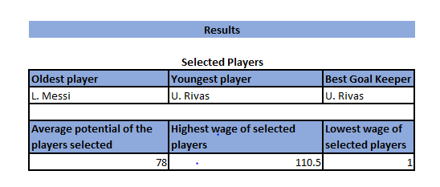
Results of the Analysis:
Match, Min, Max and Average Functions:
To find the oldest, youngest players and best goal keeper performed the match function.
=INDEX($B$5:$E$5,MATCH(MAX($B$6:$E$6),$B$6:$E$6,0))
=INDEX($B$5:$E$5,MATCH(MIN($B$6:$E$6),$B$6:$E$6,0))
To find the average potential of the players
selected used the average function
=AVERAGE(B9:E9)
To find the highest and lowest wages of the
players used the max and min functions
=MAX(B12:E12)
=MIN(B12:E12)

Slide 11
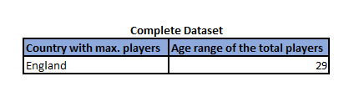
Results of the Analysis:
Range:
To find the age range of all the players within the country that has maximum players used the range function.
Formula:
=MAX(data!$D$2:$D$18208)-MIN(data!$D$2:$D$18208)

Slide 12
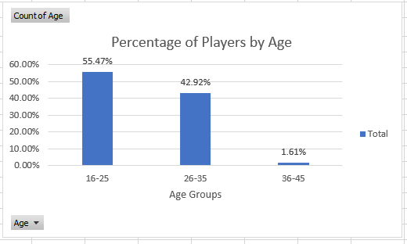
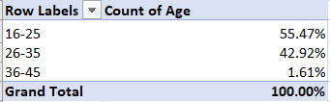
Results of the Analysis:
Pivot Tables and Pivot Charts:
1. To perform the percentage of players in different age groups.

Slide 13
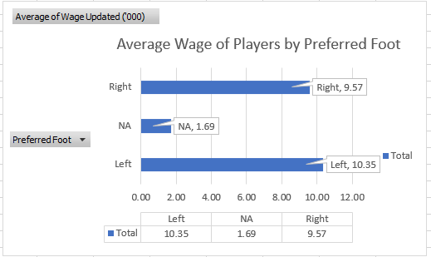
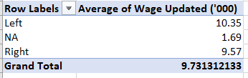
Results of the Analysis:
Pivot Tables and Pivot Charts:
2. To find out the average age of the players wages by their preferred foot.

Slide 14
Results of the Analysis:
Removing Duplicates:
In the data I found that same players has multiple records with the same club name which gives the duplicate records which is invalid.
Created a new column by concatenating the names column and club column and deleted duplicate records
Creating Subtotals:
Calculated the sum of the wages updated of each country and also calculated the sub-totals of all the countries that joined one particular club.

Slide 15
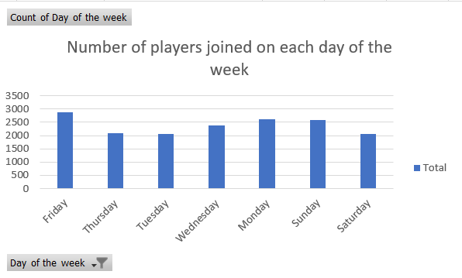
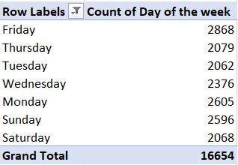
Results of the Analysis:
Date-Time Functions:
To find the number of players joined FIFA 19 by days of the week and represented with pivot chart.

Slide 16
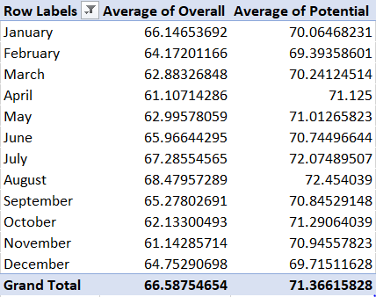
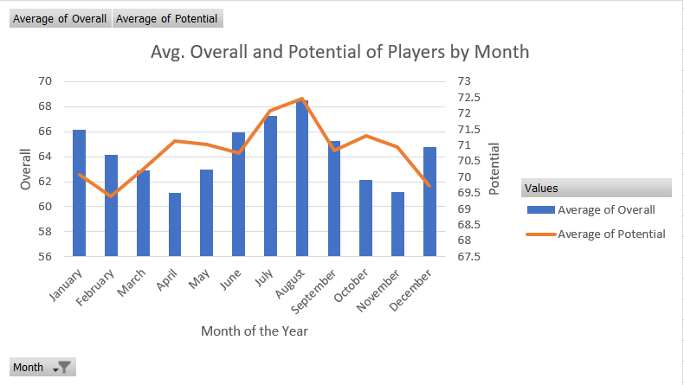
Results of the Analysis:
Date-Time Functions:
To compare the overall and potential of the players by month and represented with the combo chart

Slide 17
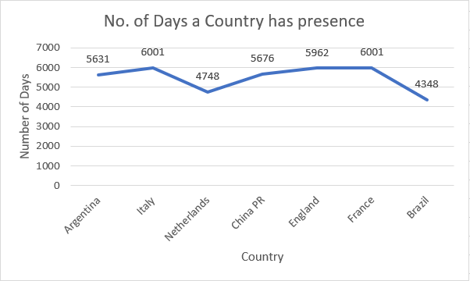
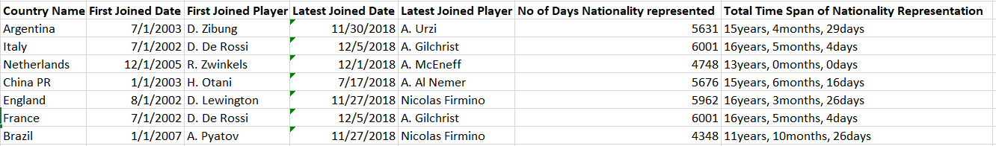
Results of the Analysis:
Date-Time Functions:
To find the total time span of a nationality represented in FIFA 19 and represented with line chart.

Slide 18
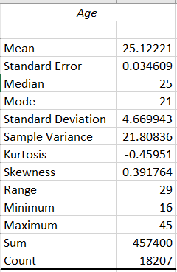
Descriptive Statistics:
Using the Age column from the data I performed the descriptive statistics

Slide 19
Conclusion:
I have performed all the functions mentioned in the data goals.
As the data is very elaborate it gives us an option to perform different types of analysis on the players.
More than half of the players in the dataset are below 25 years this proves that an ideal age for an athlete is below 25.
The game is very popular in most of the countries.
The players in the dataset are from a wide range of age groups where the age gap between oldest and youngest player is 29 years.
Most of the nationalities have a representation of more than a decade in the game.

Slide 20
Thank You

