Slide 1
RASHMI JAKKANI
INFO 4670/5810 Summer 2022

Slide 2
TEXT MINING – FINAL PROJECT
This Project contains the dataset of Microsoft Employees Reviews with 9000 records. I performed the data mining techniques to analyze the data using rapid miner.

Slide 3
List of Contents:
INTRODUCTION
DATASET
DATA CLEANING
DATA GOALS
DATA ANALYSIS
RESULTS OF THE ANALYSIS
CONCLUSION

Slide 4
Introduction:
This dataset has the information about the employee reviews of the company Microsoft at different locations.
It has different kinds of information like pros, cons, overall ratings, location, job title of the employee, work-life-balance, date of the review given by employee, culture-value-stars, career opportunities, comp-benefits, senior-management, helpful-count and link of the review.
This data can be considered as good dataset for analysis as it contains different types of integer values.
This dataset is downloaded from Kaggle.

Slide 5
Dataset:
Dataset Name: Microsoft Employee Review
Dataset Source: https://www.kaggle.com/code/umaimat/employee-review-comment-analysis-of-top-companies/notebook
Description: This dataset has 9000 records with 17 columns.
It has 9 columns with text data and the other columns are numeric data.
Data Cleaning:
I used remove duplicates in correlation analysis to remove duplicate records from the data.

Slide 6
Analysis Goals:
To analyze the reviews of Microsoft Employees.
To find out the employees needs and comforts provided by the company
To find the employee reviews summary.
To find the correlation, association rules and k-means clustering using rapid miner.

Slide 7
Data Analysis:
I used data mining techniques like correlation, Association Analysis and K-means Clustering analysis using rapid miner.
Using rapid miner, these techniques becomes very useful and easy to use.
For correlation analysis the data is a combination of text and numerical data and Association analysis is performed to find the Association rules .
In association analysis, process documents using data is used to process the analysis where as tokenization, filter stop words, transform cases are performed.
K-means clustering is used to find the K-means clusters.

Slide 8
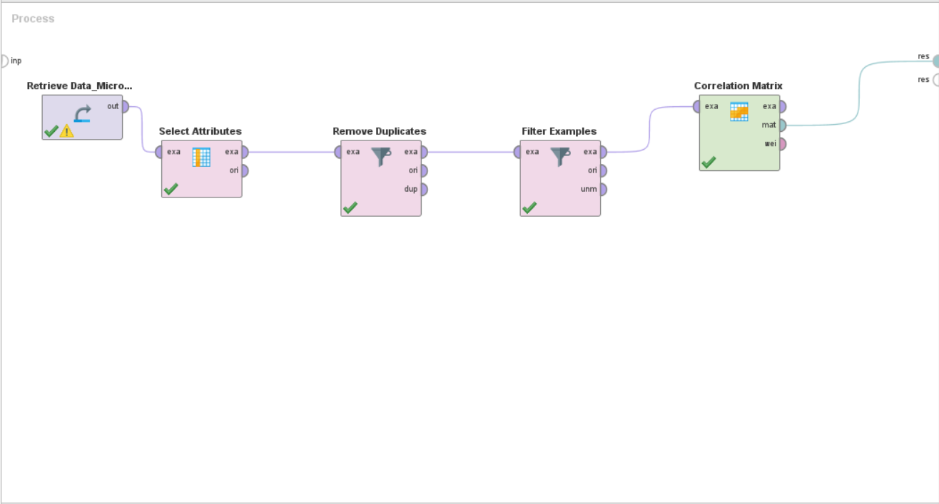
Results:
Correlation Analysis: A correlation is a number between -1 and +1 that measures the association between the attributes.
Design:

Slide 9
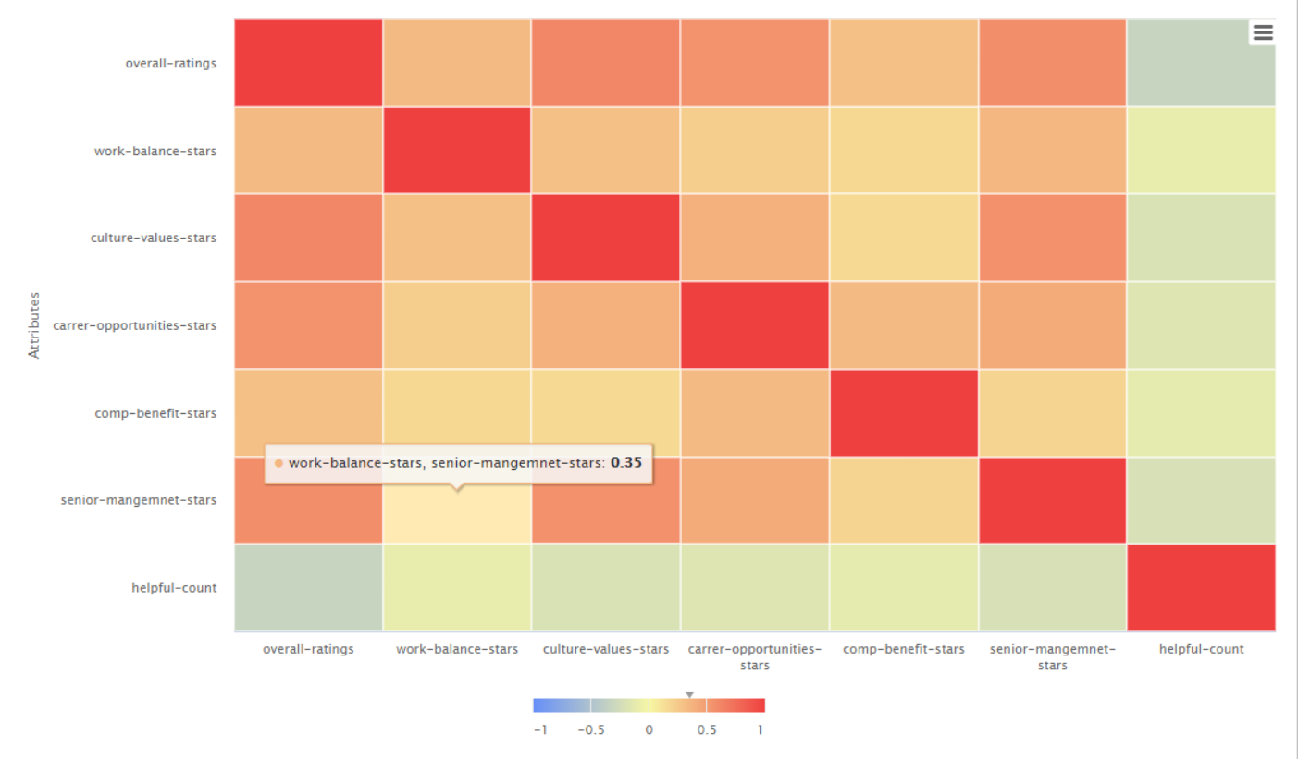
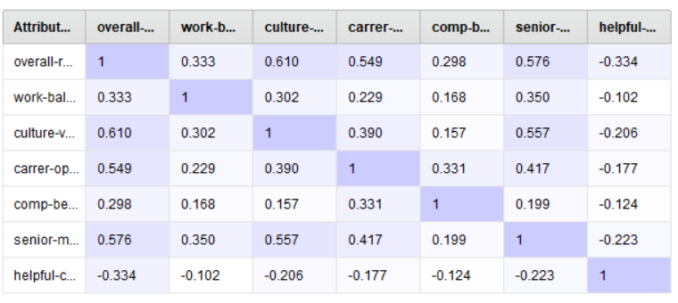
Results:
Correlation Matrix and Visualization:

Slide 10
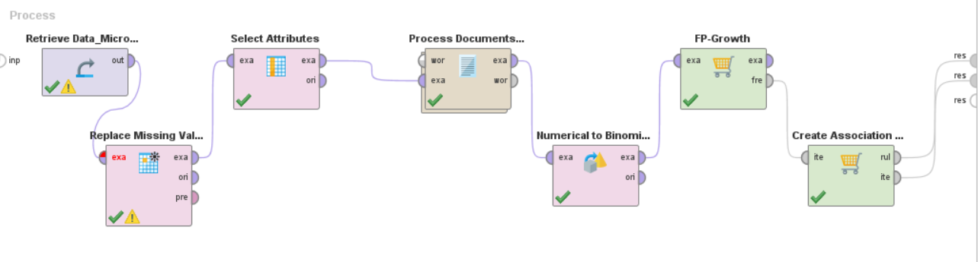
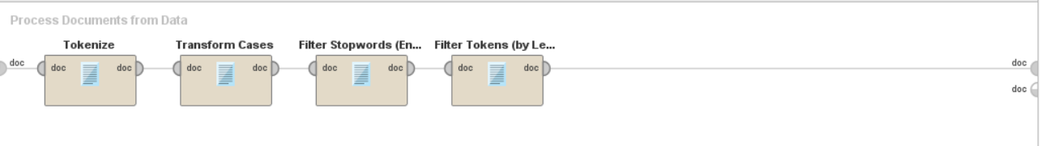
Results:
Association Analysis:
It is the task of finding
interesting relationships
in large datasets
Design and Process
documents from data:

Slide 11
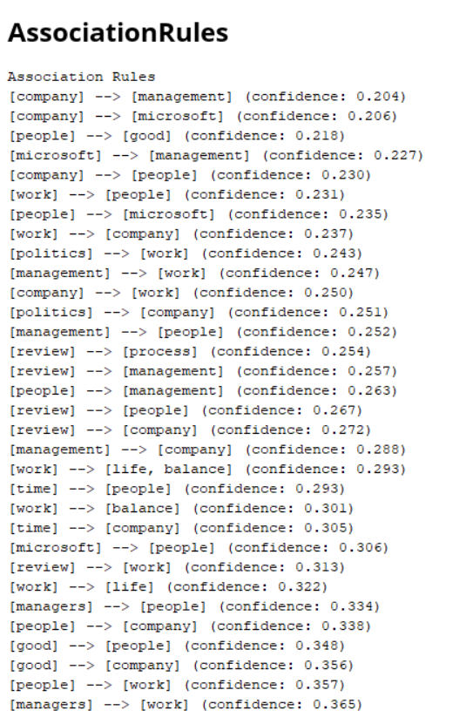
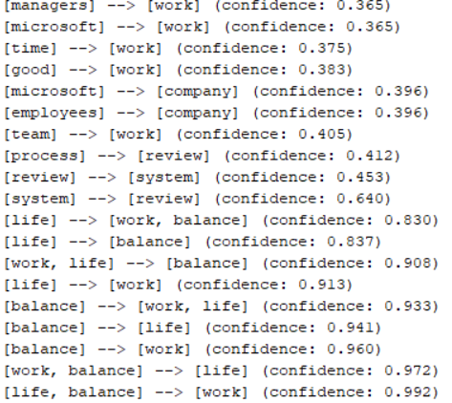
Results:

Slide 12
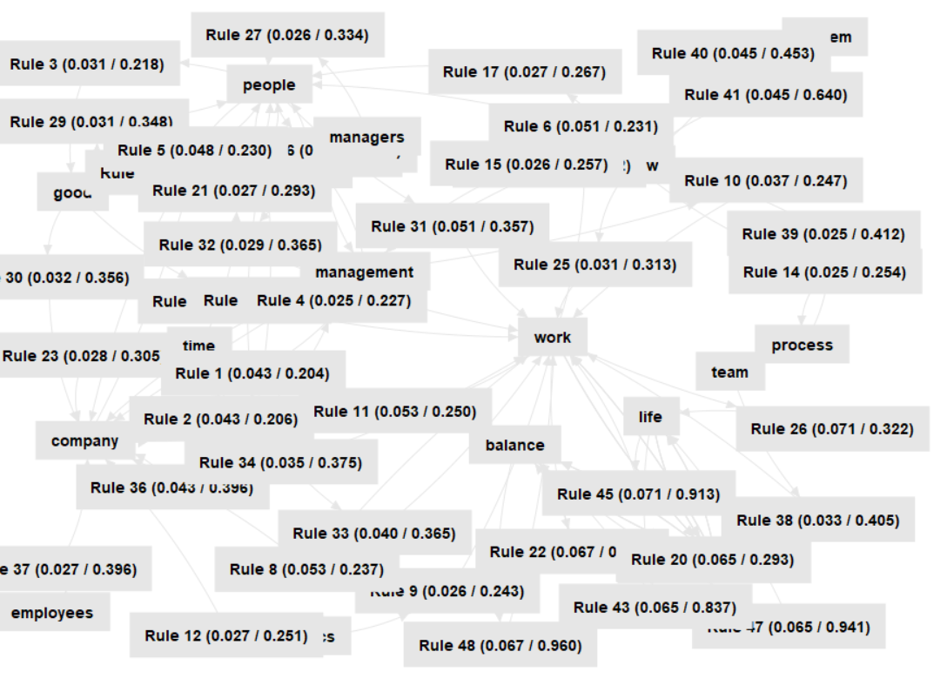
Results:
Graph:

Slide 13
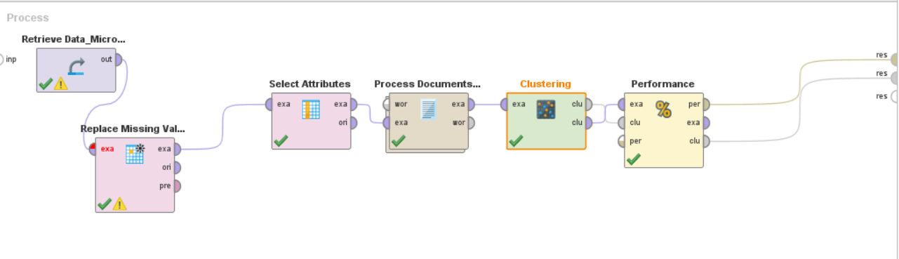
Results:
K-Means Clustering: The K-means algorithm determines the set of k clusters and provides each examples to one cluster.
Design:

Slide 14
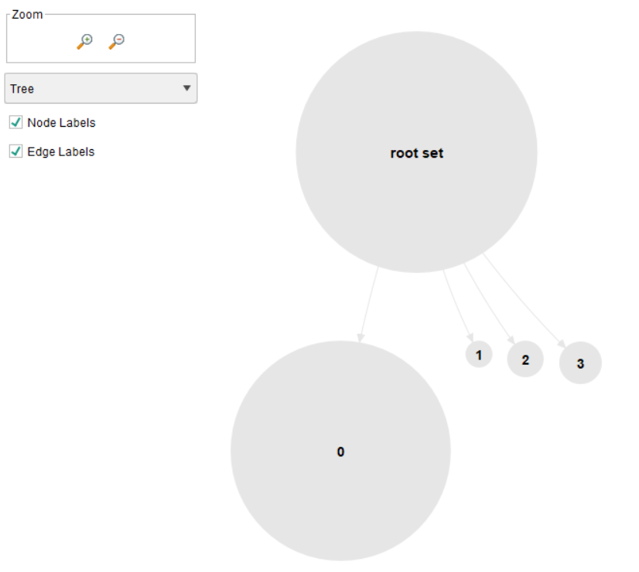
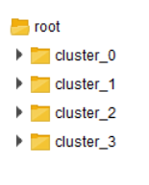
Results:
Folder View and Graph:

Slide 15
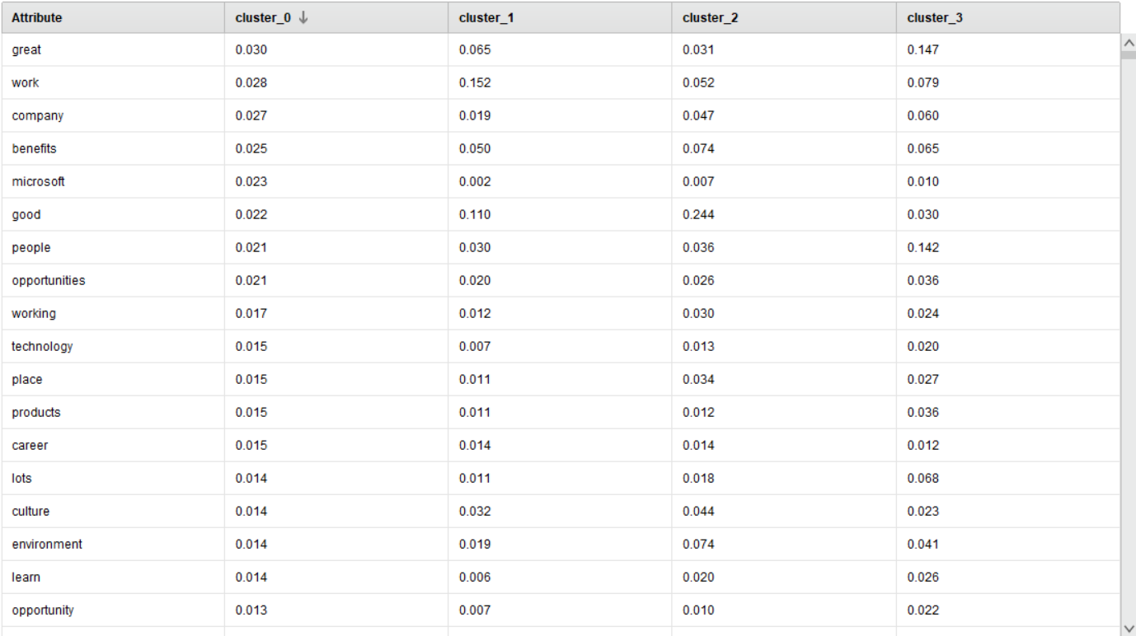
Results:
Centroid Table:

Slide 16
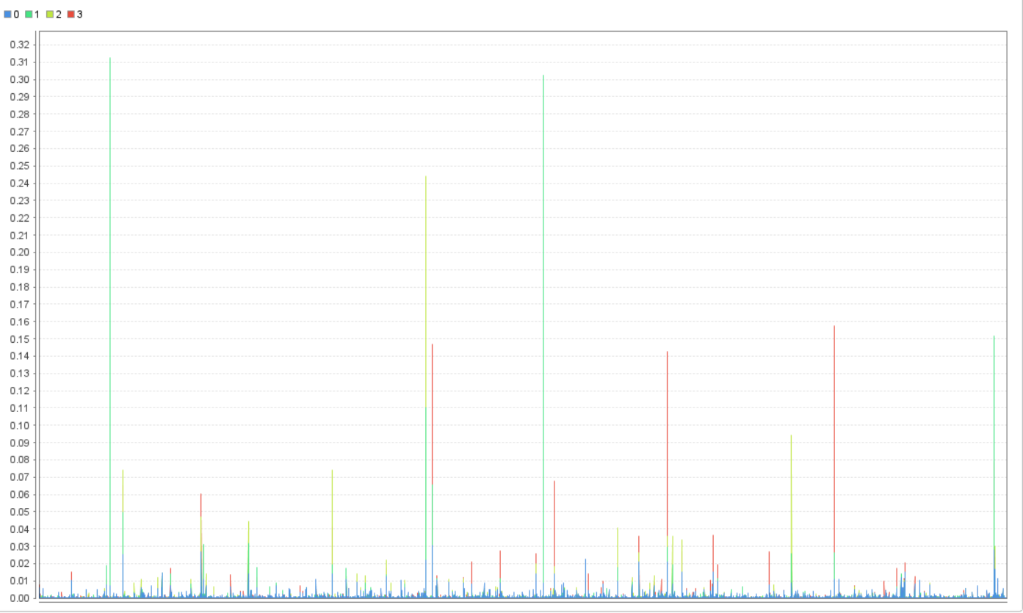
Results:
Plot:

Slide 17
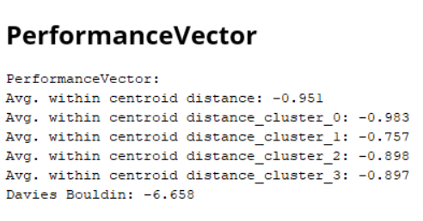
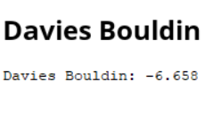
Results:

Slide 18
Conclusion and Experience:
I have learned about the data mining techniques that are correlation, association analysis and clustering
I learned about the usage of rapid miner with different techniques and performed analysis.
The techniques of these analysis are to learn performing the data mining techniques. In correlation analysis correlation matrix and visualization is also displayed.
In Association Analysis, association rules are determined and using process document from data this analysis is performed.
In K-means Clustering, K-means clusters are found and performance reports with the help of process documents from data tokenization, filter stop words, filter examples and transform cases are used.

Slide 19
Thank You

