Slide 1

Project Title – Retail Insights from Superstore Data
Rashmi Thakre

Slide 2

PROBLEM STATEMENT
The primary goal is to analyze the superstore's historical data to derive actionable insights that can improve business strategies, enhance customer satisfaction, and boost overall profitability. This involves understanding sales trends, identifying key performance drivers, and uncovering potential areas for improvement.
To derive actionable insights from Superstore retail data to optimize operational efficiency and enhance profitability.

Slide 3
Project Description This project aims to analyze Superstore's retail data to uncover actionable insights that can drive better business decisions. Evaluate overall sales performance across different regions, categories, and time periods. Identify top-performing and underperforming products and categories. Use historical data to forecast future sales and inventory needs. Identify emerging market trends and adapt business strategies accordingly.

Slide 4

WHO ARE THE END USERS?
1 Sales and Marketing Teams:
Purpose: To develop and execute sales strategies, marketing campaigns, and promotions.
Insights Needed: Customer segmentation, purchasing behavior, product performance, and campaign effectiveness.
2 Customer Service and Experience Teams:
Purpose: To enhance customer satisfaction, address customer issues, and improve overall customer experience.
Insights Needed: Customer demographics, feedback, and service performance metrics.
3 IT and Data Analytics Teams:
Purpose: To support data infrastructure, perform advanced analytics, and maintain data accuracy.
Insights Needed: Data quality reports, technical performance metrics, and analytical model outputs.
Each of these end users can leverage the insights from Superstore data analysis to optimize their specific areas of responsibility, ultimately contributing to the overall success and efficiency of the retail organization.

Slide 5

Technology Used
Data Collection:
Gather historical sales data, customer information, inventory records, and other relevant datasets from the Superstore’s database.
Data Cleaning and Preprocessing:
Clean and preprocess the data to handle missing values, outliers, and inconsistencies.
Data Analysis and Visualization:
Use statistical analysis and data visualization tools to explore and interpret the data.
Generate visual dashboards and reports to present the findings.
Using Power Bi, Data can be analyzed and can be depicted pictorially.

Slide 6
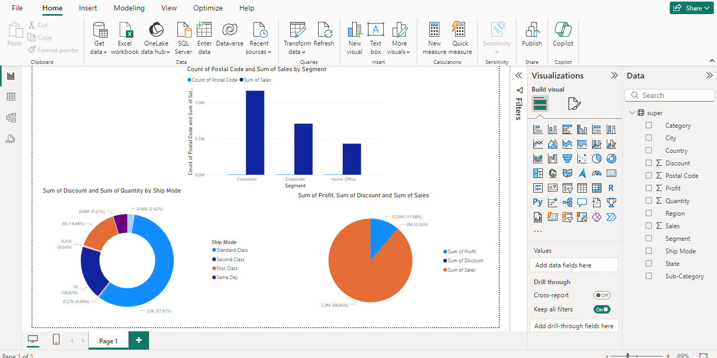
RESULTS
Demo Link
https://1drv.ms/u/c/0987458977133b8c/EaeWuhwbTiJFjUDEEV5Gv5kBQuVhLLrfxU-qU_dSFHODfQ?e=otUlgm

Slide 7
Thank you
By leveraging data analytics and machine learning techniques, this project aims to transform raw data into meaningful insights that can drive strategic decisions and enhance the overall performance of the Superstore.
.
.

