Slide 1

Project Title –Real Time Analysis of Bank Customers
Rashmi Thakre

Slide 2

PROBLEM STATEMENT
The banking industry faces significant challenges in understanding and responding to customer needs in real time. Traditional methods of customer analysis are often slow and reactive, resulting in missed opportunities for enhancing customer experience, increasing retention rates, and preventing fraud.
This project aims to develop a comprehensive real-time analysis system for bank customers that leverages advanced data analytics and machine learning techniques to provide actionable insights. The system will enable banks to monitor customer behavior, detect anomalies, predict future actions, and deliver personalized services in real time, thereby improving customer satisfaction, optimizing operations, and enhancing overall business performance

Slide 3
Project Description Identify and categorize customers based on real-time behavior and transaction data to tailor services and marketing efforts effectively. Implement machine learning algorithms to detect and alert for fraudulent activities as they occur. Predict which customers are likely to leave the bank using real-time data to take proactive measures. Deliver personalized offers and services to customers based on their real-time activity and preferences. Enhance the efficiency of banking operations by providing real-time insights into customer interaction and transactions. Ensuring customer data privacy and compliance with regulations while performing real-time analysis.

Slide 4

WHO ARE THE END USERS?
Bank Management:
Executives: Use the insights for strategic decision-making, improving customer satisfaction, and optimizing overall business performance.
Branch Managers: Gain insights into branch-specific customer behavior to tailor services and manage operations more effectively.
Customer Service Representatives:
Use real-time data to address customer inquiries and issues promptly and accurately, enhancing the customer experience.
IT and Data Science Teams:
Develop, maintain, and improve the real-time analysis system, ensuring it operates efficiently and effectively.
These end users will benefit from the enhanced insights and operational efficiencies provided by a real-time customer analysis system, ultimately leading to improved customer satisfaction, increased loyalty, and better overall business performance.

Slide 5

Technology Used
Data Collection and Integration
For real-time data streaming and message brokering to handle high-throughput data ingestion from various sources.
Data Storage and Management
For storing large volumes of unstructured and semi-structured data.
Data Processing and Analytics
For distributed data processing and real-time stream analytics.
Visualization and Reporting
Power BI: For creating interactive dashboards and visualizations.
Using these technologies, a robust real-time analysis system can be developed to provide valuable insights into customer behavior, detect fraud, predict churn, and personalize services, enhancing the overall customer experience and operational efficiency of the bank.

Slide 6
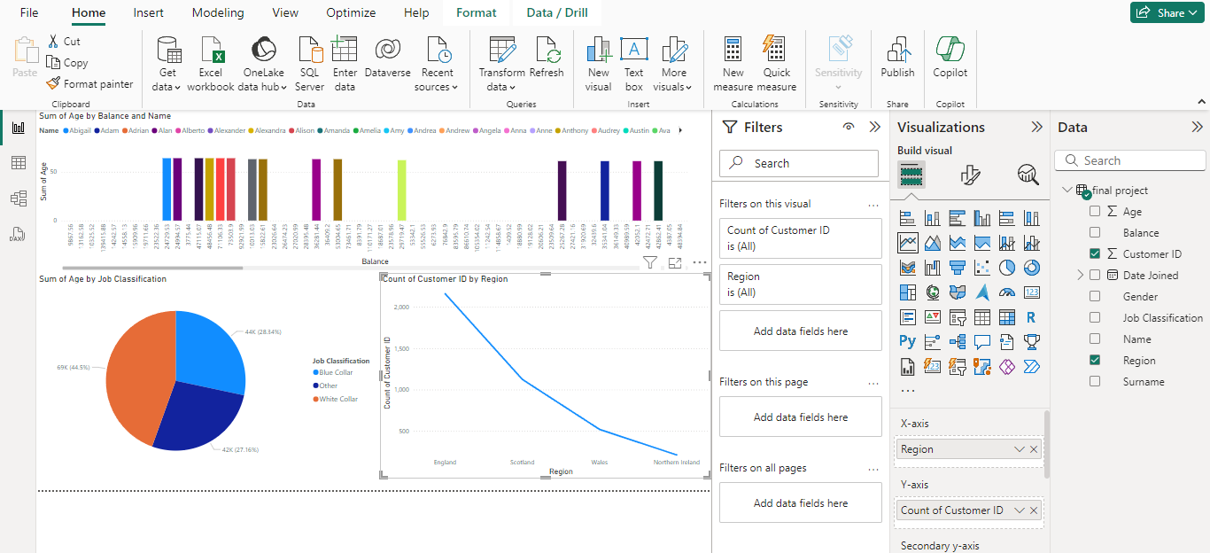
RESULTS
Demo Link
https://1drv.ms/u/c/0987458977133b8c/EWKM4ifRvUFNp9ypuHMZkOoBAblQ1N3ZgfFomcU4H-JVuw?e=GKMYb2

Slide 7
Thank you
This problem statement encapsulates the key goals and challenges of implementing a real-time customer analysis system in a banking context.
.
.

