Slide 1
TRACK 1 · AI FOR DIGITAL PUBLIC INFRASTRUCTURE
BENGALURU SMART CITY 2026
CivicAI
Smart Public Issue Resolution
Next-generation digital public infrastructure for real-time defect detection, dynamic triage & verifiable public proof.
CORE PROJECT TEAM
KEY VALUE PROPOSITIONS
Panchaksharayya
Full-Stack Architecture & AI Integration
Rashmi
UI/UX Systems & Civic Experience Design
Computer Vision Telemetry
Instant defect classification
Autonomous Priority Engine
Multi-factor weighted triage
Transparent Verification
Before & after photo proof audit
CIVICAI
01 / 12

Slide 2
DIGITAL PUBLIC INFRASTRUCTURE TREND
The Shift to Autonomous Civic Governance
01
02
03
Edge Computer Vision
Data-Driven DPI
Proof-Based Governance
AUTOMATING URBAN SENSING
DYNAMIC ALGORITHMIC TRIAGE
VERIFIABLE PHOTOGRAPHIC AUDIT
Public infrastructure reporting is transitioning from slow, text-heavy manual hotlines to instantaneous computer vision scanning from citizen devices with real-time HUD telemetry.
Cities can no longer operate on first-come-first-serve queues. Future governance relies on intelligent priority engines balancing severity, recurrence, and public impact.
Closing the public trust deficit through mandatory before & after visual verification, AI clearance metrics, and citizen sign-off before municipal funds are disbursed.
CIVICAI
02 / 12

Slide 3
URBAN INFRASTRUCTURE CHALLENGES
Why Modern Cities Fail to Resolve Defects
₹14,300 Cr
30+ Days
73%
12M+
Annual economic waste from unresolved road & infrastructure damage in metros
Average legacy complaint turnaround time in municipal portals
Of complaints closed without citizen verification or photo proof
Bengaluru citizens impacted daily by municipal infrastructure delays
Unreported Road Hazards
Garbage Accumulation
Potholes remain unaddressed for months, escalating from minor cracks into hazardous craters causing lethal accidents.
Overflowing waste dumping points lack continuous monitoring and SLA accountability, creating public health crises.
Opaque Municipal Routing
Ghost Resolutions
Citizen complaints disappear into bureaucratic departmental silos with zero visibility into inspection schedules.
Contractors close work orders on paper without photographic proof of work completed, eroding citizen trust.
CIVICAI
03 / 12

Slide 4
THE SOLUTION ARCHITECTURE
CivicAI: End-to-End Smart Governance Platform
Vision AI Scanner
Priority Engine
Dual-Panel Admin
Verifiable Proof
INSTANT DEFECT TELEMETRY
ALGORITHMIC TRIAGE
COMMAND & CONTROL CENTER
BEFORE & AFTER ASSURANCE
Citizens snap or upload photos. Real-time neural inference detects issue category (pothole, garbage, streetlight, waterlogging), calculates severity, and overlays a futuristic visor HUD.
Multi-weighted triage score computes importance based on severity (35%), duplicate cluster count (25%), location density (20%), and public impact (20%).
Municipal officers access two portals: a real-time complaints queue with before/after review and an interactive geospatial map covering 35+ Bengaluru zones.
Resolution requires mandatory after-photo evidence. The system computes a clearance score (85–100%) and a 1-tap citizen confirmation before closing the ticket.
CIVICAI
04 / 12

Slide 5
TECHNOLOGICAL INNOVATIONS
Pioneering Capabilities Built into CivicAI
Futuristic Visor HUD Lens
Whole-City Geospatial Coverage
CivicBot Autonomous Assistant
Live scanning overlay showing bounding coordinates, defect classification, confidence telemetry, and severity diagnostics.
Intelligent location engine with 35+ pre-mapped Bengaluru ward zones, GPS radius geocoding, and instant suggestions.
Context-aware AI conversational guide assisting citizens in drafting reports, checking ticket status, and finding emergency services.
Role-Based Municipal Auth
Guided Pitch Demonstration Mode
Offline-First PWA Architecture
Granular three-tier access control: citizen reporter, field inspection officer, and BBMP administrative commander.
Interactive guided tour with preset scenarios (pothole, garbage, streetlight) for automated hackathon demonstration.
Local asset fallbacks and cached storage ensuring seamless operation even in low-bandwidth municipal field environments.
CIVICAI
05 / 12

Slide 6
FULL-STACK SYSTEM DESIGN
Production-Ready Modern Technology Stack
FRONTEND LAYER
AI / ML ENGINE
BACKEND SERVICES
DEPLOY & DPI OPS
React 18 & TypeScript for bulletproof typing
Google Gemini Vision API integration
FastAPI (Python) high-throughput backend
Vercel serverless edge deployment
Vite 5.4 for lightning-fast build bundling
Neural defect classification pipeline
RESTful API endpoints for issue lifecycle
GitHub CI/CD automated pipeline
Tailwind CSS 3 for futuristic responsive UI
Automated severity & confidence scoring
Context-based reactive global state
Offline-resilient image asset caching
React-Leaflet & OpenStreetMap for GIS
Spatial deduplication & cluster matching
LocalStorage client state persistence
Standardized open city data format
Lucide Icons & Canvas Confetti interactions
CivicBot NLP assistant for dialogue
Real-time event synthesis & telemetry
Zero-latency municipal dashboard views
CIVICAI
06 / 12

Slide 7
CITIZEN EXPERIENCE FLOW
Three Steps From Defect Discovery to Fix
01
02
03
SNAP & GEO-TAG
AI TRIAGE & TRACK
VERIFY & AUDIT
Citizen detects a road hazard, opens the CivicAI visor lens, snaps a photo, and the app auto-resolves Bengaluru zone coordinates and street address in milliseconds.
The AI categorizes severity, computes a priority score, checks for duplicate cluster reports, and provides a live tracking card with real-time status updates.
Once municipal teams execute the repair, the citizen inspects before & after proof photos directly in the app, confirms resolution, and logs satisfaction.
→
→
CIVICAI
07 / 12

Slide 8
MUNICIPAL OPERATIONS
Dual-View Command & Control for Officers
VIEW 1: COMPLAINTS DATA QUEUE
VIEW 2: GEOSPATIAL RESOLUTION MAP
Chronological & severity-sorted cards with high-contrast status tags
Interactive Leaflet GIS map with fluid zoom and smooth pan navigation
Dual photo preview: defect photo permanently anchored with resolution slot
Color-coded status markers: pulsing amber (active) vs solid emerald (fixed)
One-click 'Resolve with Proof' modal triggering verification workflow
Ward-level density clustering for rapid field contractor dispatch
Inspection detail modal with comprehensive citizen and AI audit logs
Interactive marker popups displaying issue photo, severity, and instant actions
Status progression lifecycle: Pending → In Progress → Resolved
Citywide quick-focus pills covering Koramangala, Indiranagar, Whitefield, etc.
CIVICAI
08 / 12

Slide 9
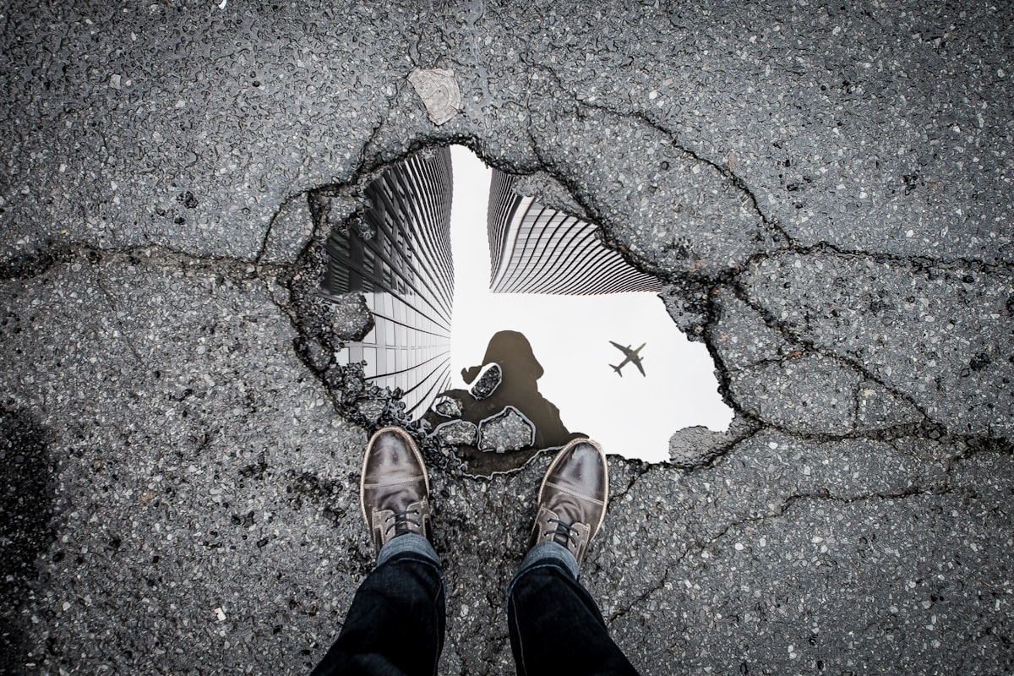
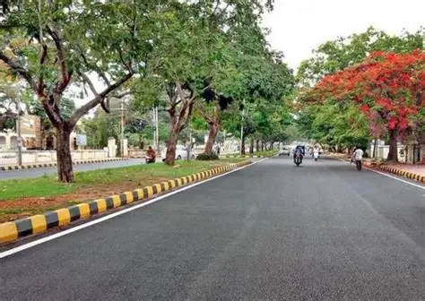
VERIFIABLE PHOTOGRAPHIC PROOF
Closing the Loop: Visual Audit & Citizen Verification
98%
Clearance Score
1.8 Days
Resolution Time
100%
Citizen Confirmed Verified
Severity: Critical Pothole (14cm depth)
Status: Bitumen Patch Sealed & Leveled
Location: 80ft Road, Koramangala 4th Block
Clearance: 98% AI Quality Confidence · BBMP Audit Seal
BEFORE REPAIR · CITIZEN REPORT
AFTER REPAIR · ADMIN RESOLUTION PROOF
CIVICAI
09 / 12

Slide 10
IMPACT & PERFORMANCE
Tangible Governance Transformation in Bengaluru
40%
3.2 Days
94%
35+
ACCIDENT REDUCTION
AVG TURNAROUND
DEFECT ACCURACY
BENGALURU LOCALITIES
Drop in localized road accidents in pilot wards within 60 days of deployment
From 30+ days down to 76 hours average time to verified fix
High-precision computer vision defect categorization and severity tagging
Complete zone coverage across Central, South, East, and Tech Corridors
STRATEGIC CIVIC IMPACT FOR DIGITAL PUBLIC INFRASTRUCTURE
Restoring Public Faith
Preventing Budget Leakage
Scalable DPI Blueprint
Direct visual proof builds unmatched transparency between citizens and government.
Municipal funds are paid only upon visual verification of completed work orders.
Modular design allows rapid deployment to other Indian Tier-1 & Tier-2 smart cities.
CIVICAI
10 / 12

Slide 11
FUTURE ROADMAP
Scaling from Local Hackathon to National DPI
Phase 1 · Current Release
Phase 2 · Q4 2026
Phase 3 · 2027
Hackathon MVP & Live Cloud
Municipal Integration
Autonomous Smart Cities
React + TypeScript + Vite responsive web platform
Direct API bridges to BBMP Sahaya & e-Governance
Predictive road maintenance: AI forecasting failures
35+ Bengaluru pre-configured urban zones
Contractor mobile companion app for field crews
Decentralized proof of repair on public blockchain
Computer vision defect scanner with HUD telemetry
Automated push notifications via WhatsApp & SMS
Gamified citizen contribution rewards & green credits
Before & after photo upload & verification loop
PostgreSQL + PostGIS geospatial enterprise backend
National DPI expansion across 15+ smart cities
Live production deployment on Vercel
Automated drone & dashcam survey ingestion
Integration with National Emergency & 112 services
CIVICAI
11 / 12

Slide 12
Thank You!
Track 1 — AI for Digital Public Infrastructure & Governance
CivicAI: Transforming Citizen Grievances into Verifiable Public Solutions
TEAM MEMBERS
PROJECT LINKS & REPOSITORY
Panchaksharayya
Full-Stack Development & AI Integration
Rashmi
UI/UX & Civic Engagement Systems
Live Web Deployment
civicai-neon.vercel.app
GitHub Repository
github.com/panchaksharayya12/civicai
Hackathon Track
Track 1 — AI for DPI & Governance

