Slide 1


Vivekanand Education Society’s Institute of Technology, Computer Department
Website for Freedom for you
Team name : tryCatch
SE CMPN
Rashmi Singh
Dhruvisha Mondhe
Asmita Bhangare

Slide 2
Abstract
Make a responsive website for “Freedom for You” NGO.
Easy to understand , user-friendly interface.
A brief description of the events that have been conducted.
Information about the upcoming events.
Enable users to register for the events.
A page for giving feedback ,submitting grievances or requesting a callback.

Slide 3
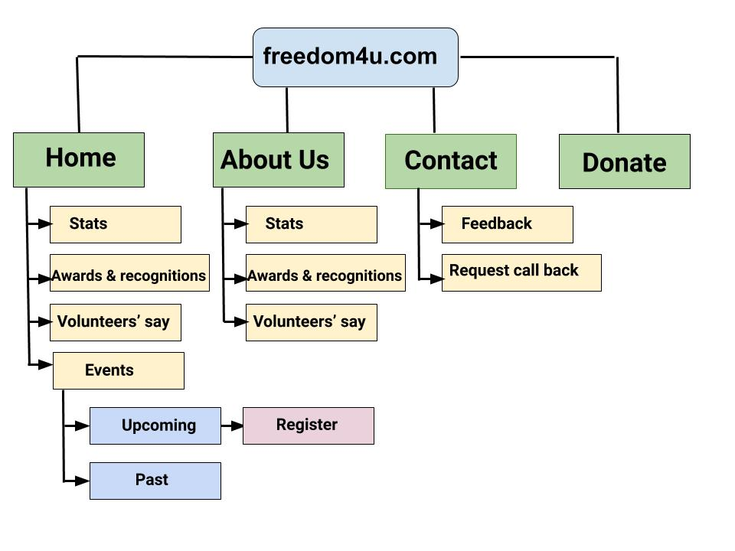
Proposed Architecture
(Diagram/Example/Flowchart/Etc)

Slide 4
SITEMAP
<?xml version="1.0" encoding="UTF-8"?>
<urlset
xmlns="http://www.sitemaps.org/schemas/sitemap/0.9"
xmlns:xsi="http://www.w3.org/2001/XMLSchema-instance"
xsi:schemaLocation="http://www.sitemaps.org/schemas/sitemap/0.9
http://www.sitemaps.org/schemas/sitemap/0.9/sitemap.xsd">
<!-- created with Free Online Sitemap Generator www.xml-sitemaps.com -->
<url>
<loc>http://trycatch4u.c1.biz/</loc>
<lastmod>2020-11-17T13:05:44+00:00</lastmod>
<priority>1.00</priority>
</url>
<url>

Slide 5
SITEMAP
<lastmod>2020-11-17T13:05:44+00:00</lastmod>
<priority>0.80</priority>
</url>
</urlset>
<loc>http://trycatch4u.c1.biz/index.html</loc>
<lastmod>2020-11-17T13:05:44+00:00</lastmod>
<priority>0.80</priority>
</url>
<url>
<loc>http://trycatch4u.c1.biz/AboutUs.html</loc>
<lastmod>2020-11-17T13:05:44+00:00</lastmod>
<priority>0.80</priority>
</url>
<url>
<loc>http://trycatch4u.c1.biz/Donate.html</loc>
<lastmod>2020-11-17T13:05:44+00:00</lastmod>
<priority>0.80</priority>
</url>
<url>
<loc>http://trycatch4u.c1.biz/ContactUs.html</loc>

Slide 6
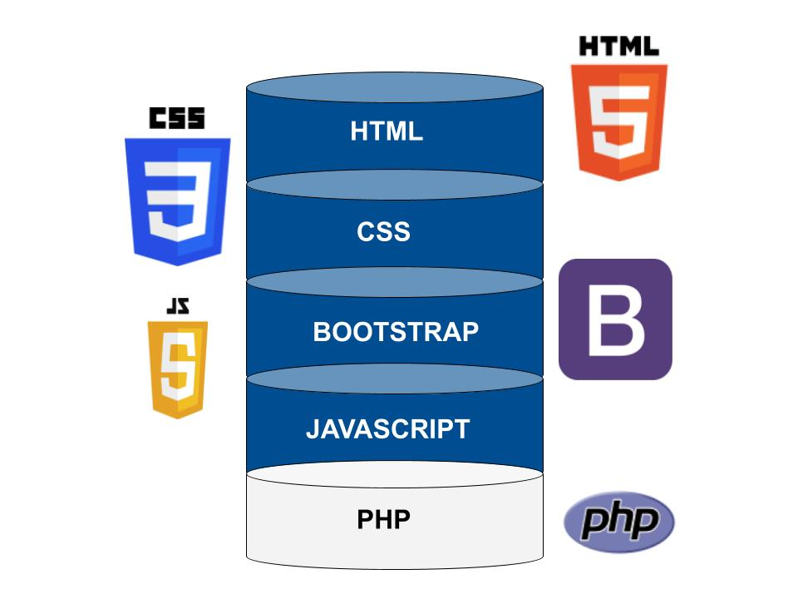
Technology Stack

Slide 7
Conclusion
Create an attractive , user-friendly website.
Show a list of upcoming events.
Enable users to Register for the various events online.
Enable people to Donate money for social causes.
Incase, users aren’t able to fill out the form, they can request a callback.

Slide 8
Github Repository Link
https://github.com/Rashmiii1001/tryCatch_freedom4u

