Slide 1
Privilege Escalation Attack Detection and Mitigation in Cloud Using Machine Learning
Presented by:
23r01a05z2
23r01a05z4
23r01a05z5

Slide 2
ABSTRACT
Cloud computing is powerful but faces security risks like privilege escalation.
Privilege escalation means attackers get more access than they should (normal user → admin).
Insider threats are dangerous because they already have valid access.
This project uses machine learning to detect and stop such attacks.
Algorithms tested: Random Forest, AdaBoost, XGBoost, LightGBM, CatBoost.
LightGBM gave the best accuracy (97%).
The system helps in better detection, protection, and security for cloud environments.

Slide 3
INTRODUCTION
Cloud computing helps store and process data online without heavy hardware costs.
While convenient, it faces security risks like unauthorized access and data breaches.
Attackers can perform privilege escalation:
Horizontal – gaining access to another user’s data at the same level.
Vertical – moving from normal user to admin/root access.
These attacks allow hackers to steal, alter, or misuse sensitive information.
Machine learning can help detect unusual user behavior and prevent such attacks.

Slide 4
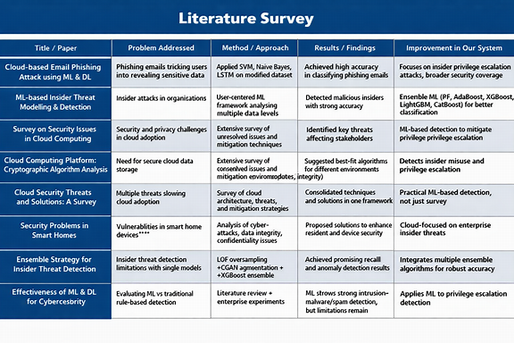

Slide 5
EXISTING WORK
In the existing system, insider threats (people inside the organization) are the biggest danger because they already have valid access.
These insiders can misuse their privileges to cause serious damage.
Machine learning is used to detect unusual activities that may signal privilege escalation attacks.
The system combines multiple models (ensemble learning) to improve detection.
Problems with the existing system:
It cannot properly identify all types of attacks.
Security is weaker and less reliable.

Slide 6
proposed SYSTEM
The new system uses advanced machine learning algorithms (Random Forest, AdaBoost, XGBoost, LightGBM, and CatBoost).
It trains models on insider attack data (CERT dataset) to detect unusual or malicious activities.
Each algorithm’s performance is measured using accuracy, precision, recall, and F-score.
LightGBM gave the best accuracy (97%), but CatBoost is added as an extension for even better results.
The system provides proper identification of attacks and ensures stronger security compared to the existing system.
A comparison graph is used to show how each algorithm performs.

Slide 7
Methodology
Upload CERT Dataset → Load insider attack data into the system.
Pre-process & Split Data → Clean missing values, normalize, shuffle, then split (80% training, 20% testing).
Train Models → Apply different machine learning algorithms:
Random Forest
AdaBoost
XGBoost
LightGBM
CatBoost (extension for better accuracy)
Test Models → Use the trained models on test data to check prediction accuracy.
Evaluate Performance → Compare results using accuracy, precision, recall, and F-score.

Slide 8
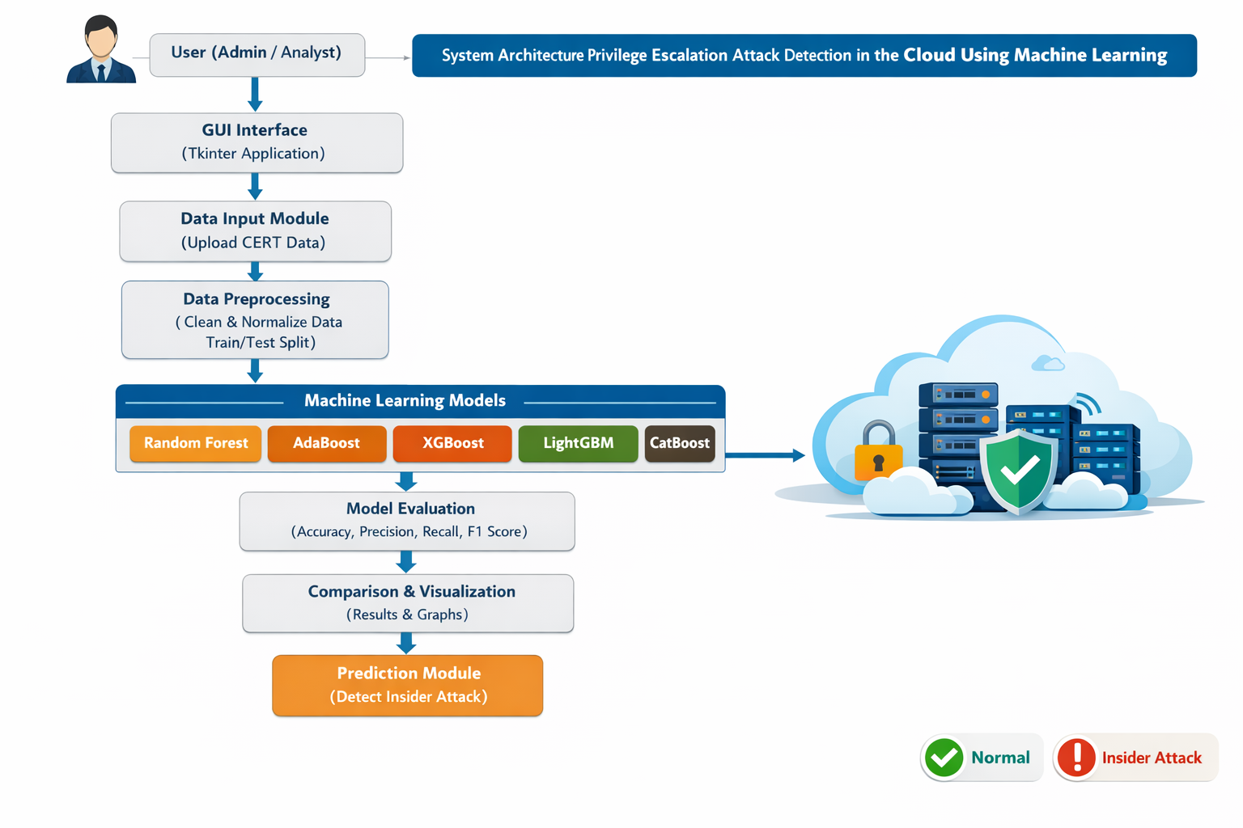
SYSTEM ARCHITECTURE

Slide 9
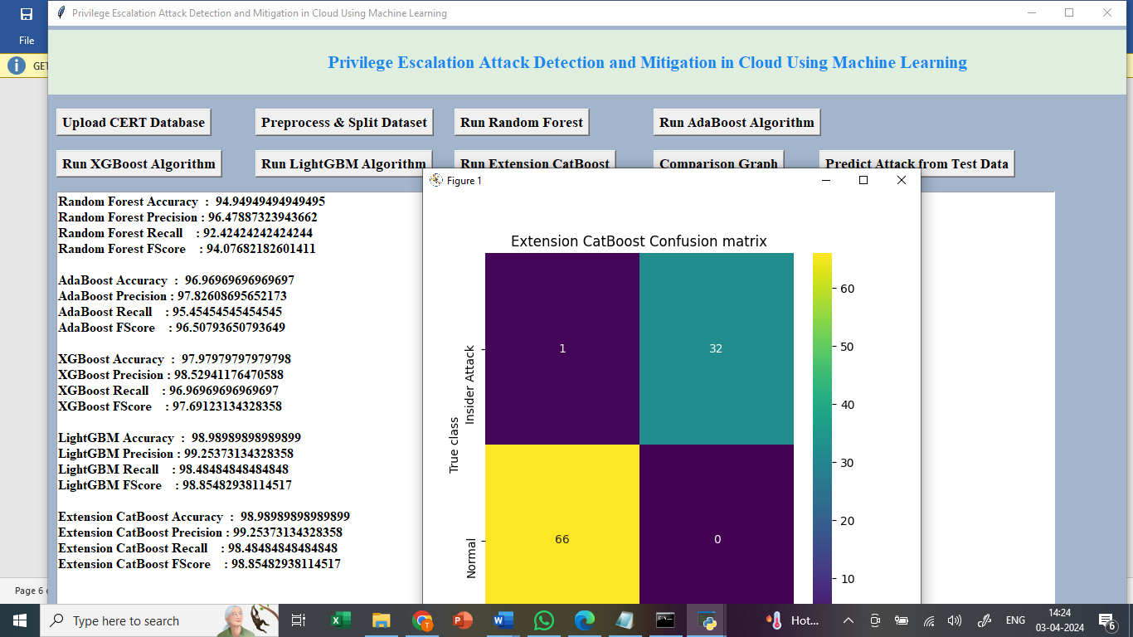
output

Slide 10
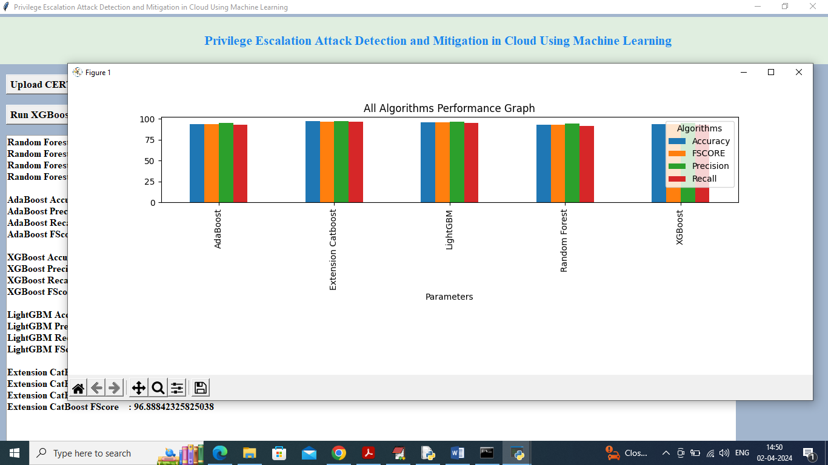

Slide 11
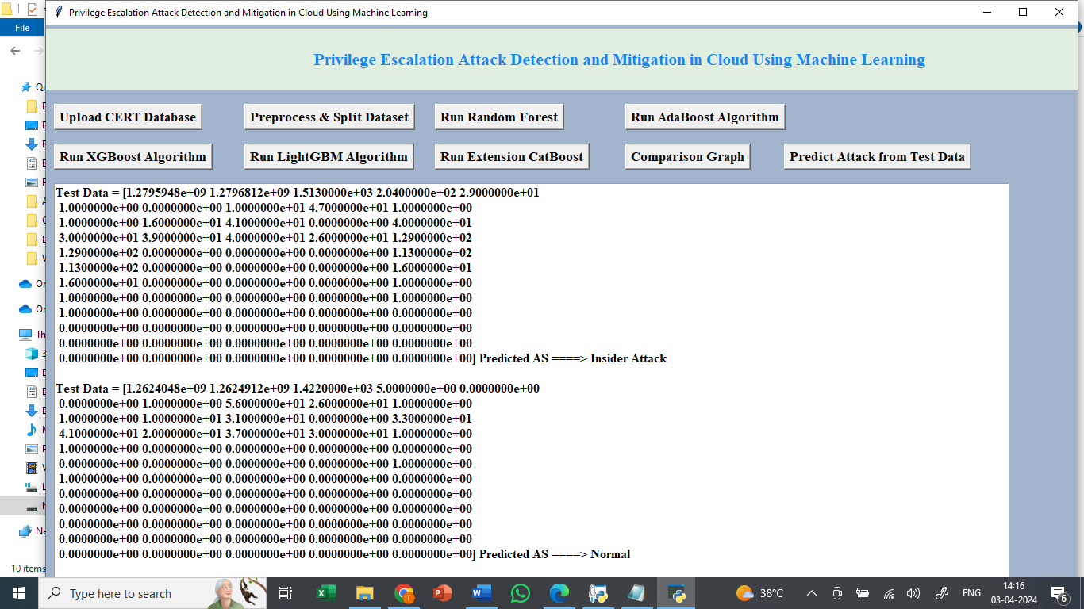

Slide 12
Future scope
Use Deep Learning – In future, advanced methods like CNN and RNN can be used to catch attacks more accurately.
Real-Time Alerts – The system can be improved to give instant warnings when an attack happens.
Work on All Clouds – Make the system work not just on one cloud, but on AWS, Azure, Google Cloud, etc.
Automatic Action – The system can be built to block or stop suspicious users automatically.

Slide 13
conclusion
Privilege escalation attacks in cloud systems are a serious threat, especially from insiders with valid access.
The proposed system uses machine learning algorithms to detect and classify these attacks effectively.
By applying ensemble models like LightGBM, CatBoost, Random Forest, AdaBoost, and XGBoost, the system improves accuracy and security.
LightGBM achieved the highest accuracy (97%), and CatBoost adds further strength to the detection process.
This approach ensures better protection, faster detection, and smarter mitigation of insider threats in cloud environments.

Slide 14
THANK YOU

