Slide 1


KONGU ENGINEERING COLLEGE
PERUNDURAI ERODE-638060
DEPARTMENT OF AI
DATA ANALYSIS
YOUTUBE TRENDING DATA ANALYSIS AND DASHBOARD CREATION
TEAM MEMBERS
PADMAPRIYA. R (22ALR063)
RASHMIKA.KR (22ALR076)
RITHIK CHANDRASEKAR (22ALR081)

Slide 2


YOUTUBE TRENDING DATA ANALYSIS
Project Overview:
YouTube is a major platform for content creators and consumers, offering a diverse range of videos across various categories and channels. This project aims to address this gap by creating a YouTube Trending Data Analysis Dashboard.
Need for Analysis: YouTube offers diverse content, but lacks a comprehensive tool for analyzing video performance, engagement, and optimization strategies.
Project Goal: Create a YouTube Trending Data Analysis Dashboard to analyze performance, identify trends, and evaluate SEO impact across categories and channels.
Outcome: Provide a valuable tool to optimize content strategies, enhance viewer engagement, and offer deeper insights for creators and analysts.

Slide 3
DATASET SUMMARY
The dataset used for this analysis was sourced from YouTube's trending data on Kaggle. It captures daily records of trending videos across different categories and channels.
The dataset includes key features such as the Video ID (unique identifier), Title, Published At (date/time of publication), Channel Title, Category ID, Trending Date, and Tags (keywords). It also contains metrics like View Count, Likes, Dislikes, and Comment Count, along with flags indicating if Comments or Ratings are disabled. The Description provides additional context for each video.
This dataset enables a comprehensive analysis of video performance and trends on YouTube.

Slide 4
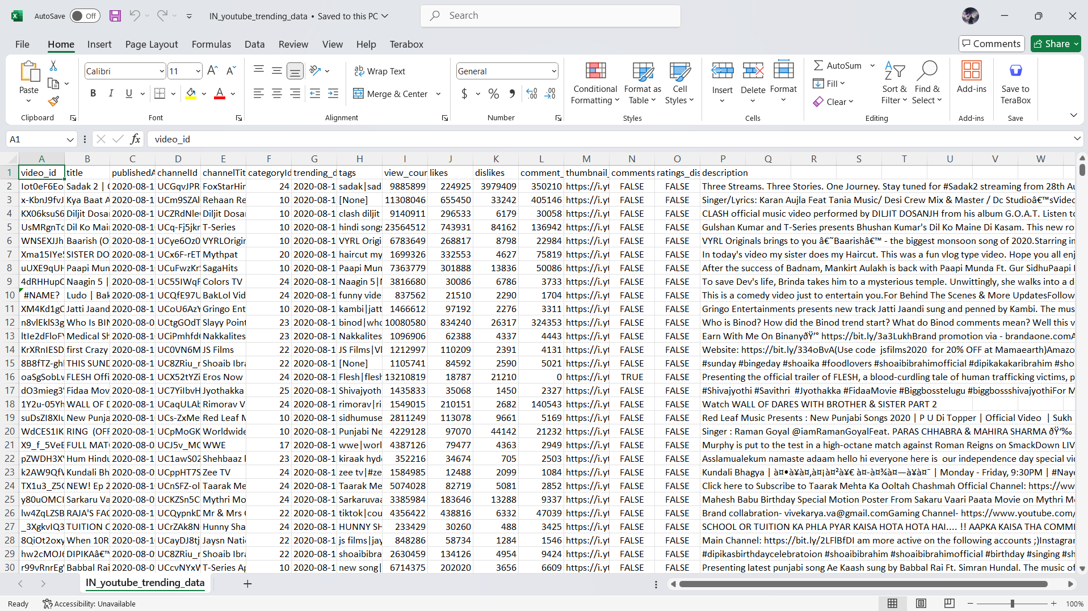
DATASET

Slide 5
DATASET SOURCE
Kaggle Dataset: Youtube trending video dataset
Dataset Link : https://www.kaggle.com/datasets/rsrishav/youtube-trending-video-dataset
This dataset contains historical data on YouTube trending videos, providing insights into video performance, viewer engagement, and content strategies.
YouTube is a global platform for content creators and consumers, offering a wide range of videos across various categories and channels.

Slide 6
DATA PREPROCESSING
Handling Missing Values: Filled or removed missing data points to maintain consistency.
Date Formatting: Standardized publishedAt and trending_date for time-series analysis.
Removing Duplicates: Removed duplicate entries to avoid skewed results.
Text Cleaning: Cleaned title, tags, and description by removing special characters and converting to lowercase.
Converting Data Types: Ensured numerical columns like view_count, likes, and dislikes were correctly formatted.

Slide 7
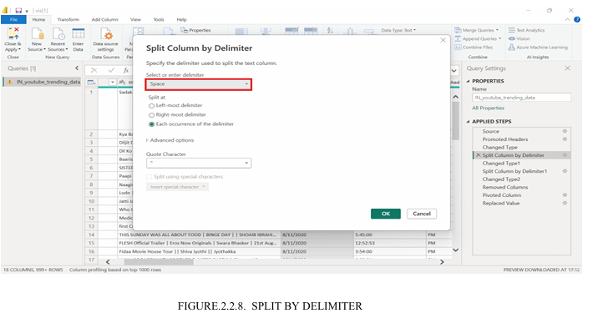
DATA PREPROCESSING

Slide 8
QUESTIONS ANALYSED
1.What is the sum of maximum views for each video?
Sum of maximum views for video is :66419664931578
2.What is the total video count for each category based on categoryId?
1) Ucvrhwpnp -852579588
2) Ucjvggbppn- 714669690
3) UC6-F5t08- 665182896
3.What is the sum of maximum likes based on channelTitle?
1)Vijay television-54 billion 2) Souravjoshi vlog-45 billion 3) Sonysab-39 billion
4) Sun tv-26 billion 5) Asianet-25 billion
4.What is the total number of videos uploaded in each month?
1)January -90k 2) February-84k 31 3) March -89k 4) April-76k 5) May-65k
6) June-74k 7) July-91k 8) August -85k 9) September-92k 10) October-84k
11) November-90k 12) December-89k
5.What is the ratio of likes to dislikes for all videos?
1) Fox star hindi- 202.60 2) Zee music- 113.80 3) Zee studio- 101.90
4) Colors rishtey- 75.51

Slide 9
QUESTIONS ANALYSED
6.What is the percentage of videos in each category?
1) Vijay television-3.39% 2) Surav joshi vlogs-1.53% 3) Sony sab-1.16%
4) suntv-1%
7.What is the cumulative number of views over time?
1)Vijay television-23 billion 2) Surav joshi vlogs-19 billion 3) Sony sab-17 billion
4) Suntv-14billion
8.Which videos have above-average engagement (in terms of views, likes, and comments)?
Vijay television has the above average engagement of 18 billion views
9.What is the sum of average views by category?
Average views by category is 701.94 billion
10.What is the video count for each category?
1) Ucvrhwpnp -852579588 2) Ucjvggbppn- 714669690 3) UC6-F5t08- 667852163

Slide 10
QUESTIONS ANALYSED
11. Which channel has the highest percentage of videos among the top channels?
Vijay Television has the highest percentage of videos at 3.39% among the channels listed.
12. What is the average number of videos uploaded per month?
Average uploads per month=83,250 videos
13. Which category has the highest cumulative number of views over time?
Vijay Television has the highest cumulative view with 23 billion views.
14. What is the total video count across all categories?
Total video count:2,235,101,441
15. Which channel has the highest like-to-view ratio?
Fox Star Hindi has the highest like-to-view ratio at 202.60.

Slide 11
DAX QUERIES
1. Maxviewsvideo
MaxViewsVideo = MAX(IN_youtube_trending_data, IN_youtube_trending_data[view_count])
2. Videocountbycategory
VideoCountByCategory = COUNTROWS(IN_youtube_trending_data)
3. upload date
UploadDay = WEEKDAY(IN_youtube_trending_data[publishedAt.1], 2)
4. Dislikelikeratio
DislikeLikeRatio = DIVIDE(IN_youtube_trending_data[dislikes], IN_youtube_trending_data[likes],0)
5. VideoPercentageCategory
VideoPercentageByCategory = DIVIDE(COUNTROWS(IN_youtube_trending_data), CALCULATE(COUNTROWS(IN_youtube_trending_data), ALL(IN_youtube_trending_data)), 0)

Slide 12
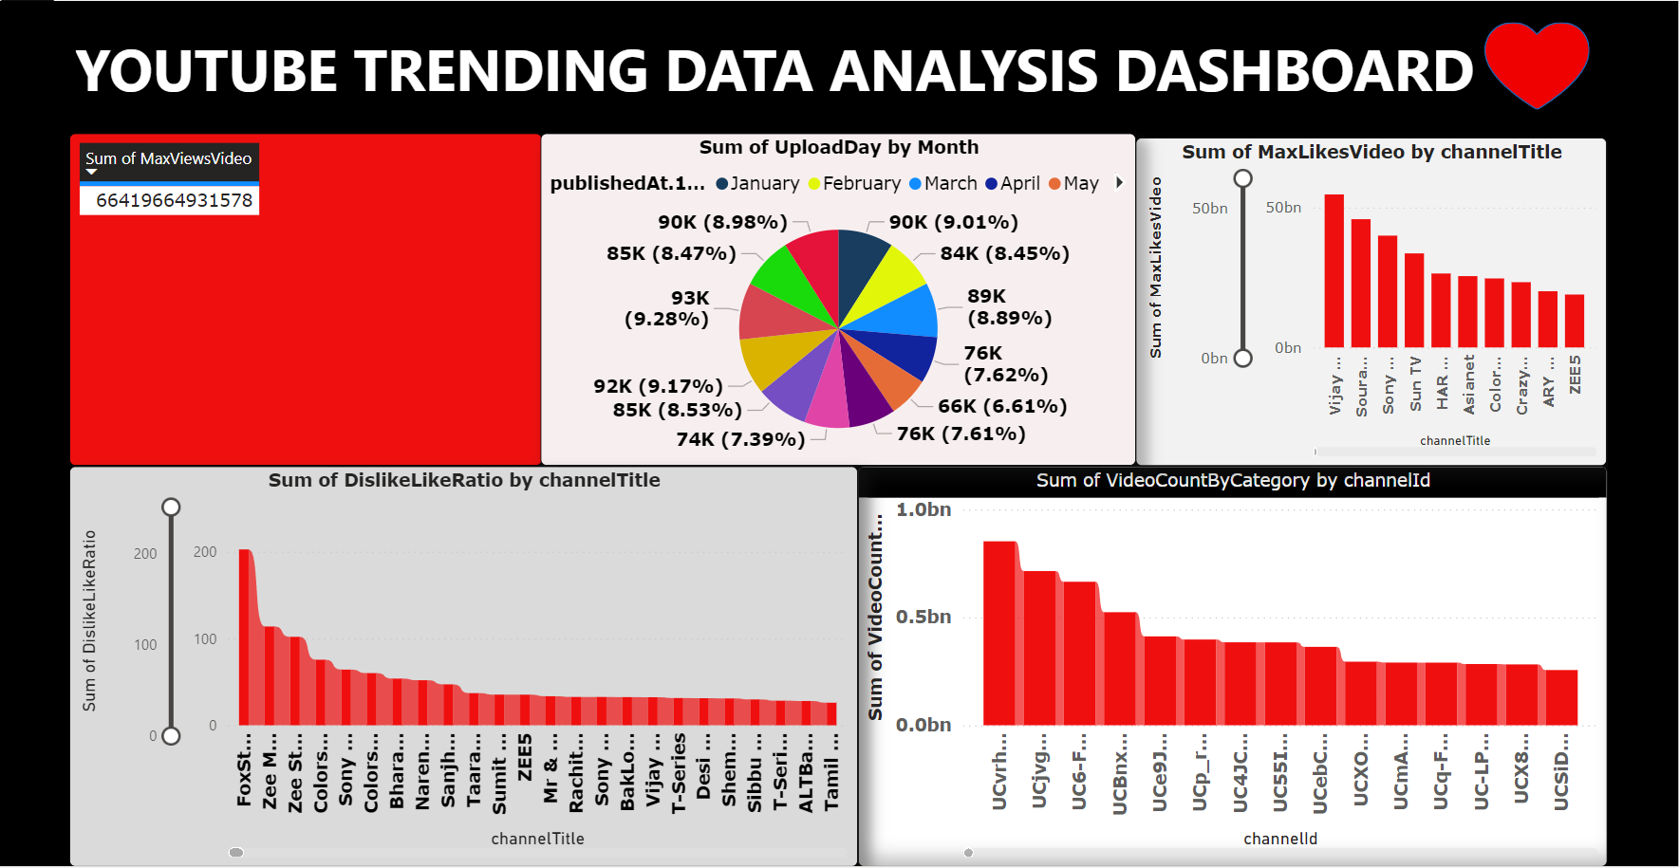
DASHBOARD OVERVIEW

Slide 13
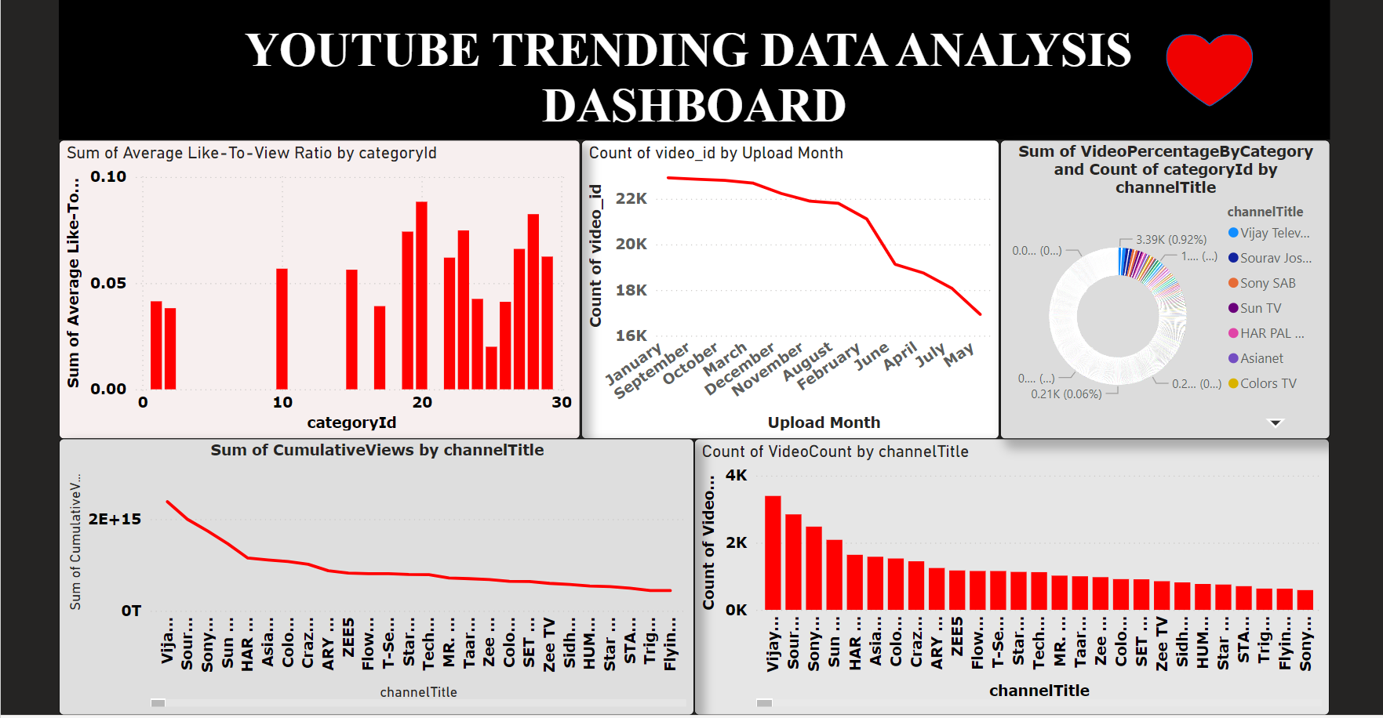
DASHBOARD OVERVIEW

Slide 14
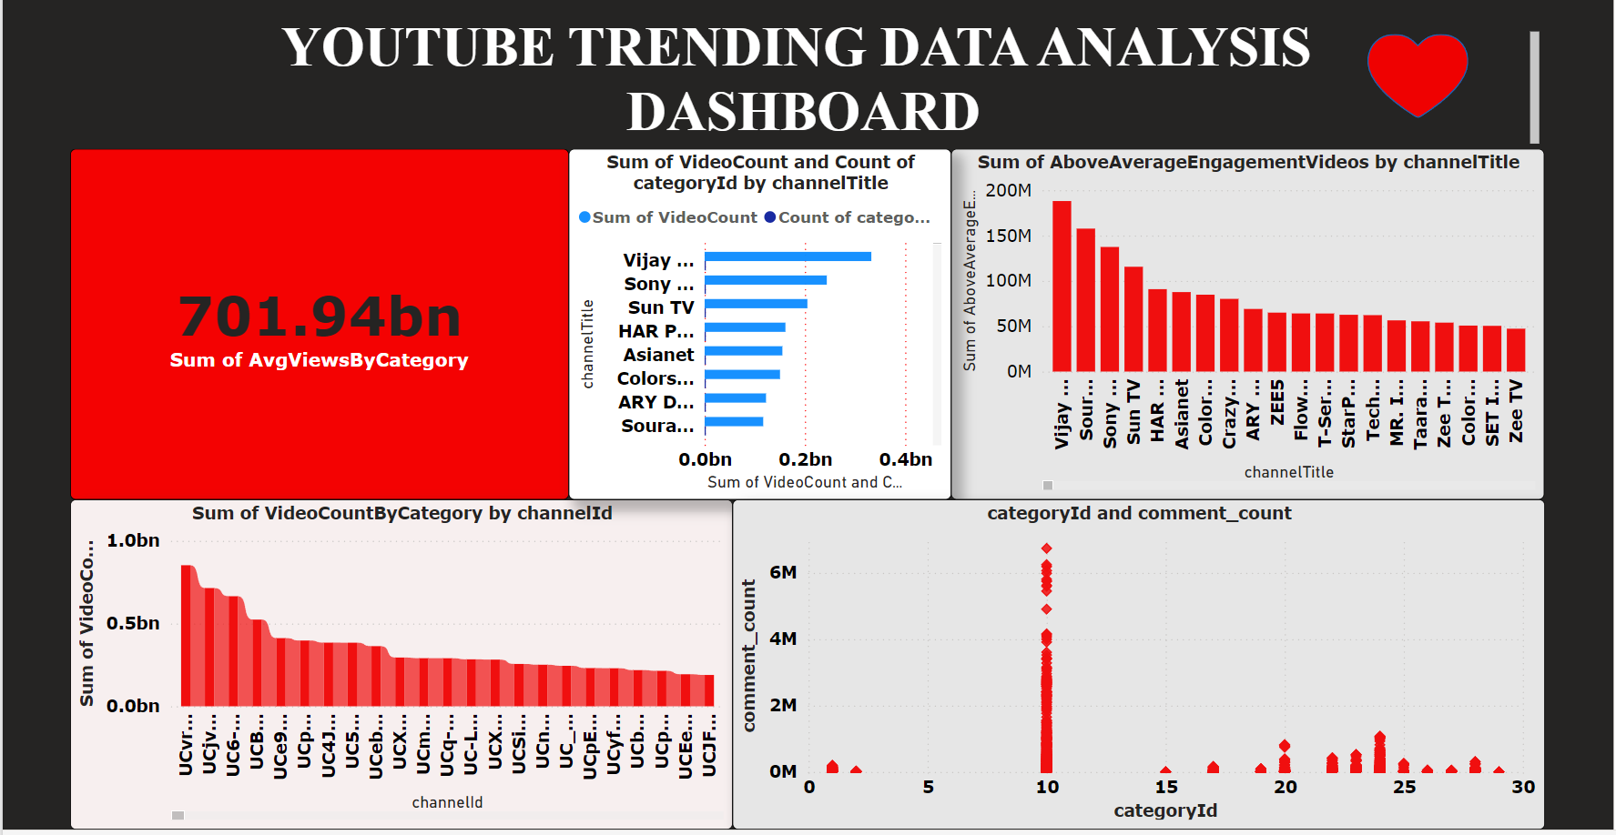
DASHBOARD OVERVIEW

Slide 15
DASHBOARD LINK
https://app.powerbi.com/groups/me/reports/efccd3f9-a207- 48ca-a09d-9ab272547a9b/323060252a40896018ad?experience=power-bi
GITHUB LINK
https://github.com/RashmikaRamkumar/YoutubeData_Analys-is.git

Slide 16
REFERENCES
1. A. Deza and D. Parikh, "Understanding image virality," Proc. IEEE Comput. Soc. Conf. Comput. Vis. Pattern Recognit., vol. 07, pp. 1818-1826, Dec. 2015.
2. L. T. Rui, Z. A. Afif, R. D. R. Saedudin, A. Mustapha, and N. Razali, "A regression approach for prediction of Youtube views," Bull. Electr. Eng. Informatics, vol. 8, no. 4, pp. 1502-1506, 2019.
3. Q. Wang, F. Miao, G. K. Tayi, and E. Xie, "What makes online content viral? The contingent effects of hub users versus non-hub users on social media platforms," J. Acad. Mark. Sci., vol. 47, no. 6, pp. 1005-1026, 2019.
4. I. Mohr, "Going Viral: An Analysis of YouTube Videos," J. Mark. Dev. Compet., vol. 8, no. 3, pp. 43-48, 2014.
5. J. Arthurs, S. Drakopoulou, and A. Gandini, "Researching YouTube," Convergence, vol. 24, no. 1, pp. 3-15, 2018.

Slide 17
Thank You !!

