Slide 1
Impact of Wildfire Smoke on Adolescent Health in Yakima
Rashmika Reddy Vookanti,
University of Washington, MS in Data Science

Slide 2
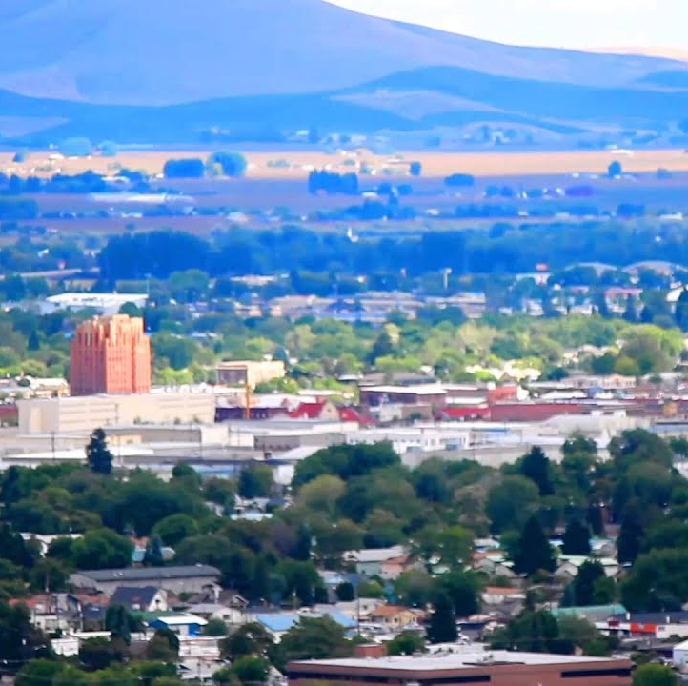
Yakima: An Overview
Yakima: Nestled in the heart of Washington, renowned for its vineyards and orchards.

Slide 3
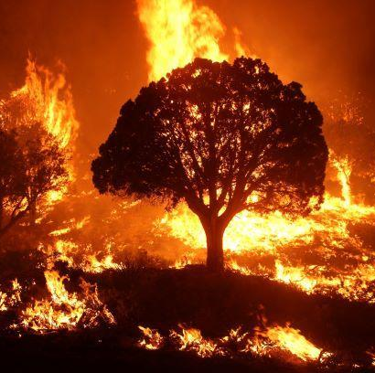
The Challenge
An Emerging Threat: Wildfires. Their smoke shrouds Yakima, compromising air quality and posing a silent risk to public health.

Slide 4


Data Sources
Asthma Prevalence Data:
Wildfire Incident Data

Slide 5
Methodology Overview
Data Collection
Data Analysis
Predictive Modeling

Slide 6
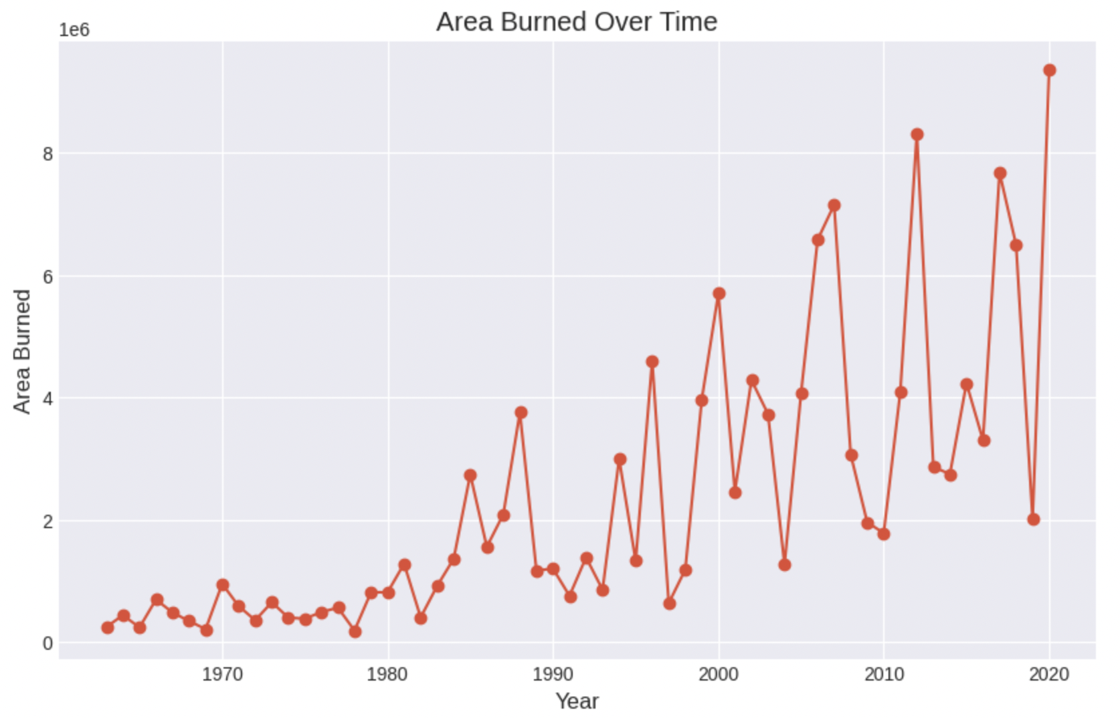
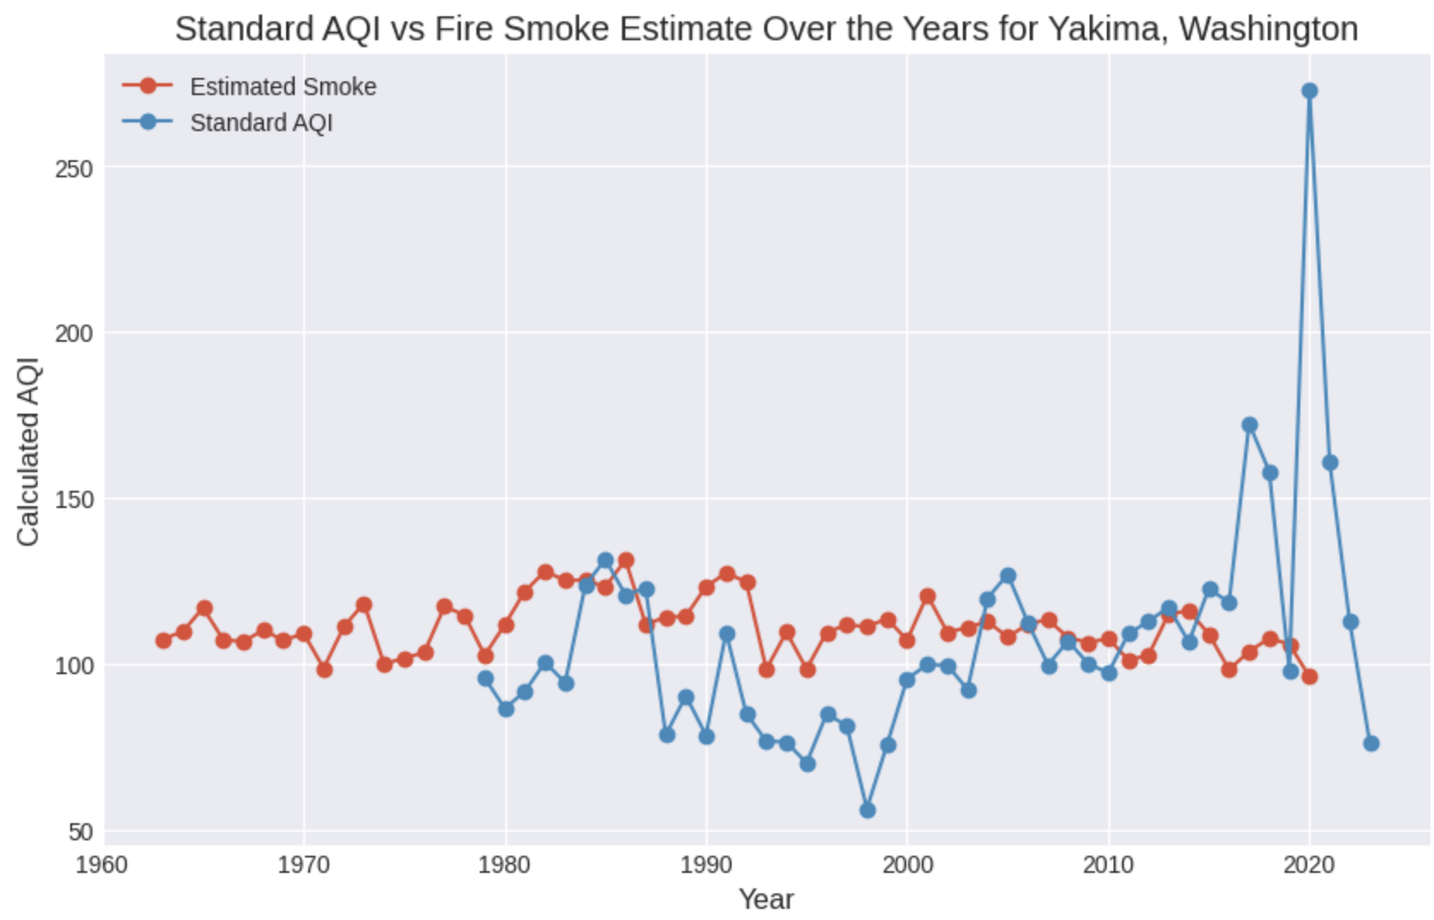
Wild Fire Analysis

Slide 7
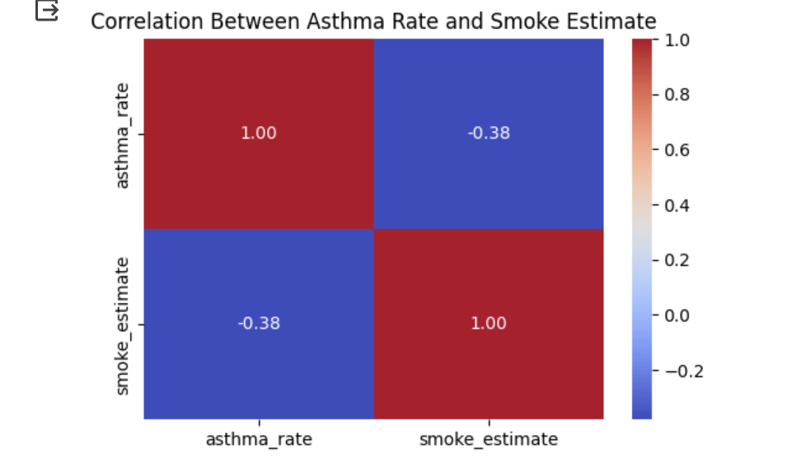
Correlation Analysis

Slide 8
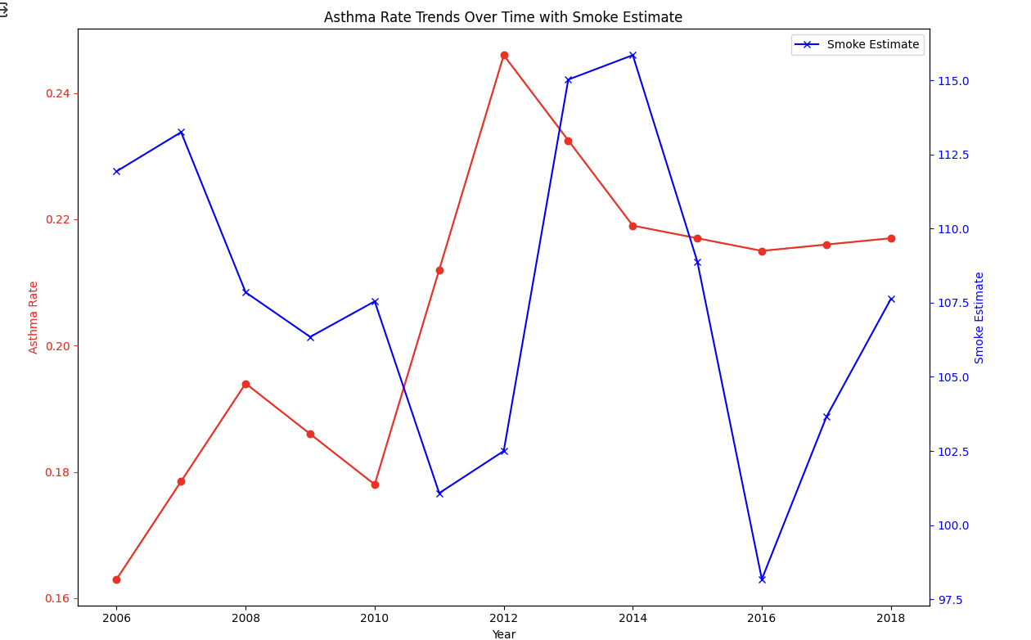
Asthma Trends over time with Smoke Estimates

Slide 9
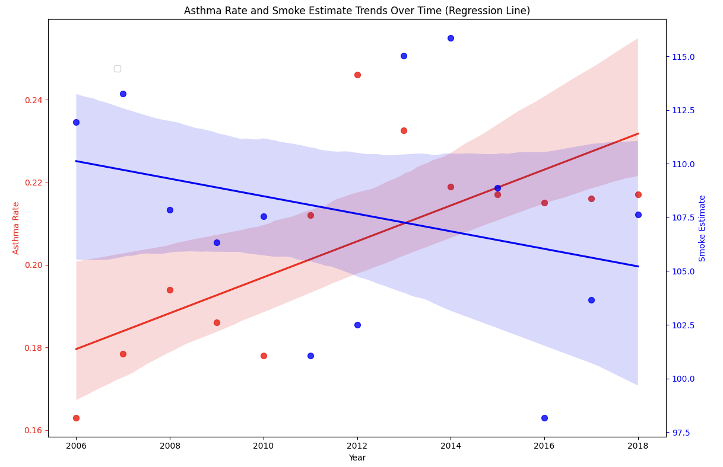
Asthma Rate and Smoke Estimate Regression Line

Slide 10
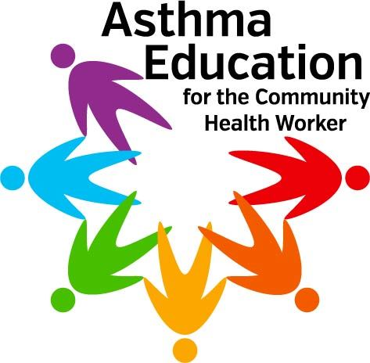
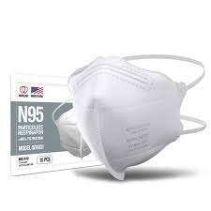
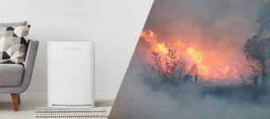
Public Health Strategies

Slide 11


Concluding Insights
It's time to act, to transform insights into action, ensuring a healthier future for Yakima's adolescents.

