Slide 1

A Blockchain-Integrated Hybrid Cryptographic Framework For Secure and Tamper-Resistant Digital Forensic Evidence Storage System
by
D. Prashanth
Roll No. 224G1A3374
P. Poojitha
Roll No. 224G1A3371
K. Rashmi
Roll No. 224G1A3379
M. Saipriya
Roll No. 224G1A3390
Under the guidance of
Mr. K. Kondanna M.Tech.,(Ph.D.)
Department of Computer Science and Engineering (AI & ML)
Srinivasa Ramanujan Institute of Technology
(Affiliated to JNTUA & Approved by AICTE) (Accredited by NAAC with ‘A’ Grade & Accredited by NBA (CIV,EEE,MEC, ECE & CSE)
Rotarypuram Village, B K Samudram Mandal, Ananthapuramu – 515701.
2025 - 2026
B-16
Dept.of.Computer science and Engineering(AI&ML)
Srinivasa Ramanujan Institute of Technology

Slide 2
Abstract
Secure Digital Forensic Evidence Storage System
In the modern digital era, the rapid growth of cyber crimes has increased the importance of securely storing and managing digital forensic evidence. However, traditional systems often fail to provide adequate security, integrity, and access control, making sensitive data vulnerable to tampering and unauthorized access. This project proposes a Digital Forensic Evidence Storage System designed to address these challenges by ensuring secure and reliable handling of digital evidence.
The system implements advanced security mechanisms such as AES-256 encryption for data confidentiality and SHA-256 hashing for integrity verification. It also incorporates Multi-Factor Authentication (MFA), JWT-based authentication, and Role-Based Access Control (RBAC) to ensure secure user access. Additionally, blockchain technology is used to maintain a tamper-proof audit trail. Overall, the system provides a robust and efficient solution for secure digital evidence storage and management.
B-16
Srinivasa Ramanujan Institute of Technology
2

Slide 3
Contents
Secure Digital Forensic Evidence Storage System
• Introduction
• Existing System
• Literature survey
• Objectives
• Proposed System
Requirements
System Architecture
Workflow and Implementation
Result
Conclusion
• References
• Paper Submission Proof
Github Link
B-16
Srinivasa Ramanujan Institute of Technology
3

Slide 4
Introduction
Secure Digital Forensic Evidence Storage System
In today’s digital world, cyber crimes such as hacking, data theft, and fraud are increasing rapidly. In such cases, digital evidence plays a very crucial role in identifying criminals and supporting legal investigations. However, managing and storing this evidence securely is a major challenge.
Traditional systems often lack proper security, integrity, and access control, which can lead to data tampering or unauthorized access. This creates serious issues in maintaining the authenticity of evidence in legal proceedings.
To overcome these challenges, our project focuses on developing a secure and efficient system for storing digital forensic evidence. The system ensures data confidentiality, integrity, and controlled access using advanced techniques like encryption and multi-factor authentication.
Through this project, we aim to provide a trustworthy and tamper-proof solution for digital evidence management.
B-16

Slide 5
Existing System
Secure Digital Forensic Evidence Storage System
In the current scenario, digital forensic evidence is often stored using traditional centralized systems such as local servers or basic cloud storage. These systems mainly rely on password-based authentication and lack advanced security mechanisms.
They do not provide strong encryption, proper access control, or effective tracking of user activities. As a result, digital evidence is vulnerable to unauthorized access, data tampering, and potential loss.
Additionally, there is no proper audit mechanism to maintain a chain of custody, which reduces the reliability and admissibility of evidence in legal investigations.
B-16
Dept. of Computer Science and Engineering (AI&ml) Srinivasa Ramanujan Institute of Technology 5

Slide 6
Literature Survey for Objectives
Secure Digital Forensic Evidence Storage System.
No | Title | Author | Journal Name & Year | Methodology Adapted | Key Findings | Gaps
1. | Improving Digital Forensic Security: A Secure Storage Model with Authentication and Optimal Key Generation based Encryption | Abdullah Mujawib Alashjaee, Fahad Alqahtani | IEEE Access, 2024 | Blockchain-based decentralized storage, SBVM authentication, EEO-based key generation, Multi-Key Homomorphic Encryption | Improved security, authentication, and integrity of forensic data in cloud environments | High computational overhead, complex encryption, lacks lightweight and practical implementation
2 | A Novel Blockchain Framework for Digital Forensics in Cloud Environment | Apirajitha & Devi | Wireless Personal Communications, 2023 | Blockchain with optimization algorithms for forensic data protection | Improved evidence traceability and integrity | Lacks efficient authentication and access control mechanisms
Srinivasa Ramanujan Institute of Technology

Slide 7
Objectives
Secure Digital Forensic Evidence Storage System
To design a highly secure system for storing digital forensic evidence using advanced encryption techniques like AES-256 and ECC.
To ensure data integrity and prevent tampering by implementing SHA-256 hashing and blockchain-based audit logging.
To provide strong authentication and access control using Multi-Factor Authentication (MFA), JWT tokens, and Role-Based Access Control (RBAC).
To enable secure and controlled access to evidence through a one-time decryption key mechanism with admin approval.
To improve overall system security and performance using techniques like file fragmentation and Genetic Algorithm-based optimization.
B-16
Dept. of Computer Science and Engineering (AI&ml) Srinivasa Ramanujan Institute of Technology 7

Slide 8
Proposed System
Secure Digital Forensic Evidence Storage System
Multi-layer secure system for storing digital forensic evidence → The system uses multiple security layers to ensure that evidence is protected at every stage from storage to access.
Multi-Factor Authentication (MFA) and JWT-based authentication → Users must verify their identity using both password and OTP, and secure JWT tokens are used for safe session management.
Role-Based Access Control (RBAC) → Access to data is restricted based on user roles like Admin, Investigator, or Analyst to prevent unauthorized usage.
AES-256 encryption for securing uploaded files → All files are encrypted using a strong encryption algorithm to ensure confidentiality of sensitive data.
B-16

Slide 9
Proposed System
Secure Digital Forensic Evidence Storage System
Elliptic Curve Cryptography (ECC) for key protection → Encryption keys are further secured using ECC, making it difficult for attackers to access them.
SHA-256 hashing for data integrity → A unique hash value is generated for each file to detect any tampering or modification.
Blockchain-based audit ledger → All system activities are recorded in a tamper-proof ledger to maintain a secure chain of custody.
One-time decryption key mechanism → Users receive a secure one-time key for accessing files, ensuring controlled and limited access.
B-16
Dept. of Computer Science and Engineering (AI&ml) Srinivasa Ramanujan Institute of Technology 9

Slide 10
Requirements
Secure Digital Forensic Evidence Storage System
1 . Functional Requirements
User Registration with Email Verification
Multi-Factor Authentication (MFA) Setup using QR Code
Secure Login using Password and OTP
Admin Approval for User Access
Role-Based Access Control (RBAC)
Secure File Upload and AES-256 Encryption
Document Access Request and Admin Approval
One-Time Decryption Key and Secure File Download
B-16
Dept. of Computer Science and Engineering (AI&ml) Srinivasa Ramanujan Institute of Technology 10

Slide 11
Requirements
Secure Digital Forensic Evidence Storage System
2. Non-Functional Requirements
Security: Multi-layer protection using MFA and encryption
Performance: Fast encryption and system response
Reliability: Ensures safe and consistent data storage
Scalability: Supports growing users and data
Usability: Simple and user-friendly interface
Auditability: Tamper-proof logging using blockchain
B-16
Dept. of Computer Science and Engineering (AI&ml) Srinivasa Ramanujan Institute of Technology 11

Slide 12
Requirements
Secure Digital Forensic Evidence Storage System
3System Requirements
🔹 Software
OS: Windows / Linux
Backend: Django (Python)
Frontend: HTML, CSS, Bootstrap
Database: SQLite / PostgreSQL
Libraries: PyOTP, PyJWT, PyCryptodome, Cryptography
🔹 Hardware
Processor: i3 or above
RAM: Minimum 4 GB
Internet Connection
B-16
Dept. of Computer Science and Engineering (AI&ml) Srinivasa Ramanujan Institute of Technology 12

Slide 13
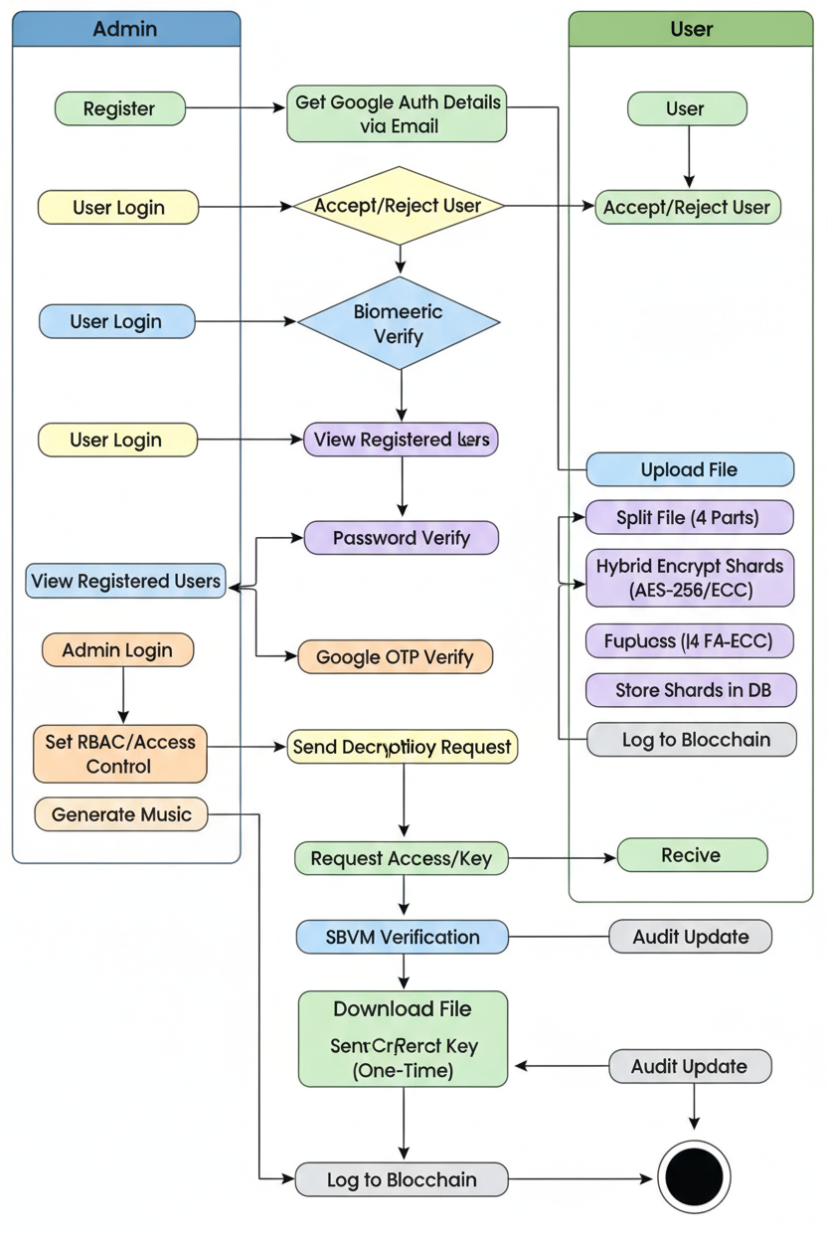
Proposed System
Secure Digital Forensic Evidence Storage System
System Architecture
B -16
Dept. of Computer Science and Engineering (AI&ml) Srinivasa Ramanujan Institute of Technology 13

Slide 14
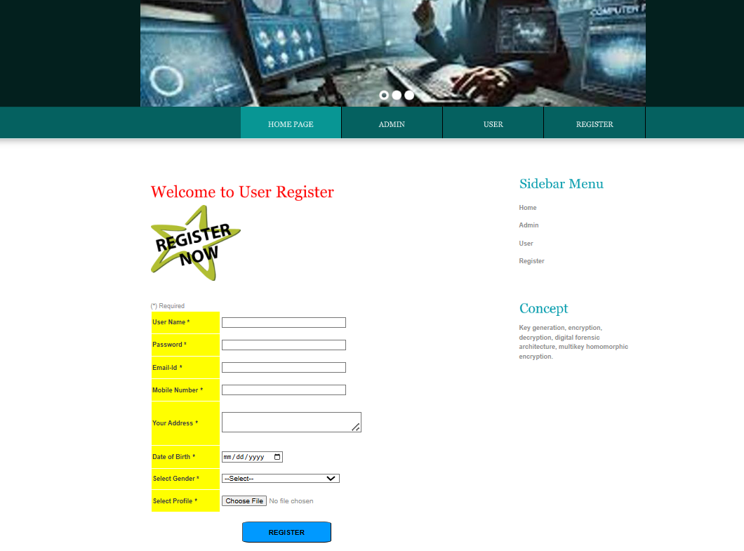
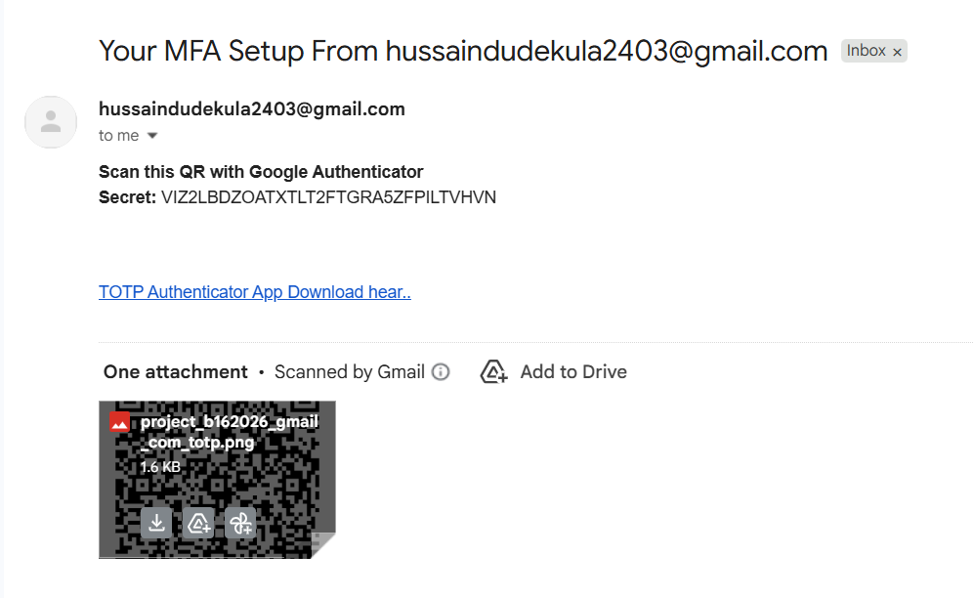
Workflow and Implementation
Secure Digital Forensic Evidence Storage System
1. User Registration & MFA Setup
User registers and system generates a secret key and sends QR code via email
User scans QR code using authenticator app
Admin reviews and approves the user
B-16

Slide 15
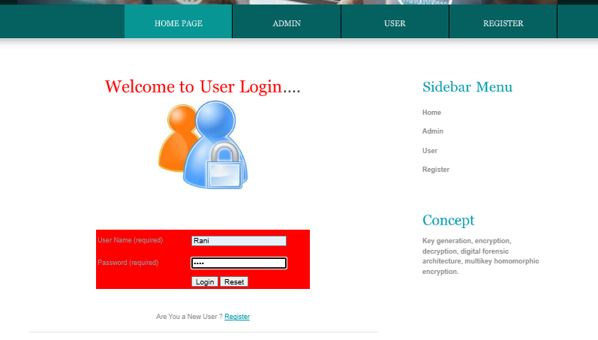
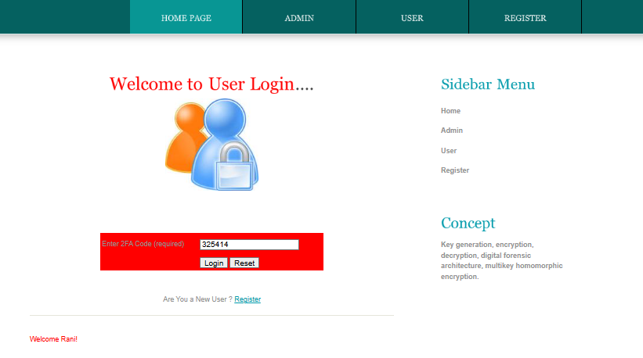
Contd..
Secure Digital Forensic Evidence Storage System
2. Secure Login with OTP
User enters username and password
System asks for OTP (from authenticator app)
OTP is verified for authentication
B-16

Slide 16
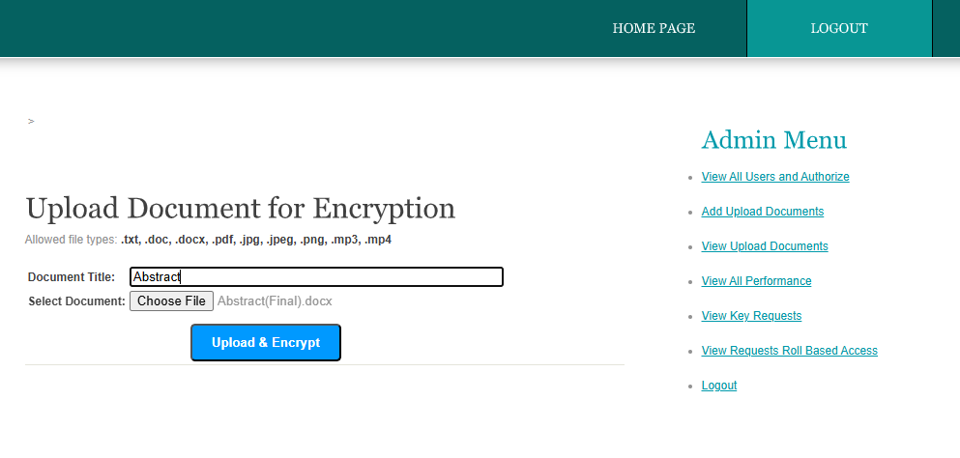
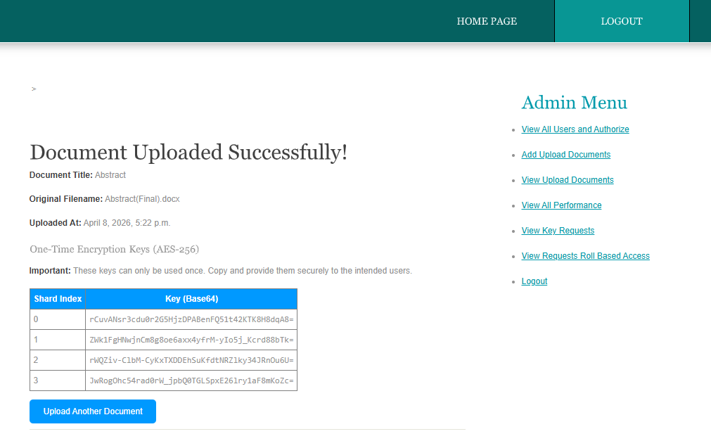
Contd..
Secure Digital Forensic Evidence Storage System
3. Admin Uploads Evidence
Admin uploads files (PDF, images, videos, etc.)
File is encrypted using AES-256
Encrypted file is divided into multiple parts
Encryption key is secured using ECC
B-16

Slide 17
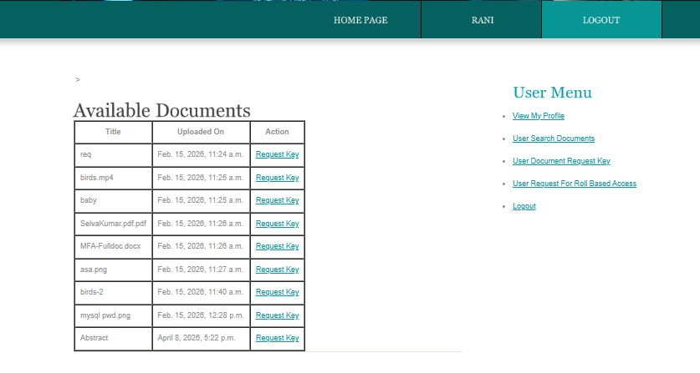
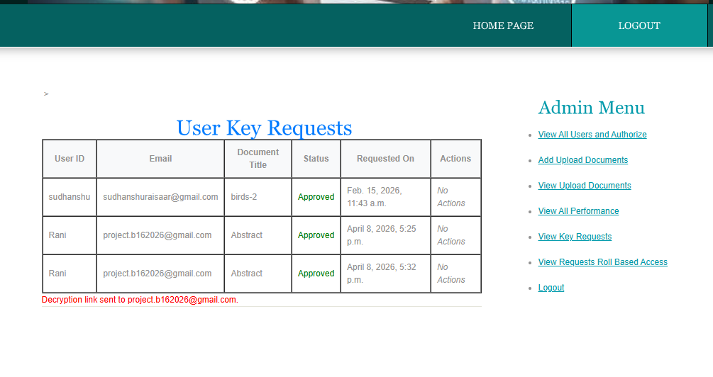
Contd..
Secure Digital Forensic Evidence Storage System
4. User Requests Access
User searches for required document
Sends request for access or decryption key
Request is sent to Admin for approval
B-16

Slide 18
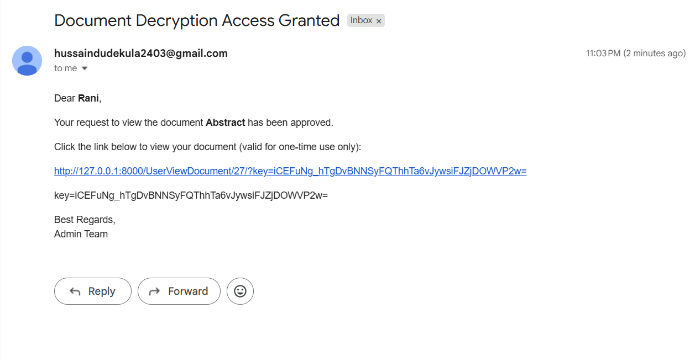
Contd..
Secure Digital Forensic Evidence Storage System
5. Admin Approval & Key Generation
Admin reviews request
If approved → system generates one-time key
Key is sent securely to user via email
B-16

Slide 19
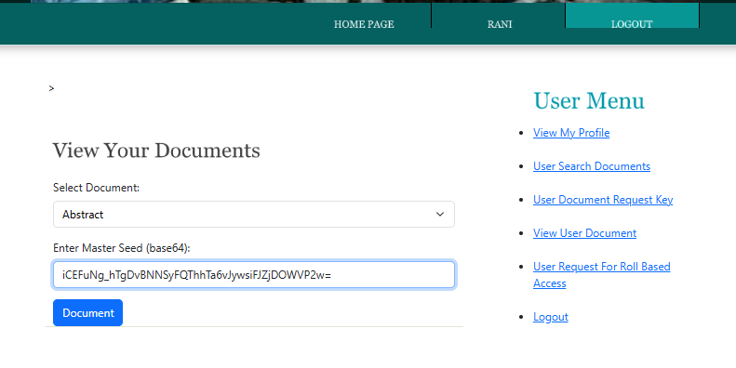
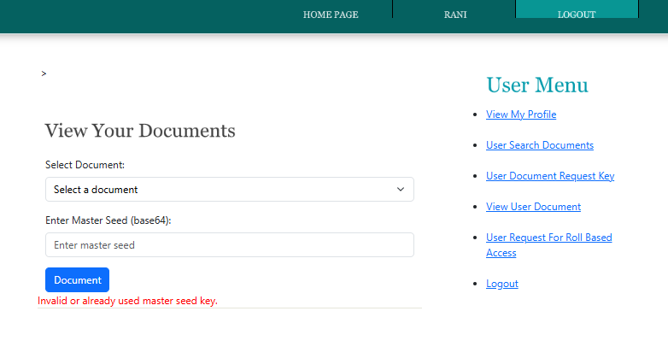
Contd..
Secure Digital Forensic Evidence Storage System
6. File Decryption & Download
User enters one-time key
System reconstructs file parts
File is decrypted and verified
User downloads original file
B-16

Slide 20
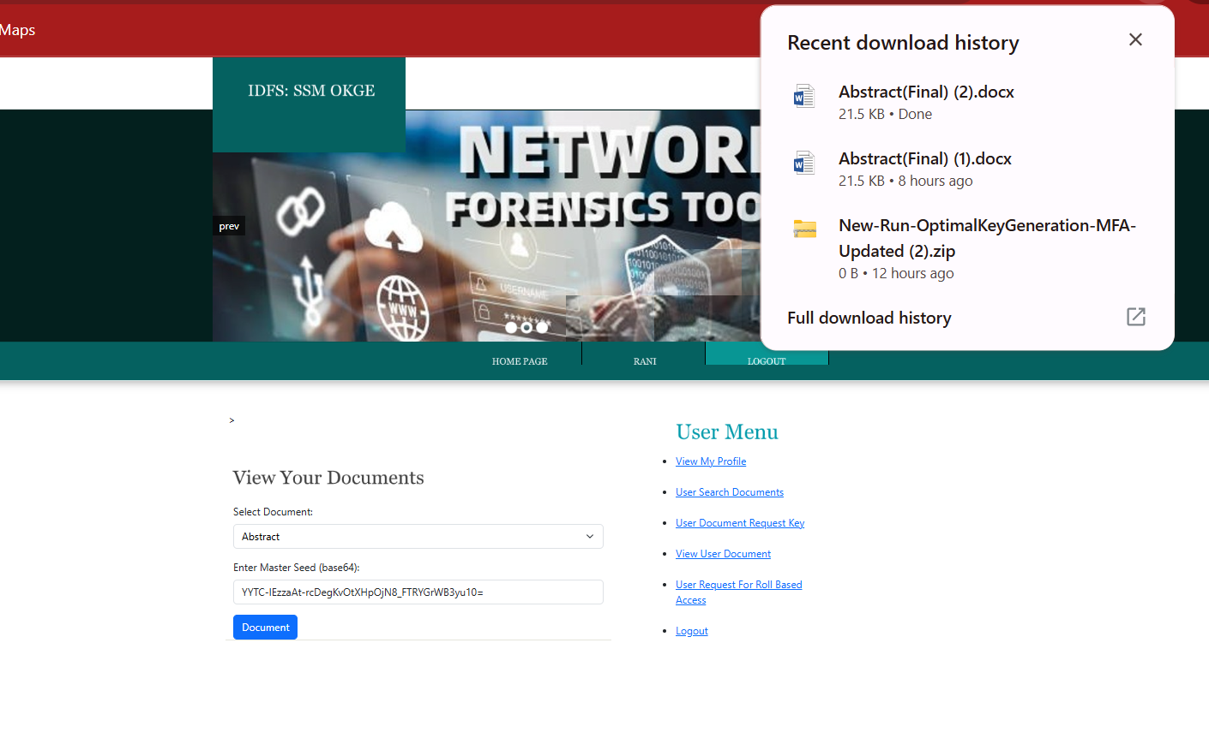
Result
Secure Digital Forensic Evidence Storage System
Secure storage achieved using AES & ECC
Strong authentication using MFA
Integrity ensured using SHA-256
Blockchain used for audit logging
Controlled access using RBAC & one-time keys
B-16

Slide 21
Conclusion
Secure Digital Forensic Evidence Storage System
The proposed Digital Forensic Evidence Storage System provides a secure and efficient solution for managing sensitive digital evidence. It ensures confidentiality through advanced encryption techniques such as AES-256 and ECC, while maintaining data integrity using SHA-256 hashing. The system also implements strong authentication mechanisms like Multi-Factor Authentication (MFA) and JWT to prevent unauthorized access.
Furthermore, Role-Based Access Control enables controlled access to users, and the integration of blockchain technology ensures a tamper-proof audit trail, maintaining a proper chain of custody. Overall, the system enhances the security, reliability, and transparency of digital evidence management, making it suitable for real-world forensic and legal applications.
B-16

Slide 22
References
Secure Digital Forensic Evidence Storage System
[1] E. Casey, Digital Evidence and Computer Crime: Forensic Science, Computers, and the Internet, 3rd ed. Academic Press, 2011.
[2] F. Prakash and H. Sadawarti, “Blockchain-Based Chain of Custody: A Secure Digital Evidence Framework for Digital Forensics Investigation,” 2024.
[3] H. F. Atlam, “Blockchain Forensics: A Systematic Literature Review of Digital Forensic Frameworks and Methodologies,” Electronics, vol. 13, no. 17, 2024.
[4] N. Hanif, “Blockchain-Based Chain of Custody in Digital Forensics: Ensuring Integrity and Legal Admissibility of Evidence,” Forensics & Security Journal, vol. 1, no. 1, 2025.
[5] M. Crosby, P. Pattanayak, S. Verma, and V. Kalyanaraman, “Blockchain Technology: Beyond Bitcoin,” Applied Innovation Review, vol. 2, pp. 6–19, 2016.
[6] S. Nakamoto, “Bitcoin: A Peer-to-Peer Electronic Cash System,” 2008.
B-16

Slide 23
References
Secure Digital Forensic Evidence Storage System
[7] M. Kohn, M. Eloff, and J. Eloff, “Integrated Digital Forensic Process Model,” Computers & Security, vol. 38, pp. 103–115, 2013.
[8] D. R. Kuhn, E. J. Coyne, and T. R. Weil, “Adding Attributes to Role Based Access Control,” Computer, vol. 43, no. 6, pp. 79–81, 2010.
[9] National Institute of Standards and Technology, “Security and Privacy Controls for Information Systems,” NIST SP 800-53 Rev.5, 2020.
[10] P. Mell and T. Grance, “The NIST Definition of Cloud Computing,” NIST SP 800-145, 2011.
B-16

Slide 24
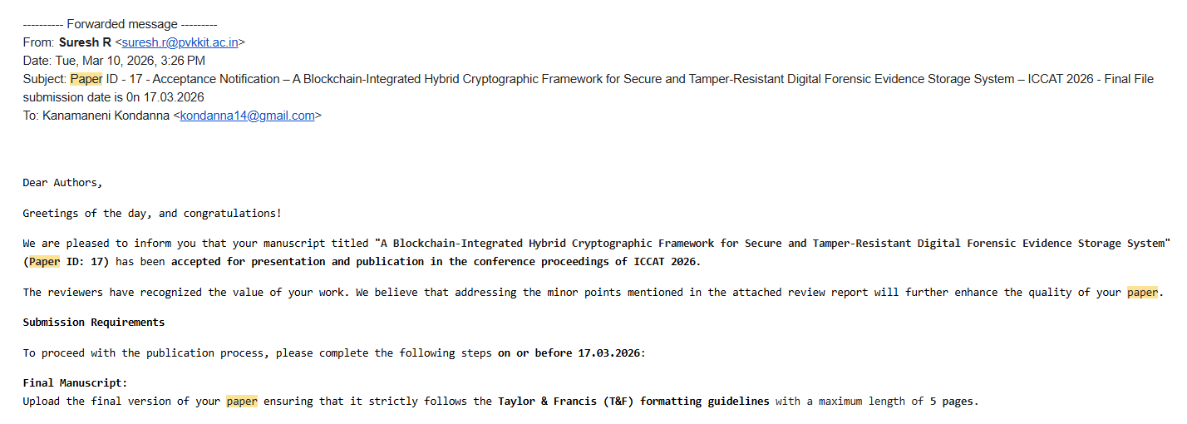
Paper Submission Proof
Secure Digital Forensic Evidence Storage System
B-16

Slide 25
https://github.com/Rashmikondeti/CSM-2025-26-BATCH-B16
Secure Digital Forensic Evidence Storage System
GITHUB LINK
Srinivasa Ramanujan Institute of Technology

Slide 26
Thank You!!!
Secure Digital Forensic Evidence Storage System
Srinivasa Ramanujan Institute of Technology

