Slide 1

Secure Digital Forensic Evidence Storage System
by
D. Prashanth
Roll No. 224G1A3374
P. Poojitha
Roll No. 224G1A3371
K. Rashmi
Roll No. 224G1A3379
M. Saipriya
Roll No. 224G1A3390
Under the guidance of
^{Mr. K. Kondanna} M.Tech. (Ph. D.)
Assistant Professor
Department of Computer Science and Engineering (AI & ML)
Srinivasa Ramanujan Institute of Technology
(Affiliated to JNTUA & Approved by AICTE) (Accredited by NAAC with ‘A’ Grade & Accredited by NBA (EEE, ECE & CSE)
Rotarypuram Village, B K Samudram Mandal, Ananthapuramu – 515701.
2025 - 2026
B-16
Dept.of.Computer science and Engineering(AI&ML)
Srinivasa Ramanujan Institute of Technology

Slide 2
Contents
Secure Digital Forensic Evidence Storage System
Review Remarks
Abstract
Problem statement
Objectives of Project
Literature survey for Objectives
Introduction
Existing System
Proposed System
Planning
Requirements
Data Flow Diagrams
Data Preprocessing Techniques
Sample Code
Project Output
References
GitHub Link
Queries
B-16
Srinivasa Ramanujan Institute of Technology
2

Slide 3
Review Remarks
Secure Digital Forensic Evidence Storage System
Review-0 Remarks:
No remarks
Review-1 Remarks:
Specification of cryptographic key sizes used in the system
Clear explanation of blockchain role in evidence management
Clarification on the decryption mechanism of encrypted data
B-16
Srinivasa Ramanujan Institute of Technology
3

Slide 4
Abstract
Secure Digital Forensic Evidence Storage System
Digital forensic investigations require secure and tamper-proof storage of electronic evidence to maintain integrity and legal admissibility. Existing systems lack strong access control, immutable audit trails, and protection against insider attacks. This project proposes a Secure Digital Evidence Storage System using Multi-Factor Authentication, Role-Based Access Control, hybrid cryptographic encryption, and blockchain-based audit logging. Evidence is encrypted, integrity-verified, and tracked through an immutable chain-of-custody ledger. The system ensures confidentiality, authenticity, and scalability for modern forensic investigations.
Keywords: Digital Forensics, Evidence Storage, Blockchain, Chain of Custody, Hybrid Encryption, MFA, RBAC, Data Integrity, Secure Storage
B-16

Slide 5
Problem Statement
Secure Digital Forensic Evidence Storage System
Digital forensic systems must securely preserve electronic evidence with confidentiality, integrity, and a verifiable chain of custody. However, centralized storage solutions lack strong access control, secure key management, and immutable audit trails, making them vulnerable to insider threats and data tampering. Single-key encryption and weak authentication further reduce legal reliability. Hence, a secure multi-layered evidence storage system using MFA, encrypted shard-based storage, optimized key management, and blockchain-based auditing is required to ensure forensic integrity and legal admissibility.
B-16

Slide 6
Objectives
Secure Digital Forensic Evidence Storage System
To protect digital forensic evidence using advanced cryptographic mechanisms, including hybrid encryption (AES-256), SHA-256 integrity verification, and optimized key management.
To implement strong authentication and authorization controls, integrating Multi-Factor Authentication (password, biometric, OTP) and Role-Based Access Control (RBAC).
To establish a tamper-proof chain-of-custody mechanism, by recording all evidence operations on a blockchain-based immutable audit ledger.
To enable secure evidence access and lifecycle management, including controlled one-time decryption key release and secure handling of large-scale forensic data.
B-16
Dept. of Computer Science and Engineering (AI&ml) Srinivasa Ramanujan Institute of Technology 6

Slide 7
Literature Survey for Objectives
Secure Digital Forensic Evidence Storage System.
No | Title | Author | Journal Name & Year | Methodology Adapted | Key Findings | Gaps
1. | Improving Digital Forensic Security: A Secure Storage Model with Authentication and Optimal Key Generation based Encryption | Abdullah Mujawib Alashjaee, Fahad Alqahtani | IEEE Access, 2024 | Blockchain-based decentralized storage, SBVM authentication, EEO-based key generation, Multi-Key Homomorphic Encryption | Improved security, authentication, and integrity of forensic data in cloud environments | High computational overhead, complex encryption, lacks lightweight and practical implementation
2 | A Novel Blockchain Framework for Digital Forensics in Cloud Environment | Apirajitha & Devi | Wireless Personal Communications, 2023 | Blockchain with optimization algorithms for forensic data protection | Improved evidence traceability and integrity | Lacks efficient authentication and access control mechanisms
Srinivasa Ramanujan Institute of Technology

Slide 8
Introduction
Secure Digital Forensic Evidence Storage System.
The rapid growth of digital technologies has increased cybercrimes, making digital evidence such as emails, logs, images, videos, and network records crucial in modern investigations. Secure handling and storage of this evidence are essential to maintain integrity, authenticity, and legal admissibility. However, traditional storage systems often lack strong encryption, access control, and reliable chain-of-custody mechanisms, leading to risks such as insider threats and data tampering. This project proposes a Secure Digital Forensic Evidence Storage System that integrates cryptographic techniques, role-based access control, and blockchain technology to ensure confidentiality, integrity, and traceability of digital evidence throughout the investigation lifecycle.
Srinivasa Ramanujan Institute of Technology

Slide 9
Existing System
Secure Digital Forensic Evidence Storage System
Digital forensic evidence is commonly stored in centralized servers, external storage devices, or basic cloud platforms with limited security features.
Most systems rely on password-based authentication, making them vulnerable to unauthorized access and insider threats.
Encryption is often absent or weak, increasing the risk of data leakage and cyberattacks.
Chain-of-custody tracking is inadequate, with manual or poorly monitored access logs that can be altered.
Integrity verification uses basic hashing, but hash values are stored within the same system, allowing possible manipulation.
B-16
Dept. of Computer Science and Engineering (AI&ml) Srinivasa Ramanujan Institute of Technology 9

Slide 10
Proposed System
Secure Digital Forensic Evidence Storage System
Step 1: User Authentication & Authorization
Users authenticate using Multi-Factor Authentication (password, biometric, OTP).
Role-Based Access Control (RBAC) determines permitted actions (upload, view, download, verify).
Step 2: Evidence Acquisition
Authorized investigators upload digital evidence (images, videos, logs, documents, audio).
Step 3: Integrity Generation
A SHA-256 hash is generated immediately to preserve evidence integrity.
Step 4: Secure Encryption & Sharding
Evidence is split into multiple shards.
Shards are encrypted using AES-256.
Encryption keys are optimized using a Genetic Algorithm and protected via ECC encryption.
B-16

Slide 11
Proposed System
Secure Digital Forensic Evidence Storage System
Step 5: Secure Storage
Encrypted shards are stored in a secure server / cloud database.
Hash values are stored on a blockchain ledger to ensure immutability.
Step 6: Blockchain-Based Chain of Custody
All operations (upload, access, transfer, verification, key release) are time-stamped and logged on blockchain.
Step 7: Controlled Evidence Access
Authorized users receive one-time decryption keys for controlled evidence access.
Step 8: Audit & Verification
Tamper-proof audit logs maintain transparency.
Any modification attempt triggers a hash mismatch alert.
B-16
Dept. of Computer Science and Engineering (AI&ml) Srinivasa Ramanujan Institute of Technology 11

Slide 12
Planning
Secure Digital Forensic Evidence Storage System
Phased Development Approach
Requirement Analysis & Threat Modeling
System Architecture Design
Module-wise Implementation
Integration & Testing
Performance Evaluation
Documentation & Deployment
B-16
Dept. of Computer Science and Engineering (AI&ml) Srinivasa Ramanujan Institute of Technology 12

Slide 13
Requirements
Secure Digital Forensic Evidence Storage System
Functional Requirements
User registration and admin approval
Multi-Factor Authentication (MFA) login
Role-Based Access Control (RBAC)
Upload and encryption of evidence
File sharding for security
Blockchain-based audit logging
Access request and one-time decryption key
Audit log visualization
B-16
Dept. of Computer Science and Engineering (AI&ml) Srinivasa Ramanujan Institute of Technology 13

Slide 14
Modules
Secure Digital Forensic Evidence Storage System
Authentication Module
MFA Module
Evidence Upload Module
Encryption Engine
Key Optimization Engine
Blockchain Audit Module
RBAC Module
Access Request Handler
Decryption Key Manager
Notification Service
B-16
Dept. of Computer Science and Engineering (AI&ml) Srinivasa Ramanujan Institute of Technology 14

Slide 15
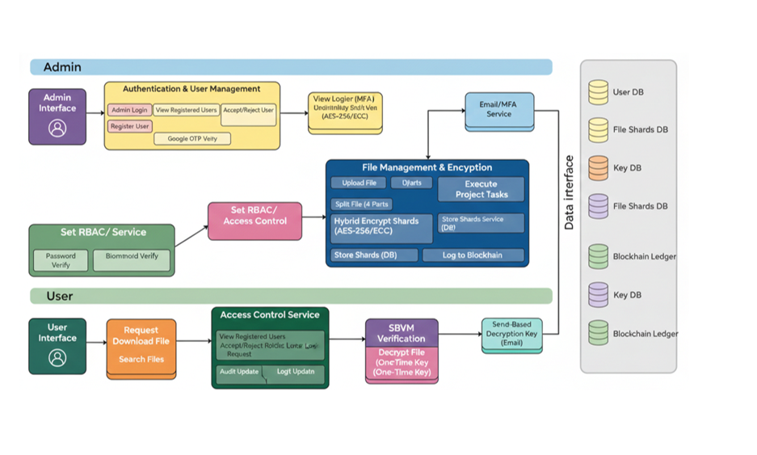
System Design
Secure Digital Forensic Evidence Storage System
B-16
Dept. of Computer Science and Engineering (AI&ml) Srinivasa Ramanujan Institute of Technology 15

Slide 16
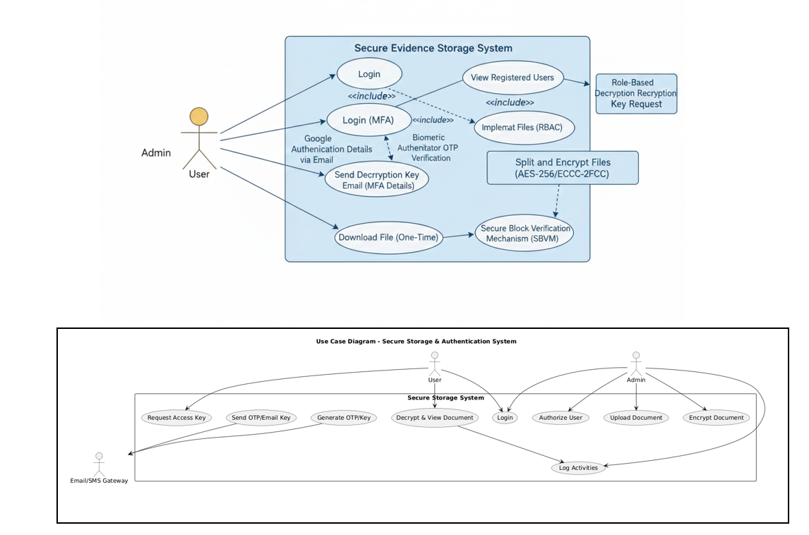
Data Flow Diagram
Secure Digital Forensic Evidence Storage System
B-16
Dept. of Computer Science and Engineering (AI&ml) Srinivasa Ramanujan Institute of Technology 16

Slide 17
Data Preprocessing Techniques
Secure Digital Forensic Evidence Storage System
Check file format: Make sure the file type is supported
Scan for malware: Remove any harmful content
Extract metadata: Save file info like date, device, location
Split files: Divide evidence into 4 parts for security
Generate hash: Create SHA-256 code to check integrityblocks
Add timestamp & signature: Record time and verify authenticity
Process biometric data: Clean and extract features for MFA
Prepare text/logs: Make searchable without revealing sensitiv
Compress & pad files: Save space and make uniform e info
B-16
Dept. of Computer Science and Engineering (AI&ml) Srinivasa Ramanujan Institute of Technology 17

Slide 18
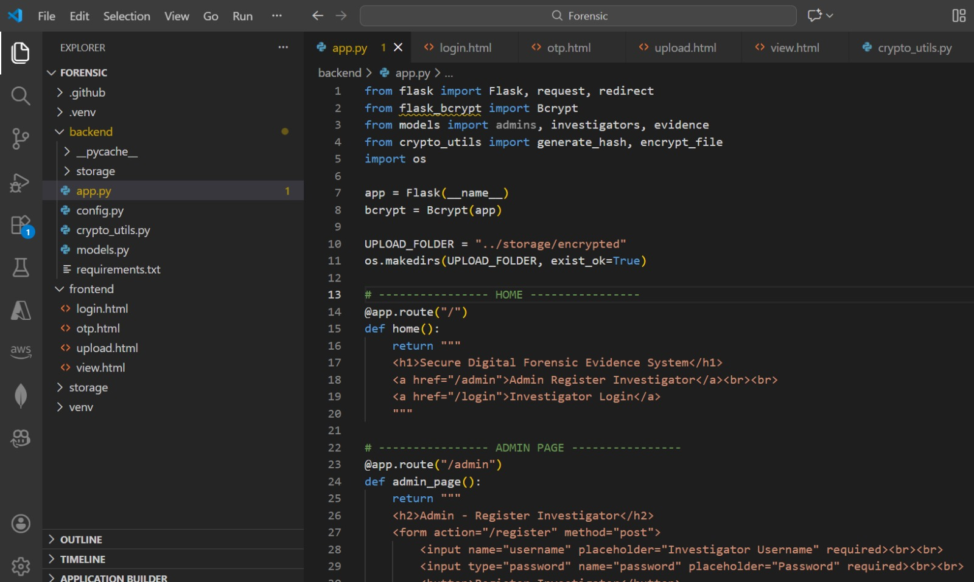
Sample Code
Secure Digital Forensic Evidence Storage System
B-16
Dept. of Computer Science and Engineering (AI&ml) Srinivasa Ramanujan Institute of Technology 18

Slide 19
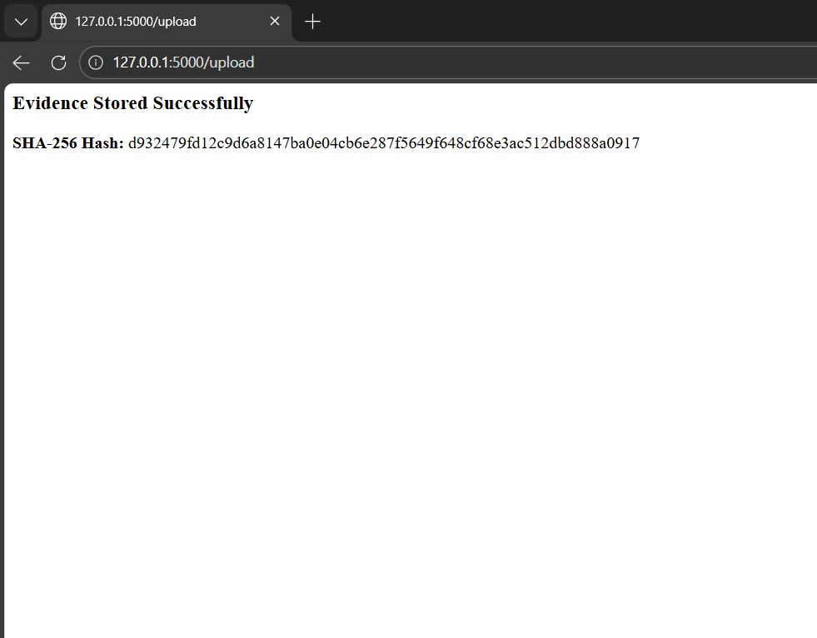
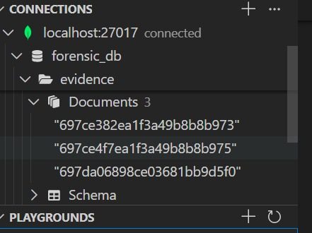
Project Execution
Secure Digital Forensic Evidence Storage System
B-16
Dept. of Computer Science and Engineering (AI&ml) Srinivasa Ramanujan Institute of Technology 18

Slide 20
References
Secure Digital Forensic Evidence Storage System
A. M. Alashjaee and F. Alqahtani,
“Improving Digital Forensic Security: A Secure Storage Model with Authentication and Optimal Key Generation based Encryption,”
IEEE Access, vol. 12, pp. 29738–29747, 2024.
P. S. Apirajitha and R. R. Devi,
“A Novel Blockchain Framework for Digital Forensics in Cloud Environment,”
Wireless Personal Communications, 2023.
B-16

Slide 21
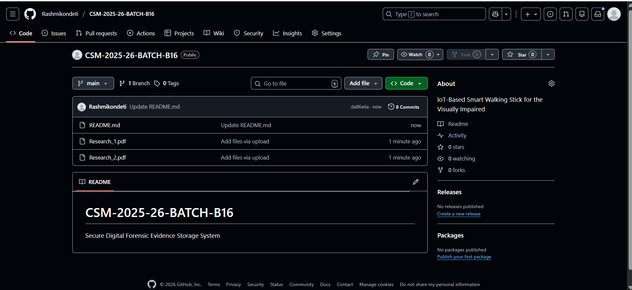
Github Dashboard
Secure Digital Forensic Evidence Storage System
B-16

Slide 22
Any Queries?
Secure Digital Forensic Evidence Storage System
Srinivasa Ramanujan Institute of Technology

Slide 23
Thank You!!!
Secure Digital Forensic Evidence Storage System
Srinivasa Ramanujan Institute of Technology

