Slide 1

Secure Digital Forensic Evidence Storage System
by
D. Prashanth
Roll No. 224G1A3374
P. Poojitha
Roll No. 224G1A3371
K. Rashmi
Roll No. 224G1A3379
M. Saipriya
Roll No. 224G1A3390
Under the guidance of
^{Mr. Kondanna}
M. Tech
Assistant Professor
e
Department of Computer Science and Engineering (AI & ML)
Srinivasa Ramanujan Institute of Technology
(Affiliated to JNTUA & Approved by AICTE) (Accredited by NAAC with ‘A’ Grade & Accredited by NBA (EEE, ECE & CSE)
Rotarypuram Village, B K Samudram Mandal, Ananthapuramu – 515701.
2025 - 2026
B-16
Dept.of.Computer science and Engineering(AI&ML)
Srinivasa Ramanujan Institute of Technology

Slide 2
Contents
Secure Digital Forensic Evidence Storage System
• Abstract
• Problem statement
• Objectives of Project
• Literature survey for objectives
• Existing System
• Proposed System
• References
• GitHub Link
• Queries
B-16
Srinivasa Ramanujan Institute of Technology
2

Slide 3
Abstract
Secure Digital Forensic Evidence Storage System
Digital forensic investigations require secure preservation and handling of electronic evidence to maintain its integrity and ensure admissibility in court. Traditional evidence storage systems often lack secure audit trails and are vulnerable to unauthorized access, insider attacks, and data tampering, which can compromise the confidentiality and authenticity of digital evidence. This project proposes a Secure Digital Forensic Evidence Storage System that integrates Multi-Factor Authentication (MFA), Role-Based Access Control (RBAC), Hybrid Cryptographic Encryption, and Blockchain-based Audit Logging to enhance security. Evidence files are divided into multiple shards and encrypted using AES-GCM, Data Integrity is verified using SHA-256 hashing, Merkle root verification, and HMAC authentication. A blockchain ledger maintains immutable chain-of-custody records for evidence operations such as upload, access, and verification.
B-16

Slide 4
Problem Statement
Secure Digital Forensic Evidence Storage System
Digital forensic investigations depend heavily on the proper preservation and management of electronic evidence. However, many existing evidence storage systems rely on centralized architectures that may not provide adequate protection against security threats. These systems often lack immutable audit trails and robust authentication mechanisms, making them vulnerable to unauthorized access and data manipulation. Such vulnerabilities can lead to the loss or modification of critical evidence, which may negatively impact legal investigations and judicial proceedings. Another major problem is the lack of transparency and accountability in tracking evidence handling activities. Without a secure logging mechanism, it becomes difficult to maintain a reliable chain-of-custody for digital evidence.
B-16

Slide 5
Objectives
Secure Digital Forensic Evidence Storage System
Design a secure digital forensic evidence storage system
Ensure confidentiality, integrity, and accessibility of digital evidence
Prevent unauthorized access using advanced authentication mechanisms
Implement hybrid cryptographic techniques (AES-GCM + ECC) for data protection
Integrate Multi-Factor Authentication (MFA) and Role-Based Access Control (RBAC)
Ensure secure chain-of-custody for evidence handling
Provide a scalable and reliable framework for forensic investigations
B-16
Dept. of Computer Science and Engineering (AI&ml) Srinivasa Ramanujan Institute of Technology 5

Slide 6
Literature Survey for Objectives
Secure Digital Forensic Evidence Storage System.
No | Title | Author | Journal Name & Year | Methodology Adapted | Key Findings | Gaps
1. | Improving Digital Forensic Security: A Secure Storage Model with Authentication and Optimal Key Generation based Encryption | Abdullah Mujawib Alashjaee, Fahad Alqahtani | IEEE Access, 2024 | Blockchain-based decentralized storage, SBVM authentication, EEO-based key generation, Multi-Key Homomorphic Encryption | Improved security, authentication, and integrity of forensic data in cloud environments | High computational overhead, complex encryption, lacks lightweight and practical implementation
2 | A Novel Blockchain Framework for Digital Forensics in Cloud Environment | Apirajitha & Devi | Wireless Personal Communications, 2023 | Blockchain with optimization algorithms for forensic data protection | Improved evidence traceability and integrity | Lacks efficient authentication and access control mechanisms
Srinivasa Ramanujan Institute of Technology

Slide 7
Existing System
Secure Digital Forensic Evidence Storage System
Digital forensic evidence is commonly stored in offline storage devices or basic cloud storage systems without advanced security mechanisms.
Authentication and access control are limited, making it difficult to prevent unauthorized or insider access.
Uses simple authentication (username and password)
There is no reliable automated method to detect tampering or modification of digital evidence.
Chain of custody is often maintained manually, which reduces transparency and affects legal reliability.
B-16
Dept. of Computer Science and Engineering (AI&ml) Srinivasa Ramanujan Institute of Technology 7

Slide 8
Proposed System
Secure Digital Forensic Evidence Storage System
Step 1:
A secure web-based application for managing digital forensic evidence
Step 2:
Provides authenticated and role-based access for authorized users
Step 3:
Encrypts digital evidence using hybrid encryption techniques
Step 4:
Ensures integrity verification through hash comparison
Step 5:
Maintains tamper-proof chain of custody using blockchain audit logs
B-16

Slide 9
Proposed System
Secure Digital Forensic Evidence Storage System
Step 6:
Detects unauthorized modifications and records all user actions
Step 7:
Improves confidentiality, accountability, and legal reliability of evidence
B-16
Dept. of Computer Science and Engineering (AI&ml) Srinivasa Ramanujan Institute of Technology 9

Slide 10
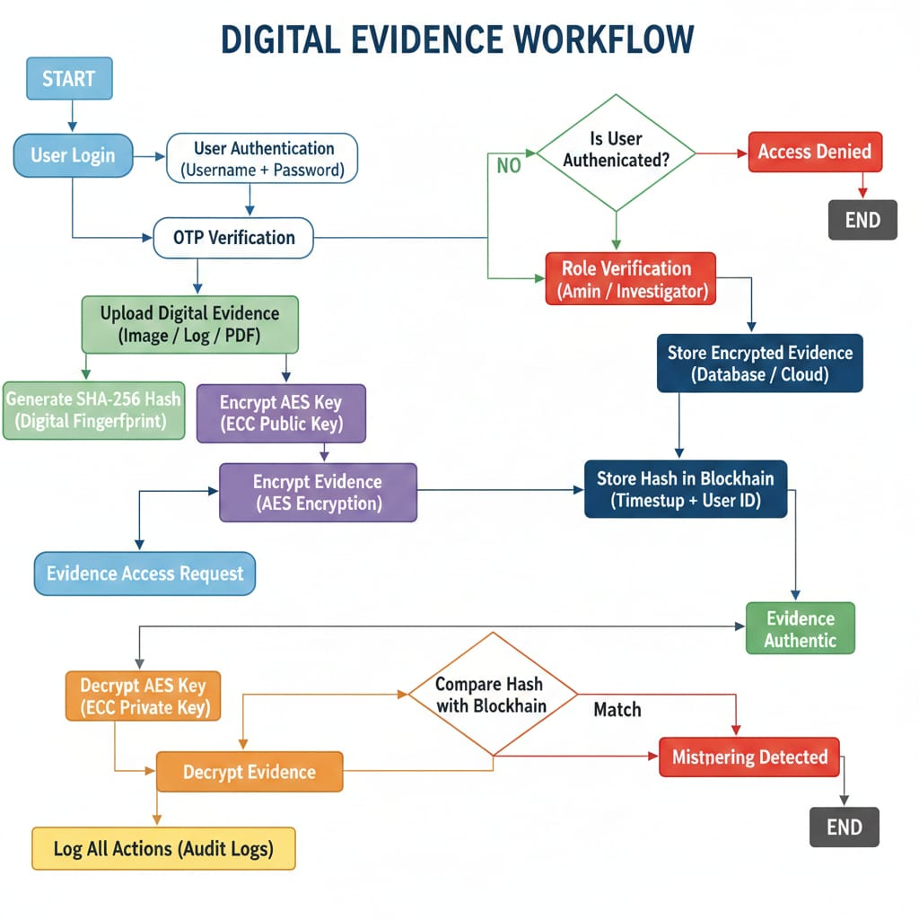
Proposed System
Secure Digital Forensic Evidence Storage System
B -16
Dept. of Computer Science and Engineering (AI&ml) Srinivasa Ramanujan Institute of Technology 10

Slide 11
References
Secure Digital Forensic Evidence Storage System
A. M. Alashjaee and F. Alqahtani,
“Improving Digital Forensic Security: A Secure Storage Model with Authentication and Optimal Key Generation based Encryption,”
IEEE Access, vol. 12, pp. 29738–29747, 2024.
P. S. Apirajitha and R. R. Devi,
“A Novel Blockchain Framework for Digital Forensics in Cloud Environment,”
Wireless Personal Communications, 2023.
B-16

Slide 12
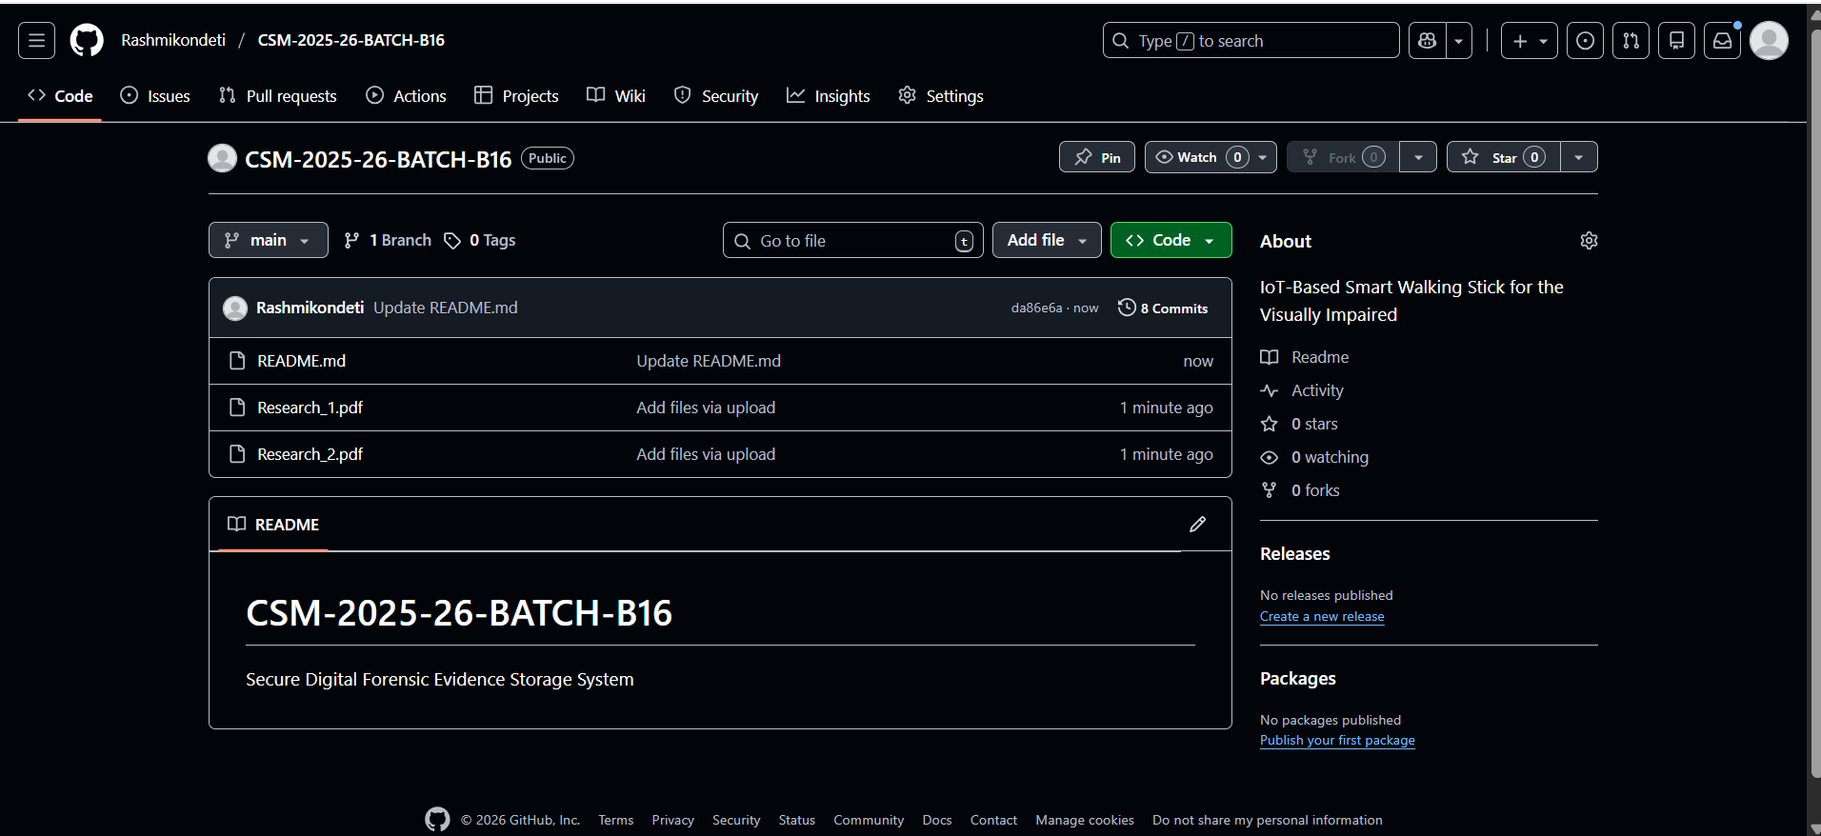
Github Dashboard
Secure Digital Forensic Evidence Storage System
B-16

Slide 13
Any Queries?
Secure Digital Forensic Evidence Storage System
Srinivasa Ramanujan Institute of Technology

Slide 14
Thank You!!!
Secure Digital Forensic Evidence Storage System
Srinivasa Ramanujan Institute of Technology

