Slide 1
SMARTmARK
Smart Attendance System for Students

Slide 2
Smart Attendance System for Students
In the era of digitization smart attendance system helps to capture attendance digitally by reducing the likelihood of proxy attendance. smart attendance system utilizes face detection and location identification technology that offers a more efficient and accurate way to track and manage attendance digitally. the system uses facial recognition technology to identify and authenticate students. Each student's face is enrolled in the system, and the camera captures their face during the attendance process. The system ensures that it captures a live image, preventing the use of photos to deceive the system. The system also uses GPS to identify the physical location of the students. This is particularly useful for ensuring that students are present in the right place when recording attendance, Geofencing is set up to define specific attendance zones. Students need to be within these zones to mark their attendance. This is useful for ensuring that students are in the classroom or at the campus location.

Slide 3
Need for smart attendance system for students
A smart attendance system for students addresses various needs and challenges in educational institutions. Here are some key reasons for the need for such systems:
Enhanced Accuracy: Smart attendance systems, especially those using face recognition and location identification, offer a higher level of accuracy in tracking student attendance. This reduces the likelihood of proxy attendance or errors associated with manual attendance taking.
Efficiency and Time Savings: These systems streamline the attendance recording process. Students can mark their attendance quickly and easily by simply standing in front of a camera or using a mobile app.

Slide 4
Reduced Administrative Burden: Traditional methods of attendance tracking often involve manual data entry and recordkeeping. Smart attendance systems automate this process, reducing the administrative burden on teachers and staff.
Integration with Other Systems: Smart attendance systems can be integrated with other school management and communication systems, making it easier to manage student data

Slide 5
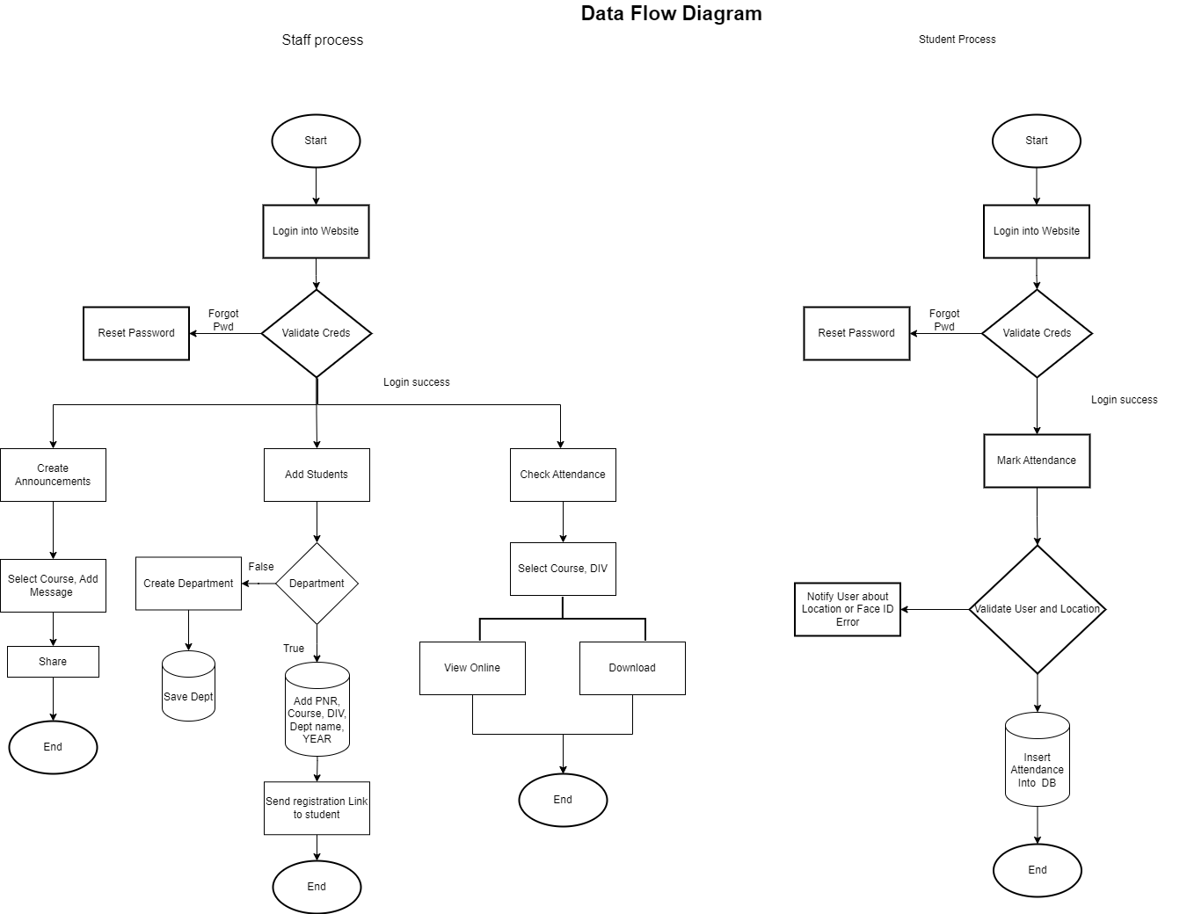

Slide 6
Show Alert and report of user with more absent
Add option to select Subject

Slide 7
System & Hardware requirement
Language and Software
Front end:- HTML, CSS3, Javascript, Android
BackEnd:- Python, SQL
Operating System:- Windows, Linux
backend architecture:- Microservice
Frameworks:- Django, FastAPI, Tensorflow/Pytorch:
RAM:- 4GB Storage:- 10 GB Processor:- Intel/AMD dual core or above

Slide 8
Thank you..
Presented By:
Rashmith Devadiga and Satyam Pawar

