Slide 1
Major Project (EI481P)
Phase - 2
Title: Design and Development of a Low-Power, High-Speed FPGA-Based System for Real-Time Seizure Detection
Subtitle: Simulation Phase — Behavioral Verification Using Vivado XSim
Guide: Dr. B. G. Sudarshan
NAME | USN
Rashmitha Rani BN | 1RV22EI040

Slide 2
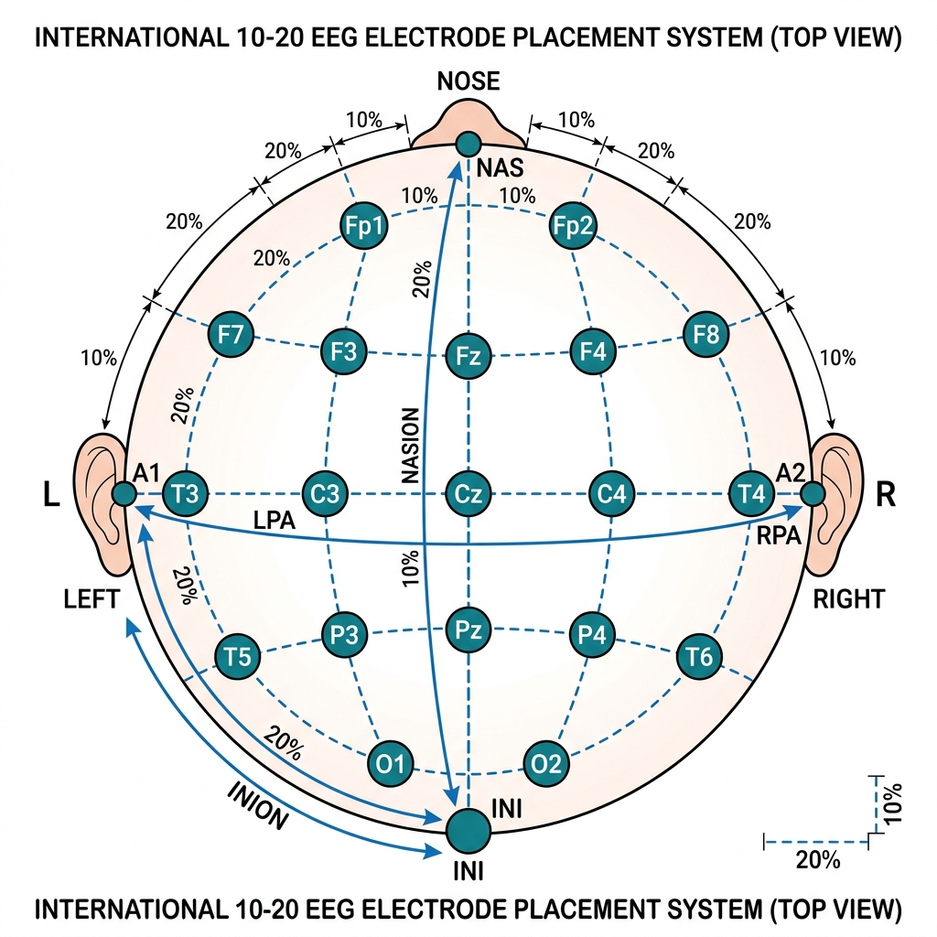
INTRODUCTION
Epilepsy is one of the most common neurological disorders, affecting over 50 million people worldwide (WHO, 2023).
Seizures are caused by sudden, abnormal electrical discharges in the brain.
Early and accurate detection of seizures is critical for timely medical intervention and improving patient quality of life.
Electroencephalogram (EEG) is the gold standard for monitoring brain electrical activity and detecting epileptic events.
Current software-based detection systems suffer from high latency and power consumption, making them unsuitable for portable, real-time applications.

Slide 3
PROBLEM STATEMENT
Existing seizure detection systems are predominantly software-based (running on CPUs/GPUs), which introduces:
1. High processing latency (milliseconds to seconds)
2. High power consumption (unsuitable for wearable/implantable devices)
3. Dependency on operating systems (risk of crashes, delays)
The Critical Need:
There is a critical need for a dedicated hardware solution that can process EEG signals in real-time with:
- Ultra-low latency (nanosecond-level response)
- Low power consumption
- Deterministic, always-on operation

Slide 4
LITERATURE REVIEW
Author(s) | Year | Title | Description
Adeli, H., Zhou, Z., & Dadmehr, N. | 2003 | Analysis of EEG records in an epileptic patient using wavelet transform | Introduced the use of wavelet transform for EEG analysis, showing that DWT can effectively decompose EEG signals into clinically relevant frequency sub-bands such as delta, theta, alpha, beta, and gamma.
Acharya, U.R., et al. | 2013 | Automated EEG analysis of epilepsy: A review | Provided a comprehensive review of EEG-based seizure detection techniques, highlighting the importance of combining non-linear features (entropy, Hjorth parameters) with time-frequency methods for improved accuracy.
Shoka, A., et al. | 2023 | An Efficient FPGA-Based Approach for Automatic Epileptic Seizure Detection Using EEG Signals | Presented an FPGA implementation using Hjorth descriptors and KNN classifier on Spartan-6, achieving 90.74% accuracy with fast classification and low resource utilization (<10% LUTs).
Hossain, K.M., et al. | 2023 | FPGA-Based Multi-Channel EEG Seizure Detection System | Developed a multi-channel EEG seizure detection system using DWT and SVM on Zynq-7000 FPGA, achieving 88.6% accuracy with efficient processing and moderate power consumption.

Slide 5
LITERATURE REVIEW
Author(s) | Year | Title | Description
Chen, Z., et al. | 2024 | Wearable Epilepsy Seizure Detection Using Spiking Neural Networks on FPGA | Proposed an ultra-low-power FPGA implementation using spiking neural networks (SNN), achieving very fast inference time (0.5 µs) and extremely low energy consumption, suitable for wearable systems.
Daoud, H. & Bhatt, M.A. | 2023 | Automated Seizure Detection on FPGA Using Artix-7 | Demonstrated a threshold-based seizure detection system on Artix-7 FPGA with high accuracy (~98%) and very low power consumption, though with relatively higher detection latency.
Rafiee, J., et al. | 2011 | Wavelet basis functions in biomedical signal processing | Identified Daubechies-4 (db4) as an optimal wavelet for EEG signal analysis due to its superior time-frequency resolution for detecting epileptic patterns.
Park, J., et al. | 2023 | Resource-Optimized DWT on Virtex-7 FPGA | Proposed an optimized DWT architecture using polyphase structure, reducing area and power while improving processing speed for FPGA-based implementations.

Slide 6
IDENTIFIED GAPS IN EXISTING SYSTEMS:
1. Power-Accuracy Trade-off: Systems achieving high accuracy often consume more power, while ultra-low-power systems sacrifice detection accuracy.
2. Limited Multi-channel Support: Most implementations process single-channel EEG, limiting clinical utility.
3. High Detection Latency: Several systems exhibit latencies >3 seconds, which is too slow for responsive neurostimulation.
4. Lack of Adaptability: Fixed-algorithm implementations cannot adapt to patient-specific seizure patterns.
KEY INSIGHT:
Most prior works either use computationally expensive ML models or are implemented purely in software. Our approach balances simplicity, speed, and hardware efficiency.

Slide 7
OBJECTIVES
1. To design a real-time seizure detection algorithm suitable for hardware implementation.
2. To implement the algorithm in Verilog HDL targeting FPGA architecture.
3. To verify correctness through behavioral simulation using Xilinx Vivado XSim.
4. To validate the design using the CHB-MIT Scalp EEG Database — a clinically recorded, publicly available dataset.
5. To demonstrate a simulation-first development methodology before hardware deployment on the Basys 3 (Artix-7) FPGA board.

Slide 8
METHODOLOGY
1. Data Acquisition: Real patient EEG recordings from CHB-MIT database
2. Preprocessing: Python (MNE library) → Extract channel → Scale to microvolts → Quantize to 16-bit signed integers
3. Hardware Design: Verilog HDL module with sliding window algorithm
4. Verification: Vivado XSim behavioral simulation with waveform analysis

Slide 9
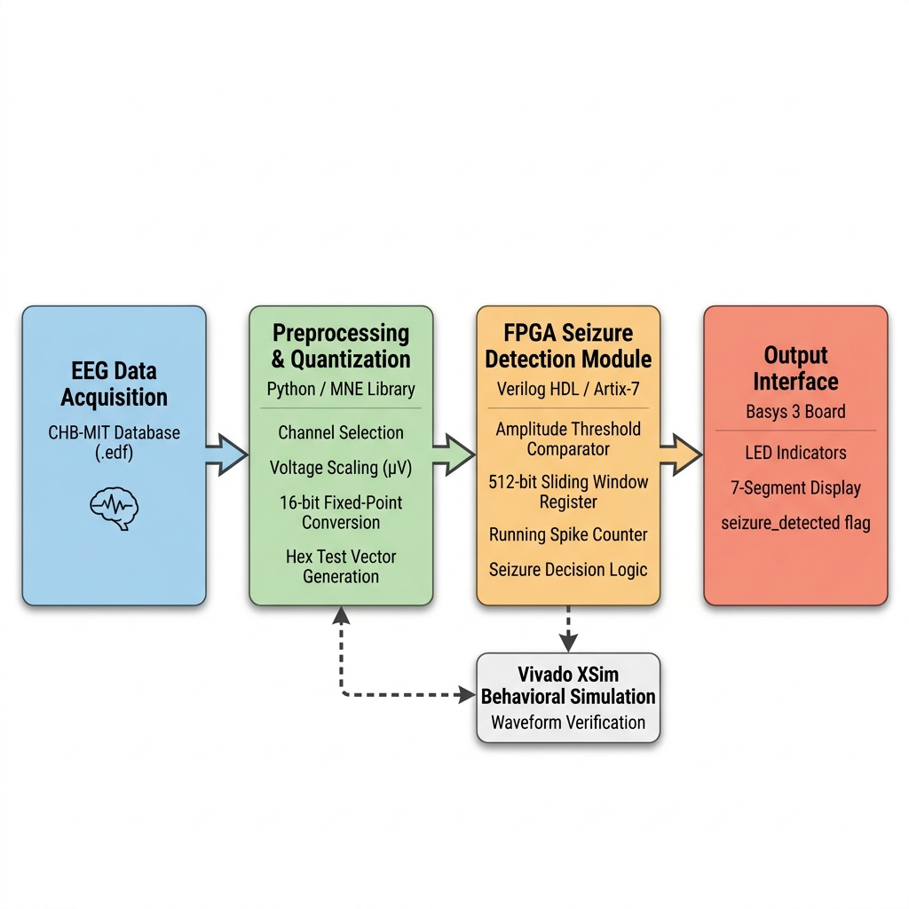
SYSTEM ARCHITECTURE

Slide 10
DATASET DESCRIPTION
CHB-MIT Scalp EEG Database
Source: Children's Hospital Boston & MIT (PhysioNet)
- Subjects: 23 pediatric patients with intractable epilepsy
- Channels: 23 EEG channels (International 10-20 system)
- Sampling Rate: 256 Hz, Resolution: 16-bit
- Used Recording: Patient `chb01`, File `chb01_03.edf`
- Total duration: 3600 seconds (1 hour)
- Seizure event: 2996s to 3036s (40 seconds)
- Test Window: 2800s to 3100s (300 seconds = 5 minutes)
- 196 seconds of normal activity before seizure
- 40 seconds of seizure activity
- 64 seconds of normal activity after seizure
- Channel Used: FP1-F7 (frontal lobe — highly sensitive to seizure activity)

Slide 11
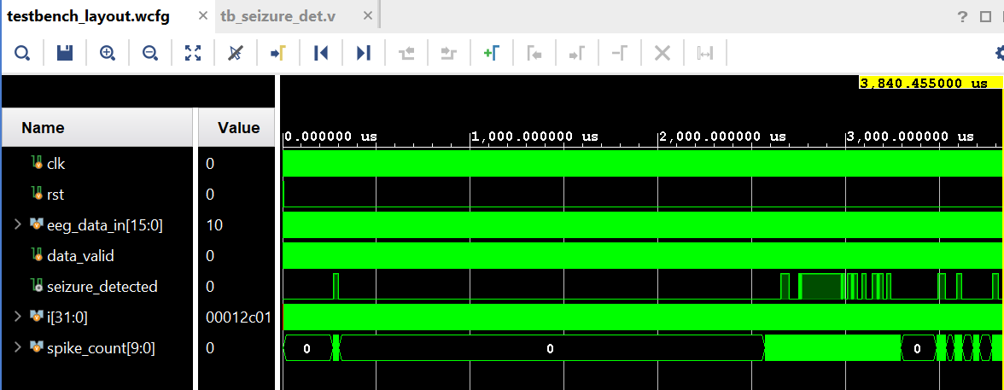
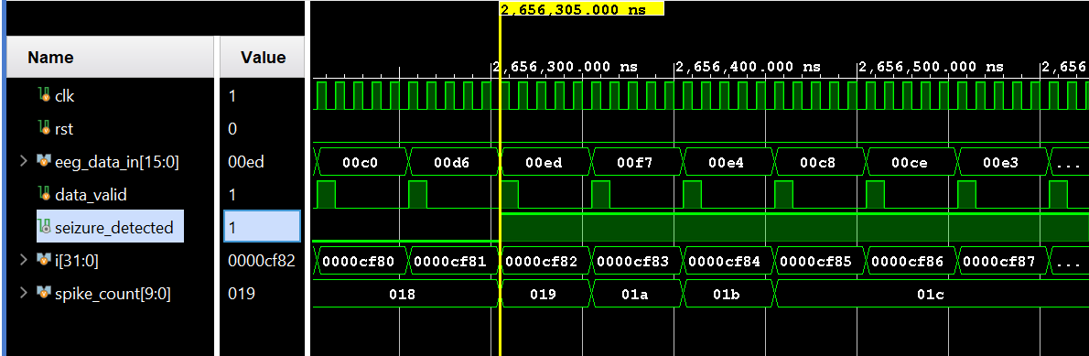
SIMULATION RESULTS
Behavioral Simulation Results — Vivado XSim
Show `spike_count` gradually increasing
- Show the exact moment `spike_count` crosses threshold of 25
- Show `seizure_detected` transitioning from 0 → 1
Show the entire 5-minute simulation
- `seizure_detected` remains LOW during normal activity
- `seizure_detected` goes HIGH during the seizure window
- `seizure_detected` returns LOW after seizure ends

Slide 12
CONCLUSION
Successfully designed and simulated a real-time epileptic seizure detection system using Verilog HDL on Xilinx Vivado.
The Sliding Window Spike Counter algorithm provides robust detection by requiring sustained abnormal activity, effectively filtering random noise and artifacts.
Behavioral simulation using real patient data from the CHB-MIT database confirms:
Correct detection during seizure periods
Zero false alarms during normal brain activity
Clean state transitions at seizure onset and offset
The design consumes less than 3% of FPGA resources, making it highly scalable.
- The simulation-first methodology ensures design correctness before hardware deployment, reducing debugging time and risk.
Key Observations:
- Zero false positives during the 196-second normal activity period
- Seizure correctly detected within the known seizure window
- Clean ON/OFF transitions with no flickering

Slide 13
FUTURE SCOPE
1. Hardware Deployment: Program the verified design onto the Basys 3 FPGA board with LED and 7-segment display outputs.
2. Multi-Channel Processing: Extend the design to process multiple EEG channels simultaneously for improved accuracy.
3. Advanced Algorithms: Implement frequency-domain features (FFT/Wavelet Transform) for more sophisticated classification.
4. Machine Learning Integration: Deploy a lightweight neural network classifier on FPGA for higher sensitivity.
5. Real-Time ADC Interface: Connect an Analog-to-Digital Converter for live EEG signal acquisition.
6. Clinical Validation: Test with additional patients from the CHB-MIT database and the University of Bonn dataset.
7. Low-Power Optimization: Target Xilinx Spartan or Lattice iCE40 FPGAs for ultra-low-power wearable applications.

