Slide 1

Code Refactoring and Bug Fixing

Slide 2
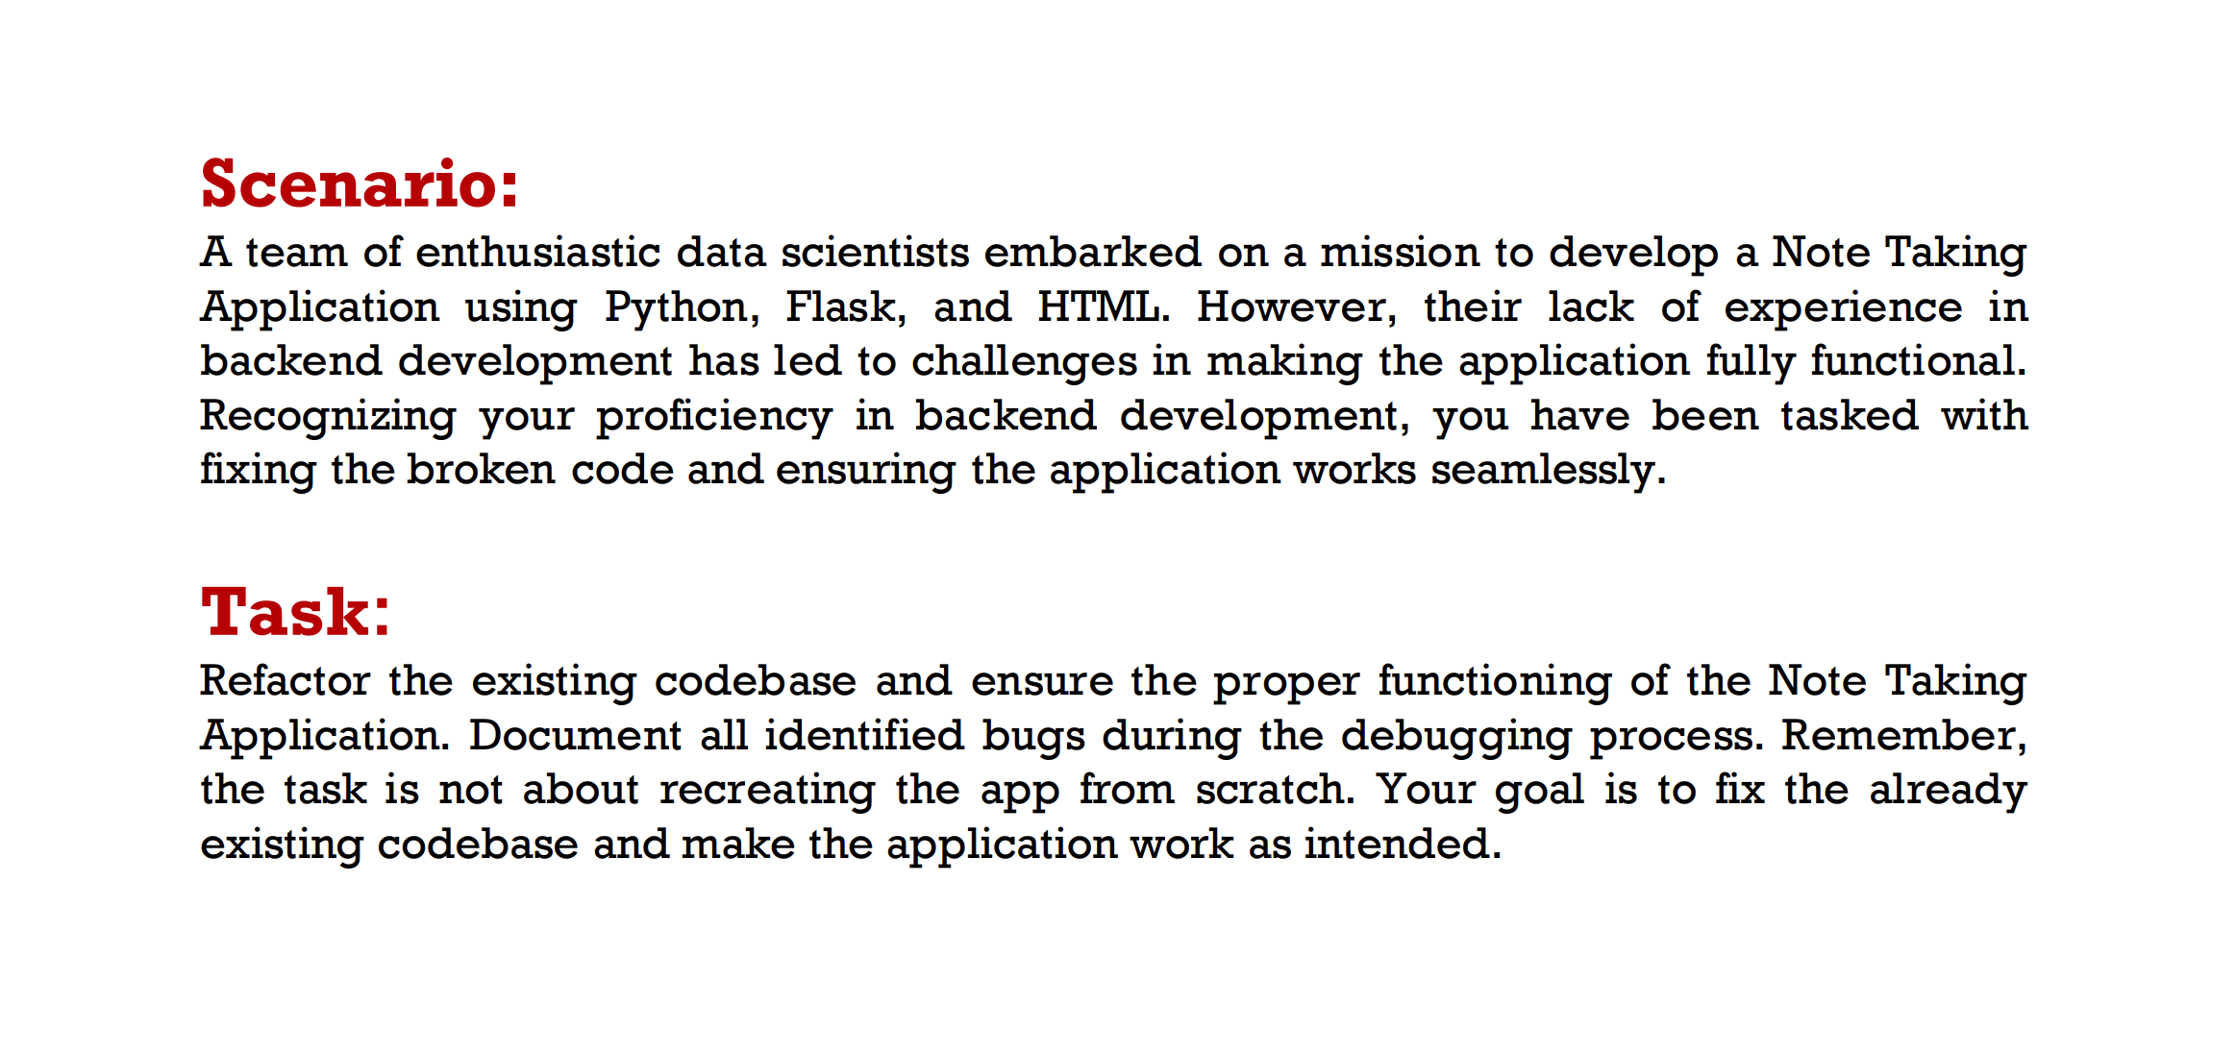

Slide 3
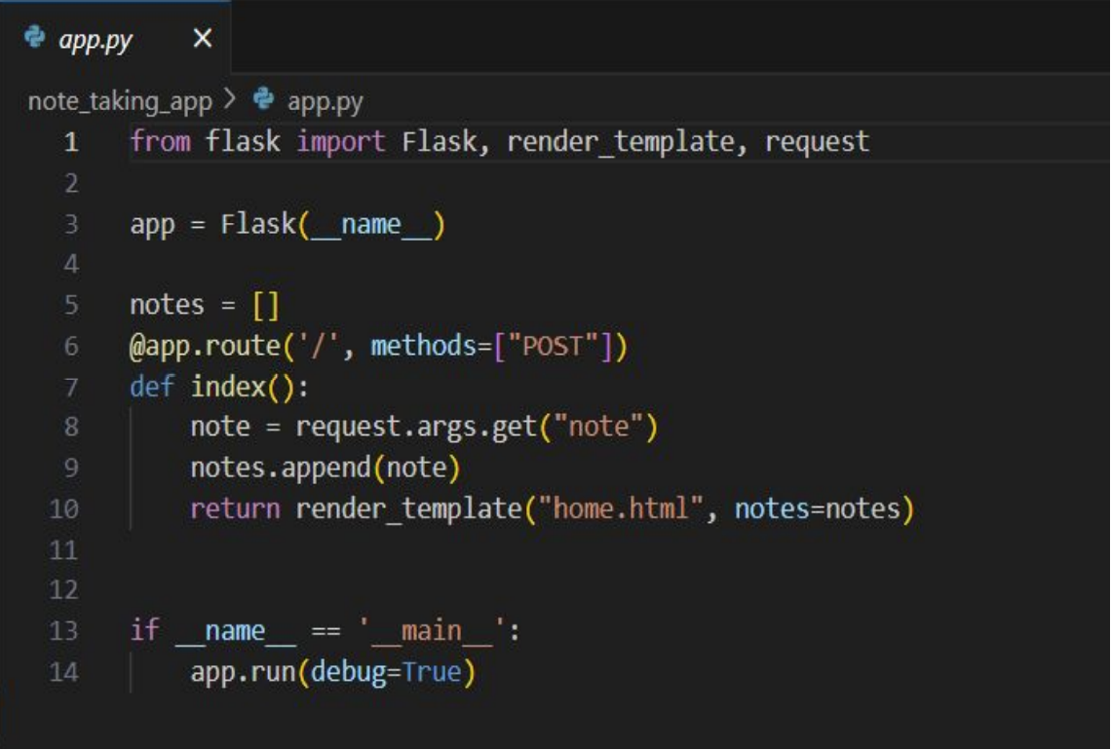
BUG 1
Bug: In app.py the route was defined with methods =[‘POST’], but in home.html was using default GET Method.
Bug Fixing: I have changed method to [“POST”,”GET”] in app.py

Slide 4
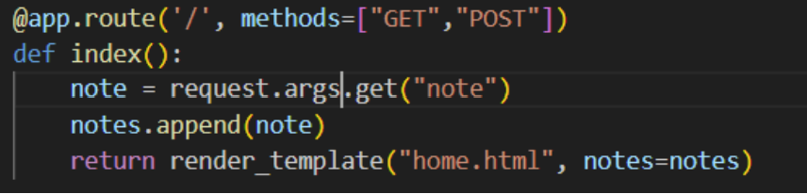
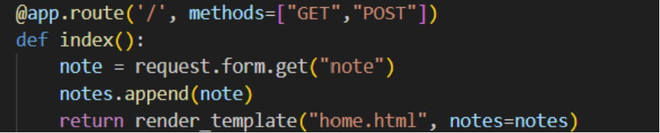
BUG 2
Previous code:
After fixing the previous bug, webpage opened
Bug: For this page, data need to sent as a part of the URL, typically in the form of key-value pairs. This is not a correct way to get data from the client.
Bug Fixing: Replace ‘args’ with ‘form’ in the following line of code.
Modified code:

Slide 5
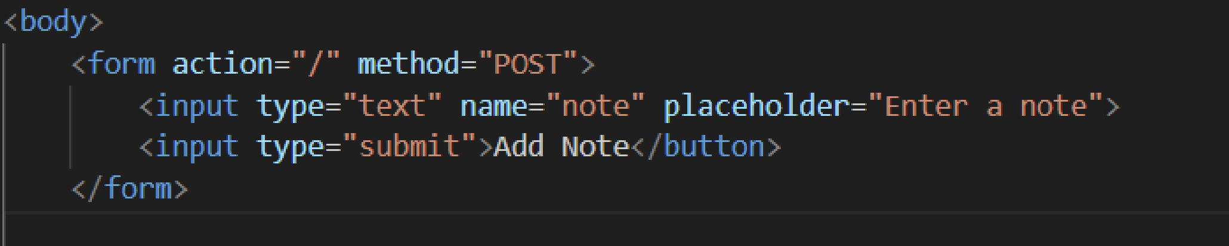
BUG 3
Bug: Type of the button is not mentioned
Bug Fixing: Mention the type of the button.(“Submit”)

Slide 6
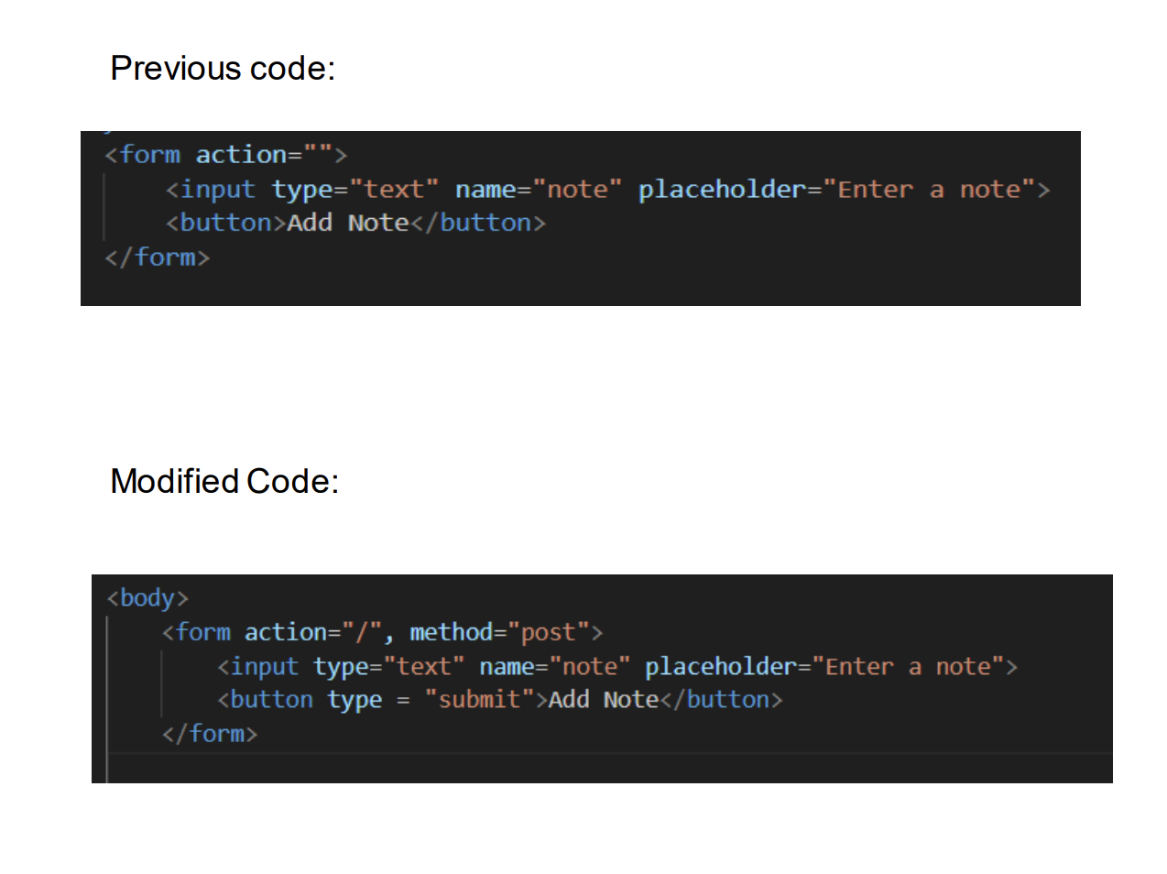
BUG 4
Bug: method for the form tag is not given.
Bug Fixing: Give “POST” as the attribute value for method.

Slide 7
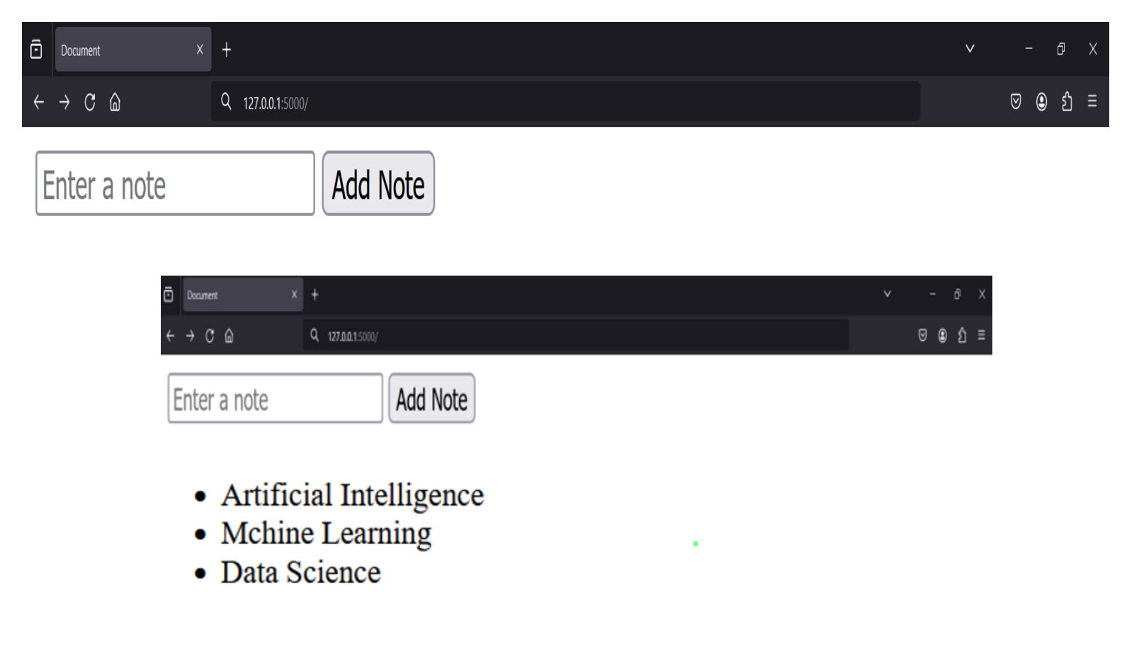
After refactoring and bug fixing ,displayed in the browser, code runs successfully

Slide 8

THANK YOU

