Slide 1
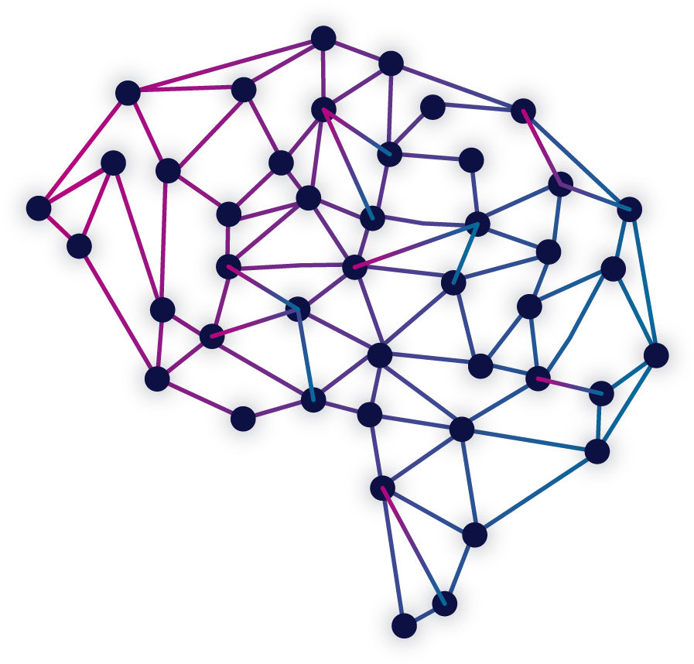
Name:- Rashmi Upadhyay Topic:- Deep Learning (Use Case) Batch:-DSFT4 Mentor Name:- Kshitij Upadhyay

Slide 2
CONTEXT & Business Goals Use Case 1
Advance car assistance system. Develop a system that collects, stores and analyzes the data periodically and repeatedly simulates the data as new data comes.
Also perform voice based commands(tasks).
Tool should warn the customer when any unusual activity/behavior detected in data.
Increase car performance.
Increase customer satisfaction.
Increase sales and profit.

Slide 3
Deep Learning Applications &Accomplish Business goals by DL applications
By using deep learning we can prevent accidents, can track status of cars such as if it needs servicing or some parts need to be change.
DL/ML algorithms can be used to perform tasks based on voice commands such as opening/closing doors/windows, using location, music system, ac etc.
Any vulnerability can be fixed such as defects in engine, heating problems.
Defects can be fixed on early stage.
Maintenance would be easy if defects can be found on early stage and may prevent some dangerous events or accidents.
By using sensors in cars (self driving) can prevent the breaching of traffic rules by using the image/video of traffic signal light and by using image/video processing, and it can prevent to lead the major accidents as well.
Advance assistance system machine learning tasks can be accomplished by DL applications.
It will increase customer satisfaction and it will lead to increase sales and profit.

Slide 4
Kind of data needed for application
Automated anomaly detected on based on data gathering any corrupted files or data shouldn’t be there.
Data need to be stored such as engine type, condition, fuel type, tyre condition etc.
Deep learning is a key technology behind driverless cars, enabling them to recognize a stop sign, or to distinguish a pedestrian from a lamppost.

Slide 5
CONTEXT & Business Goals (Use Case – 2)
Advance voice based system. Develop a system that collects, stores and analyzes the data periodically and repeatedly simulates the data as new data comes.
Tool should warn the customer when any unusual activity/behavior detected in data.
Increase payment system performance.
Increase customer satisfaction (mostly senior citizens and illiterate people.)
Increase sales and profit.
More efficient transactions.
To avoid standing in line in banks for hours.

Slide 6
Deep Learning Applications &Accomplish Business goals by DL applications
By using deep learning we can prevent frauds , can track bank account details.
By using command based system we can target audience such as senior citizens and illiterate people who are not able to use such tools and applications so they don’t need to go to bank for every single transaction.
Can make payment, check balance, can avail some other services such as bank statement generation, time efficient etc.
All these services they can avail via voice system, in their linguistics, so it may also solve language barrier, that will lead to make them also to avail digital services.
Accepting voice commands as input and then using DL/Machine learning algorithms to understand human speech using speech recognition model, then decoding into Natural language understanding to text (Natural Language Processing) and responding back.
It may can happen that someone can try to misuse so, to prevent these kinds of fraudulent- dl/ml algorithms can be used to analyze the pattern, behavior and character of voice that is unique for everyone and it’s called the individualization of user experience.
Advance assistance system machine learning tasks can be accomplished by DL applications.
It will increase customer satisfaction and it will lead to increase sales and profit.

Slide 7
Kind of data needed for application
Automated voice based system works based on data gathering, analysis (details, voice commands).
Data need to be stored such as bank details and personal details such as bank account number, IFSC code, contact number, e-mail etc.
Deep learning and Machine learning algorithms are the key technology behind these kind of application (e.g. advance voice based payment system etc.).

