Slide 1

Amazon Product Review
(Topic: Digital music and Musical Instruments)
-by Group 3
Preeti Pal
Rashmi R. Upadhyay
Minnu Jacob K.
Adithia V.
( DSFT-4
FINAL PROJECT)

Slide 2

Review analysis is important because it helps you understand what customers think of your product, app, or service experience. At its heart reviews/ratings is a customer centric activity. It enables you to make decisions on what to improve based on what your customers value.

Slide 3
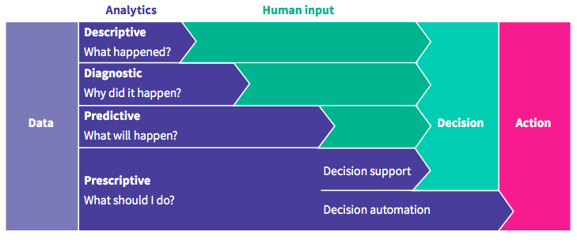
Project Objective:
Analysis of the data and make use of best approaches for forecasting.

Slide 4
DESCRIPTIVE ANALYSIS
There are four initial dataset, namely: reviews_Digital_Music,
reviews_Musical_Instruments,
ratings_Digital_Music,
ratings_Musical_Instruments
Two product review file, and two product rating file, after importing all the data, the review files and ratings file have been concatenated respectively.
The shape of both concatenated files have been displayed.
Null value checks have been done. DataFrames info has been derived.
Central tendency measures has been calculated.
Uniqueness of reviewer/rating ID has been checked.
Distribution of ploys on different attributes has been performed to visualize and better understand the data.

Slide 5
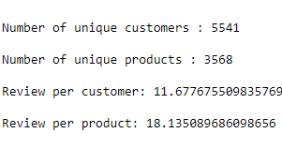
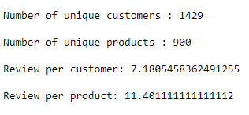
REVIEWS
Describing the data sets
DIGITAL MUSIC:
Rows: 64706
Columns: 9
Other details:
MUSICAL INSTRUMENT:
Rows: 10261
Columns: 9
Other details:

Slide 6
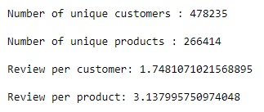
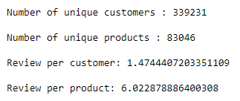
RATING
Describing the data sets
DIGITAL MUSIC:
Rows: 836006
Columns: 4
Other details:
MUSICAL INSTRUMENT:
Rows: 500176
Columns: 4
Other details:

Slide 7
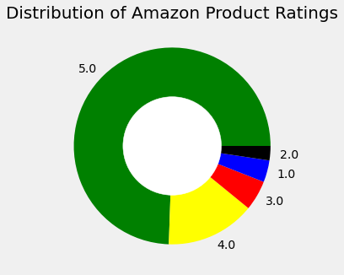
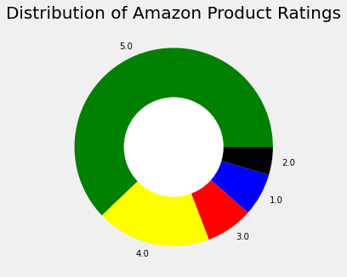
EXPLORATORY ANALYSIS
The adjacent pie chart shows distribution of ratings from 1 to 5, for products.
DIGITAL MUSIC
MUSICAL INSTRUMENT
ITEM CODES | NO. OF 5 RATINGS
B004D1GZ2E | 1576
B0026P3G12 | 1494
B0000AGWEC | 1405
B008K9SG9K | 958
B000BGR18W | 929
ITEM CODES | NO. OF 5 RATINGS
B000ULAP4U | 2829
B003VWJ2K8 | 1780
B003VWKPHC | 1235
B00FPPQYXM | 1077
B009E3EWPI | 967

Slide 8
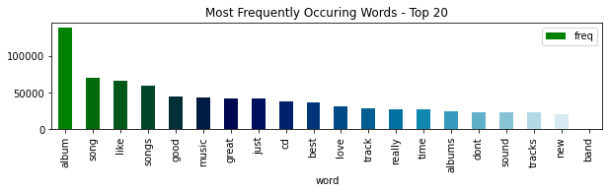
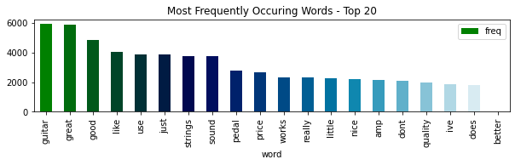

Punctuations, numbers, accented characters and special characters have been removed here for further analysis.
DIGITAL
MUSIC
No of words
MUSICAL
INSTRUMENT

Slide 9
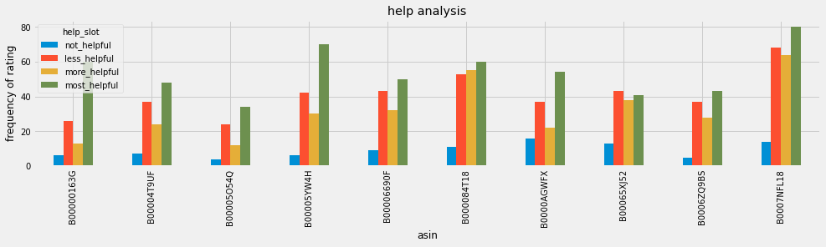
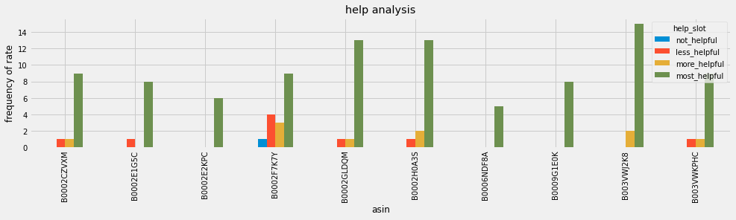
The below graph depicts comparison of helpful reviews of top 10 most rated products.
DIGITAL
MUSIC
MUSICAL
INSTRUMENT

Slide 10
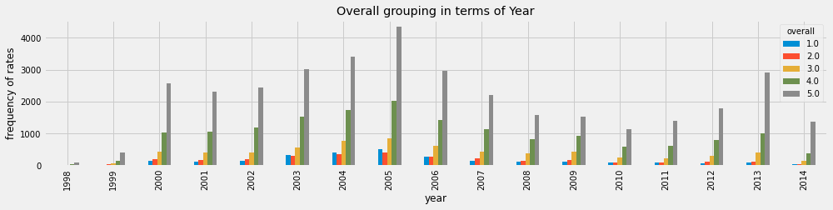
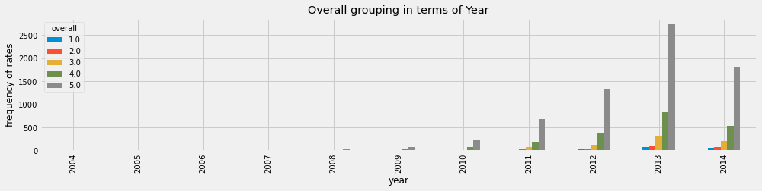
The below graph shows the ratings over years also the trend of the graph indicated popularity of one product over another.
DIGITAL
MUSIC
MUSICAL
INSTRUMENT

Slide 11
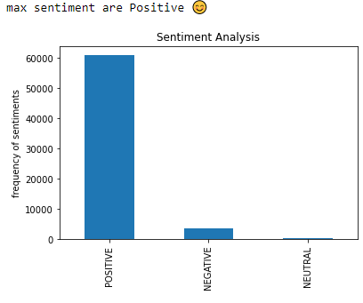

PREDICTIVE ANALYSIS
Based on the ‘review text’ and ‘summary’ of the data, identify how a review can be classified into a particular category (for example, positive, negative and neutral).
Analyse the text well to build the categories. In case of many negative sentiments associated with a product, try to find out the reasons.
FEW EXAMPLES OF REVIEW TEXT FROM EACH SENTIMENT TYPE.
PRODUCT CODES | REVIEW TEXT | SENTIMENT
5555991584 | I just recently purchased her ''Paint The Sky, New Enya Fan. Simply beautiful”. | POSITIVE
5555991584 | Over the past twenty-odd years, Enya Brennan has Definitely One of Her Best. | POSITIVE
B00000016W | You simply can't not have this album. It's ridiculous album. | NEGATIVE
B00HUAP0NK | Horrible Quality can hardy hear it !!!!! Stinks......... | NEGATIVE
B00000053B | i cant get enough of this CD. all the songs. Do Ur Thing. | NEUTRAL
B00FY9KQ9C | I felt like they did not know the music, as it | NEUTRAL
DIGITAL MUSIC

Slide 12
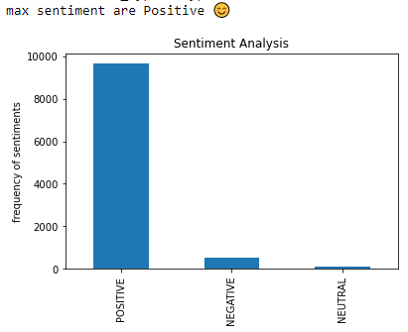

FEW EXAMPLES OF REVIEW TEXT FROM EACH SENTIMENT TYPE.
PRODUCT CODE | REVIEW TEXT | SENTIMENT
1384719342 | Nice windscreen protects my MXL mic and prevent. GOOD WINDSCREEN FOR THE MONEY | POSITIVE
B00JBIVXGC | Great, just as expected. Thank to all. Five star. | POSITIVE
B000068NW5 | I didn't expect this cable to be so thin. Cannot recommend. | NEGATIVE
B00FXKIG5I | Added December 5:Has yet to fall off the fiddle. Has there ever been a bad Snark tuner with this | NEGATIVE
B000068O4H | Just a basic female XLR to 1/4 inch male adapt. Works as intended | NEUTRAL
B00005ML71 | I bought this to use in my home studio to cont. It works! | NEUTRAL
MUSICAL INSTRUMENT

Slide 13
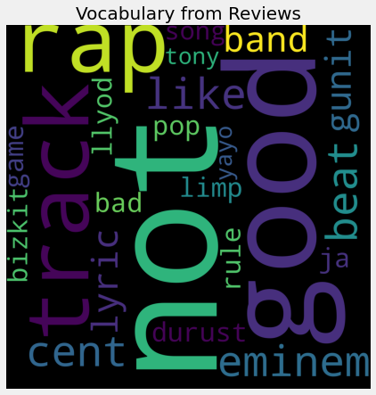
DIGITAL MUSIC
PRODUCT CODE | REASON FOR NEGATIVE REVIEWS
B00004T9UF | eminem rap not good track
B00004XOWM | durust band limp bizkit band not good lyric
B00006690F | eminem rap track not good lyric
B00006ZCFJ | ja rule bad rap pop track
B000084T18 | cent rap not good beat
B0000TAZS8 | gunit llyod cent track beat not good
B00065XJ52 | not like eminem
B0006ZQ9BS | game not like rap
B0007NFL18 | song beat not like cent track
B0009SCVTG | gunit tony yayo not good
Here are few examples of top negative rated products, by the help of word cloud for each record, we tried to find out the reason for a product being negative.
The word clouds show why the reviews have been selected as negative. Eg the biggest word in word cloud is ‘not’, which is a negative word.

Slide 14
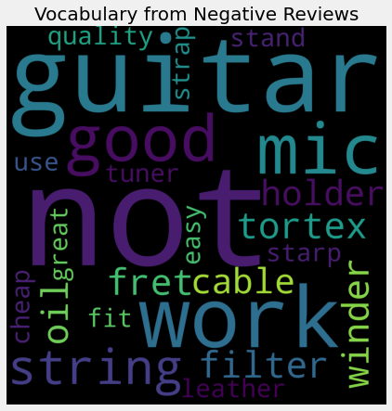
MUSICAL INSTRUMENT
PRODUCT CODE | REASON FOR NEGATIVE REVIEWS
B0002CZW0Y | mic filter not work
B0002D0CEO | tortex not good
B0002D0CQC | guitar string oil fret
B0002E1G5C | guitar winder string not work
B0002GLDQM | guitar holder not work
B0002GMGYA | cable quality not fit
B0002IHFVM | guitar strap cheap
B0009G1E0K | leather strap not great
B0018TAITA | mic stand not good
B003VWJ2K8 | guitar tuner not easy use
Here are few examples of top negative rated products, by the help of word cloud for each record, we tried to find out the reason for a product being negative.
The word clouds show why the reviews have been selected as negative. Eg the biggest word in word cloud is ‘not’, which is a negative word.

Slide 15
2. Identify the names of few products by analysing your input text data.
PREDICTIVE ANALYSIS
Names have been assigned to each product code. This has been done by using word cloud for each records to fetch product name. Here are list of top 10 most positive rated products.
DIGITAL MUSIC
MUSICAL INSTRUMENT
PRODUCT CODE | MUSIC ALBUM NAME
B00000163G | classic_song_album
B0000025RI | michael_jackson_thriller_song_album
B000023VR6 | dr_dre_rap_beat_classic_song_album
B00004T9UF | eminem_song_album_1
B00005O54Q | jayz_classic_song_album
B00005YW4H | norah_jones_song_album
B00006690F | eminem_song_album_2
B000084T18 | cent_eminem_rap_beat_song_album
B0000AGWFX | andre_love_song_album
B0007NFL18 | dre_eminem_cent_good_beat_song_album
PRODUCT CODE | MUSIC INSTRUMENT NAME
B0002CZVXM | guitar_strap_lock_screw
B0002E1G5C | guitar_string_winder_pin
B0002E2KPC | guitar_capo_string
B0002F7K7Y | daddario_electric_guitar_string
B0002H0A3S | acoustic_daddario_guitar_tring
B0006NDF8A | guitar_stand_strap
B0009G1E0K | guitar_leather_strap
B003VWJ2K8 | guitar_snark_tuner1
B003VWKPHC | guitar_snark_tuner2
B004XNK7AI | guitar_snark_tuner3

Slide 16
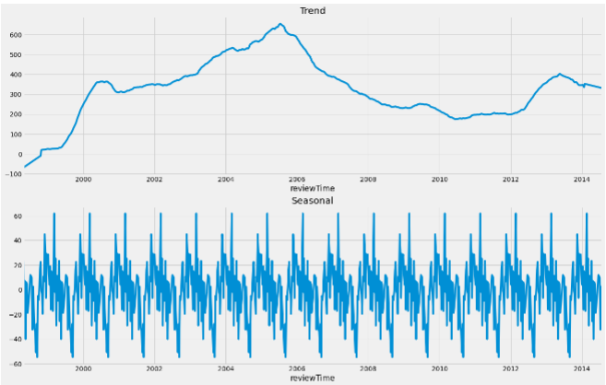
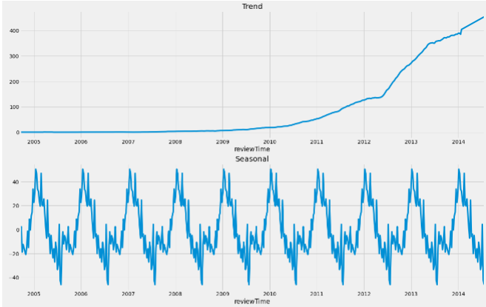
3. Predict future data trends: How the sentiments of reviewers change with time. Suppose input data is provided for the period 1996-2014. Your task is to predict the trends after 2014.
From both graphs seasonality is prominent and thus can be said that buyers of these products follow a trend in equal intervals.
DIGITAL MUSIC
MUSICAL INSTRUMENT

Slide 17
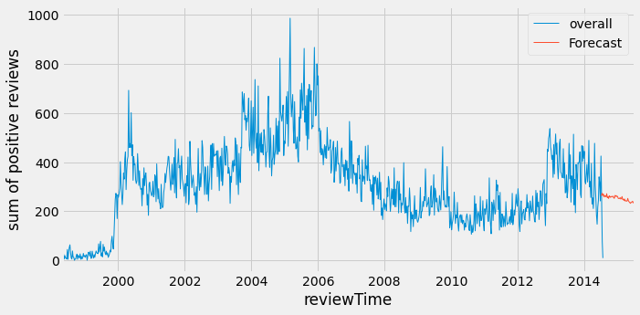
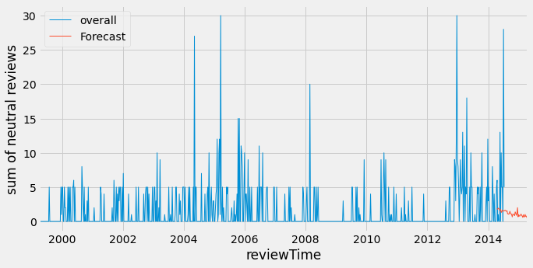
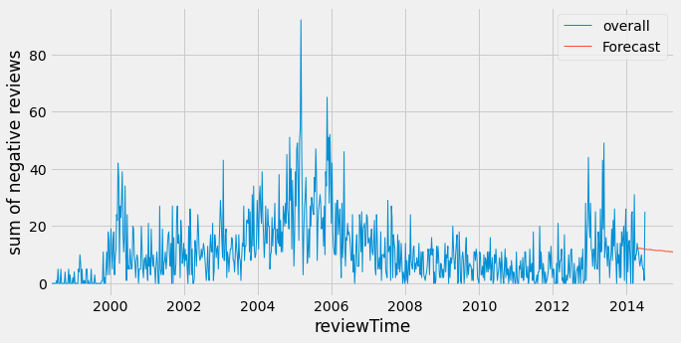


TIME SERIES USING SARIMA MODEL
DIGITAL MUSIC
POSITIVE
NEUTRAL
NEGATIVE
All the three sentiments are showing negative trend as they show a downwards decline, this may be concluded as the popularity of the product is going down not in market and that is not dependent on sentiment.

Slide 18
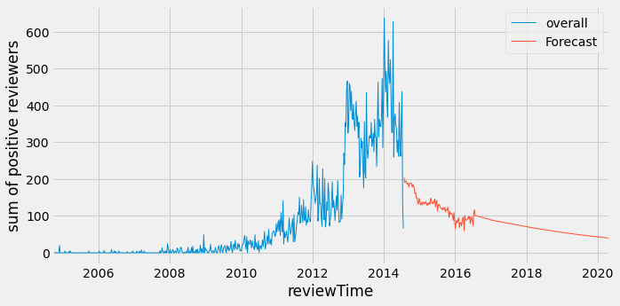
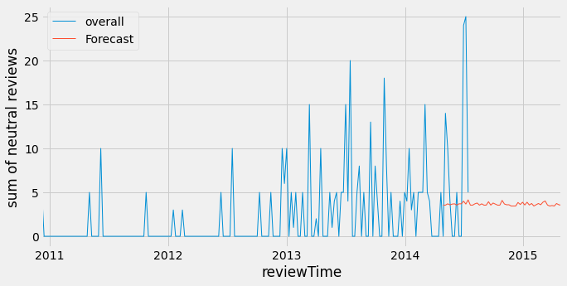
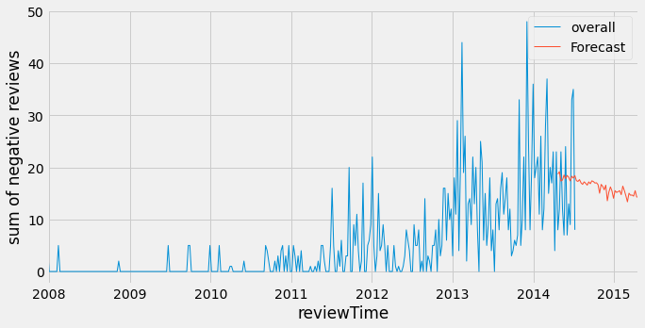
MUSICAL INSTRUMENT
POSITIVE
NEUTRAL
NEGATIVE
All the three sentiments are showing negative trend as they show a downwards decline, this may be concluded as the popularity of the product is going down not in market and that is not dependent on sentiment.
Yet, in near future positive and negative products shows a high frequency of buyers than neutral products which seems to give a stable result.

Slide 19
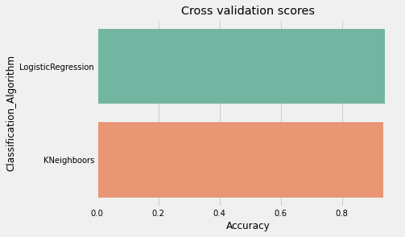


PRESCRIPTIVE ANALYSIS
DIGITAL MUSIC
MUSICAL INSTRUMENT
95%
94%
94%
Logistic regressions and K nearest neighbors classifiers have been used to understand the accuracy of sentiment analysis in terms of ratings and helpfulness of the reviews.

Slide 20
K-MEANS clustering: clustering has been used to categorize a product into quality product, good product, average product and bad product.
PRODUCT CODE | PRODUCT CATEGORY
5555991584 | Quality product
B0000000ZW | Quality product
B000051Y0T | Good product
B000051Y1V | Good product
B000NJLYSA | Average product
B000NO39EC | Average product
B000002O6V | Bad product
B000002O8D | Bad product
DIGITAL MUSIC
PRODUCT CODE | PRODUCT CATEGORY
1384719342 | Quality product
B00004Y2UT | Quality product
B0002IHP0S | Good product
B0002II6V0 | Good product
B00378GEAM | Average product
B0037GXRHM | Average product
B000RKVH0K | Bad product
B000RMQM4E | Bad product
MUSICAL INSTRUMENT
K-means clustering (i.e., an unsupervised machine learning algorithm) has helped us to cluster the Amazon products into four clusters or category, namely quality product, good product, average product and bad product. Two examples of each category from both dataframes have been displayed here.
This will help us easily understand which products are liked by users. This can more be encouraged by bringing around more of such products.
Where as products categorized as average should be modified to upgrade the quality and implemented and products that are being rated as bad repeatedly should be removed.
*A separate csv file has also been created to store the clustered records with product categories for detailed understanding.

Slide 21
4. Can you find any relations/buying trends of customers/any other interesting analysis between given pair of categories
REVIEWER ID | REVIEWER NAME | PRODUCT NAME | AVERAGE RATING OF TOTAL PURCHASES | NO OF PURCHASES
A1LQC225SE8UNI | David Burch | ALBUM | 4.4 | 9
A1T9SCT89JJ96 | David Townsend | GUITAR MUSIC | 5.0 | 5
A2C7BOQVFH1HLE | Frederick Baptist | BRILLIANT SOUNDS VERSION | 4.3 | 98
A1MI9FDCNB3CMR | Jorge Barbarosa "the_bassist" | ELVIS LYRIC ALBUM | 4.3 | 14
A2CARFAX5FNQT9 | McEldoy | GUITAR MUSIC | 4.6 | 6
A27L5L6I7OSV5B | Otto Correct | UNIQUE TITTLE SOUND | 4.3 | 9
A2KKZHISX9YKMI | PJY "pjsailor" | COMMOROCK SOUND TRACK | 4.4 | 7
A18X6ZT4AEYVKB | Yeemeister | BASS JAZZ | 3.6 | 6
A2EW01G2LNJN06 | Z. Mehrbach "Zach" | BELL ROLLINS TONE | 4.2 | 5
A13A81NN0NRD1S | aspiring saint "TATITTLE" | BABY ALBUM | 3.6 | 5
DIGITAL MUSIC:

Slide 22
MUSICAL INSTRUMENT:
REVIEWER ID | REVIEWER NAME | PRODUCT NAME | AVERAGE RATING OF TOTAL PURCHASES | NO OF PURCHASES
A1LQC225SE8UNI | David Burch | CORD | 4.7 | 27
A1T9SCT89JJ96 | David Townsend | FLEXIBLE RUBBER | 3.6 | 5
A2C7BOQVFH1HLE | Frederick Baptist | KARAOKE MIC | 4.1 | 6
A1MI9FDCNB3CMR | Jorge Barbarosa "the_bassist" | MIC | 4.5 | 10
A2CARFAX5FNQT9 | McEldoy | GUITAR | 4.5 | 8
A27L5L6I7OSV5B | Otto Correct | VE CAPO | 4.4 | 10
A2KKZHISX9YKMI | PJY "pjsailor" | PINK CAPO | 4.0 | 5
A18X6ZT4AEYVKB | Yeemeister | PEDAL | 4.7 | 10
A2EW01G2LNJN06 | Z. Mehrbach "Zach" | STRING | 4.6 | 5
A13A81NN0NRD1S | aspiring saint "TATITTLE" | STAND | 4.1 | 11
With the help of common users there will be two benefits for Amazon:
For e. reviewer McEldoy likes guitar music and also bought 8 guitars from Amazon. Now Amazon can customise offers for him to sale more and more products to him.
Also a frequent buyer will have good knowledge about the product and the reviews provided by him will be helpful for Amazon to improve its products.
Also Amazon will understand the combinations in which people are more interested, and might start selling combo products which will bring in more profit for Amazon.

Slide 23
DECISION SUPPORT
After 2005, from our graphs, we can see that there is dip in trend till 2010 in digital music. Which may be result of recession. Although we see both digital music and musical instruments is growing up after 2010.
In 2007, Amazon introduced music in mp3 format which enabled the allow consumers easily to transfer music among a variety of devices – from iPods to personal computers and compact discs. Thus the market for digital music was declining.
With the help of time series we can see there is chance of downward trend among buyers after 2015-16. To overcome this, introduction to new products or ideas may help.
Also from the list created from clustering on product category- quality, good, average, bad, we can easily understand which products are liked by users. This can more be encouraged by bringing around more of such products.
Where as products categorized as average should be modified to upgrade the quality and implemented and products that are being rated as bad repeatedly should be removed.
Our graphs also show the jumping rate of interest in buyers in musical instruments year on year. The idea of improving existing products may help to capture more market share by Amazon. For e.g. Bringing new companies that are into same music business, this may provide more options for buyers.

Slide 24
REFERENCES FOR DECISION MAKING
https://www.ft.com/content/bbe3caec-03bd-11dc-a931-000b5df10621
https://www.bbvaopenmind.com/en/articles/the-music-industry-in-an-age-of-digital-distribution/
https://www.technavio.com/report/electronic-musical-instruments-market-industry-analysis
https://www.diffen.com/difference/Amazon_MP3_vs_iTunes_Music_Store
https://www.mordorintelligence.com/industry-reports/india-musical-instrument-market
https://soundcharts.com/blog/india-music-market-overview

Slide 25
Torture the data and it will confess to anything.
-Ronald Coase
winner of the Noble Prize in economics
THANK YOU

