Slide 1

Chapter 27
The C Programming Language
Bjarne Stroustrup
www.stroustrup.com/Programming
Dennis M. Ritchie

Slide 2
Abstract
This lecture gives you the briefest introduction to C from a C++ point of view. If you need to use this language, read an introductory book (e.g. K&R). This lecture gives you a hint what to look for.
C is C++’s closest relative, and compatible in many areas, so much of your C++ knowledge carries over.
Stroustrup/PPP - Dec'13

Slide 3
Overview
C and C++
Function prototypes
printf()/scanf()
Arrays and strings
Memory management
Macros
const
C/C++ interoperability
ABIs
An example
Stroustrup/PPP - Dec'13

Slide 4

C and C++
dmr
ken
bwk
bs
doug
…
Both were “born” in the Computer Science Research Department of Bell Labs in Murray Hill, NJ
Stroustrup/PPP - Dec'13

Slide 5
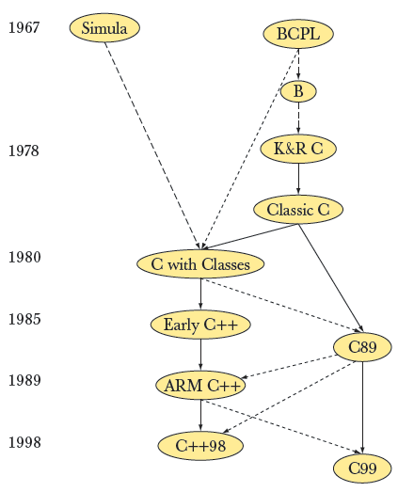
Modern C and C++ are siblings
C++11
C11
C++14
Stroustrup/PPP - Dec'13

Slide 6
C and C++
In this talk, I use “C” to mean “ISO C89”
  That’s by far the most commonly used definition of C
    Classic C has mostly been replaced (though amazingly not completely)
    C99 is not yet widely used, C11 may be catching on
Source compatibility
  C is (almost) a subset of C++
    Example of exception: int f(int new, int class, int bool); /* ok in C */
  (Almost) all constructs that are both C and C++ have the same meaning (semantics) in both languages
    Example of exception: sizeof('a') /* 4 in C and 1 in C++ */
Link compatibility
  C and C++ program fragments can be linked together in a single program
    And very often are
C++ was designed to be “as close as possible to C, but no closer”
  For ease of transition
  For co-existence
  Most incompatibilities are related to C++’s stricter type checking
Stroustrup/PPP - Dec'13

Slide 7
C and C++
Both defined/controlled by ISO standards committees
  Separate committees
    Unfortunately, leading to incompatibilities
  Many supported implementations in use
  Available on more platforms than any other languages
Both primarily aimed at and are heavily used for hard system programming tasks, such as
  Operating systems kernels
  Device drivers
  Embedded systems
  Compilers
  Communications systems
Stroustrup/PPP - Dec'13

Slide 8
C and C++
C is arguably the most successful programming language of all time
  But how would you decide?
    Number of programs written
    Importance of programs written
    Number of programmers
    Longevity
    Influence on other languages
    Benefits/development_cost
  Alternatives
    Fortran
    Cobol
    Lisp
    C++
    Java
    PHP
    Python
    …
Stroustrup/PPP - Dec'13

Slide 9
C and C++
Here we
  assume you know C++ and how to use it
  describe the differences between C and C++
  describe how to program using the facilities offered by C
    Our ideal of programming and our techniques remain the same, but the tool available to express our ideas change
  describe a few C “traps and pitfalls”
  Don’t go into all the details from the book
    Compatibility details are important, but rarely interesting
Stroustrup/PPP - Dec'13

Slide 10
C and C++
C++ is a general-purpose programming language with a bias towards systems programming that
  is a better C
  supports data abstraction
  supports object-oriented programming
  supports generic programming
C:
  Functions and structs
  Machine model (basic types and operations)
  Compilation and linkage model
Stroustrup/PPP - Dec'13

Slide 11
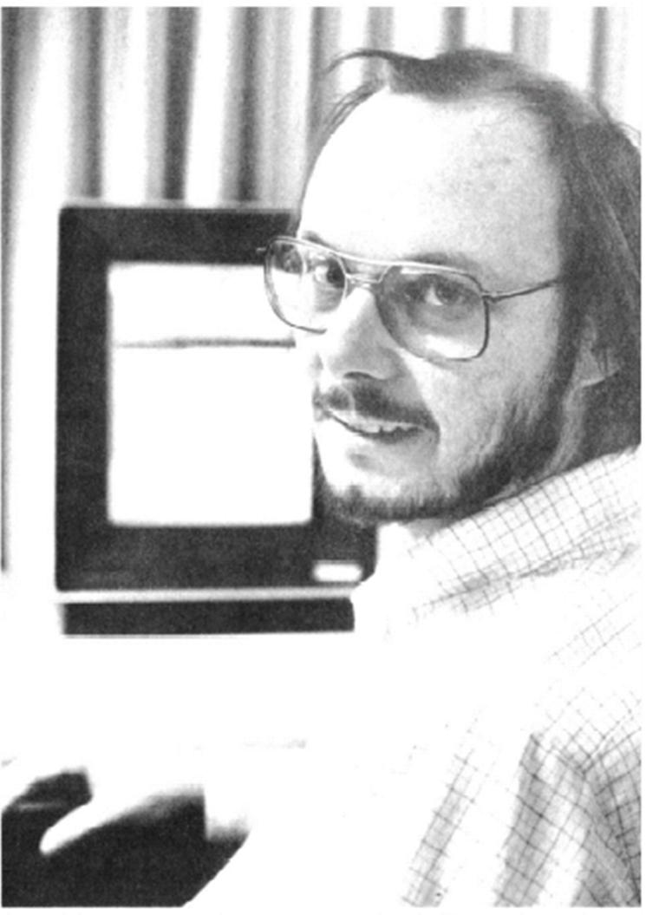
C and C++
In C, borrowed from C++
  Function prototypes (declaration and checking of function arguments)
  Function declaration notation: void f(int x, double y);
  // comments
  const (imperfectly)
  inline (imperfectly)
  Initializers in for loops: for (int i = 0; /* … */
  Declarations after statements
  complex (sort of)
  bool (sort of)
  Ban on “implicit int”: int a; f() { return 2; }
  …
I have never seen a program that could be written better in C than in C++
  I don’t think such a program could exist
Stroustrup/PPP - Dec'13

Slide 12
Missing in C (from a C++ perspective)
Classes and member functions
  Use struct and global functions
Derived classes and virtual functions
  Use struct, global functions, and pointers to functions
  You can do OOP in C, but not cleanly, and why would you want to?
  You can do GP in C, but why would you want to?
Templates and inline functions
  Use macros
Exceptions
  Use error-codes, error-return values, etc.
Function overloading
  Give each function a separate name
new/delete
  Use malloc()/free()
References
  Use pointers
const in constant expressions
  Use macros
Stroustrup/PPP - Dec'13

Slide 13
Missing in C (from a C++ perspective)
With no classes, templates, and exceptions, C can’t provide most C++ standard library facilities
  Containers
    vector, map, set, string, etc.
    Use arrays and pointers
    Use macros (rather than parameterization with types)
  STL algorithms
    sort(), find(), copy(), …
    Not many alternatives
    use qsort() where you can
    Write your own, use 3rd party libraries
  I/O streams
    Use stdio: printf(), getch(), etc.
  Regular expression
    Use a 3rd party library
Stroustrup/PPP - Dec'13

Slide 14
C and C++
Lots of useful code is written in C
  Very few language features are essential
    In principle, you don’t need a high-level language, you could write everything in assembler (but why would you want to do that?)
Emulate high-level programming techniques
  As directly supported by C++ but not C
Write in the C subset of C++
  Compile in both languages to ensure consistency
Use high compiler warning levels to catch type errors
Use “lint” for large programs
  A “lint” is a consistency checking program
C and C++ are equally efficient
  If you think you see a difference, suspect differences in default optimizer or linker settings
Stroustrup/PPP - Dec'13

Slide 15
Functions
There can be only one function of a given name
Function argument type checking is optional
  Use a compiler option that makes it compulsory
There are no references (and therefore no pass-by-reference)
  pass a pointer
There are no member functions
There is an alternative function definition syntax
Stroustrup/PPP - Dec'13

Slide 16
Function prototypes
(function argument checking is optional)
/* avoid these mistakes – use a compiler option that enforces C++ rules */
int g(int); /* prototype – like C++ function declaration */
int h(); /* not a prototype – the argument types are unspecified */
int f(p,b) char* p; char b; /* old-style definition – not a prototype */
{ /* … */ }
int my_fct(int a, double d, char* p) /* new-style definition – a prototype */
{
f(); /* ok by the compiler! But gives wrong/unexpected results */
f(d,p); /* ok by the compiler! But gives wrong/unexpected results */
h(d); /* ok by the compiler! But may give wrong/unexpected results */
ff(d); /* ok by the compiler! But may give wrong/unexpected results */
g(p); /* error: wrong type */
g(); /* error: argument missing */
}
Stroustrup/PPP - Dec'13

Slide 17
printf() – many people’s favorite C function
Format string
/* no iostreams – use stdio */
#include<stdio.h> /* defines int printf(const char* format, …); */
int main(void)
{
printf("Hello, world\n");
return 0;
}
void f(double d, char* s, int i, char ch)
{
printf("double %g string %s int %i char %c\n", d, s, i, ch);
printf("goof %s\n", i); /* uncaught error */
}
Arguments to be formatted
Formatting characters
Format strings
Stroustrup/PPP - Dec'13

Slide 18
scanf() and friends
/* the most popular input functions from <stdio.h>: */
int i = getchar(); /* note int, not char;
getchar() returns EOF when it reaches end of file */
char* q = gets(p); /* read '\n' terminated line into char array pointed to by p */
/* sets q to p if read succeeds; sets q to NULL if read fails */
void f(int* pi, char* pc, double* pd, char* ps)
{ /* read into variables whose addresses are passed as pointers: */
scanf("%i %c %g %s", pi, pc, pd, ps);
/* %s skips initial whitespace and is terminated by whitespace */
}
int i; char c; double d; char s[100]; f(&i, &c, &d, s); /* call to assign to i, c, d, and s */
Don’t ever use gets() or scanf("%s")!
  Consider them poisoned
  They are the source of many security violations
  An overflow is easily arranged and easily exploitable
  Use getchar()
Stroustrup/PPP - Dec'13

Slide 19
printf() and scanf() are not type safe
double d = 0;
int s = 0;
printf("d: %d , s: %s\n", d, s); /* compiles and runs */
/* the result might surprise you */
“s” for “string”
“d” for “decimal”, not “double” (use “g” for double)
Though error-prone, printf() is convenient for built-in types
printf() formats are not extensible to user-defined types
  E.g. no %M for My_type values
Beware: a printf () with a user-supplied format string is a cracker tool
Stroustrup/PPP - Dec'13

Slide 20
Arrays and pointers
Defined almost exactly as in C++
In C, you have to use them essentially all the time
  because there is no vector, map, string, etc.
Remember
  An array doesn’t know how long it is
    it “decays” to a pointer
  There is no array assignment
    use memcpy()
  A C-style string is a zero-terminated array of char
Stroustrup/PPP - Dec'13

Slide 21
C-style strings
In C a string (called a C-string or a C-style string in C++ literature) is a zero-terminated array of characters
  char* p = "asdf";
  char s[ ] = "asdf";
p:
'a'
's'
'd'
'f'
0
s:
'a'
's'
'd'
'f'
0
Stroustrup/PPP - Dec'13

Slide 22
C-style strings
Comparing strings
  #include <string.h>
  if (s1 = = s2) { /* do s1 and s2 point to the same array? */
  /* (typically not what you want) */
  }
  if (strcmp(s1,s2) = = 0) { /* do s1 and s2 hold the same characters? */
  }
Finding the length of a string
  int lgt = strlen(s); /* note: goes through the string at run time */
  /* looking for the terminating 0 */
Copying strings
  strcpy(s1,s2); /* copy characters from s2 into s1 */
  /* be sure that s1 can hold that many characters */
  /* and/or use strncpy */
Stroustrup/PPP - Dec'13

Slide 23
C-style strings
The string copy function strcpy() is the archetypical C function (found in the ISO C standard library)
Unless you understand the implementation below, don’t claim to understand C:
    char* strcpy(char *p, const char *q)
    {
    while (*p++ = *q++);
    return p;
    }
For an explanation see for example K&R or TC++PL4
Stroustrup/PPP - Dec'13

Slide 24
Standard function libraries
<stdio.h> printf(), scanf(), etc.
<string.h> strcmp(), etc.
<ctype.c> isspace(), etc.
<stdlib.h> malloc(), etc.
<math.h> sqrt(), etc.
Warning: By default, Microsoft tries to force you to use safer, but non-standard, alternatives to the unsafe C standard library functions
Stroustrup/PPP - Dec'13

Slide 25
Free store: malloc()/free()
#include <stdlib.h>
void f(int n) {
/* malloc() takes a number of bytes as its argument */
int* p = (int*)malloc(sizeof(int)*n); /* allocate an array of n ints */
/* … */
free(p); /* free() returns memory allocated by malloc() to free store */
}
Stroustrup/PPP - Dec'13

Slide 26
Free store: malloc()/free()
Little compile-time checking
  /* malloc() returns a void*. You can leave out the cast of malloc(), but don’t */
  double* p = malloc(sizeof(int)*n); /* probably a bug */
Little run-time checking
  int* q = malloc(sizeof(int)*m); /* m ints */
  for (int i=0; i<n; ++i) init(q[i]); /* initialize ints (Eh?) */
No initialization/cleanup
  malloc() doesn’t call constructors
  free() doesn’t call destructors
  Write and remember to use your own init() and cleanup()
There is no way to ensure automatic cleanup
Don’t use malloc()/free() in C++ programs
  new/delete are as fast and almost always better
Stroustrup/PPP - Dec'13

Slide 27
Uncast malloc()
The major C/C++ incompatibility in real-world code
  Not-type safe
  Historically a pre-standard C compatibility hack/feature
Always controversial
  Unnecessarily so IMO
void* malloc(size_t x); /* allocate x bytes */
/*in C, but not in C++, void* converts to any T* */
void f (int n)
{
int* p = malloc(n*sizeof(int)); /* ok in C; error in C++ */
int* q = (int*)malloc(n*sizeof(int)); /* ok in C and C++ */
/* … */
}
Stroustrup/PPP - Dec'13

Slide 28
void*
Why does void* convert to T* in C but not in C++?
  C needs it to save you from casting the result of malloc()
  C++ does not: use new
Why is a void* to T* conversion not type safe?
  void f()
  {
  char i = 0;
  char j = 0;
  char* p = &i;
  void* q = p;
  int* pp = q; /* unsafe, legal C; error in C++ */
  *pp = -1; /* overwrite memory starting at &i */
  }
Stroustrup/PPP - Dec'13

Slide 29
// Comments
introduced by Bjarne Stroustrup into C++ from C’s ancestor BCPL when he got really fed up with typing /* … */ comments
are accepted by most C dialects including the C99 and C11
Stroustrup/PPP - Dec'13

Slide 30
const
// in C, a const is never a compile time constant
const int max = 30;
const int x; // const not initialized: ok in C (error in C++)
void f(int v)
{
int a1[max]; // error: array bound not a constant (max is not a constant!)
int a2[x]; // error: array bound not a constant (here you see why)
switch (v) {
case 1:
// …
case max: // error: case label not a constant
// …
}
}
Stroustrup/PPP - Dec'13

Slide 31
Instead of const use macros
#define max 30
void f(int v)
{
int a1[max]; // ok
switch (v) {
case 1:
// …
case max: // ok
// …
}
}
Stroustrup/PPP - Dec'13

Slide 32
Beware of macros
#include "my_header.h"
// …
int max(int a, int b) { return a>=b?a:b; } // error: “obscure error message”
As it happened my_header.h contained the macro max from the previous slide so what the compiler saw was
int 30(int a, int b) { return a>=b?a:b; }
No wonder it complained!
There are tens of thousands of macros in popular header files.
Always define macros with ALL_CAPS names, e.g.
#define MY_MAX 30
Never give anything but a macro an ALL_CAPS name
Unfortunately, not everyone obeys the ALL_CAPS convention
Stroustrup/PPP - Dec'13

Slide 33
C/C++ interoperability
Works because of shared linkage model
Works because a shared model for simple objects
  built-in types and structs/classes
Optimal/Efficient
  No behind-the-scenes reformatting/conversions
Stroustrup/PPP - Dec'13

Slide 34
Calling C from C++
Use extern "C" to tell the C++ compiler to use C calling conventions
  // calling C function from C++:
  extern "C" double sqrt(double); // link as a C function
  void my_c_plus_plus_fct()
  {
  double sr2 = sqrt(2);
  // …
  }
Stroustrup/PPP - Dec'13

Slide 35
Calling C++ from C
No special action is needed from the C compiler
/* call C++ function from C: */
int call_f(S* p, int i); /* call f for object pointed to by p with argument i */
struct S* make_S(int x, const char* p); /* make S( x,p) on the free store */
void my_c_fct(int i)
{
/* … */
struct S* p = make_S(17, "foo");
int x = call_f(p,i);
/* … */
}
Stroustrup/PPP - Dec'13

Slide 36
ABIs
Application Binary Interface
  An interface we can use without recompiling the implementation
The problem
  struct file {
  mode_t f_mode;
  loff_t f_pos;
  unsigned short f_flags;
  unsigned short f_count;
  unsigned long f_reada, f_ramax, f_raend, f_ralen, f_rawin;
  struct file *f_next, *f_prev; int f_owner; /* pid or -pgrp where SIGIO should be sent */
  struct inode * f_inode;
  struct file_operations * f_op;
  unsigned long f_version;
  void *private_data; /* needed for tty driver, and maybe others */
  };
Stroustrup/PPP - Dec'13

Slide 37
ABI
A solution:
  Access exclusively through functions
  For example
      FILE* fopen(const char* name, const char* mode);
      printf(FILE*, const char* format, …);
      int fclose(FILE*);
    And NEVER use that FILE directly, just pass the FILE*
Stroustrup/PPP - Dec'13

Slide 38
ABI
C++ alternatives
  Use a functional ABI (exactly like C)
  Use a pure abstract class
    struct Device {
    virtual void open() = 0;
    virtual void close() = 0;
    virtual Status read_into(char*) = 0;
    virtual Status write_from(const char*) = 0;
    // …
    };
ABIs; why not?
  Performance
  Flexibility
Stroustrup/PPP - Dec'13

Slide 39
Word counting example (C++ version)
#include <map>
#include <string>
#include <iostream>
using namespace std;
int main()
{
map<string,int> m;
for (string s; cin>>s; )
m[s]++;
for(const auto& p : m)
cout << p.first << " : " << p.second << "\n";
}
Stroustrup/PPP - Dec'13

Slide 40
Word counting example (C version)
// word_freq.c
// Walter C. Daugherity
#include <stdio.h>
#include <stdlib.h>
#include <string.h>
#define MAX_WORDS 1000 /* max unique words to count */
#define MAX_WORD_LENGTH 100
#define STR(s) #s /* macros for scanf format */
#define XSTR(s) STR(s)
typedef struct record {
char word[MAX_WORD_LENGTH + 1];
int count;
} record;
Stroustrup/PPP - Dec'13

Slide 41
Word counting example (C version)
int main()
{
// … read words and build table …
qsort(table, num_words, sizeof(record), strcmp);
for (iter=0; iter<num_words; ++iter)
printf("%s %d\n",table[iter].word,table[iter].count);
return EXIT_SUCCESS;
}
Stroustrup/PPP - Dec'13

Slide 42
Word counting example (most of main)
  record table[MAX_WORDS + 1];
  int num_words = 0;
  char word[MAX_WORD_LENGTH + 1];
  int iter;
  while (scanf("%" XSTR(MAX_WORD_LENGTH) "s", word) != EOF) {
  for (iter = 0; iter < num_words && strcmp(table[iter].word, word); ++iter);
  if (iter == num_words) {
  strncpy(table[num_words].word, word, MAX_WORD_LENGTH + 1);
  table[num_words++].count = 1;
  }
  else table[iter].count++;
  if (num_words > MAX_WORDS){
  printf("table is full\n");
  return EXIT_FAILURE;
  }
  }
“too clever by half”
Stroustrup/PPP - Dec'13

Slide 43
Word counting example (C version)
In (some) colloquial C style (not written by BS)
It’s so long and complicated! How do I know it’s correct?
  My first reaction – BS
See, you don’t need any fancy and complicated language features!!!
  not my comment – BS
IMHO not a very good problem for using C
  Not an atypical application, but not low-level systems programming
It’s also C++ except the argument to qsort() should be cast to its proper type:
  (int (*)(const void*, const void*))strcmp // cast needed in C++
What are those macros doing?
Maxes out at MAX_WORD words
Doesn’t handle words longer than MAX_WORD_LENGTH
First reads and then sorts
  Inherently slower than the colloquial C++ version (which uses a map)
Stroustrup/PPP - Dec'13

Slide 44
More information
Kernighan & Ritchie: The C Programming Language
  The classic
Stroustrup: TC++PL4, Chapter 44: Compatibility
  C/C++ incompatibilities, on my home pages
Stroustrup: Learning Standard C++ as a New Language.
  Style and technique comparisons
  www.research.att.com/~bs/new_learning.pdf
Lots of book reviews: www.accu.org
Stroustrup/PPP - Dec'13

