Slide 1
C++ Programming:
From Problem Analysis to Program Design, Fourth Edition
Chapter 3: Input/Output

Slide 2
Objectives
In this chapter, you will:
Learn what a stream is and examine input and output streams
Explore how to read data from the standard input device
Learn how to use predefined functions in a program
Explore how to use the input stream functions get, ignore, putback, and peek
C++ Programming: From Problem Analysis to Program Design, Fourth Edition

Slide 3
Objectives (continued)
Become familiar with input failure
Learn how to write data to the standard output device
Discover how to use manipulators in a program to format output
Learn how to perform input and output operations with the string data type
Become familiar with file input and output
C++ Programming: From Problem Analysis to Program Design, Fourth Edition

Slide 4
I/O Streams and Standard I/O Devices
I/O: sequence of bytes (stream of bytes) from source to destination
  Bytes are usually characters, unless program requires other types of information
Stream: sequence of characters from source to destination
Input stream: sequence of characters from an input device to the computer
Output stream: sequence of characters from the computer to an output device
C++ Programming: From Problem Analysis to Program Design, Fourth Edition

Slide 5
I/O Streams and Standard I/O Devices (continued)
Use iostream header file to extract (receive) data from keyboard and send output to the screen
  Contains definitions of two data types:
    istream - input stream
    ostream - output stream
  Has two variables:
    cin - stands for common input
    cout - stands for common output
C++ Programming: From Problem Analysis to Program Design, Fourth Edition

Slide 6
I/O Streams and Standard I/O Devices (continued)
To use cin and cout, the preprocessor directive #include <iostream> must be used
Variable declaration is similar to:
  istream cin;
  ostream cout;
Input stream variables: type istream
Output stream variables: type ostream
C++ Programming: From Problem Analysis to Program Design, Fourth Edition

Slide 7

cin and the Extraction Operator >>
The syntax of an input statement using cin and the extraction operator >> is:
The extraction operator >> is binary
  Left-side operand is an input stream variable
    Example: cin
  Right-side operand is a variable
C++ Programming: From Problem Analysis to Program Design, Fourth Edition

Slide 8
cin and the Extraction Operator >> (continued)
No difference between a single cin with multiple variables and multiple cin statements with one variable
When scanning, >> skips all whitespace
  Blanks and certain nonprintable characters
>> distinguishes between character 2 and number 2 by the right-side operand of >>
  If type char or int (or double), the 2 is treated as a character or as a number 2
C++ Programming: From Problem Analysis to Program Design, Fourth Edition

Slide 9
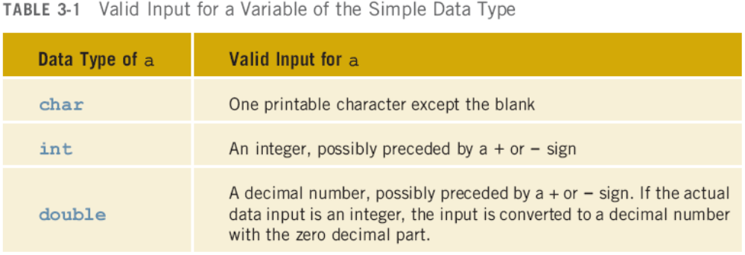
cin and the Extraction Operator >> (continued)
Entering a char value into an int or double variable causes serious errors, called input failure
C++ Programming: From Problem Analysis to Program Design, Fourth Edition

Slide 10
cin and the Extraction Operator >> (continued)
When reading data into a char variable
  >> skips leading whitespace, finds and stores only the next character
  Reading stops after a single character
To read data into an int or double variable
  >> skips leading whitespace, reads + or - sign (if any), reads the digits (including decimal)
  Reading stops on whitespace non-digit character
C++ Programming: From Problem Analysis to Program Design, Fourth Edition

Slide 11
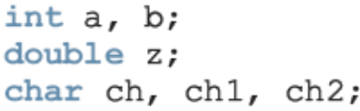
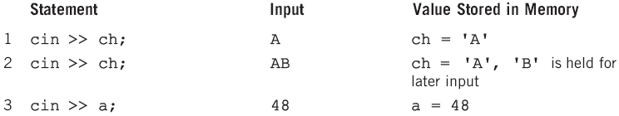
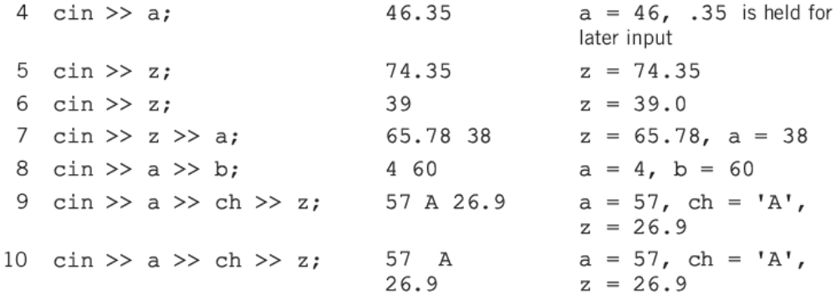
cin and the Extraction Operator >> (continued)
C++ Programming: From Problem Analysis to Program Design, Fourth Edition

Slide 12
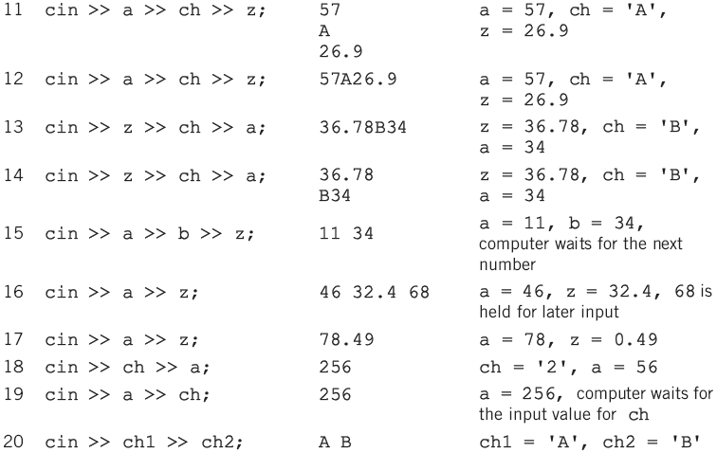

Slide 13
Using Predefined Functions in a Program
Function (subprogram): set of instructions
  When activated, it accomplishes a task
main executes when a program is run
Other functions execute only when called
C++ includes a wealth of functions
  Predefined functions are organized as a collection of libraries called header files
C++ Programming: From Problem Analysis to Program Design, Fourth Edition

Slide 14
Using Predefined Functions in a Program (continued)
Header file may contain several functions
To use a predefined function, you need the name of the appropriate header file
  You also need to know:
    Function name
    Number of parameters required
    Type of each parameter
    What the function is going to do
C++ Programming: From Problem Analysis to Program Design, Fourth Edition

Slide 15
Using Predefined Functions in a Program (continued)
To use pow (power), include cmath
  Two numeric parameters
  Syntax: pow(x,y) = x^{y}
    x and y are the arguments or parameters
  In pow(2,3), the parameters are 2 and 3
C++ Programming: From Problem Analysis to Program Design, Fourth Edition

Slide 16
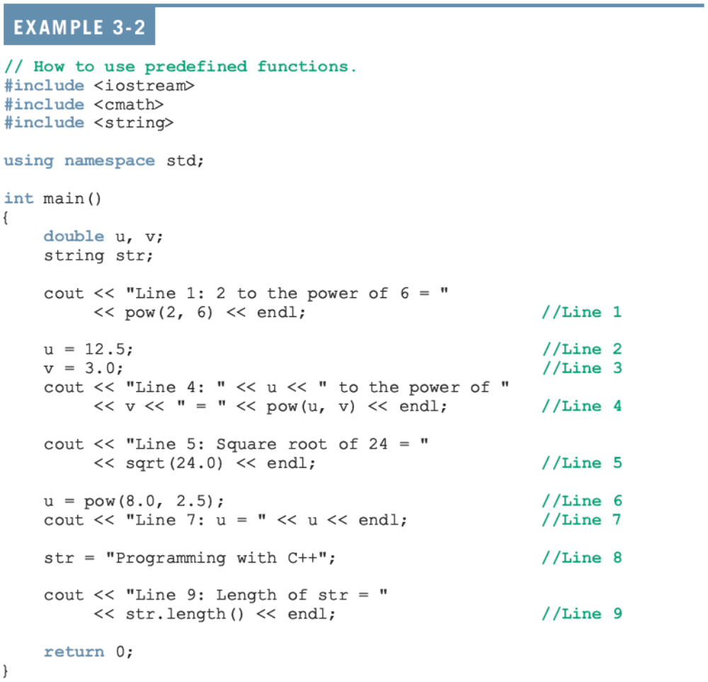

Slide 17
Using Predefined Functions in a Program (continued)
Sample Run:
  Line 1: 2 to the power of 6 = 64
  Line 4: 12.5 to the power of 3 = 1953.13
  Line 5: Square root of 24 = 4.89898
  Line 7: u = 181.019
  Line 9: Length of str = 20
C++ Programming: From Problem Analysis to Program Design, Fourth Edition

Slide 18
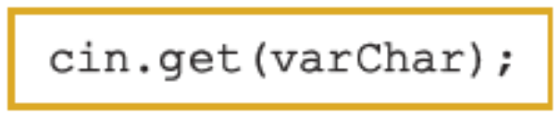
cin and the get Function
The get function
  Inputs next character (including whitespace)
  Stores in memory location indicated by its argument
The syntax of cin and the get function:
varChar
  Is a char variable
  Is the argument (parameter) of the function
C++ Programming: From Problem Analysis to Program Design, Fourth Edition

Slide 19
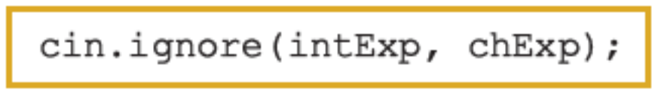
cin and the ignore Function
ignore: discards a portion of the input
The syntax to use the function ignore is:
intExp is an integer expression
chExp is a char expression
If intExp is a value m, the statement says to ignore the next m characters or all characters until the character specified by chExp
C++ Programming: From Problem Analysis to Program Design, Fourth Edition

Slide 20
putback and peek Functions
putback function
  Places previous character extracted by the get function from an input stream back to that stream
peek function
  Returns next character from the input stream
  Does not remove the character from that stream
C++ Programming: From Problem Analysis to Program Design, Fourth Edition

Slide 21
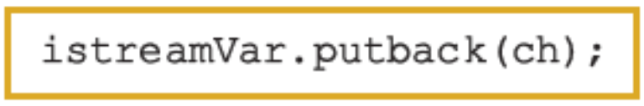

putback and peek Functions (continued)
The syntax for putback:
  istreamVar: an input stream variable (cin)
  ch is a char variable
The syntax for peek:
  istreamVar: an input stream variable (cin)
  ch is a char variable
C++ Programming: From Problem Analysis to Program Design, Fourth Edition

Slide 22
The Dot Notation Between I/O Stream Variables and I/O Functions
In the statement
cin.get(ch);
cin and get are two separate identifiers separated by a dot
Dot separates the input stream variable name from the member, or function, name
In C++, dot is the member access operator
C++ Programming: From Problem Analysis to Program Design, Fourth Edition

Slide 23
Input Failure
Things can go wrong during execution
If input data does not match corresponding variables, program may run into problems
Trying to read a letter into an int or double variable will result in an input failure
If an error occurs when reading data
  Input stream enters the fail state
C++ Programming: From Problem Analysis to Program Design, Fourth Edition

Slide 24
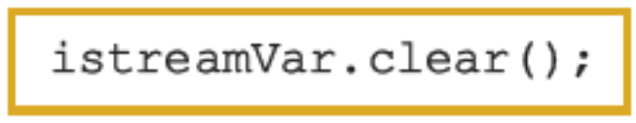
The clear Function
Once in a fail state, all further I/O statements using that stream are ignored
The program continues to execute with whatever values are stored in variables
  This causes incorrect results
The clear function restores input stream to a working state
C++ Programming: From Problem Analysis to Program Design, Fourth Edition

Slide 25
Output and Formatting Output
Syntax of cout when used with <<
Expression is evaluated
Value is printed
Manipulator is used to format the output
  Example: endl
C++ Programming: From Problem Analysis to Program Design, Fourth Edition

Slide 26
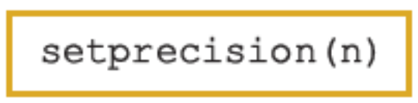
setprecision Manipulator
Syntax:
Outputs decimal numbers with up to n decimal places
Must include the header file iomanip:
  #include <iomanip>
C++ Programming: From Problem Analysis to Program Design, Fourth Edition

Slide 27
fixed Manipulator
fixed outputs floating-point numbers in a fixed decimal format
  Example: cout << fixed;
  Disable by using the stream member function unsetf
    Example: cout.unsetf(ios::fixed);
The manipulator scientific is used to output floating-point numbers in scientific format
C++ Programming: From Problem Analysis to Program Design, Fourth Edition

Slide 28
showpoint Manipulator
showpoint forces output to show the decimal point and trailing zeros
Examples:
  cout << showpoint;
  cout << fixed << showpoint;
C++ Programming: From Problem Analysis to Program Design, Fourth Edition

Slide 29
setw
Outputs the value of an expression in specific columns
  cout << setw(5) << x << endl;
If number of columns exceeds the number of columns required by the expression
  Output of the expression is right-justified
  Unused columns to the left are filled with spaces
Must include the header file iomanip
C++ Programming: From Problem Analysis to Program Design, Fourth Edition

Slide 30
Additional Output Formatting Tools
Additional formatting tools that give you more control over your output:
  setfill manipulator
  left and right manipulators
  unsetf manipulator
C++ Programming: From Problem Analysis to Program Design, Fourth Edition

Slide 31
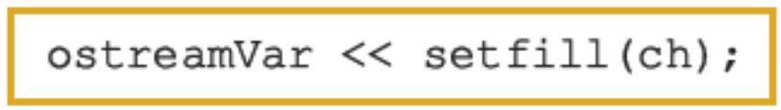
setfill Manipulator
Output stream variables can use setfill to fill unused columns with a character
Example:
  cout << setfill('#');
C++ Programming: From Problem Analysis to Program Design, Fourth Edition

Slide 32
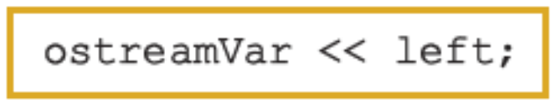
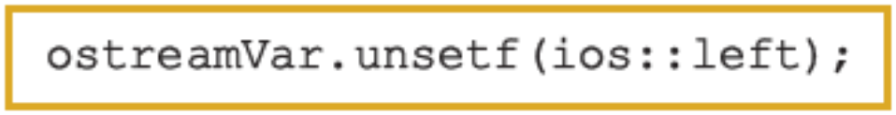
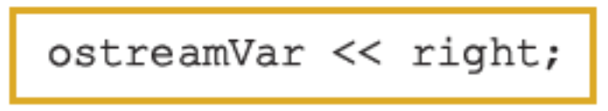
left and right Manipulators
left: left-justifies the output
Disable left by using unsetf
right: right-justifies the output
C++ Programming: From Problem Analysis to Program Design, Fourth Edition

Slide 33
Types of Manipulators
Two types of manipulators:
  With parameters
  Without parameters
Parameterized: require iomanip header
  setprecision, setw, and setfill
Nonparameterized: require iostream header
  endl, fixed, showpoint, left, and flush
C++ Programming: From Problem Analysis to Program Design, Fourth Edition

Slide 34
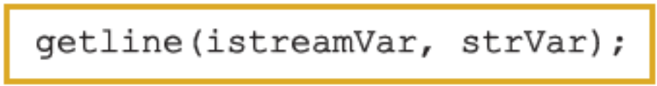
Input/Output and the string Type
An input stream variable (cin) and >> operator can read a string into a variable of the data type string
Extraction operator
  Skips any leading whitespace characters and reading stops at a whitespace character
The function getline
  Reads until end of the current line
C++ Programming: From Problem Analysis to Program Design, Fourth Edition

Slide 35
File Input/Output
File: area in secondary storage to hold info
File I/O is a five-step process
  Include fstream header
  Declare file stream variables
  Associate the file stream variables with the input/output sources
  Use the file stream variables with >>, <<, or other input/output functions
  Close the files
C++ Programming: From Problem Analysis to Program Design, Fourth Edition

Slide 36
Programming Example: Movie Ticket Sale and Donation to Charity
A theater owner agrees to donate a portion of gross ticket sales to a charity
The program will prompt the user to input:
  Movie name
  Adult ticket price
  Child ticket price
  Number of adult tickets sold
  Number of child tickets sold
  Percentage of gross amount to be donated
C++ Programming: From Problem Analysis to Program Design, Fourth Edition

Slide 37
Programming Example: I/O
Inputs: movie name, adult and child ticket price, # adult and child tickets sold, and percentage of the gross to be donated
Program output:
-*-*-*-*-*-*-*-*-*-*-*-*-*-*-*-*-*-*-*-*-*-*-*-*-*-*
Movie Name: ....................... Journey to Mars
Number of Tickets Sold: ........... 2650
Gross Amount: ..................... $ 9150.00
Percentage of Gross Amount Donated: 10.00%
Amount Donated: ................... $ 915.00
Net Sale: ......................... $ 8235.00
C++ Programming: From Problem Analysis to Program Design, Fourth Edition

Slide 38
Programming Example: Problem Analysis
The program needs to:
  Get the movie name
  Get the price of an adult ticket price
  Get the price of a child ticket price
  Get the number of adult tickets sold
  Get the number of child tickets sold
C++ Programming: From Problem Analysis to Program Design, Fourth Edition

Slide 39
Programming Example: Problem Analysis (continued)
  Calculate the gross amount
grossAmount = adultTicketPrice * noOfAdultTicketsSold + childTicketPrice * noOfChildTicketsSold;
  Calculate the amount donated to the charity
amountDonated = grossAmount * percentDonation / 100;
  Calculate the net sale amount
netSale = grossAmount – amountDonated;
  Output the results
C++ Programming: From Problem Analysis to Program Design, Fourth Edition

Slide 40
Programming Example: Variables
string movieName;
double adultTicketPrice;
double childTicketPrice;
int noOfAdultTicketsSold;
int noOfChildTicketsSold;
double percentDonation;
double grossAmount;
double amountDonated;
double netSaleAmount;
C++ Programming: From Problem Analysis to Program Design, Fourth Edition

Slide 41
Programming Example: Formatting Output
First column is left-justified
  When printing a value in the first column, use left
Numbers in second column are right-justified
  Before printing a value in the second column, use right
Use setfill to fill the empty space between the first and second columns with dots
C++ Programming: From Problem Analysis to Program Design, Fourth Edition

Slide 42
Programming Example: Formatting Output (continued)
In the lines showing gross amount, amount donated, and net sale amount
  Use blanks to fill space between the $ sign and the number
Before printing the dollar sign
  Use setfill to set the filling character to blank
C++ Programming: From Problem Analysis to Program Design, Fourth Edition

Slide 43
Programming Example: Main Algorithm
Declare variables
Set the output of the floating-point to:
  Two decimal places
  Fixed
  Decimal point and trailing zeros
Prompt the user to enter a movie name
Input movie name using getline because it might contain spaces
Prompt user for price of an adult ticket
C++ Programming: From Problem Analysis to Program Design, Fourth Edition

Slide 44
Programming Example: Main Algorithm (continued)
Input price of an adult ticket
Prompt user for price of a child ticket
Input price of a child ticket
Prompt user for the number of adult tickets sold
Input number of adult tickets sold
Prompt user for number of child tickets sold
Input the number of child tickets sold
C++ Programming: From Problem Analysis to Program Design, Fourth Edition

Slide 45
Programming Example: Main Algorithm (continued)
Prompt user for percentage of the gross amount donated
Input percentage of the gross amount donated
Calculate the gross amount
Calculate the amount donated
Calculate the net sale amount
Output the results
C++ Programming: From Problem Analysis to Program Design, Fourth Edition

Slide 46
Summary
Stream: infinite sequence of characters from a source to a destination
Input stream: from a source to a computer
Output stream: from a computer to a destination
cin: common input
cout: common output
To use cin and cout, include iostream header
C++ Programming: From Problem Analysis to Program Design, Fourth Edition

Slide 47
Summary (continued)
get reads data character-by-character
putback puts last character retrieved by get back to the input stream
ignore skips data in a line
peek returns next character from input stream, but does not remove it
Attempting to read invalid data into a variable causes the input stream to enter the fail state
C++ Programming: From Problem Analysis to Program Design, Fourth Edition

Slide 48
Summary (continued)
The manipulators setprecision, fixed, showpoint, setw, setfill, left, and right can be used for formatting output
Include iomanip for the manipulators setprecision, setw, and setfill
File: area in secondary storage to hold info
Header fstream contains the definitions of ifstream and ofstream
C++ Programming: From Problem Analysis to Program Design, Fourth Edition

