Slide 1
C++ Programming:
From Problem Analysis to Program Design, Fourth Edition
Chapter 7: User-Defined Functions II

Slide 2
Objectives
In this chapter, you will:
Learn how to construct and use void functions in a program
Discover the difference between value and reference parameters
Explore reference parameters and value-returning functions
Learn about the scope of an identifier
C++ Programming: From Problem Analysis to Program Design, Fourth Edition

Slide 3
Objectives (continued)
Examine the difference between local and global identifiers
Discover static variables
Learn function overloading
Explore functions with default parameters
C++ Programming: From Problem Analysis to Program Design, Fourth Edition

Slide 4
Void Functions
Void functions and value-returning functions have similar structures
  Both have a heading part and a statement part
User-defined void functions can be placed either before or after the function main
If user-defined void functions are placed after the function main
  The function prototype must be placed before the function main
C++ Programming: From Problem Analysis to Program Design, Fourth Edition

Slide 5
Void Functions (continued)
A void function does not have a return type
  return statement without any value is typically used to exit the function early
Formal parameters are optional
A call to a void function is a stand-alone statement
C++ Programming: From Problem Analysis to Program Design, Fourth Edition

Slide 6
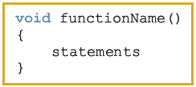

Void Functions without Parameters
Function definition syntax:
void is a reserved word
Function call syntax:
C++ Programming: From Problem Analysis to Program Design, Fourth Edition

Slide 7
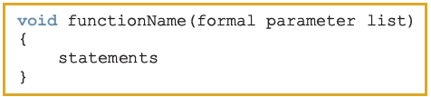

Void Functions with Parameters
Function definition syntax:
Formal parameter list syntax:
Function call syntax:
Actual parameter list syntax:
C++ Programming: From Problem Analysis to Program Design, Fourth Edition

Slide 8
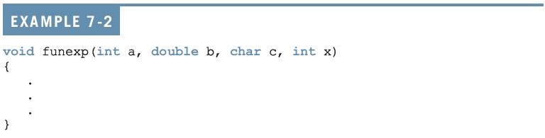
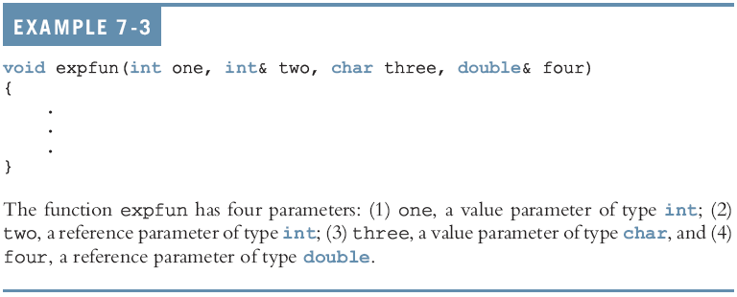
Void Functions with Parameters (continued)
C++ Programming: From Problem Analysis to Program Design, Fourth Edition

Slide 9
Void Functions with Parameters (continued)
Value parameter: a formal parameter that receives a copy of the content of corresponding actual parameter
Reference parameter: a formal parameter that receives the location (memory address) of the corresponding actual parameter
C++ Programming: From Problem Analysis to Program Design, Fourth Edition

Slide 10
Value Parameters
If a formal parameter is a value parameter
  The value of the corresponding actual parameter is copied into it
The value parameter has its own copy of the data
During program execution
  The value parameter manipulates the data stored in its own memory space
C++ Programming: From Problem Analysis to Program Design, Fourth Edition

Slide 11
Reference Variables as Parameters
If a formal parameter is a reference parameter
  It receives the memory address of the corresponding actual parameter
A reference parameter stores the address of the corresponding actual parameter
During program execution to manipulate data
  The address stored in the reference parameter directs it to the memory space of the corresponding actual parameter
C++ Programming: From Problem Analysis to Program Design, Fourth Edition

Slide 12
Reference Variables as Parameters (continued)
Reference parameters can:
  Pass one or more values from a function
  Change the value of the actual parameter
Reference parameters are useful in three situations:
  Returning more than one value
  Changing the actual parameter
  When passing the address would save memory space and time
C++ Programming: From Problem Analysis to Program Design, Fourth Edition

Slide 13
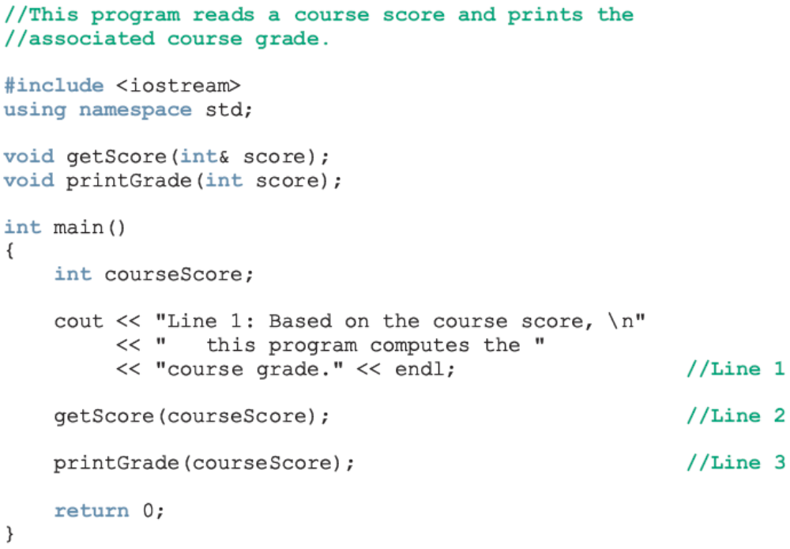
Calculate Grade
C++ Programming: From Problem Analysis to Program Design, Fourth Edition

Slide 14
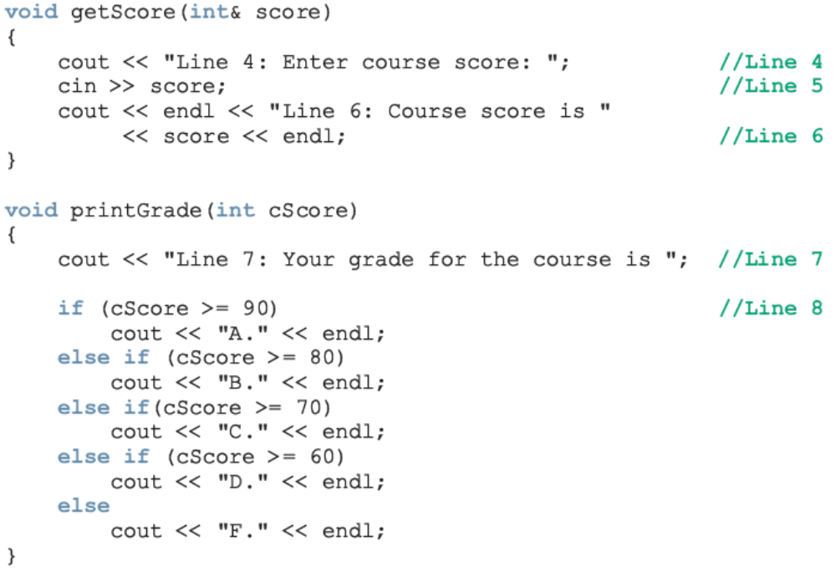
Calculate Grade (continued)
C++ Programming: From Problem Analysis to Program Design, Fourth Edition

Slide 15

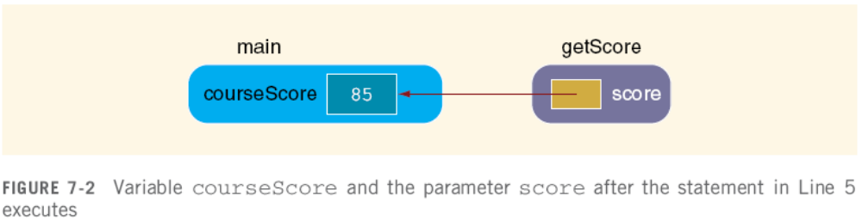

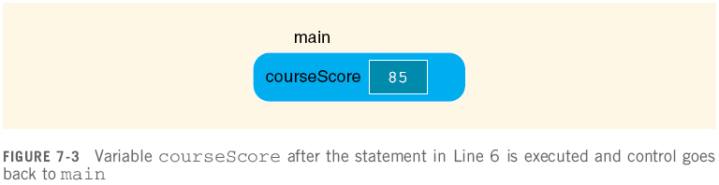



Slide 16
Value and Reference Parameters and Memory Allocation
When a function is called
  Memory for its formal parameters and variables declared in the body of the function (called local variables) is allocated in the function data area
In the case of a value parameter
  The value of the actual parameter is copied into the memory cell of its corresponding formal parameter
C++ Programming: From Problem Analysis to Program Design, Fourth Edition

Slide 17
Value and Reference Parameters and Memory Allocation (continued)
In the case of a reference parameter
  The address of the actual parameter passes to the formal parameter
Content of formal parameter is an address
During execution, changes made by the formal parameter permanently change the value of the actual parameter
Stream variables (e.g., ifstream) should be passed by reference to a function
C++ Programming: From Problem Analysis to Program Design, Fourth Edition

Slide 18
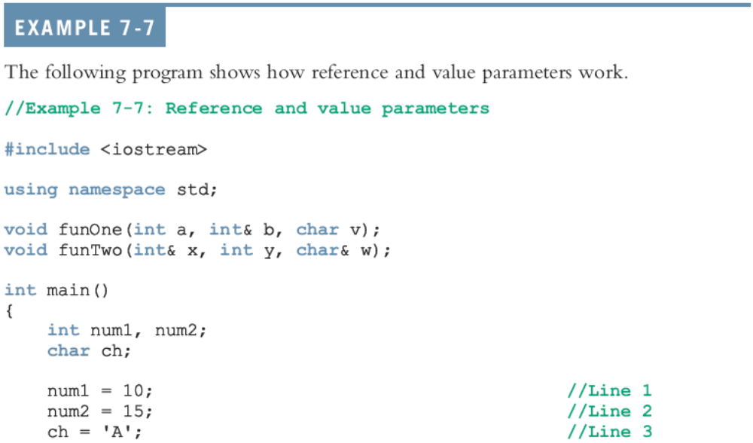
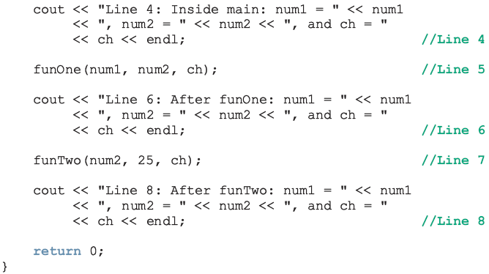

Slide 19
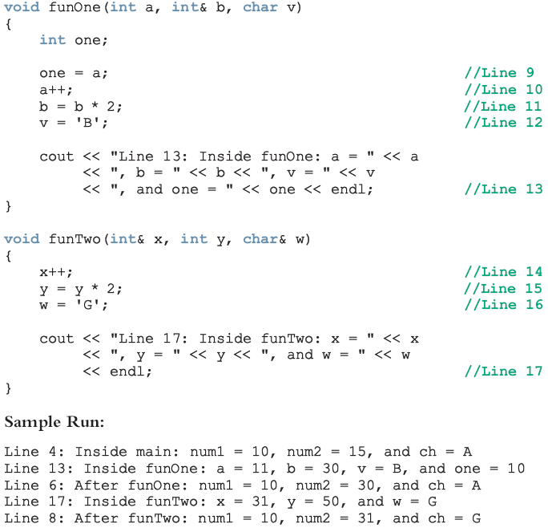

Slide 20

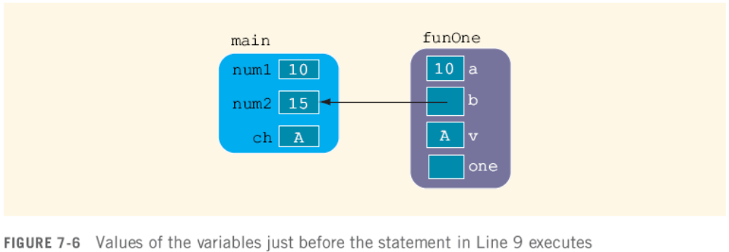
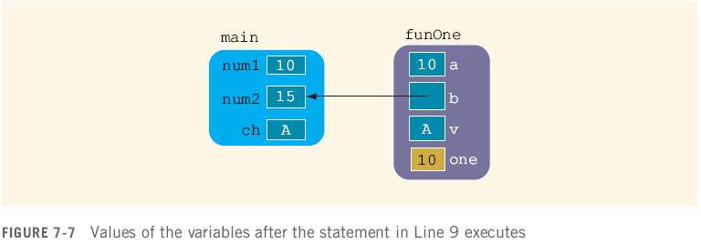

Slide 21




Slide 22



Slide 23




Slide 24
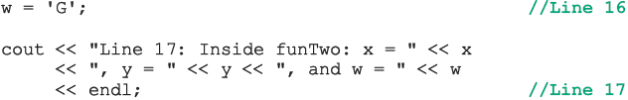



Slide 25
Reference Parameters and Value-Returning Functions
You can also use reference parameters in a value-returning function
  Not recommended
By definition, a value-returning function returns a single value
  This value is returned via the return statement
If a function needs to return more than one value, you should change it to a void function and use the appropriate reference parameters to return the values
C++ Programming: From Problem Analysis to Program Design, Fourth Edition

Slide 26
Scope of an Identifier
The scope of an identifier refers to where in the program an identifier is accessible
Local identifier: identifiers declared within a function (or block)
Global identifier: identifiers declared outside of every function definition
C++ does not allow nested functions
  The definition of one function cannot be included in the body of another function
C++ Programming: From Problem Analysis to Program Design, Fourth Edition

Slide 27
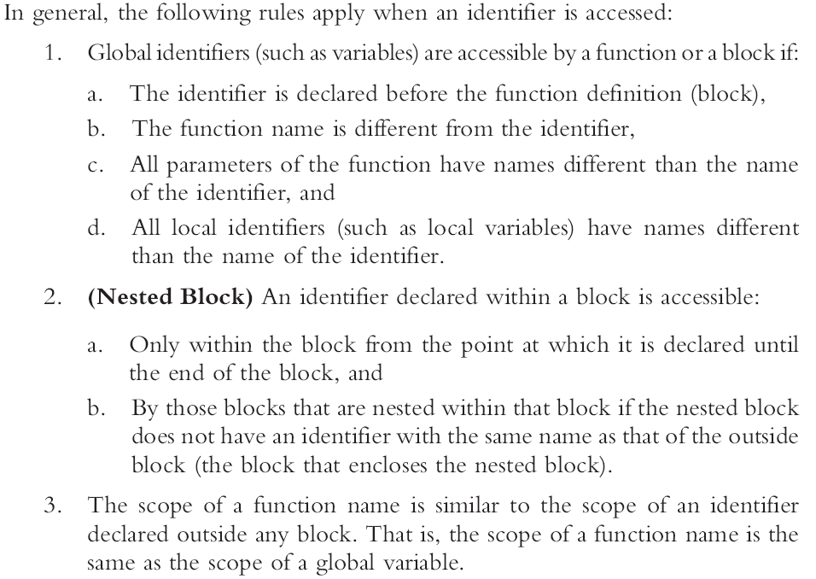

Slide 28
Scope of an Identifier (continued)
Some compilers initialize global variables to default values
The operator :: is called the scope resolution operator
By using the scope resolution operator
  A global variable declared before the definition of a function (block) can be accessed by the function (or block) even if the function (or block) has an identifier with the same name as the variable
C++ Programming: From Problem Analysis to Program Design, Fourth Edition

Slide 29
Scope of an Identifier (continued)
C++ provides a way to access a global variable declared after the definition of a function
  In this case, the function must not contain any identifier with the same name as the global variable
C++ Programming: From Problem Analysis to Program Design, Fourth Edition

Slide 30
Global Variables, Named Constants, and Side Effects
Using global variables has side effects
A function that uses global variables is not independent
If more than one function uses the same global variable and something goes wrong
  It is difficult to find what went wrong and where
  Problems caused in one area of the program may appear to be from another area
Global named constants have no side effects
C++ Programming: From Problem Analysis to Program Design, Fourth Edition

Slide 31
Static and Automatic Variables
Automatic variable: memory is allocated at block entry and deallocated at block exit
  By default, variables declared within a block are automatic variables
Static variable: memory remains allocated as long as the program executes
  Variables declared outside of any block are static variables
  Declare a static variable within a block by using the reserved word static
C++ Programming: From Problem Analysis to Program Design, Fourth Edition

Slide 32

Static and Automatic Variables (continued)
The syntax for declaring a static variable is:
The statement
static int x;
  declares x to be a static variable of the type int
Static variables declared within a block are local to the block
  Their scope is the same as any other local identifier of that block
C++ Programming: From Problem Analysis to Program Design, Fourth Edition

Slide 33
Function Overloading: An Introduction
In a C++ program, several functions can have the same name
  This is called function overloading or overloading a function name
C++ Programming: From Problem Analysis to Program Design, Fourth Edition

Slide 34
Function Overloading (continued)
Two functions are said to have different formal parameter lists if both functions have:
  A different number of formal parameters, or
  If the number of formal parameters is the same, then the data type of the formal parameters, in the order you list them, must differ in at least one position
C++ Programming: From Problem Analysis to Program Design, Fourth Edition

Slide 35
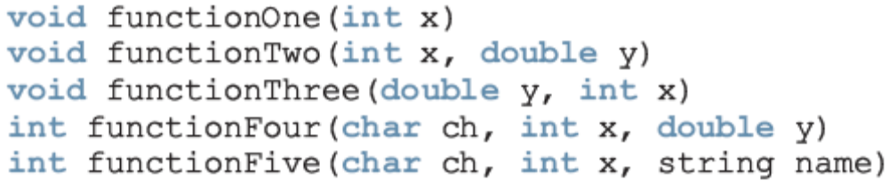
Function Overloading (continued)
The following functions all have different formal parameter lists:
The following functions have the same formal parameter list:
C++ Programming: From Problem Analysis to Program Design, Fourth Edition

Slide 36
Function Overloading (continued)
Function overloading: creating several functions with the same name
The signature of a function consists of the function name and its formal parameter list
Two functions have different signatures if they have either different names or different formal parameter lists
Note that the signature of a function does not include the return type of the function
C++ Programming: From Problem Analysis to Program Design, Fourth Edition

Slide 37
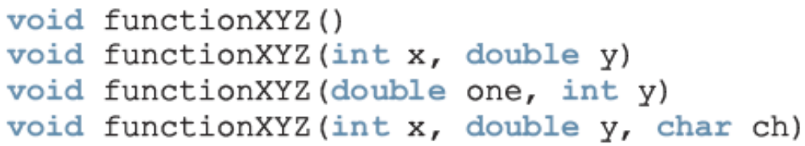
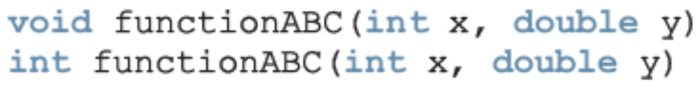
Function Overloading (continued)
Correct function overloading:
Syntax error:
C++ Programming: From Problem Analysis to Program Design, Fourth Edition

Slide 38
Functions with Default Parameters
In a function call, the number of actual and formal parameters must be the same
  C++ relaxes this condition for functions with default parameters
You specify the value of a default parameter when the function name appears for the first time (e.g., in the prototype)
If you do not specify the value of a default parameter, the default value is used
C++ Programming: From Problem Analysis to Program Design, Fourth Edition

Slide 39
Functions with Default Parameters (continued)
All default parameters must be the rightmost parameters of the function
In a function call where the function has more than one default parameter and a value to a default parameter is not specified:
  You must omit all of the arguments to its right
Default values can be constants, global variables, or function calls
  However, you cannot assign a constant value as a default value to a reference parameter
C++ Programming: From Problem Analysis to Program Design, Fourth Edition

Slide 40
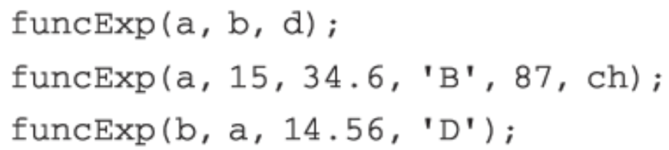
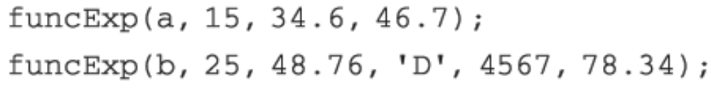
Functions with Default Parameters (continued)
Consider the following prototype:
Assume:
  a, b are int, ch is char, d is double
Examples of legal calls:
Examples of illegal calls:
C++ Programming: From Problem Analysis to Program Design, Fourth Edition

Slide 41
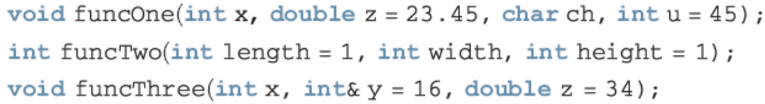
Functions with Default Parameters (continued)
Examples of illegal function prototypes with default parameters:
C++ Programming: From Problem Analysis to Program Design, Fourth Edition

Slide 42
Programming Example: Classify Numbers
In this example, we use functions to rewrite the program that determines the number of odds and evens from a given list of integers
Main algorithm remains the same:
  Initialize variables, zeros, odds, evens to 0
  Read a number
  If number is even, increment the even count
    If number is also zero, increment the zero count; else increment the odd count
  Repeat Steps 2-3 for each number in the list
C++ Programming: From Problem Analysis to Program Design, Fourth Edition

Slide 43
Programming Example: Classify Numbers (continued)
The program functions include:
  initialize: initialize the variables, such as zeros, odds, and evens
  getNumber: get the number
  classifyNumber: determine if number is odd or even (and whether it is also zero); this function also increments the appropriate count
  printResults: print the results
C++ Programming: From Problem Analysis to Program Design, Fourth Edition

Slide 44
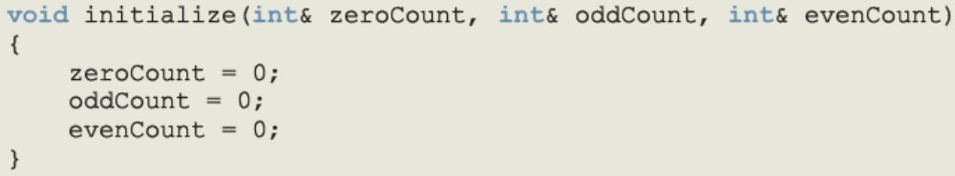
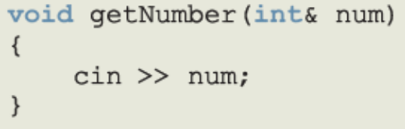
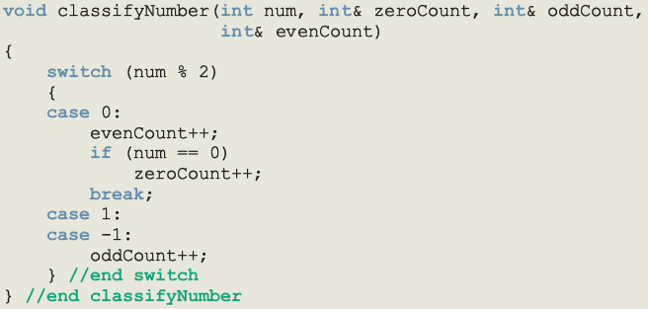
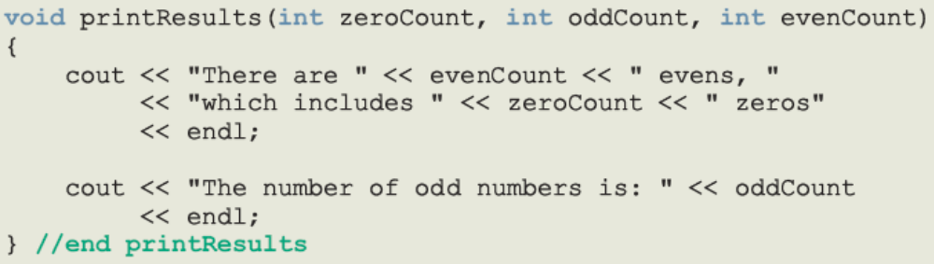

Slide 45
Programming Example: Main Algorithm
Call initialize to initialize variables
Prompt the user to enter 20 numbers
For each number in the list
  Call getNumber to read a number
  Output the number
  Call classifyNumber to classify the number and increment the appropriate count
Call printResults to print the final results
C++ Programming: From Problem Analysis to Program Design, Fourth Edition

Slide 46
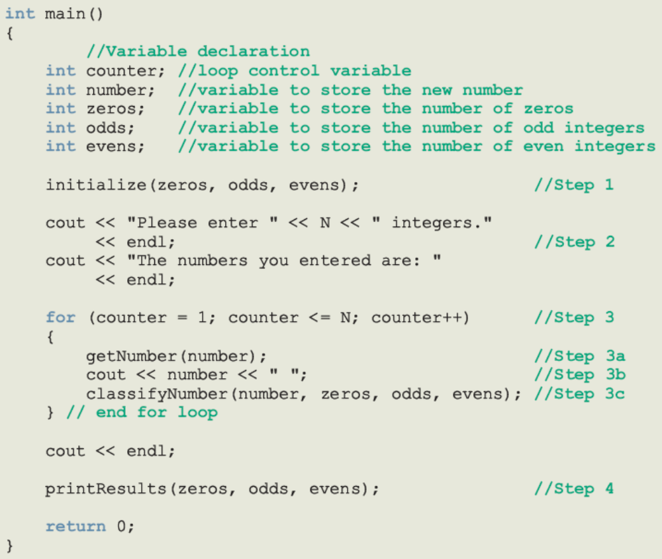

Slide 47
Summary
Void function: does not have a data type
  A return statement without any value can be used in a void function to exit it early
  The heading starts with the word void
  To call the function, you use the function name together with the actual parameters in a stand-alone statement
Two types of formal parameters:
  Value parameters
  Reference parameters
C++ Programming: From Problem Analysis to Program Design, Fourth Edition

Slide 48
Summary (continued)
A value parameter receives a copy of its corresponding actual parameter
A reference parameter receives the memory address of its corresponding actual parameter
  If a formal parameter needs to change the value of an actual parameter, you must declare this formal parameter as a reference parameter in the function heading
C++ Programming: From Problem Analysis to Program Design, Fourth Edition

Slide 49
Summary (continued)
Variables declared within a function (or block) are called local variables
Variables declared outside of every function definition (and block) are global variables
Automatic variable: variable for which memory is allocated on function/block entry and deallocated on function/block exit
Static variable: memory remains allocated throughout the execution of the program
C++ functions can have default parameters
C++ Programming: From Problem Analysis to Program Design, Fourth Edition

