Slide 1

The C++ Language

Slide 2
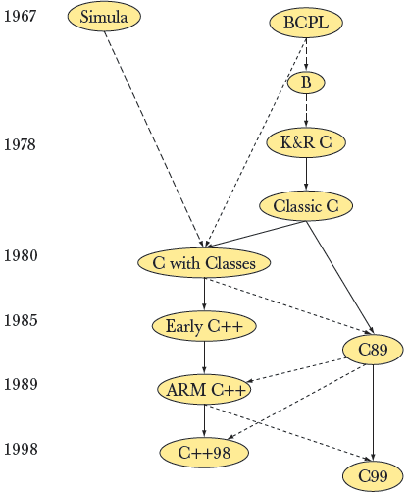
Overview of ‘C++’
Bjarne Stroupstrup, the language’s creator
C++ was designed to provide Simula’s facilities for program organization together with C’s efficiency and flexibility for systems programming.
Modern C and C++ are siblings

Slide 3
Outline
C++ basic features
Programming paradigm and statement syntax
Class definitions
Data members, methods, constructor, destructor
Pointers, arrays, and strings
Parameter passing in functions
Templates
Friend
Operator overloading
I/O streams
An example on file copy
Makefile

Slide 4
C++ Features
Classes
User-defined types
Operator overloading
Attach different meaning to expressions such as a + b
References
Pass-by-reference function arguments
Virtual Functions
Dispatched depending on type at run time
Templates
Macro-like polymorphism for containers (e.g., arrays)
Exceptions

Slide 5
Compiling and Linking
A C++ program consists of one or more source files.
Source files contain function and class declarations and definitions.
Files that contain only declarations are incorporated into the source files that need them when they are compiled.
Thus they are called include files.
Files that contain definitions are translated by the compiler into an intermediate form called object files.
One or more object files are combined with to form the executable file by the linker.

Slide 6
A Simple C++ Program
#include <cstdlib>
#include <iostream>
using namespace std;
int main ( ) {
intx, y;
cout << “Please enter two numbers:”;
cin >> x >> y;
int sum = x + y;
cout << “Their sum is “ << sum << endl;
return EXIT_SUCCESS;
}

Slide 7
The #include Directive
The first two lines:
#include <iostream>
#include <cstdlib>
incorporate the declarations of the iostream and cstdlib libraries into the source code.
If your program is going to use a member of the standard library, the appropriate header file must be included at the beginning of the source code file.

Slide 8
The using Statement
The line
using namespace std;
tells the compiler to make all names in the predefined namespace std available.
The C++ standard library is defined within this namespace.
Incorporating the statement
using namespace std;
is an easy way to get access to the standard library.
But, it can lead to complications in larger programs.
This is done with individual using declarations.
using std::cin;
using std::cout;
using std::string;
using std::getline;

Slide 9
Compiling and Executing
The command to compile is dependent upon the compiler and operating system.
For the gcc compiler (popular on Linux) the command would be:
g++ -o HelloWorld HelloWorld.cpp
For the Microsoft compiler the command would be:
cl /EHsc HelloWorld.cpp
To execute the program you would then issue the command
HelloWorld

Slide 10
Interesting, right?
This is just a sneak preview of the full presentation. We hope you like it! To see the rest of it, just click here to view it in full on PowerShow.com. Then, if you’d like, you can also log in to PowerShow.com to download the entire presentation for free.

