Slide 1
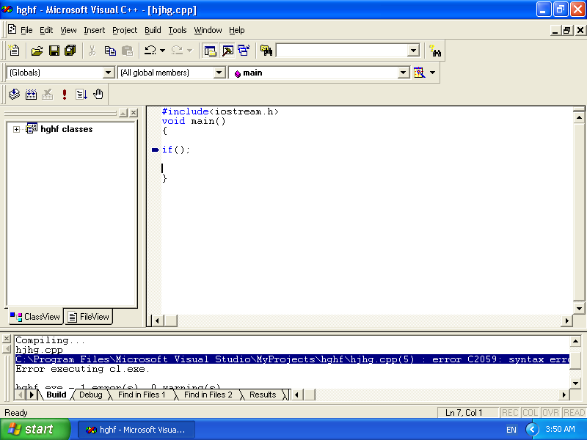

Slide 2
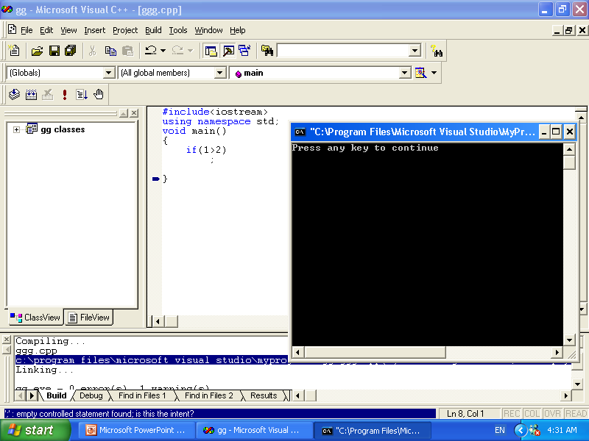

Slide 3
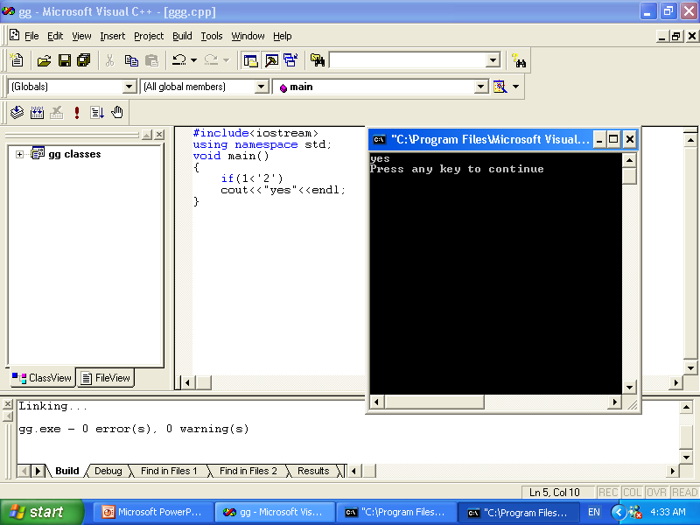

Slide 4
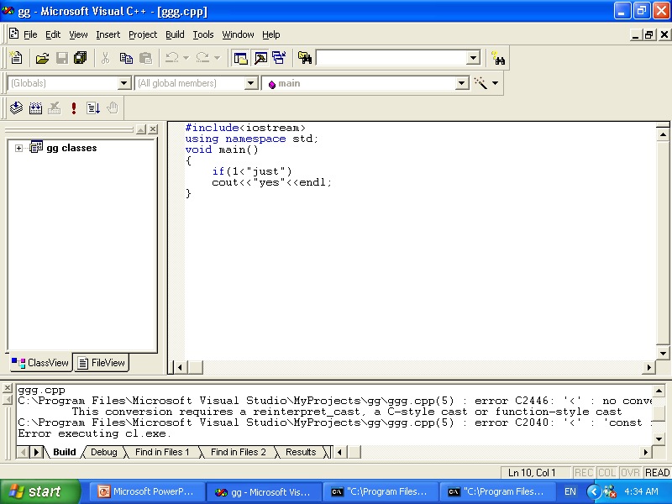

Slide 5
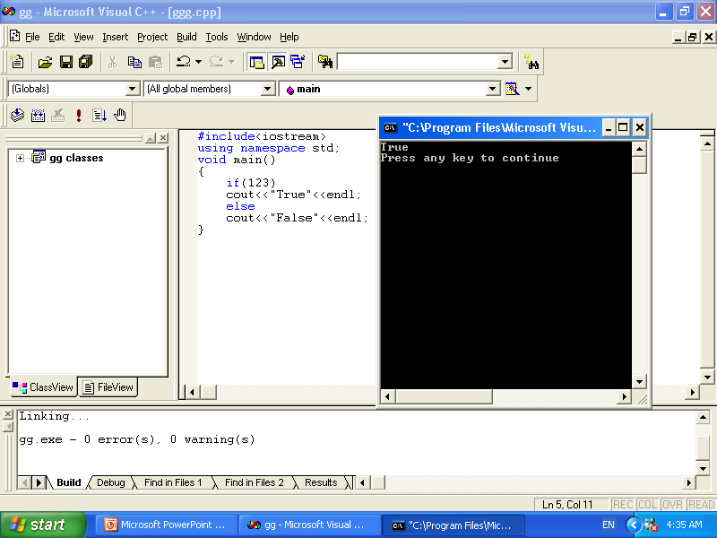

Slide 6
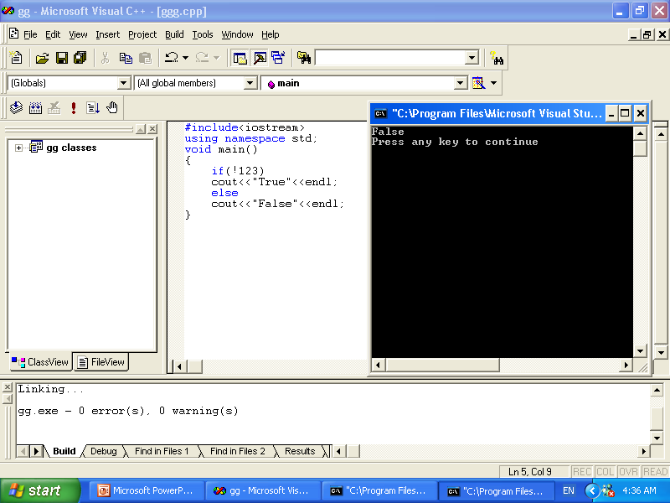

Slide 7
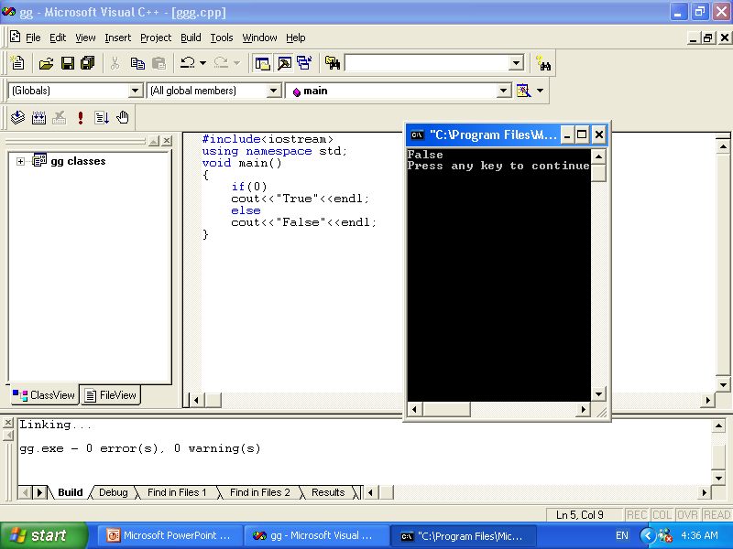

Slide 8
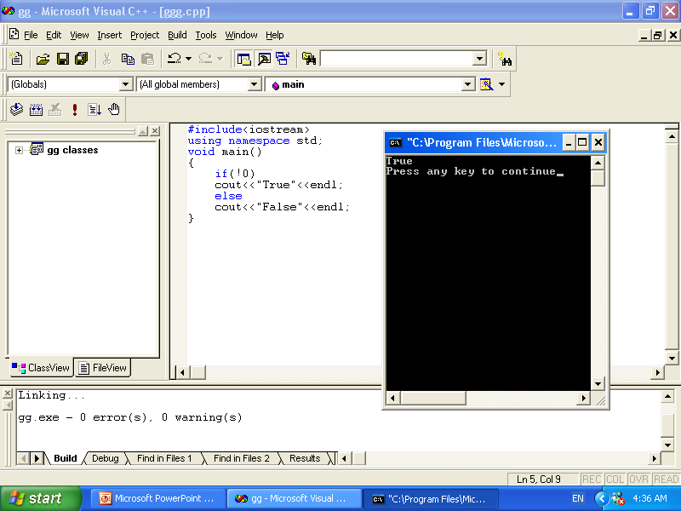

Slide 9
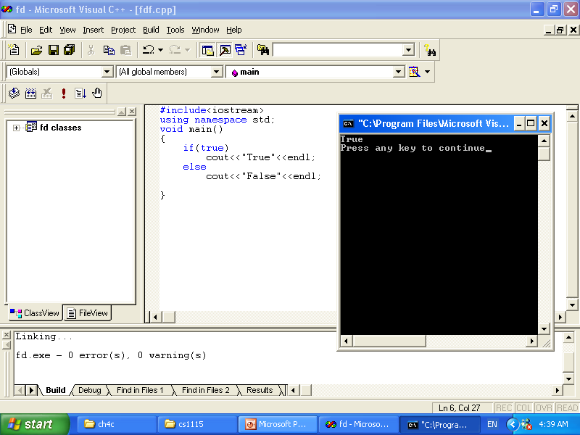

Slide 10
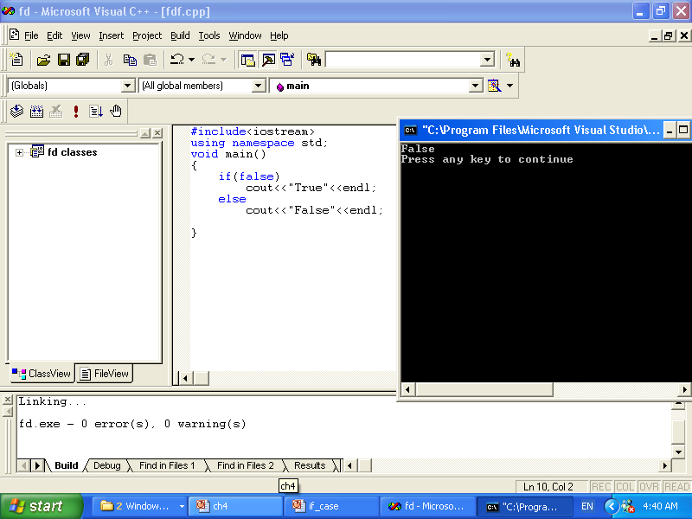

Slide 11
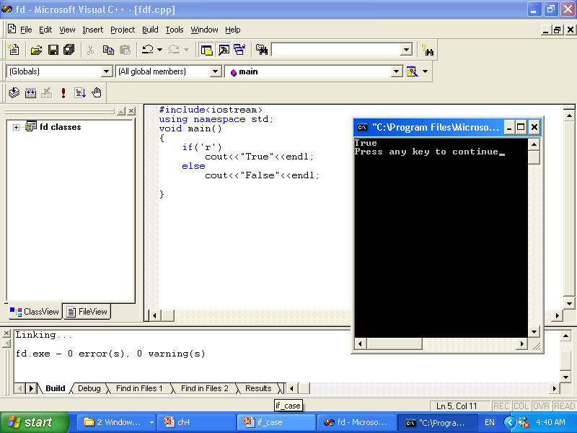

Slide 12
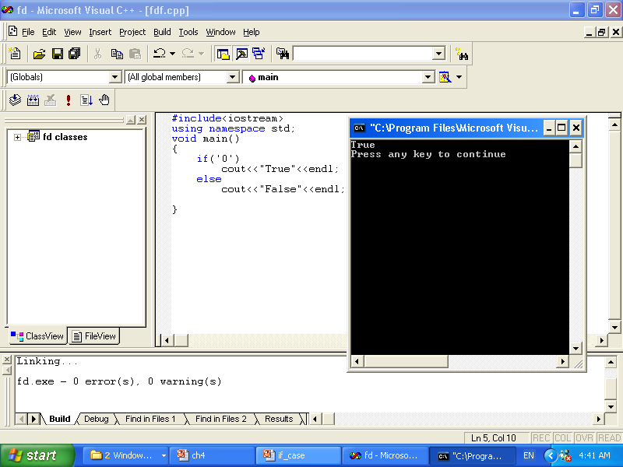

Slide 13
Conditional Operator (?:)
Conditional operator (?:) takes three arguments (ternary)
Syntax for using the conditional operator:
expression1 ? expression2 : expression3
If expression1 is true, the result of the conditional expression is expression2. Otherwise, the result is expression3

Slide 14
Conditional Operator (?:)
if(a>=b)
Max=a;
else
Max=b;
*******************
Max=(a>=b)?a:b;

Slide 15
switch ( test )
{
case 1 : // Process for test = 1 ...
break;
case 5 : // Process for test = 5 ...
break;
default : // Process for all other cases.
}

Slide 16
switch works as follows:-
The expression, just test in this case, is evaluated.
The case labels are checked in turn for the one that matches the value.
If none matches, and the optional default label exists, it is selected,
the break statement is normally added before the next case label to transfer control out of the switch statement.

Slide 17
#include <iostream>
using namespace std;
int main()
{
char grade;
cout << "Enter your grade: ";
cin >> grade;
cout << endl;
switch (grade)
{
case 'A':
cout << "Your grade is A." << endl;
break;
case 'B':
cout << "Your grade is B." << endl;
break;
case 'C':
cout << "Your grade is C." << endl;
break;
case 'F':
cout << "Your grade is F." << endl;
break;
default:
cout<<" The grade is invalid."<<endl;
}
return 0;
}

Slide 18
switch with break
#include <iostream>
using namespace std;
int main()
{
Int place ;
cout << "Enter your place : ";
cin >> place;
cout << endl;
switch (place)
{
case 1: cout << "we're first" << endl;
break;
case 2: cout << "we're second" << endl; break;
default:
cout << "we're not first or second" << endl;
}
return 0;
}

Slide 19
switch with break
#include <iostream>
using namespace std;
int main()
{
int place ;
cout << "Enter your place : ";
cin >> place;
cout << endl;
switch (place)
{
case 1: cout << "we're first" << endl;
break;
case 2: cout << "we're second" << endl;
break;
default:
cout << "we're not first or second" << endl;
}
cout<<endl<<endl;
return 0;
}

Slide 20
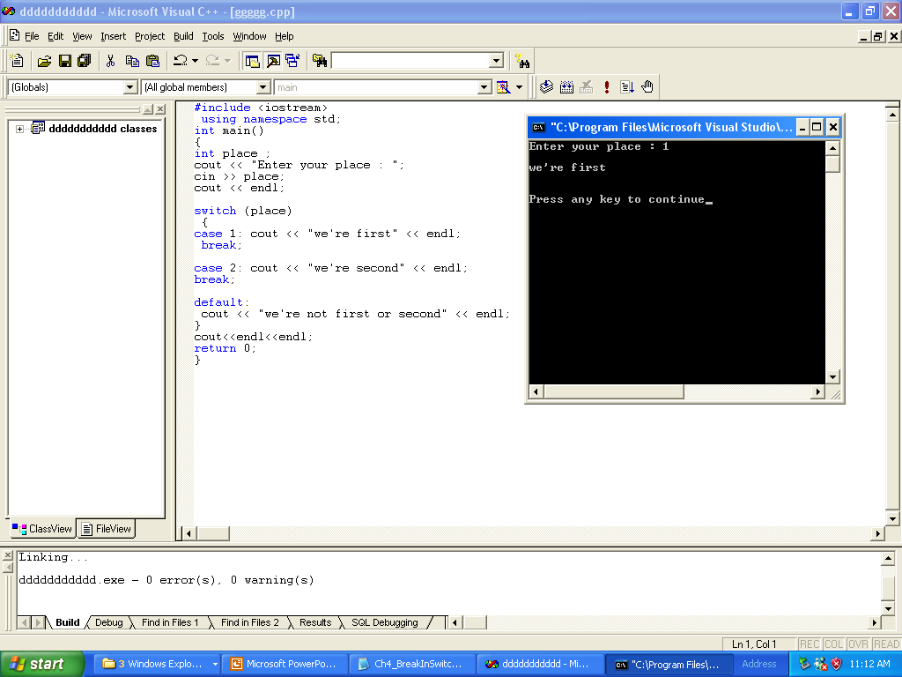
switch with break

Slide 21
switch without break
#include <iostream>
using namespace std;
int main()
{
int place ;
cout << "Enter your place : ";
cin >> place;
cout << endl;
switch (place)
{
case 1: cout << "we're first" << endl;
case 2: cout << "we're second" << endl;
default:
cout << "we're not first or second" << endl;
}
cout<<endl<<endl;
return 0;
}

Slide 22
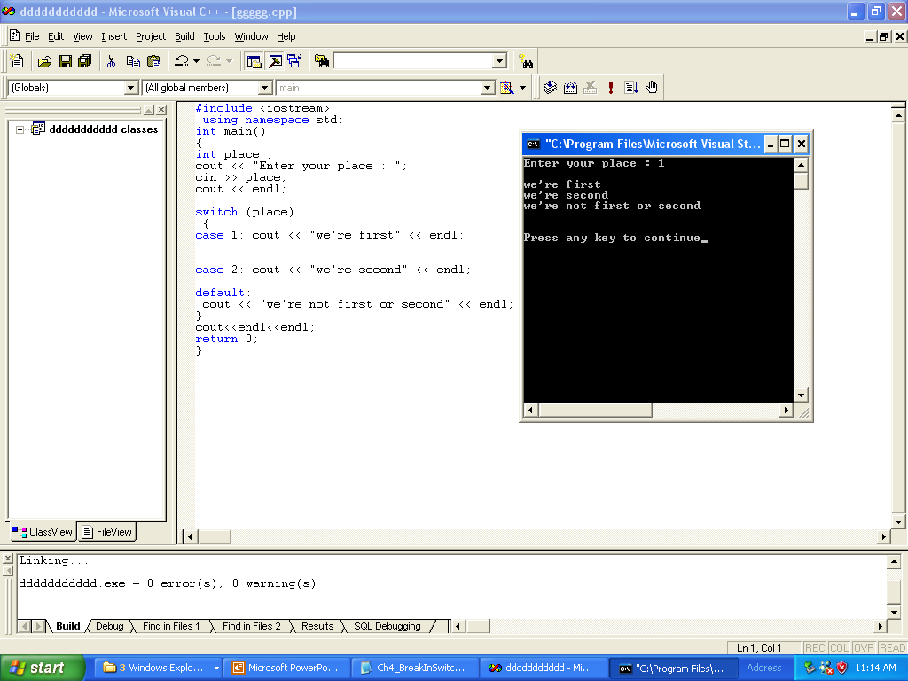

Slide 23
What is the output
#include <iostream>
using namespace std;
int main()
{
int place ;
cout << "Enter your place : ";
cin >> place;
cout << endl;
switch (place)
{
case 1: cout << "we're first" << endl;
case 1: cout << "we're second" << endl;
default:
cout << "we're not first or second" << endl;
}
cout<<endl<<endl;
return 0;
}

Slide 24
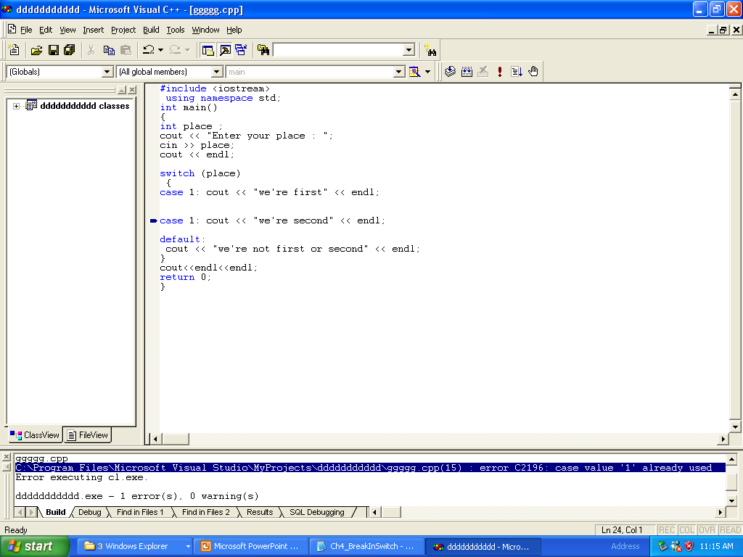

Slide 25
assert
q=n/d;
If d is 0,the program would terminate with error message stating that an illegal operation has occurred
Solution:
assert(d);
q=n/d
You need preprocessor directive #include<cassert>
Assert statement identifies the expression where assertion failed ,the name of file containing the source code ,and the line number where the assertion failed

