Slide 1
What is the out put
#include<iostream>
using namespace std;
void main()
{
int i;
for(i=1;i<10;i++)
{
cout<<i<<endl;
}
cout<<endl<<i<<endl;
}

Slide 2
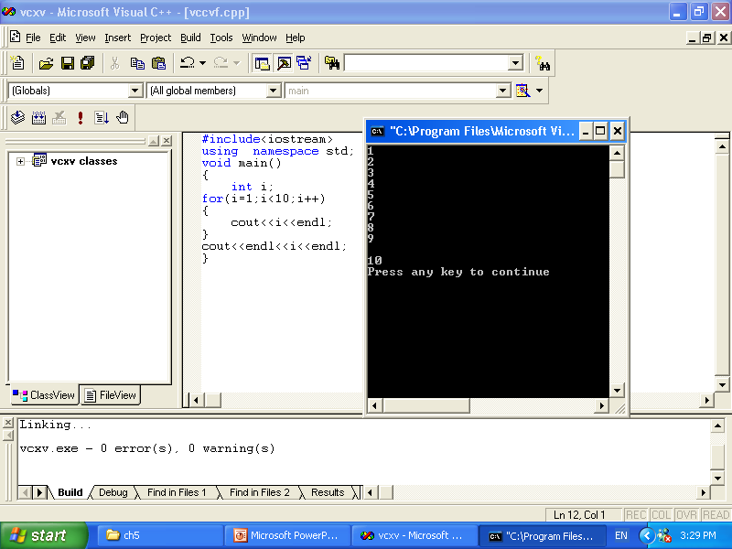

Slide 3
What is the out put
#include<iostream>
using namespace std;
void main()
{
int i;
for(i=1;i<10;++i)
{
cout<<i<<endl;
}
cout<<endl<<i<<endl;
}

Slide 4
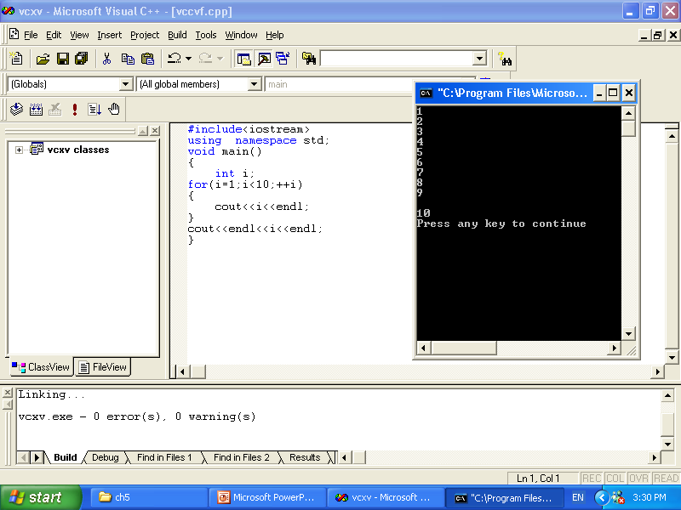

Slide 5
What is the out put
#include<iostream>
using namespace std;
void main()
{
int i;
for(;i<10;++i)
{
cout<<i<<endl;
}
cout<<endl<<i<<endl;
}

Slide 6
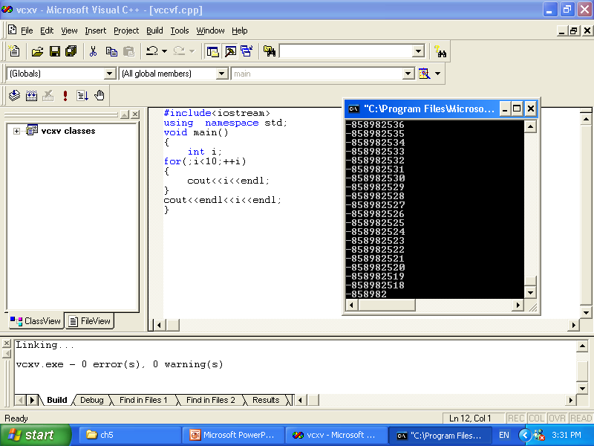
Infinite loop

Slide 7
What is the out put
#include<iostream>
using namespace std;
void main()
{
int i;
for(i=1;;++i)
{
cout<<i<<endl;
}
cout<<endl<<i<<endl;
}

Slide 8
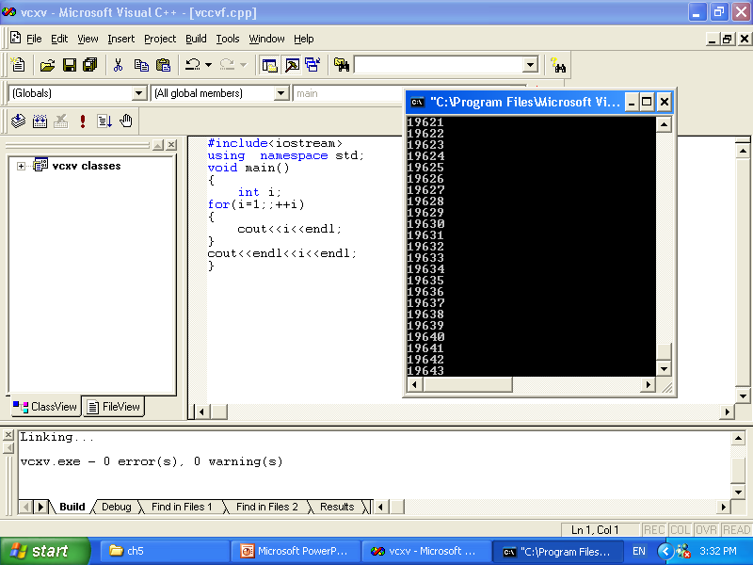
Infinite loop

Slide 9
What is the out put
#include<iostream>
using namespace std;
void main()
{
int i;
for(i=1;i<10;)
{
cout<<i<<endl;
}
cout<<endl<<i<<endl;
}

Slide 10
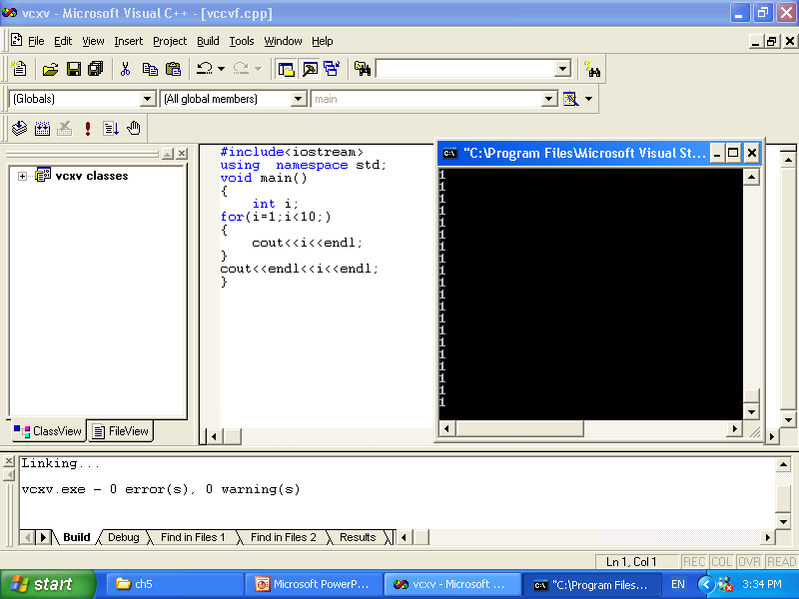
Infinite loop

Slide 11
What is the out put
#include<iostream>
using namespace std;
void main()
{
int i;
for(;;)
{
cout<<i<<endl;
}
cout<<endl<<i<<endl;
}

Slide 12
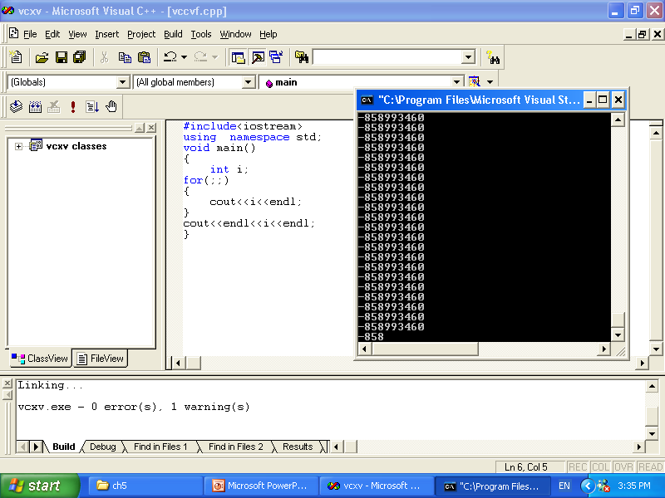
Infinite loop

Slide 13
What is the out put
#include<iostream>
using namespace std;
void main()
{
int i;
for(i=1;i<10;++i);
{
cout<<i<<endl;
}
cout<<endl<<i<<endl;
}

Slide 14
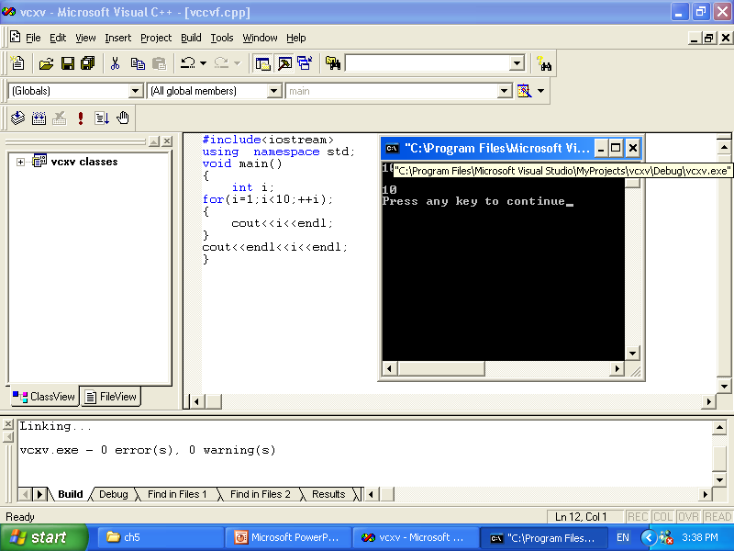
The out put

Slide 15
x to the y power
// raise x to the y power
#include <iostream>
using namespace std;
int main()
{
int x, y, i, power;
i = 1;
power = 1;
cout << "Enter base as an integer: ";
cin >> x;
cout << "Enter exponent as an integer: ";
cin >> y;
while ( i <= y ) {
power *= x;
++i;
}
cout << power << endl;
return 0;
}

Slide 16
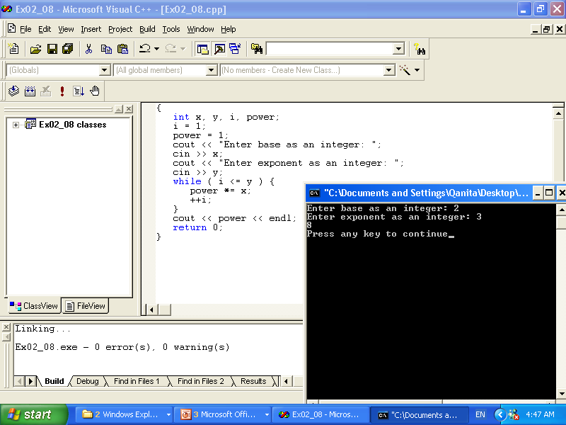

Slide 17
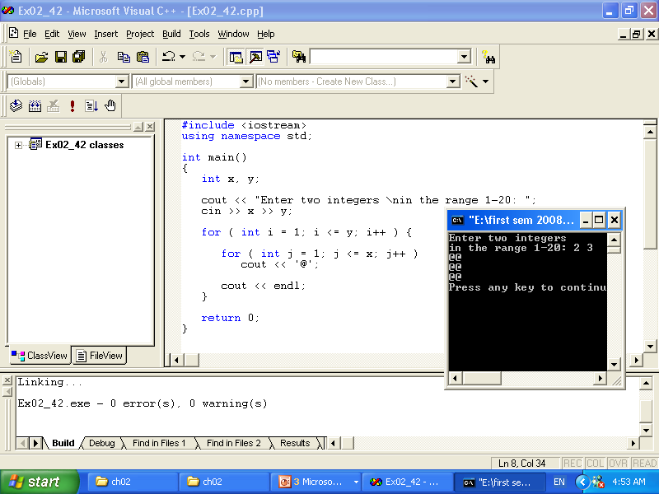

Slide 18
// Class average program with counter-controlled repetition (Example)
#include <iostream>
using namespace std;
int main()
{
int total, // sum of grades
gradeCounter, // number of grades entered
grade, // one grade
average; // average of grades
// initialization phase
total = 0; // clear total
gradeCounter = 1; // prepare to loop
// processing phase
while ( gradeCounter <= 5 ) { // loop 10 times
cout << "Enter grade: "; // prompt for input
cin >> grade; // input grade
total = total + grade; // add grade to total
gradeCounter = gradeCounter + 1; // increment counter
}
// termination phase
average = total / 5; // integer division
cout << "Class average is " << average << endl;
return 0; // indicate program ended successfully
}

Slide 19
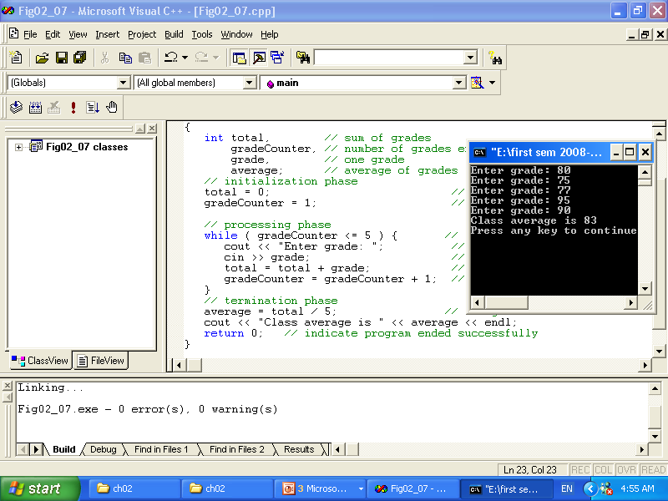

Slide 20
Example
// Counter-controlled repetition
#include <iostream>
using namespace std;
int main()
{
int counter = 1; // initialization
while ( counter <= 10 ) { // repetition condition
cout << counter << endl;
++counter; // increment
}
return 0;
}

Slide 21
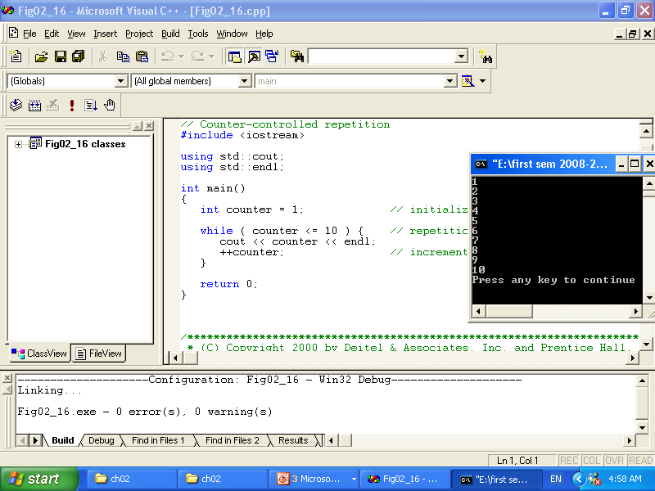

Slide 22
// Summation with for example
#include <iostream>
using namespace std;
int main()
{
int sum = 0;
for ( int number = 1; number <= 10; number += 2 )
{ cout<<number<<endl;
sum += number;
}
cout <<endl<< "Sum is " << sum << endl<<endl;
return 0;
}

Slide 23
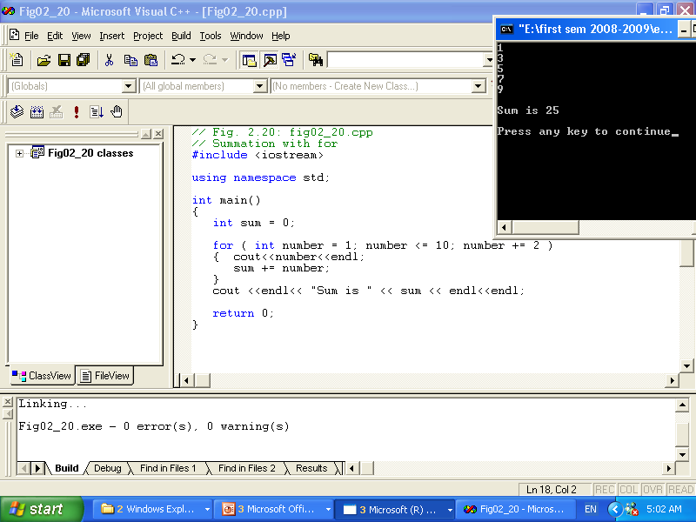
Summation with for example

Slide 24
Using the break statement in a for structure
// Using the break statement in a for structure
#include <iostream>
using namespace std;
int main()
{
// x declared here so it can be used after the loop
int x;
for ( x = 1; x <= 10; x++ ) {
if ( x == 5 )
break; // break loop only if x is 5
cout << x << " ";
}
cout << "\nBroke out of loop at x of " << x << endl;
return 0;
}

Slide 25
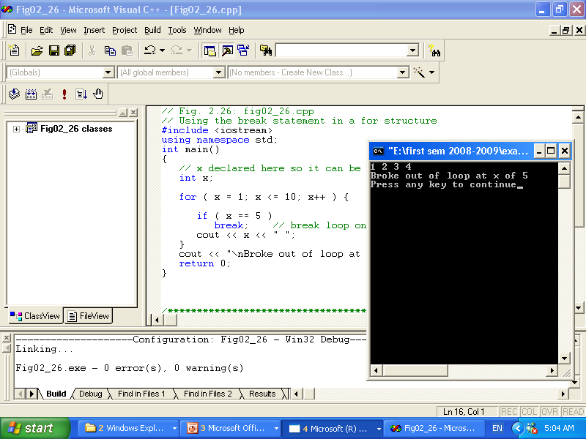

Slide 26
// Using the continue statement in a for structure
// Using the continue statement in a for structure
#include <iostream>
using namespace std;
int main()
{
for ( int x = 1; x <= 10; x++ ) {
if ( x == 5 )
continue; // skip remaining code in loop
// only if x is 5
cout << x << " ";
}
cout << "\nUsed continue to skip printing the value 5"
<< endl;
return 0;
}

Slide 27
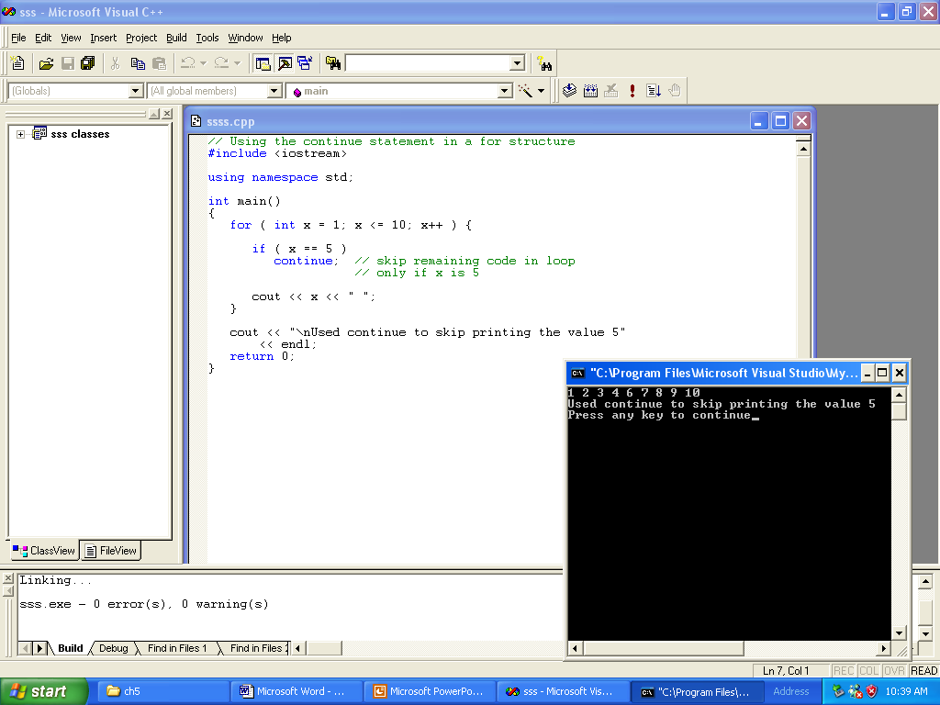
// Using the continue statement in a for structure

Slide 28
example
#include <iostream>
using namespace std;
int main()
{
int count = 1;
while ( count <= 10 ) {
cout << (count % 2 ? "****" : "++++++++")
<< endl;
++count;
}
return 0;
}

Slide 29
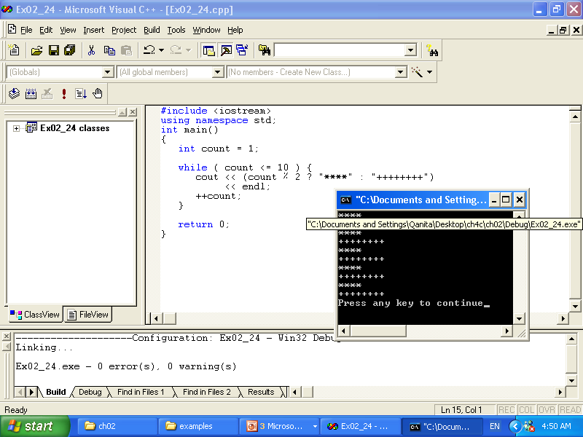

Slide 30
Nested Control Structures
#include <iostream>
using namespace std;
int main ()
{
int i,j;
for (i = 1; i <= 5 ; i++)
{
for (j = 1; j <= i; j++)
cout << "*";
cout << endl;
}
return 0;
}

Slide 31
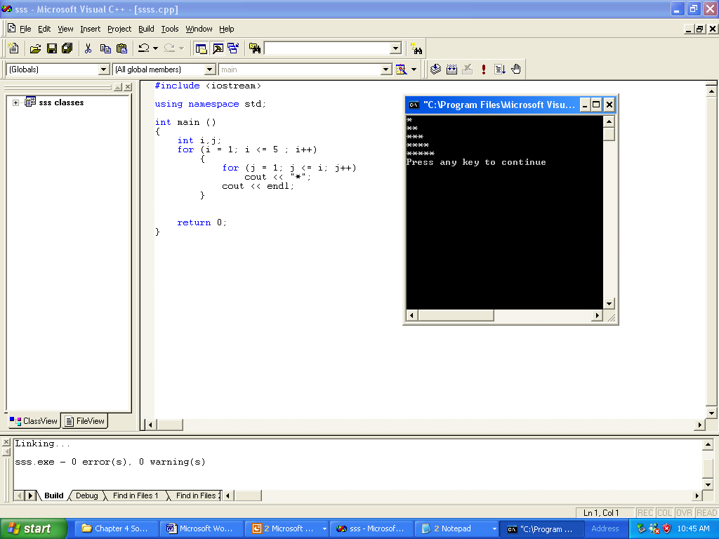
Nested Control Structures

Slide 32
Nested Control Structures
#include <iostream>
using namespace std;
int main ()
{
int i,j;
for (i = 1; i <= 5 ; i++)
{
for (j = i; j <= 5; j++)
cout << "*";
cout << endl;
}
return 0;
}

Slide 33
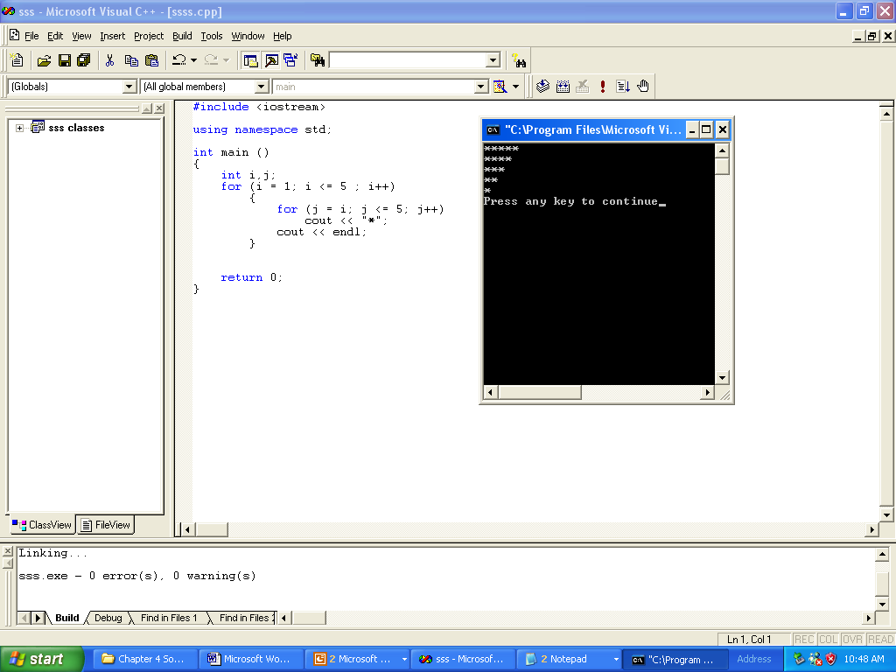
Nested Control Structures

Slide 34
Nested Control Structures
#include <iostream>
using namespace std;
int main ()
{
int i,j;
for (i = 1; i <= 5 ; i++)
{
for (j = 1; j <= 5; j++)
cout << "*";
cout << endl;
}
return 0;
}

Slide 35
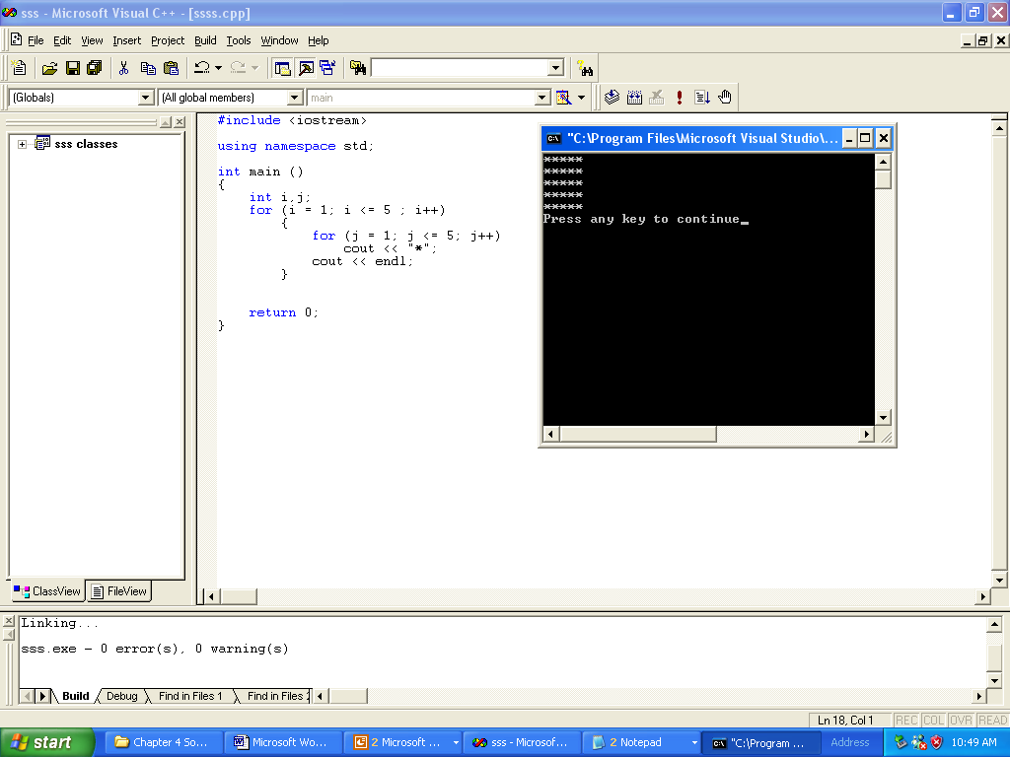
Nested Control Structures

Slide 36
Count Control
#include<iostream>
using namespace std;
int main()
{
int limit; //variable to store the number of items
//in the list
int number; //variable to store the number
int sum; //variable to store the sum
int counter; //loop control variable
cout << "Line 1: Enter number of data for processing"
<< endl; //Line 1
cin >> limit; //Line 2
sum = 0; //Line 3
counter = 0; //Line 4
while (counter < limit) //Line 5
{
cout<<"the number is:";
cin >> number; //Line 6
sum = sum + number; //Line 7
counter++; //Line 8
}
cout << "Line 9: The sum of the " << limit
<< " numbers = " << sum << endl; //Line 9
if (counter != 0) //Line 10
cout << "Line 11: The average = "
<< sum / counter << endl; //Line 11
else //Line 12
cout << "Line 13: No input." << endl; //Line 13
return 0;
}

Slide 37
//Flag-controlled while loop.
//Number guessing game.
#include <iostream>
#include <cstdlib>
#include <ctime>
using namespace std;
int main()
{
//declare the variables
int num; //variable to store the random
//number
int guess; //variable to store the number
//guessed by the user
bool done; //boolean variable to control
//the loop
num = (rand() + time(0)) % 100; //Line 1
done = false; //Line 2
while (!done) //Line 3
{ //Line 4
cout << "Enter an integer greater" << " than or equal to 0 and "<< "less than 100: "; //Line 5
cin >> guess; //Line 6
cout << endl; //Line 7
if (guess == num) //Line 8
{ //Line 9
cout << "You guessed the correct "
<< "number." << endl; //Line 10
done = true; //Line 11
} //Line 12
else //Line 13
if (guess < num) //Line 14
cout << "Your guess is lower "
<< "than the number.\n"
<< "Guess again!" << endl; //Line 15
else //Line 16
cout << "Your guess is higher "
<< "than the number.\n"
<< "Guess again!" << endl; //Line 17
} //end while //Line 18
return 0;
}

Slide 38
Sentinel Control
//Program: AVG2
#include <iostream>
using namespace std;
const int SENTINEL = -999;
int main()
{
int number; //variable to store the number
int sum = 0; //variable to store the sum
int count = 0; //variable to store the total
//numbers read
cout << "Line 1: Enter integers ending with "
<< SENTINEL << endl; //Line 1
cin >> number; //Line 2
while (number != SENTINEL) //Line 3
{
sum = sum + number; //Line 4
count++; //Line 5
cin >> number; //Line 6
}
cout << "Line 7: The sum of the " << count
<< " numbers is " << sum << endl; //Line 7
if (count != 0) //Line 8
cout << "Line 9: The average is "
<< sum / count << endl; //Line 9
else //Line 10
cout << "Line 11: No input." << endl; //Line 11
return 0;
}

Slide 39
The do…while Loop
#include <iostream>
using namespace std;
int main()
{
int i=1;
do
{
cout<<i<<endl;
i++;
}
while(i<=10);
cout<<endl<<i<<endl;
return 0;
}

Slide 40
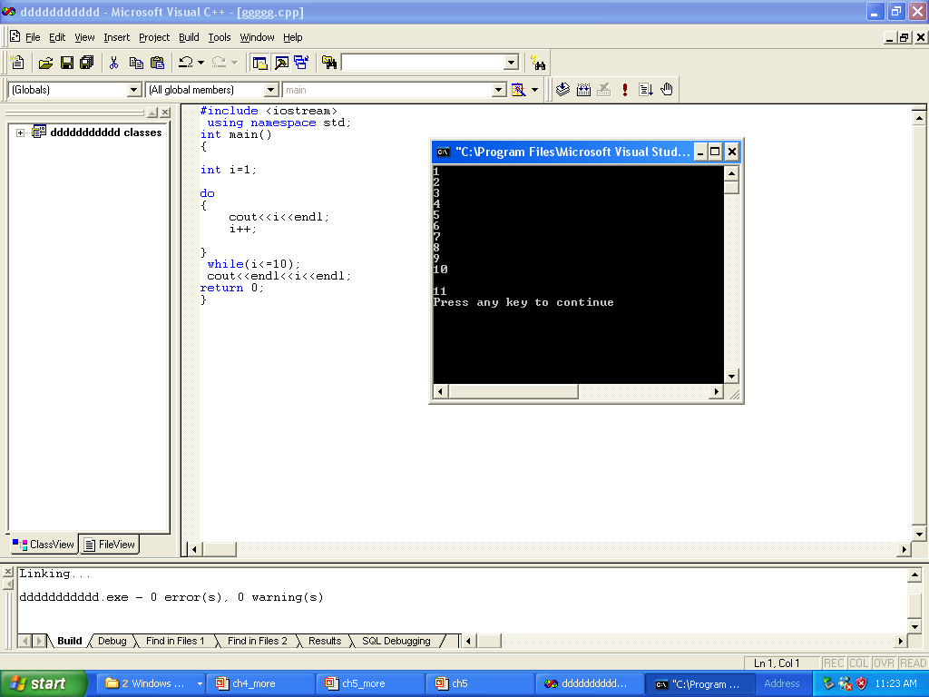

Slide 41
#include <iostream>
using namespace std;
int main()
{
int i=1;
do
cout<<i;
{
cout<<endl;
i++;
}
while(i<=10);
cout<<endl<<i<<endl;
return 0;
}

Slide 42
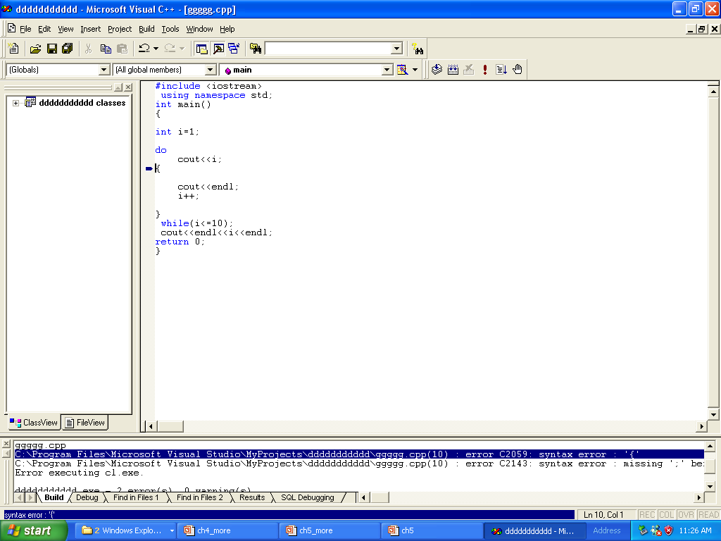

Slide 43
#include <iostream>
using namespace std;
int main()
{
int i=1;
do
{
cout<<i<<endl;
i++;
}
while(i<=10)
cout<<endl<<i;
return 0;
}

Slide 44
