Slide 1
HUBLI-DHARWAD AS SMART CITY
Guided by : presentation to:
Mohammad Tahir Mirji Sabyasachi
(L2 Trainer KTC Hubli)
TEAM MEMBERS:
Vinaya R Notad
Shankar R
Tabrez
Guruprasad
Kaiwalya K
KTC Hubli
Presentation by Team 3

Slide 2
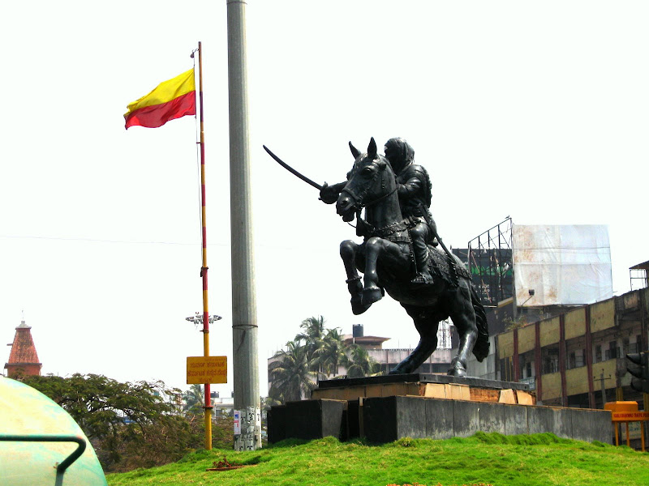
INTRODUCTION:
A smart city is an urban environment that utilizes advanced technologies and data-driven solutions to enhance the quality of life for its residents. It leverages digital infrastructure, Internet of Things (IoT) devices, and data analytics to improve the efficiency, sustainability, safety, and overall livability of the city. A smart city integrates various sectors such as transportation, energy, healthcare, public services, and governance, to create an interconnected and intelligent urban ecosystem. The goal of a smart city is to optimize resource allocation, improve citizen services, promote sustainable practices, and create a technologically advanced and inclusive urban environment.

Slide 3
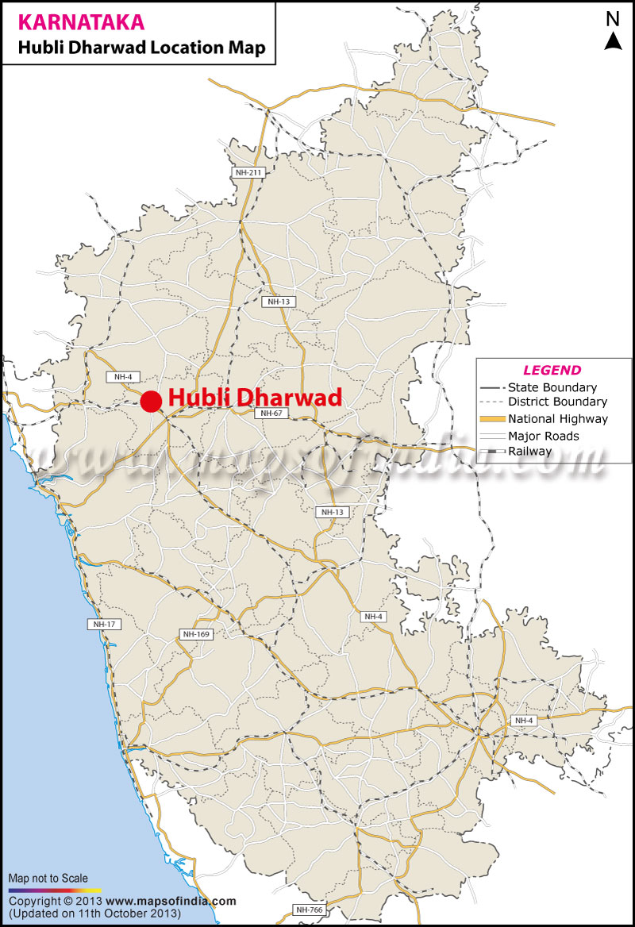
HUBLI-DHARWAD (TWIN CITY)
EXTERNAL FACTORS
Geographic Factors: Hubli-Dharwad, located in Karnataka, India, possesses strategic positioning, connectivity, and regional significance.
Geographic Advantage: Hubli-Dharwad's central location allows for connectivity with major cities and trade routes, attracting businesses and investments.

Slide 4
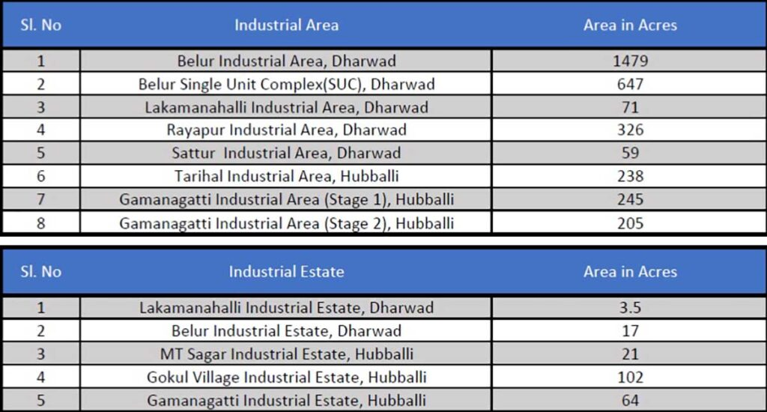
INTERNAL FACTORS
IT Infrastructure: Hubli-Dharwad's growing IT sector and tech-savvy workforce offer a foundation for leveraging digital technologies in smart city initiatives.
Mixed Infrastructure: The combination of manufacturing and service industries in Hubli-Dharwad provides diverse economic opportunities and a strong base for development.

Slide 5
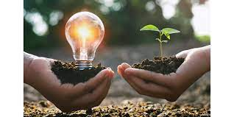
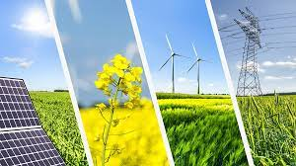
ENERGY SUSTAINABILITY FOR TWIN CITIES
Renewable Energy: Integration of solar panels, wind turbines, and other renewable sources to reduce carbon emissions and enhance energy efficiency.
Energy Management: Smart grids, energy storage, and real-time monitoring optimize energy distribution, consumption, and demand management in Hubli-Dharwad.

Slide 6
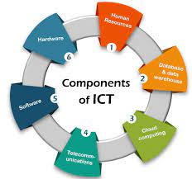
INFORMATION AND COMMUNICATION TECHNOLOGIES(ICT)
Digital Connectivity: Robust network infrastructure and widespread access to high-speed internet for seamless communication and data exchange.
Data Analytics: Leveraging data-driven insights to enhance efficiency, optimize resource allocation, and enable informed decision-making.

Slide 7
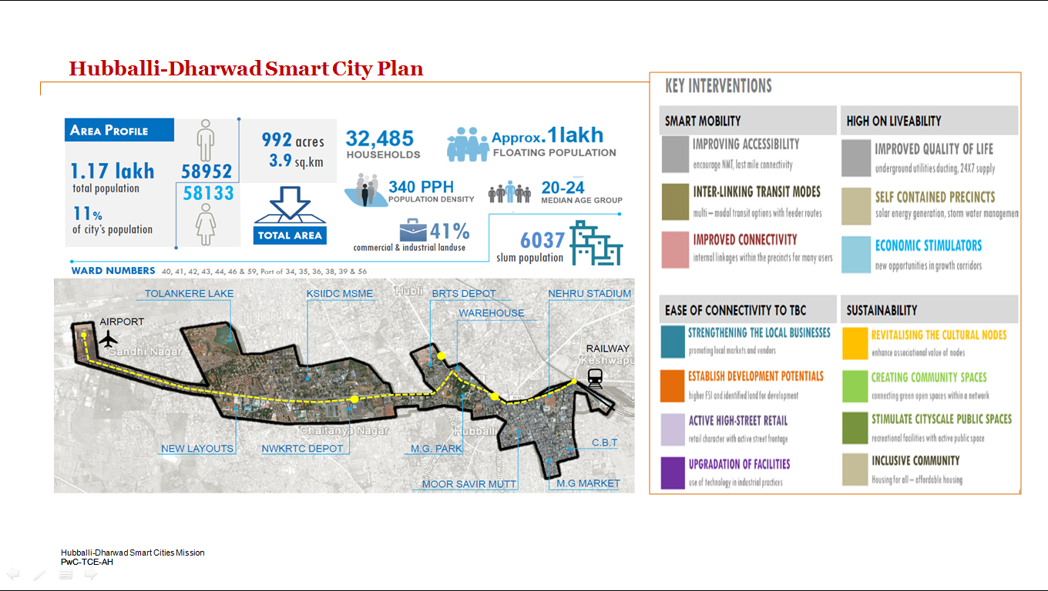

Slide 8
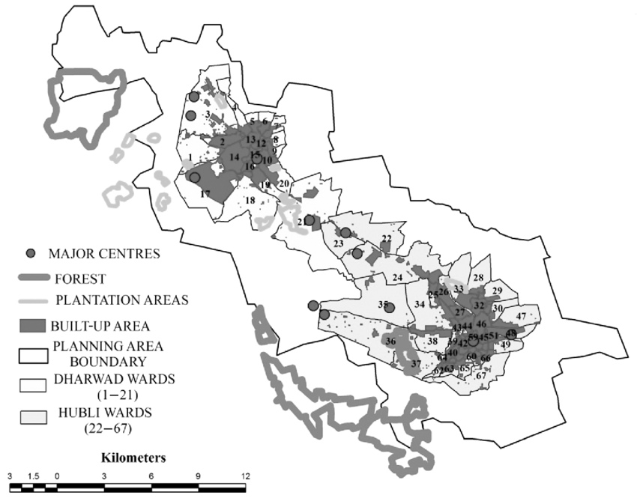
FINANCE FOR SMART CITY DEVELOPMENT
Public-Private Partnerships (PPPs): Collaborations between the government and private entities can secure funding and expertise for smart city projects.
Revenue Generation: Exploring avenues such as land monetization, tourism promotion, and attracting investments can create sustainable sources of income for smart city initiatives in Hubli-Dharwad
Planning Area Boundary of Municipal Cooperation

Slide 9
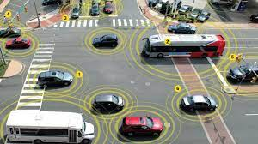

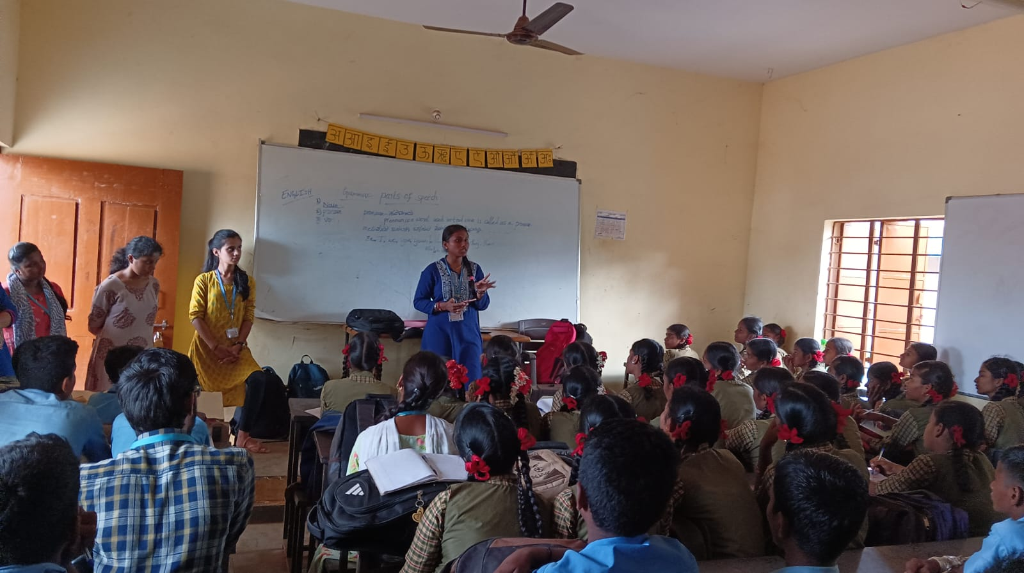
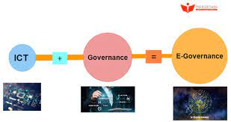
CONVERTING HUBLI-DHARWAD INTO A SMART CITY
Smart Transportation: Intelligent traffic management, enhanced public transportation systems, and smart parking solutions to ease congestion and improve mobility.
Digital Governance: Implementing e-governance platforms, citizen engagement portals, and digital services for efficient administration and citizen participation.

Slide 10
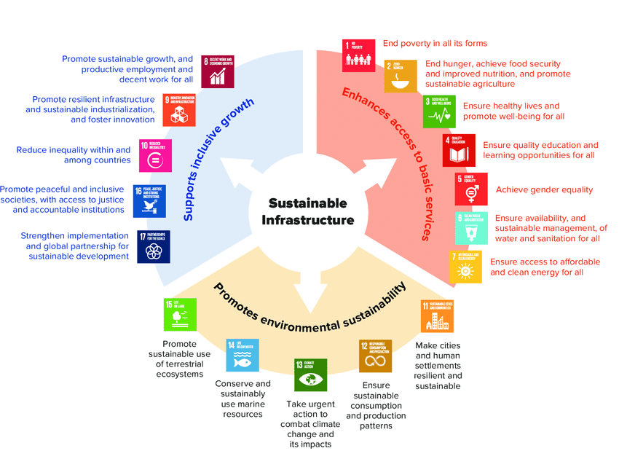
Sustainable Infrastructure:
Upgrading existing infrastructure for water supply, waste management, and public services to optimize resource utilization and reduce environmental impact.

Slide 11
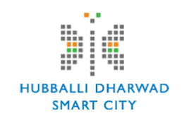
CONVERTING HUBLI-DHARWAD INTO SMART CITY:
Step 1: Assessing Existing Infrastructure and Identifying Gaps
Step 2: Developing a Comprehensive Smart City Plan, considering local needs and aspirations.
Step 3: Engaging Stakeholders: Collaboration with citizens, businesses, and academia to ensure inclusivity and gather diverse perspectives.
Step 4: Implementing Pilot Projects: Gradual implementation and testing of smart city solutions, focusing on small-scale, high-impact initiatives.
Step 5: Scaling Up: Scaling successful pilot projects and gradually expanding the smart city infrastructure and services.

Slide 12
BUILDING AND CONTROL AUTOMATION
Intelligent Infrastructure: Automated systems for efficient building management, including lighting, temperature control, and security.
IoT Integration: Connecting devices and sensors for real-time monitoring, predictive maintenance, and energy optimization.

Slide 13
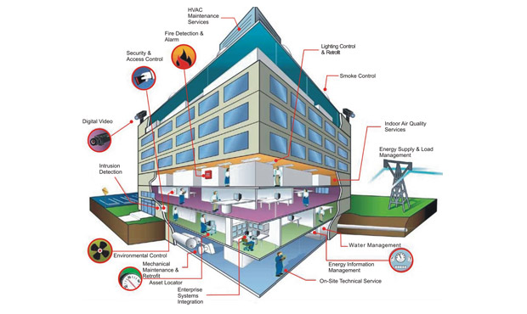
Smart Building is a Key to Smart City

Slide 14
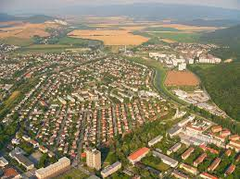
EFFICIENT URBAN PLANNING
Data-driven Planning: Utilizing GIS, data analytics, and modelling techniques for informed urban development decisions.
Smart Zoning: Implementing mixed-use zoning, walkability, and green spaces to create sustainable, liveable neighbourhood's.

Slide 15
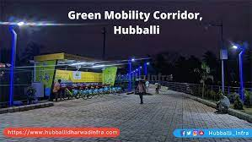
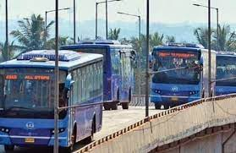
URBAN MOBILITY AND SUSTAINABLE PUBLIC TRANSPORT
Intelligent Transportation Systems: Real-time traffic monitoring, smart traffic signals, and congestion management for smoother mobility.
Public Transport Integration: Enhanced public transportation networks, promoting shared mobility options and reducing private vehicle dependency.

Slide 16
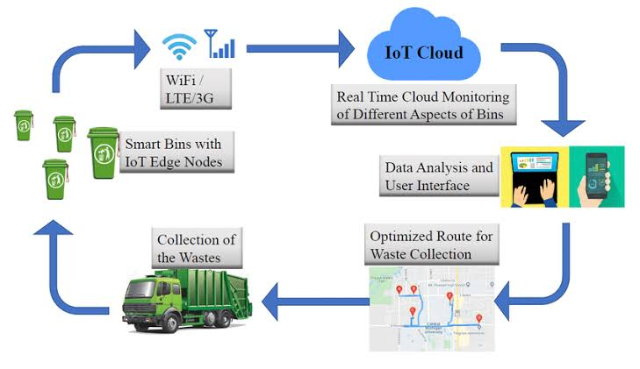

SMART WASTE MANAGEMENT
Waste Monitoring: Implementing sensors and data analytics to optimize waste collection routes and reduce environmental impact.
Recycling and Segregation: Encouraging citizen participation, promoting recycling, and implementing efficient waste disposal methods.

Slide 17
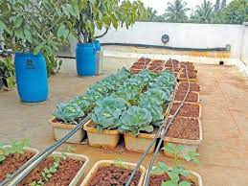
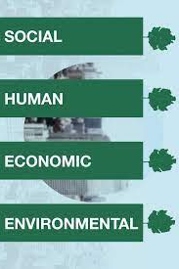
IMPROVING ENVIRONMENT SUSTAINABILITY
Green Infrastructure: Promoting green building practices, rooftop gardens, and urban farming to enhance environmental sustainability.
Water Management: Implementing smart water systems, rainwater harvesting, and efficient water distribution to address water scarcity challenges.
4 Pillars od Sustainability
Roof Top Gardens

Slide 18
SOCIAL ENVIRONMENT CONSIDERATIONS
Inclusive Approach: Ensuring accessibility, affordability, and equal access to smart city services for all residents, including marginalized communities.
Citizen Engagement: Encouraging citizen participation, feedback, and collaboration to foster a sense of ownership and social cohesion.
TECHNOLOGIES APPLIED TO EDUCATION
Digital Learning: Integrating technology in education, e-learning

Slide 19
COLLABORATION AND PARTNERSHIPS
Government Collaboration: Engaging with local, regional, and national government bodies to leverage resources and support.
Private Sector Partnerships: Collaborating with technology companies, service providers, and investors for expertise and funding.
Community Participation: Encouraging active involvement and partnerships with local residents, organizations, and academia.

Slide 20
CONCLUSION
Converting Hubli-Dharwad into a smart city presents a significant opportunity for sustainable growth, improved quality of life, and enhanced economic development.
By leveraging internal factors, addressing geographic advantages, and considering factors such as energy and finance, Hubli-Dharwad can embark on a successful smart city journey.
Smart city transformation requires strong leadership, collaboration, and a vision that aligns with the aspirations and needs of the local community.

Slide 21
Thank You

