Slide 1
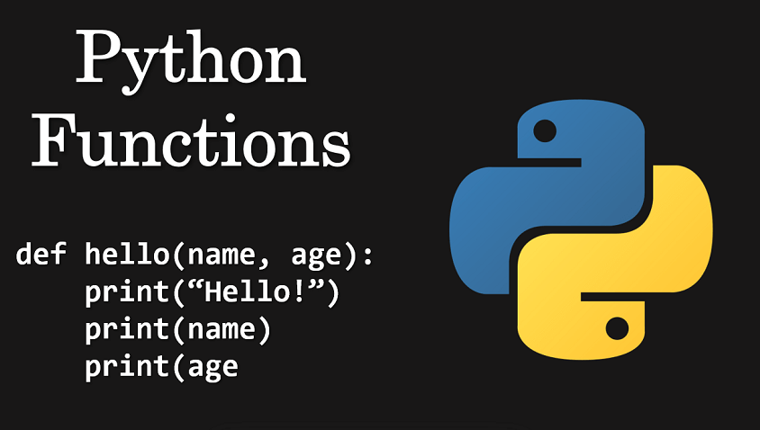
Python Advanced Python Functions
Module - 2
Presentation By
Mohammed Tahir Mirji
MTech CS

Slide 2
CONTENTS
Introduction to Types of Functions
How do we write functions
Modularize program with functions
Understanding variable scopes
What is code documentation & Importance
Lambda expressions
What are Iterators
Examples of Iterators
What are generators
Examples of generators
Assignments

Slide 3
Introduction to Types of Functions
Functions are just bundled sets of instructions that we can repeatedly use without having to write them again. They make the code more concise and readable in any language, including Python.
You can pass data, known as parameters, into a function.
A function can return data as a result.
Types of functions:
Built-in (A built-in function is a function that is already available in a programming language )
Recursion (it is a process in which a function calls itself directly or indirectly)
Lambda (Python Lambda Functions are anonymous function means that the function is without a name)
user-defined (User-defined functions are functions that you use to organize your code )

Slide 4
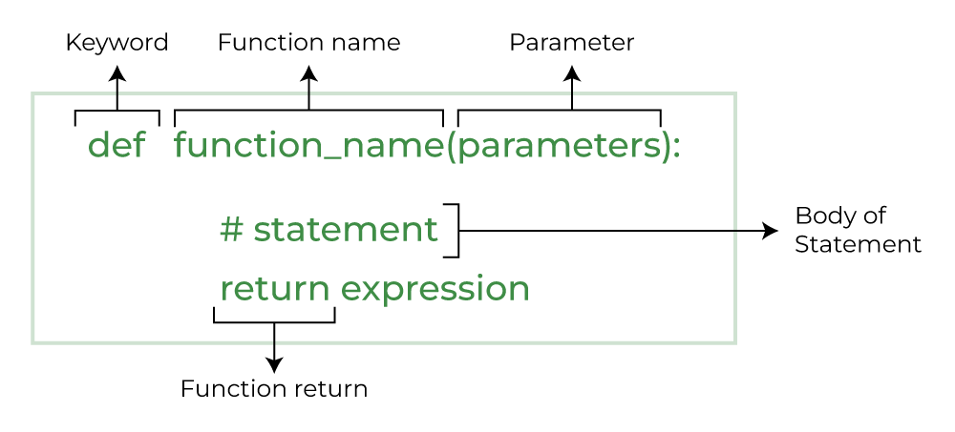
How do we write functions

Slide 5
How do we write function definition
Creating a Python Function
We can create a Python function using the def keyword.
# A simple Python function
def fun():
print("Welcome to GFG")

Slide 6
How do we write function call
# A simple Python function
def fun():
print("Welcome to GFG")
# Driver code to call a function
fun()

Slide 7
What is Modularity?
Modularity refers to the act of partitioning the code into modules building them first followed by linking and finally combining them to form a complete project. Modularity ensures re-usability and thrives to minimize the duplication.
Import math
X= math.sqrt(64)
print(x)

Slide 8
Understanding variable scopes
The location where we can find a variable and also access it if required is called the scope of a variable.
Global and local variables
Global variables are the ones that are defined and declared outside any function and are not specified to any function. They can be used by any part of the program.

Slide 9
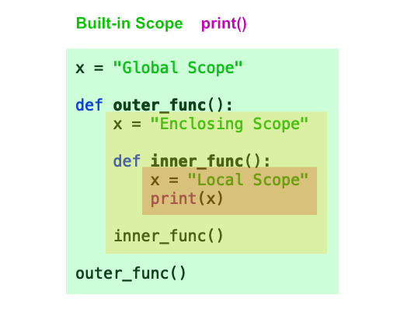
Understanding variable scopes
# This function uses global variable s
def f():
print(s)
# Global scope
s = "I love Python"
f()

Slide 10
What is code documentation & Importance
When you write code, you write it for two primary audiences: your users and your developers (including yourself). Both audiences are equally important.
In general, commenting is describing your code to/for developers. The intended main audience is the maintainers and developers of the Python code. In conjunction with well-written code, comments help to guide the reader to better understand your code and its purpose and design:
“Code tells you how; Comments tell you why.”

Slide 11
What is code documentation & Importance
Documenting your Python code is all centered on docstrings. These are built-in strings that, when configured correctly, can help your users and yourself with your project’s documentation. Along with docstrings, Python also has the built-in function help() that prints out the objects docstring to the console.

Slide 12
Lambda expressions
Python Lambda Functions are anonymous function means that the function is without a name. As we already know that the def keyword is used to define a normal function in Python. Similarly, the lambda keyword is used to define an anonymous function in Python.
lambda arguments: expression

Slide 13
Lambda expressions
This function can have any number of arguments but only one expression, which is evaluated and returned.
One is free to use lambda functions wherever function objects are required.
You need to keep in your knowledge that lambda functions are syntactically restricted to a single expression.
It has various uses in particular fields of programming besides other types of expressions in functions.

Slide 14
Lambda expressions
Ex 2:
def cube(y):
return y*y*y
lambda_cube = lambda y: y*y*y
# using the normally
# defined function
print(cube(5))
# using the lambda function
print(lambda_cube(5))
Ex 1:
string =‘Python is future'
# lambda returns a function object
print(lambda string : string)

Slide 15
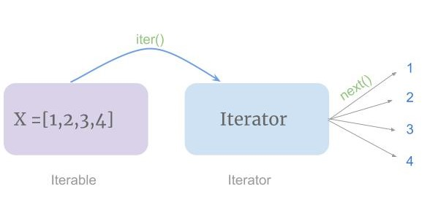
What are Iterators
Iterator in python is an object that is used to iterate over iterable objects like lists, tuples, dicts, and sets. The iterator object is initialized using the iter() method. It uses the next() method for iteration.

Slide 16
What are Iterators
Iterator in python is an object that is used to iterate over iterable objects like lists, tuples, dicts, and sets. The iterator object is initialized using the iter() method. It uses the next() method for iteration.
__iter(iterable)__ method that is called for the initialization of an iterator. This returns an iterator object
next ( __next__ in Python 3) The next method returns the next value for the iterable. When we use a for loop to traverse any iterable object, internally it uses the iter() method to get an iterator object which further uses next() method to iterate over. This method raises a StopIteration to signal the end of the iteration.

Slide 17
Examples of Iterators
Ex1:
mytuple = (“alpha", "beta", “gamma")
myit = iter(mytuple)
print(next(myit))
print(next(myit))
print(next(myit))
Ex 3:
mystr = "banana"
for x in mystr:
print(x)
Ex 2:
tuple = (“alpha", "beta", “gamma")
for x in mytuple:
print(x)

Slide 18
What are generators
A generator is a function that produces a sequence of results instead of a single value, i.e you generate ​a series of values
A generator-function is defined like a normal function, but whenever it needs to generate a value, it does so with the yield keyword rather than return. If the body of a def contains yield, the function automatically becomes a generator function.
What is use of yield() in Python?
The yield statement suspends a function’s execution and sends a value back to the caller, but retains enough state to enable the function to resume where it left off. This allows its code to produce a series of values over time.

Slide 19
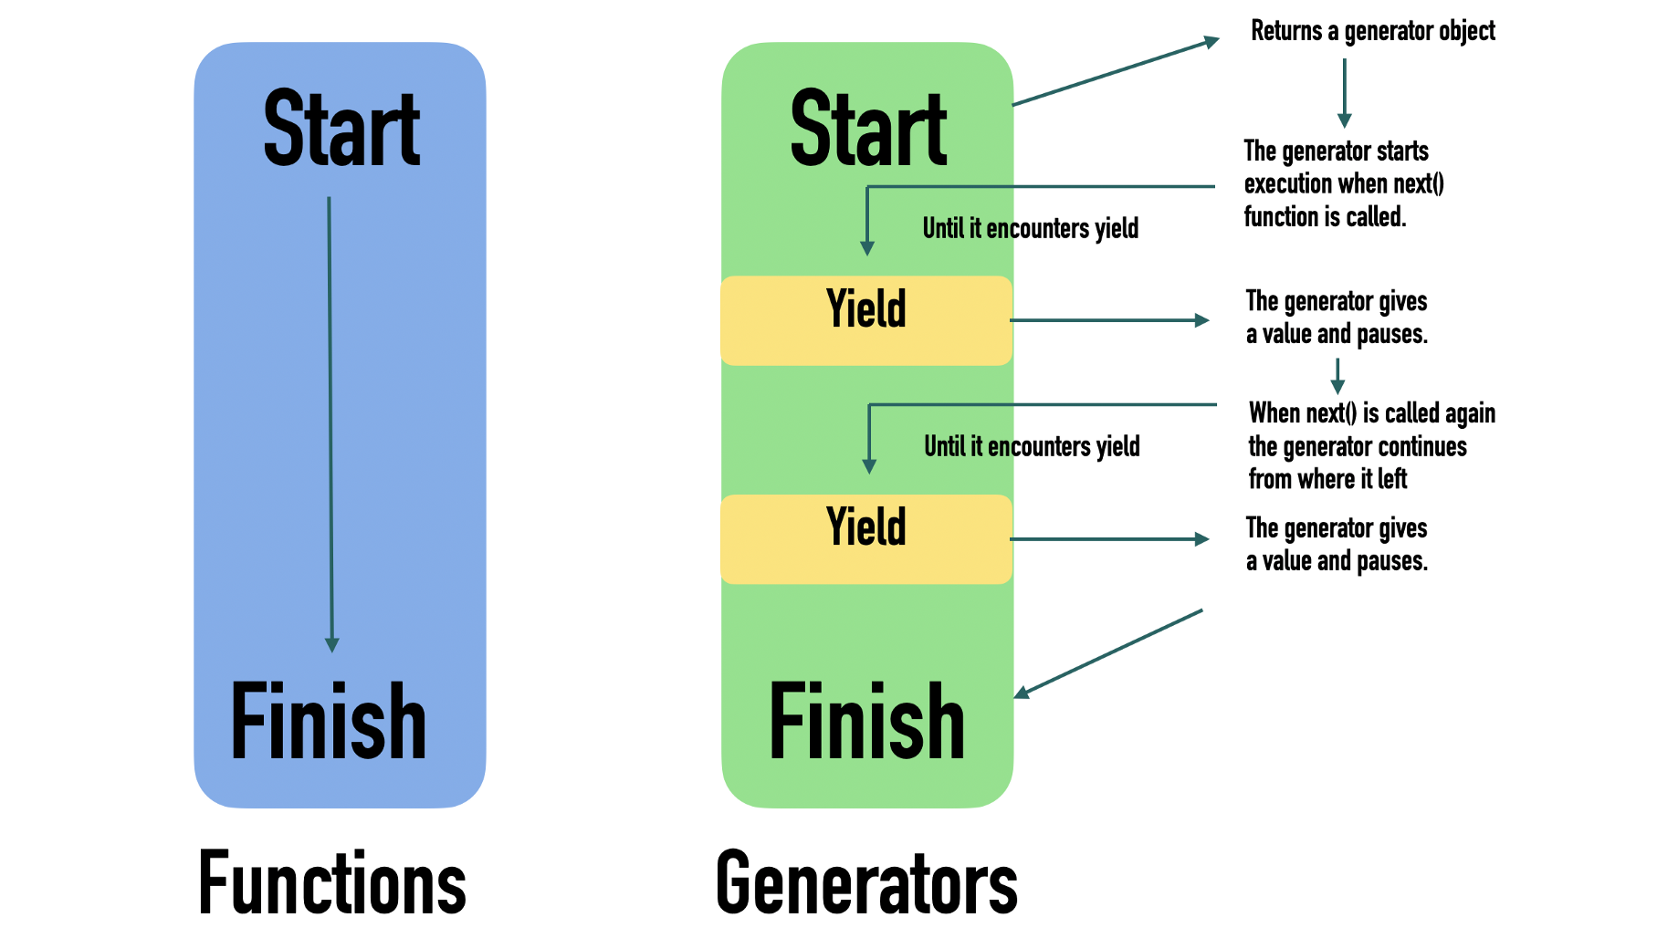
What are generators

Slide 20
What are generators
yield() in Python?
def simpleGeneratorFun():
yield 1
yield 2
yield 3
# Driver code to check above generator function
for value in simpleGeneratorFun():
print(value)

Slide 21
Examples of generators
# A generator function
def simpleGeneratorFun():
yield 1
yield 2
yield 3
# x is a generator object
x = simpleGeneratorFun()
# Iterating over the generator object using next
print(x.next()) # In Python 3, __next__()
print(x.next())
print(x.next())

Slide 22
Assignments

Slide 23
Assignments Control Flows are uploaded with below link
Refer Readme.md of github repository for list of assignments:
https://github.com/tahirmirji/ai_with_python_keonics

Slide 24
Thank You

