Slide 1

Module - 07 Neural Network and Deep Learning
By Tahir Mirji

Slide 2
Contents
Introduction to deep learning
Major Trends in deep learning, How deep learning is applied to supervised learning, Categories of models CNN,RNN & when they should be applied, when does deep learning will work well.
Deep learning Continued
Build a logistic regression model, structured as shallow neural network, Implement ML Algorithm, making predictions, derivative computation & gradient descent, implement computationally efficient and highly vectored version of models, compute derivatives for logistic regression using backpropagation mindset, familiarize Numpy, Logistic regression as a Neural Network, python and vectorization
Introduction to shallow Neural Networks
Hidden unites and hidden layers, apply various activation function, Build first forward and backward propagation with a hidden layer, apply random initialization to NN, build and train a neural network with one hidden layer
Introduction to Deep Neural Networks
Build and train deep L-Layer NN, Analyze matrix and vector dimensions to check NN implement., How to use cache to pass info from forward prop to back-propagation, role of hyper parameters in deep learning.

Slide 3
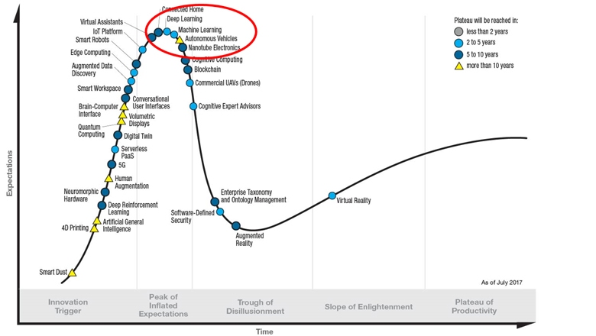
Trends in deep learning

Slide 4
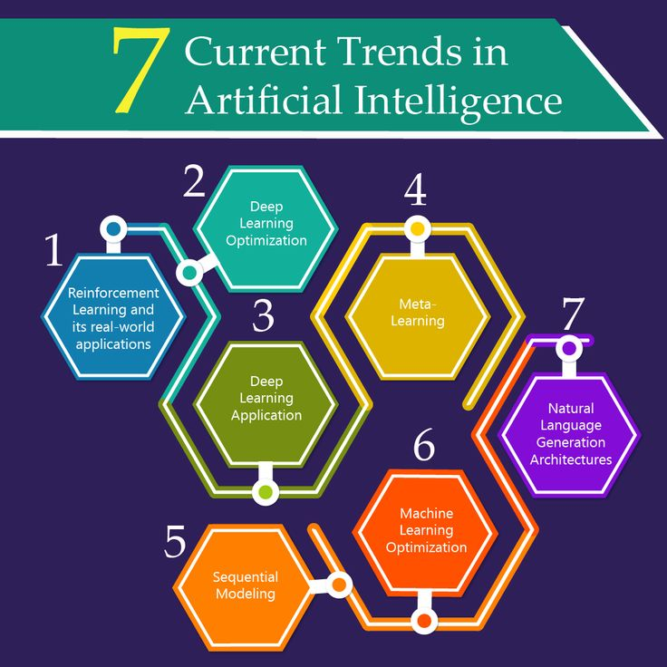

Slide 5
What's deep learning
Deep learning is a branch of machine learning which is completely based on artificial neural networks, as neural network is going to mimic the human brain so deep learning is also a kind of mimic of human brain.

Slide 6
Introduction To Deep Learning
Deep learning is a particular kind of machine learning that achieves great power and flexibility by learning to represent the world as a nested hierarchy of concepts, with each concept defined in relation to simpler concepts, and more abstract representations computed in terms of less abstract ones.

Slide 7
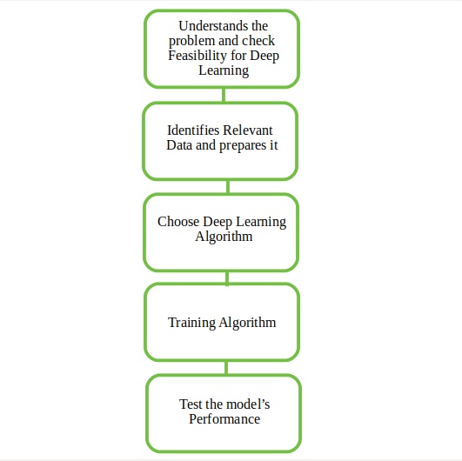

Slide 8
Architectures
In human brain approximately 100 billion neurons all together this is a picture of an individual neuron and each neuron is connected through thousand of their neighbors.
The question here is how do we recreate these neurons in a computer. So, we create an artificial structure called an artificial neural net where we have nodes or neurons.
We have some neurons for input value and some for output value and in between, there may be lots of neurons interconnected in the hidden layer.

Slide 9
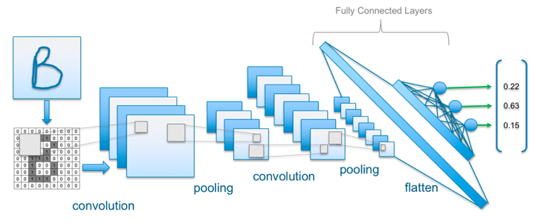
Architectures

Slide 10
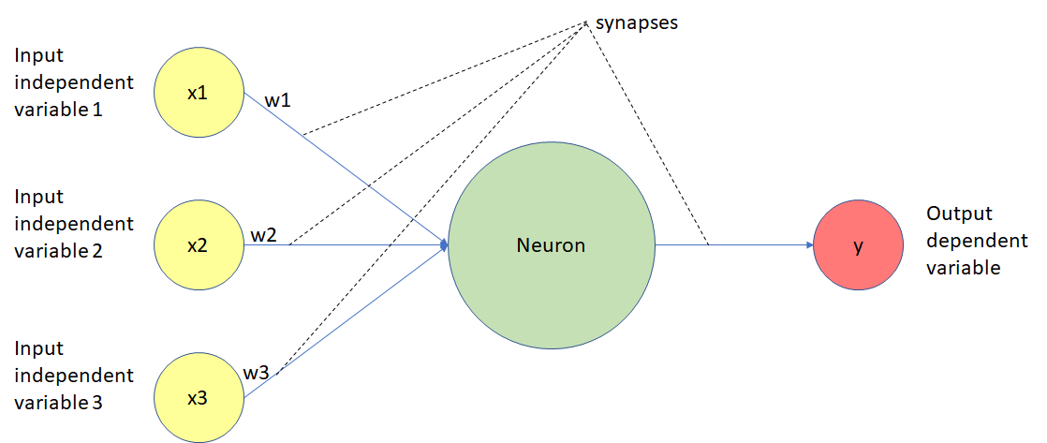
Neural Network Concept

Slide 11
Activation Functions
In Neural Network the activation function defines if given node should be “activated” or not based on the weighted sum. Let’s define this weighted sum value as z. In this section I would explain why “Step Function” and “Linear Function” won’t work and talk about “Sigmoid Function” one of the most popular activation functions. There are also other functions which I will leave aside for now.

Slide 12
Step Function
One of the first ideas would be to use so called “Step Function” (discrete output values) where we define threshold value and:
if(z > threshold) — “activate” the node (value 1) if(z < threshold) — don’t “activate” the node (value 0)
This looks nice but it has drawback since the node can only have value 1 or 0 as output. In case when we would want to map multiple output classes (nodes) we got a problem. The problem is that it is possible multiple output classes/nodes to be activated (to have the value 1). So we are not able to properly classify/decide.

Slide 13
Linear Function
Another possibility would be to define “Linear Function” and get a range of output values.
However using only linear function in the Neural Network would cause the output layer to be linear function, so we are not able to map any non-linear data. The proof for this is given by:
then by function composition we get
which is also a linear function.

Slide 14

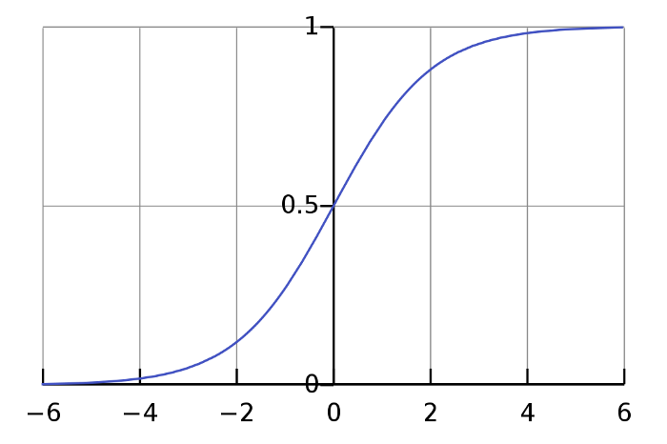
Sigmoid Function
It is one of the most widely used activation function today. It equation is given with the formula below.
It has multiple properties which makes it so popular:
It’s non-linear function
Range values are between (0,1)
Between (-2,2) on x-axis the function is very steep, that cause function to tend to classify values ether 1 or 0
Because of this properties it allows the nodes to take any values between 0 and 1. In the end, in case of multiple output classes, this would result with different probabilities of “activation” for each output class. And we will choose the one with the highest “activation”(probability) value.

Slide 15
Bias Node
Using “bias” node is usually critical for creating successful learning model. In short, a bias value allows to shift the activation function to the left or right and it helps getting better fit for the data (better prediction function as output).
Below there are 3 Sigmoid functions that I draw where you can notice how multiplication/add/subtract the variable x by some value can influence the function.
Multiplying x — makes the function steeper
Add/Subtract x — shift the function left/right

Slide 16
Forward Propagation Calculation
This process of Forward propagation is actually getting the Neural Network output value based on a given input. This algorithm is used to calculate the cost value. What it does is the same mathematical process as the one described in section 2 “Model Representation Mathematics”. Where in the end we get our hypothesis value

Slide 17
Backpropagation Algorithm
What we want to do is minimize the cost function J(θ) using the optimal set of values for θ (weights). Backpropagation is a method we use in order to compute the partial derivative of J(θ).
This partial derivative value is then used in Gradient descent algorithm for calculating the θ values for the Neural Network that minimize the cost function J(θ)
Backpropagation is about determining how changing the weights impact the overall cost in the neural network.

Slide 18
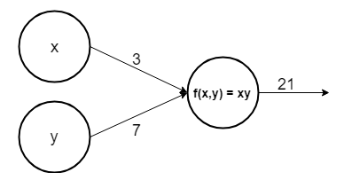
Why derivatives ?
The derivative of a function (in our case J(θ)) on each variable (in our case weight θ) tells us the sensitivity of the function with respect to that variable or how changing the variable impacts the function value.
Let’s look at a simple example neural network

Slide 19
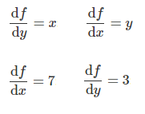
There are two input nodes x and y. The output function is calculating the product x and y. We can now compute the partial derivatives for both nodes
The partial derivative with respect to x is saying that if x value increase for some value ϵ then it would increase the function (product xy) by 7ϵ and the partial derivative with respect to y is saying that if y value increase for some value ϵ then it would increase the function by 3ϵ.

Slide 20
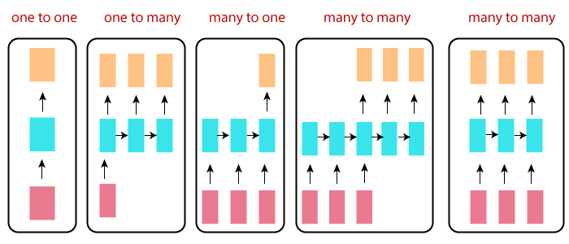
Types of RNN

Slide 21
When to Use Recurrent Neural Networks?
Recurrent Neural Networks, or RNNs, were designed to work with sequence prediction problems
Ex:
One-to-Many: An observation as input mapped to a sequence with multiple steps as an output.
Many-to-One: A sequence of multiple steps as input mapped to class or quantity prediction.
Many-to-Many: A sequence of multiple steps as input mapped to a sequence with multiple steps as output.

Slide 22
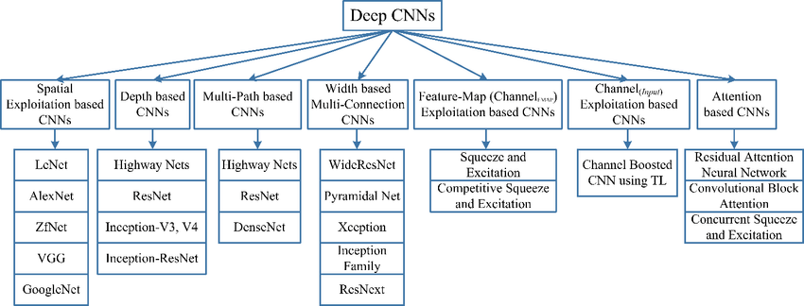
Types of CNN

Slide 23
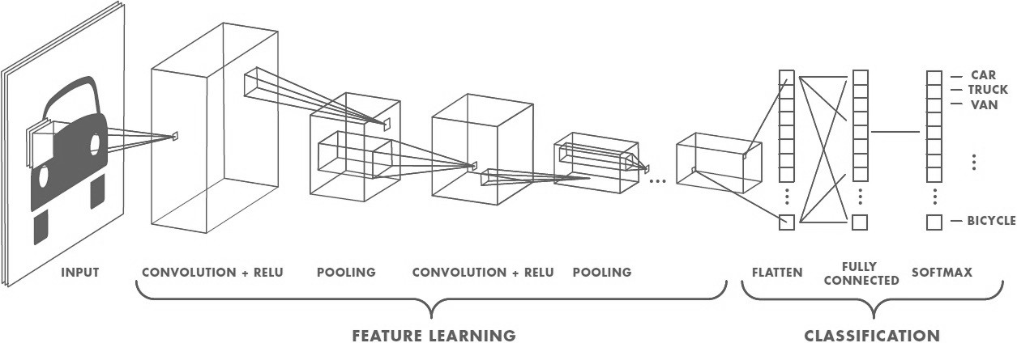
When to Use CNNs?
Convolutional Neural Networks (CNNs) are designed to map image data (or 2D multi-dimensional data) to an output variable (1 dimensional data).
They have proven so effective that they are the ready to use method for any type of prediction problem involving image data as an input.

Slide 24
Deep Learning Continued

Slide 25
Deep Learning Continued
Building logistic regression structured as Shallow neural network
Refer
More…

