Slide 1
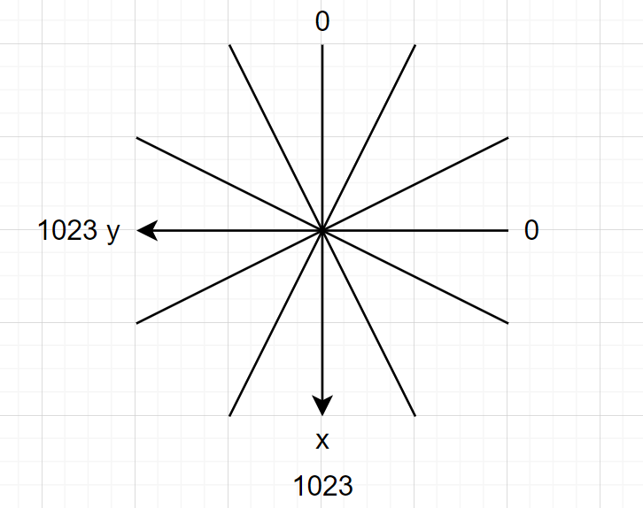



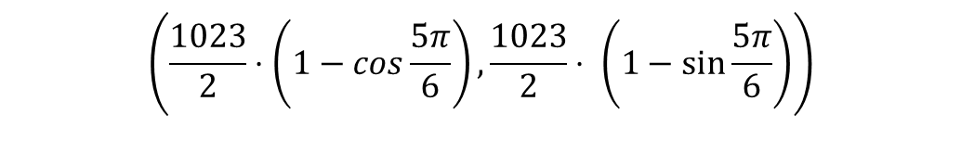




$$\left(\frac{1023}{2}⋅\left(1−\cos{\frac{11π}{6}}\right),\frac{1023}{2}⋅ \left(1−\sin{\frac{11π}{6}}\right)\right)$$
$$\left(\frac{1023}{2}⋅\left(1−\cos{\frac{π}{6}}\right),\frac{1023}{2}⋅ \left(1−\sin{\frac{π}{6}}\right)\right)$$
Front Area
$$\left(\frac{1023}{2}⋅\left(1−\cos{\frac{5π}{3}}\right),\frac{1023}{2}⋅ \left(1−\sin{\frac{5π}{3}}\right)\right)$$
$$\left(\frac{1023}{2}⋅\left(1−\cos{\frac{π}{3}}\right),\frac{1023}{2}⋅ \left(1−\sin{\frac{π}{3}}\right)\right)$$
Left Area
Right Area
$$\left(\frac{1023}{2}⋅\left(1−\cos{\frac{4π}{3}}\right),\frac{1023}{2}⋅ \left(1−\sin{\frac{4π}{3}}\right)\right)$$
$$\left(\frac{1023}{2}⋅\left(1−\cos{\frac{2π}{3}}\right),\frac{1023}{2}⋅ \left(1−\sin{\frac{2π}{3}}\right)\right)$$
Back Area
$$\left(\frac{1023}{2}⋅\left(1−\cos{\frac{7π}{6}}\right),\frac{1023}{2}⋅ \left(1−\sin{\frac{7π}{6}}\right)\right)$$
$$\left(\frac{1023}{2}⋅\left(1−\cos{\frac{5π}{6}}\right),\frac{1023}{2}⋅ \left(1−\sin{\frac{5π}{6}}\right)\right)$$

