Slide 1

HACKNOVA 2025
Theme- Assistive Technology & Inclusive Education
Problem Statement Title-Empowering Differently Abled Students Through Smart Assistive Technologies
Idea Title- Empowering Differently Abled Students Through Smart Assistive Technologies
Team ID-
Team Name- TEAM CREATION

Slide 2

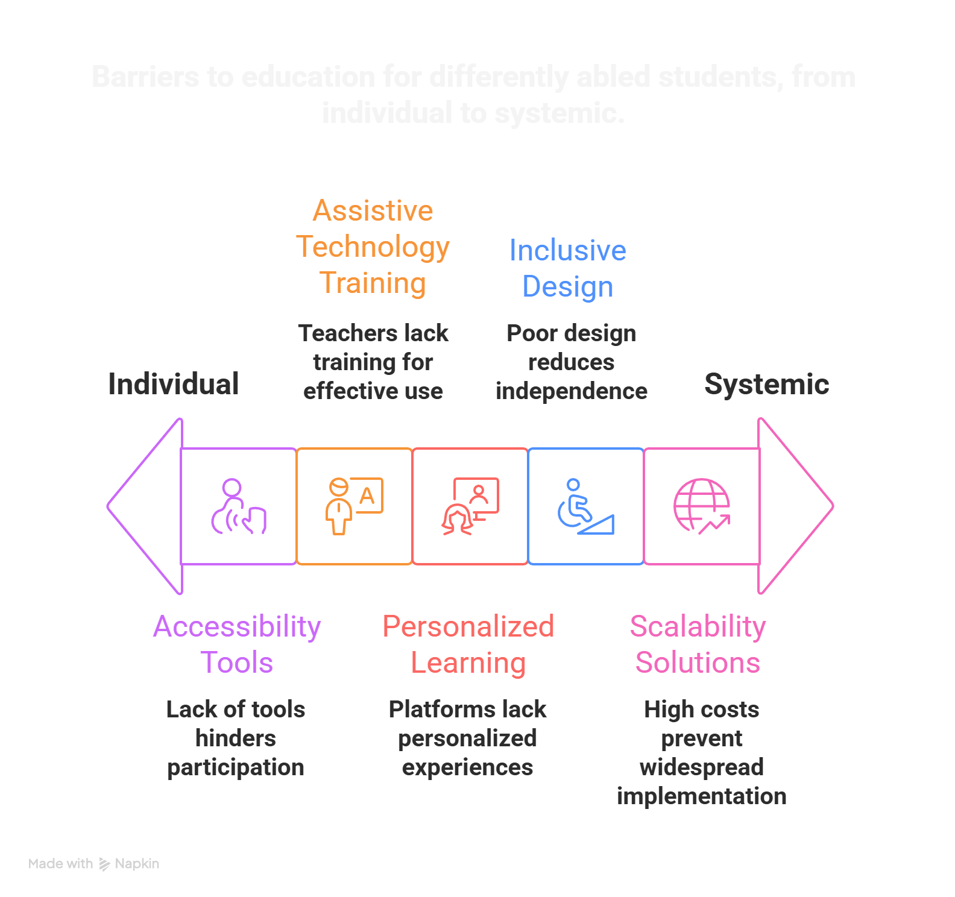

IDEA TITLE
TEAM CREATION
“EduAble is an AI-driven assistive learning system that uses smart devices and adaptive tools to make education accessible, affordable, and personalized for differently abled students.”
Problems to be Adressed:-
Proposed Solution:-
A Smart Assistive Learning Ecosystem combining AI, IoT, and adaptive technology to support differently abled students.
Accessible Platform with screen readers, speech-to-text, Braille support, and customizable UI for various disabilities.
Smart Devices like gesture-controlled tools, hearing aids, and haptic feedback systems for interactive learning.
AI-Powered Personalization that tailors lessons, pace, and content to each student’s needs.
Teacher & Parent Dashboards for progress tracking, insights, and real-time support.
Affordable & Localized using open-source tech, local manufacturing, and multi-language support.
Aims to make education inclusive, adaptive, and affordable, empowering both students and teachers.
Deployed prototype of EduAble:-
Scan this QR or click the link given below
https://eduable.onrender.com/

Slide 3
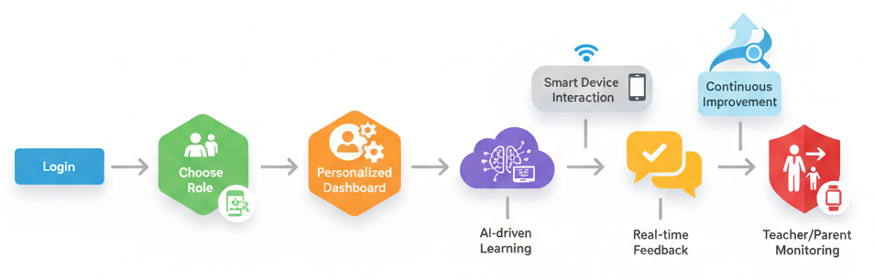
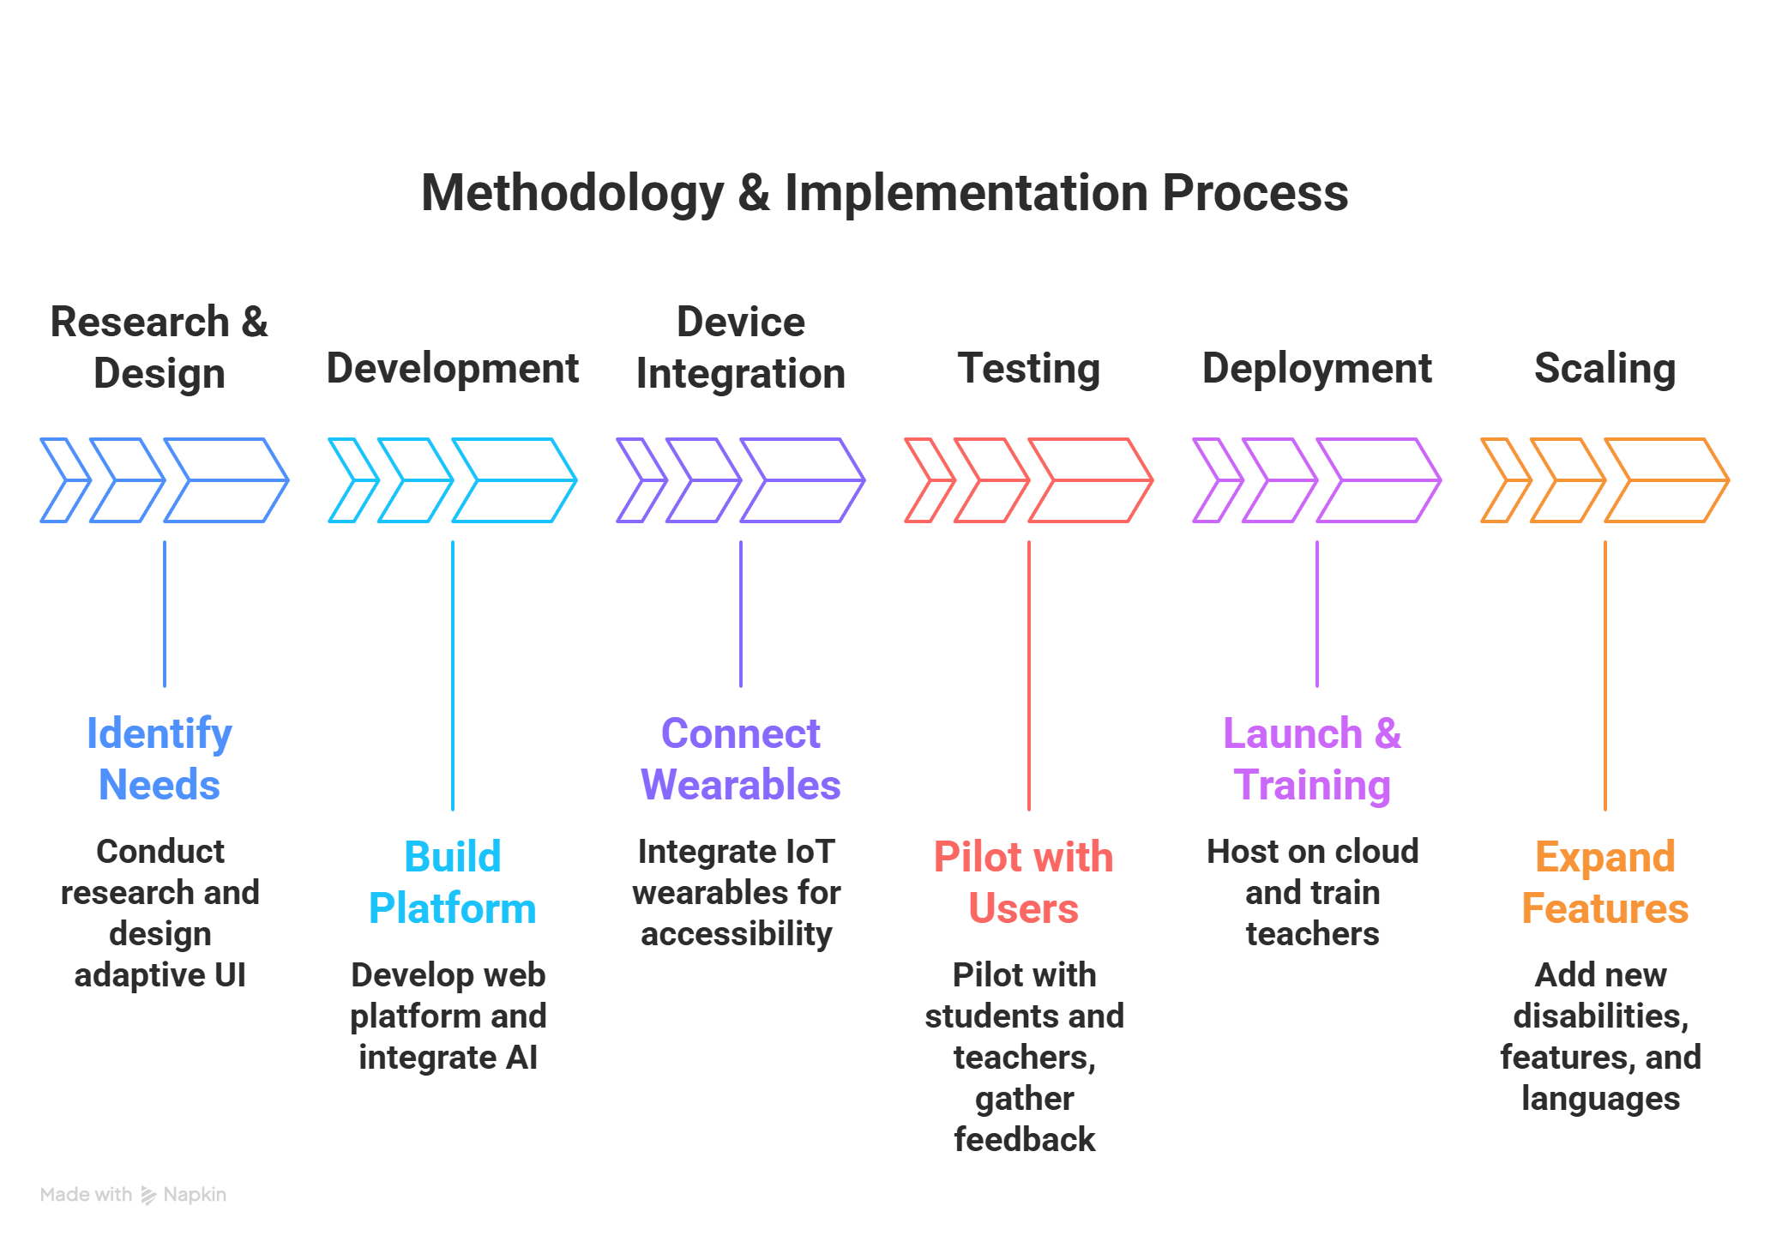
TECHNICAL APPROACH
TEAM CREATION
Technologies to be Used:-
Frontend: React.js, TailwindCSS
Backend: Node.js, Express.js
Database: MongoDB
AI/ML: TensorFlow / PyTorch for adaptive learning
APIs: Speech-to-text, screen reader, gesture recognition
Website Flow:-
Methodology and Process of Implementation:-
AI SenseMate – Smart Multimodal Learning Assistant:
“An AI-powered tool that adapts to each disability using voice, gesture, and visual recognition” — reading aloud for the visually impaired, showing subtitles or sign animations for hearing-impaired, and enabling gesture-based control for physically disabled students. It personalizes learning, making EduAble truly inclusive and interactive.

Slide 4
FEASIBILITY AND VIABILITY
TEAM CREATION
Technical Feasibility:-
Uses proven technologies (React, Node.js, MongoDB, TensorFlow).
AI + IoT integration achievable with existing APIs and devices.
Cloud hosting ensures scalability and real-time performance.
Modular design allows easy addition of new disabilities and features.
Secure architecture ensures safe data handling and user privacy.
Operational Feasibility:-
User-friendly, adaptive interface for all types of learners.
Teacher training modules support smooth adoption.
Works on basic computers, tablets, or mobile devices.
Low maintenance with cloud-based updates.
Multi-role dashboards make management easy for teachers, parents, and admins.
Economic Feasibility:-
Open-source tools and local manufacturing reduce costs.
Needs minimal hardware investment for schools.
Scalable model fits both small and large institutions.
Long-term cost savings through reusable devices and software.
Potential partnerships with NGOs and government schemes for funding.

Slide 5
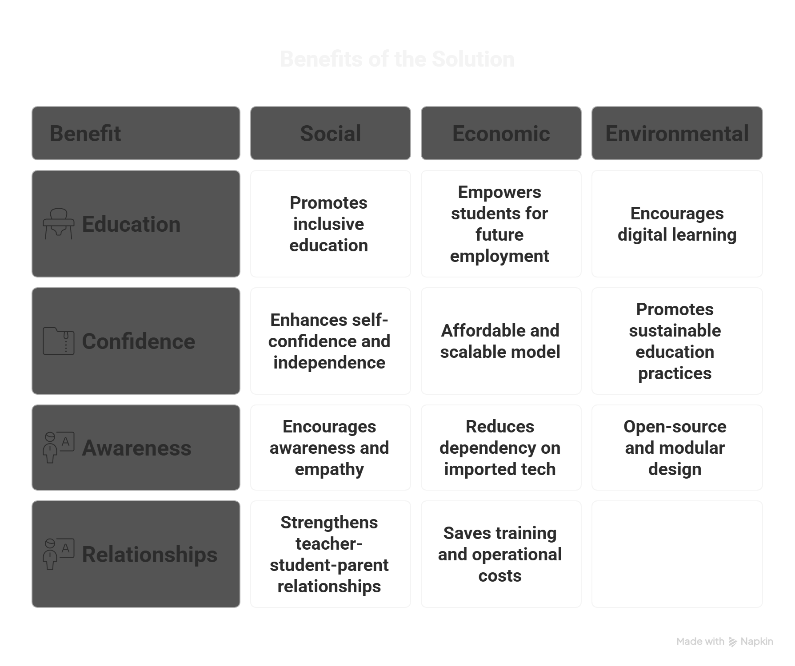
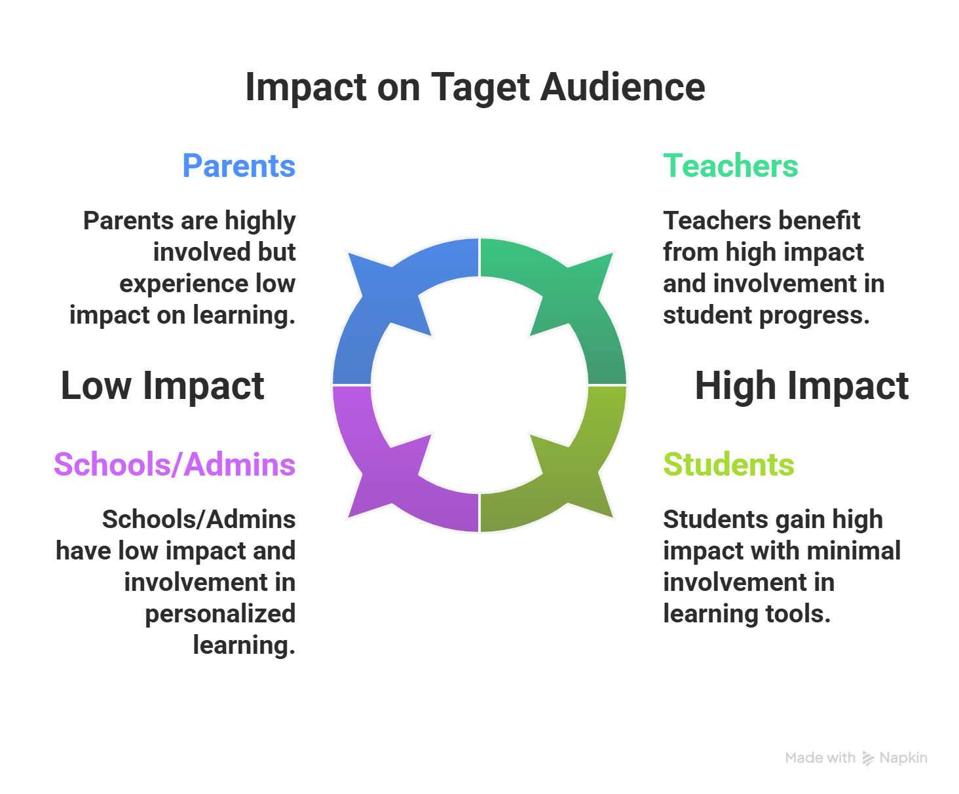

IMPACT AND BENEFITS
TEAM CREATION
https://youtu.be/K_-W4Ms0HNQ
This Photo by Unknown Author is licensed under CC BY-SA

Slide 6
RESEARCH AND REFERENCES
TEAM CREATION
Key References:-
World Health Organization & World Bank — World Report on Disability (2011): Gives global data on disability, education & participation. Link →https://www.who.int/publications/i/item/9789241564182
Web Content Accessibility Guidelines (WCAG) — Official accessibility standard for websites and digital services. Link→ https://www.atlassian.com/trust/compliance/resources/wcag
Recent Research Papers:-
“Assistive technology for the inclusion of students with disabilities: a systematic review” (2022) — A deep dive into how assistive technologies support inclusion in education and what barriers remain.
“Utilization of Assistive Technology in Special Needs Children’s Learning (Inclusive Education)” (2023) — Study on teacher readiness & usage of assistive tech in inclusive schools.
“AI for Accessible Education: Personalized Audio-Based Learning for Blind Students” (2025) — Shows how AI & adaptive systems can power assistive learning for visually impaired students.
Direct URL Links:-
WHO Report: https://www.who.int/publications/i/item/9789241564182
WCAG overview: https://webaim.org/standards/wcag/
Systematic review article: https://link.springer.com/article/10.1007/s11423-022-10127-7

