Slide 1
Ai resume & portfolio builder
CAPSTONE PROJECT
Presented By:
Student Name- RASIKA SUNIL ZADKHANDE
College Name- Hindi Seva Mandal Shri Sant Gadge Baba College of Engineering and Technology Bhusawal
Department- CSE(data science)

Slide 2
OUTLINE
Problem Statement
Proposed System/Solution
System Development Approach
Algorithm & Deployment
Result
Conclusion
Future Scope
References

Slide 3
Problem Statement
.
Students struggle to present skills and projects professionally
Generic resume templates do not highlight individual strengths
Manual resume screening is time-consuming and error-prone
Many students get rejected due to missing or unclear skills
No clear feedback on why they are disqualified

Slide 4
Proposed Solution
An AI-based system that analyzes student resumes
Automatically checks resume relevance for a selected job role
Identifies missing skills required for that role
Generates AI-based feedback, improvement tips, and ATS score
Helps students understand disqualification reasons clearly

Slide 5
System Approach
Python – core programming language
Streamlit – user interface and web app
Groq LLM (LLaMA 3) – resume analysis and content generation
NLP – text extraction and understanding
PyPDF2 – resume PDF text extraction
Generative AI – tailored feedback and suggestions
User uploads resume (PDF)
Resume text is extracted using NLP
User selects target job role
AI compares resume skills with job requirements
System identifies:
Matching skills
Missing skills
Disqualification reasons
AI generates actionable feedback

Slide 6
Algorithm & Deployment
Algorithm:
Upload resume
Extract text from PDF
Identify skills, education, experience
Compare with job role requirements
Generate ATS score and recommendations
Deployment:
Web app deployed using Streamlit
Runs locally or on Streamlit Cloud

Slide 7
Result
Students receive clear resume analysis
Missing skills are highlighted
ATS compatibility score is generated
Actionable improvement suggestions are provided
Saves time and improves resume quality

Slide 8
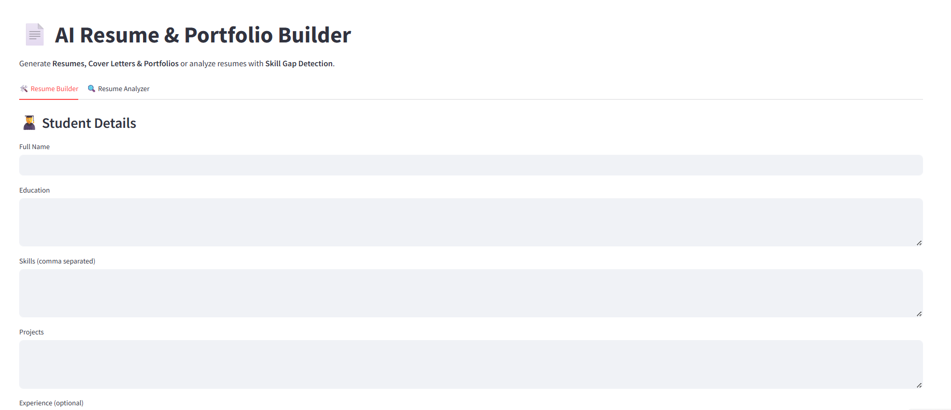
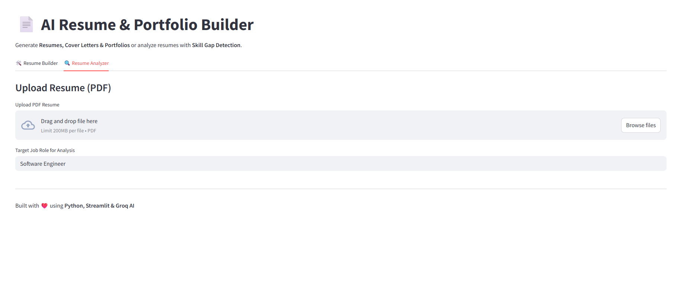
Conclusion
The system automates resume evaluation , Reduces confusion and manual effort
Helps students improve employability ,Provides transparent and unbiased feedback
Supports better career preparation

Slide 9
Future scope
Auto resume & cover letter generation
Portfolio website generator
Integration with LinkedIn & job portals
Skill learning roadmap recommendation
Multilingual resume support

Slide 10
References
Streamlit Documentation: https://docs.streamlit.io/.
PyPDF2 Documentation: https://pypdf2.readthedocs.io/
Groq API Documentation: https://console.groq.com/docs
LLaMA Large Language Model (Meta AI): https://ai.meta.com/llama/

Slide 11
Github link
Github Link :https://github.com/RasikaZadkhande/AI-Resume-Portfolio-Builder.git

Slide 12
THANK YOU

