Slide 1

Daily Step Tracking with Goal Monitoring in C++
This presentation outlines the development of a C++ application for daily step tracking and goal monitoring.

Slide 2
Importance of Tracking Daily Steps
Health Benefits
Motivation and Accountability
Regular physical activity improves cardiovascular health, reduces the risk of chronic diseases, and promotes overall well-being.
Tracking progress provides motivation and accountability, encouraging individuals to stick to their fitness goals.

Slide 3
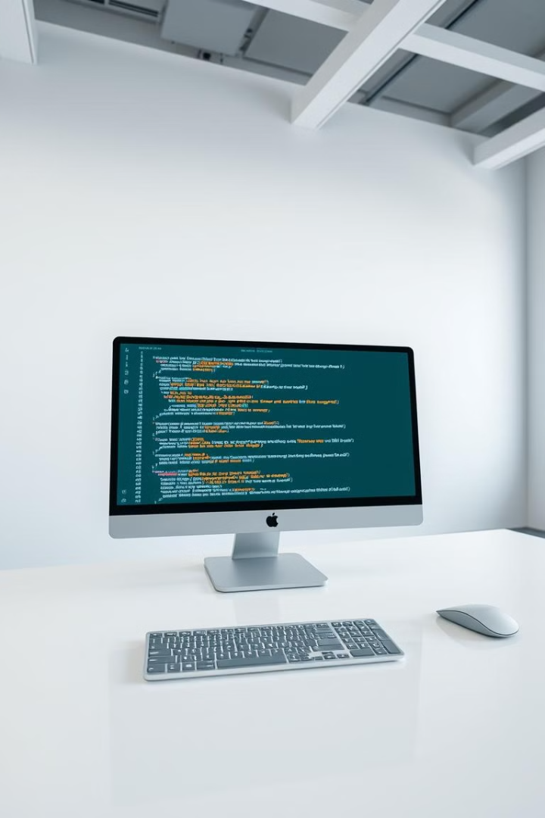
Leveraging C++ for Step Tracking
Performance and Efficiency
Hardware Integration
C++ provides access to hardware interfaces for integrating with pedometers and fitness trackers.
C++ is a high-performance language suitable for real-time data processing.
Data Storage and Management
C++ allows for efficient storage and management of step data for analysis and reporting.

Slide 4
Implementing Goal Setting and Monitoring
Goal Input
1
The application allows users to set daily, weekly, or monthly step goals.
Progress Tracking
2
The application continuously monitors step data and updates progress towards the set goal.
Notifications and Alerts
3
Users receive notifications and alerts based on their progress and goal achievements.

Slide 5



Visualizing Progress and Trends
Step Count History
1
Displaying step data over time provides insights into activity levels.
Trend Analysis
2
Identifying patterns and trends in step count helps users understand their progress.
Goal Visualization
3
Visualizing progress towards goals makes it easier to track achievements and stay motivated.

Slide 6
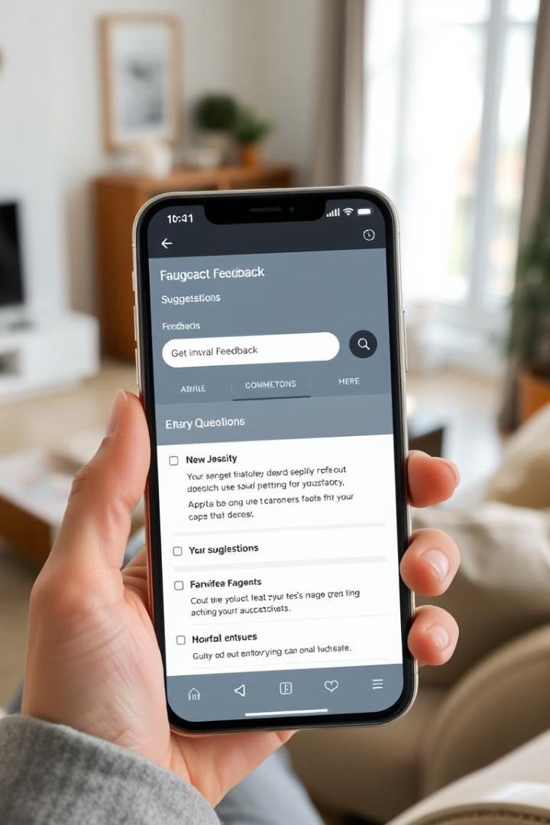



Enhancing the Experience with User Feedback
User Surveys
Suggestion Box
Regular surveys gather feedback on user experience and feature preferences.
A dedicated platform allows users to submit suggestions and improvements.
App Rating
Encouraging users to rate the application on app stores provides valuable insights.

